Slide 1
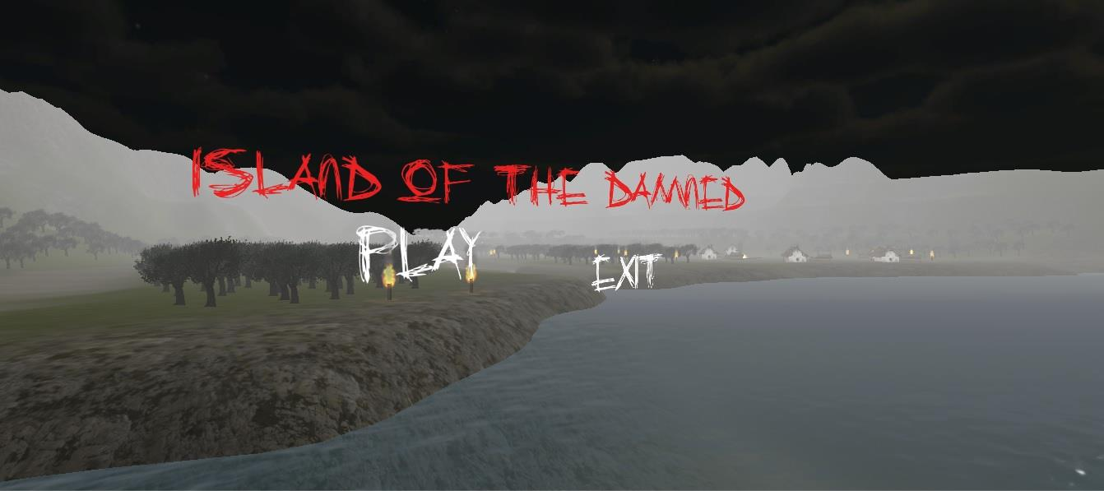
Team Tabaluga

Slide 2







TOOLS ‘n ORGANIZATION

Slide 3
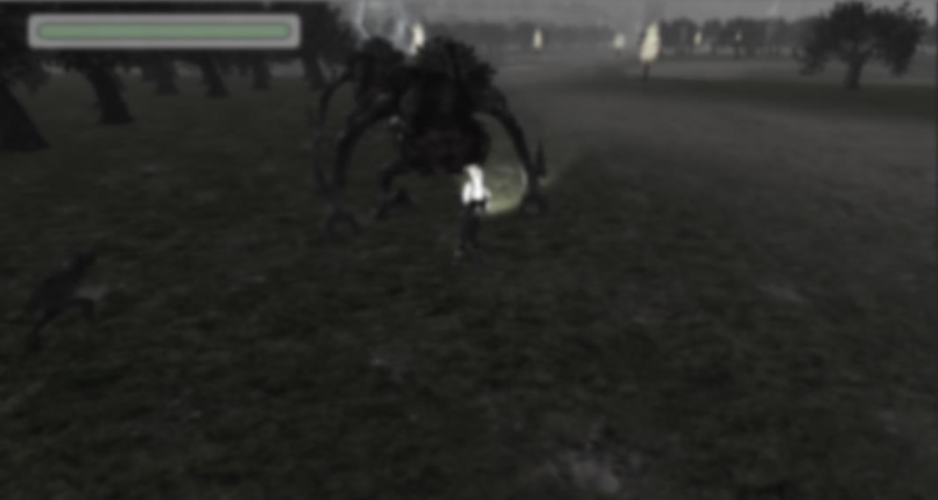
Workflow
Game Ideas
“How to” Unity Tutorials
Game Structure
More Unity Tutorials
Building Creatures, Terrain, Animation
Combine everything
Making it all work

Slide 4
Live Demo

