Slide 1
Data Analysis of GDS Grands Hotel Chain in SQL & Power BI
by Team Techzie

Slide 2
Business Objective:
Project: Provide Insights to Revenue Team in Hospitality Domain GDS Grands owns multiple five-star hotels across India.
Due to strategic moves from other competitors and ineffective decision-making in management, GDS Grands are losing its market share and revenue in the luxury/business hotels category.
As a strategic move, the managing director of GDS Grands wanted to incorporate “Business and Data Intelligence” in order to regain their market share and revenue. However, they do not have an in-house data analytics team to provide them with these insights.
Their revenue management team had decided to hire a 3rd party service provider to provide them insights from their historical data.

Slide 3
Data Analysis Project Pipeline
Imported flat files into SQL workbench to do analysis for given metrics.
Develop the SQL query
Building a data modelling structure in Power BI
Created Measures to calculate Metrics
Visualize
Summarize Findings
SQL
We created schema & imported csv files as tables in MySQL work bench.
We started exploring data using SQL.
We performed Exploratory Data Analysis using SQL for finding out given metrics and saved it as SQL script.
Power BI
We imported csv files in PowerBI, formatted, used power query to cleanup and created measures.
We created data modelling relationships for all the given tables.
Visualisations created for various metrics and charts established.

Slide 4
Architecture process followed
Requirement gathering
Data Collection
Data Transformation
Data Modelling
Build Visual in Power BI
Analyse and Insights

Slide 5
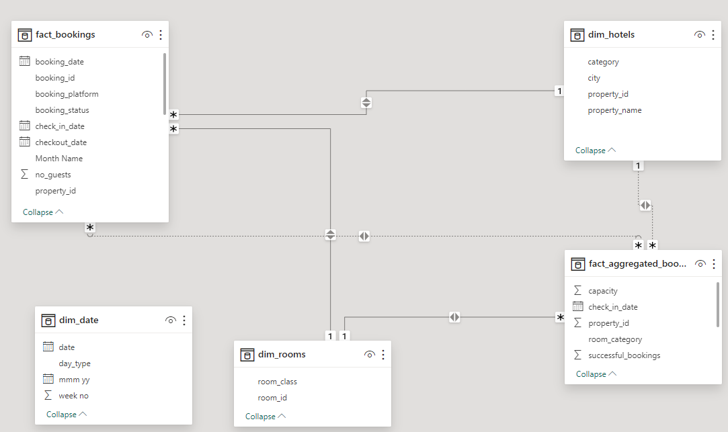
Data Modelling for GDS Grands - Analysis

Slide 6
Insights
1. Revenue is high from hotel chain in Mumbai
2. Elite and premium classrooms contribute to more than 65% of revenue.
3. Hotels with least revenues are Seasons & Grands which also has least user ratings.
4. Cancellations is more in platforms categorized as “Others” and “makeyourtrip” which co-incidentally are the ones with highest booking percentage.
Power BI Dashboard Development: We successfully developed an interactive Power BI dashboard for real-time data analysis, providing a user-friendly interface for comprehensive insights.
Hospitality Metrics Integration: Implementation of crucial hospitality domain metrics including Revenue Per Room category, Average revenue per class, Average revenue per hotel and city, average hotel ratings, platforms used for booking/cancellation, capacity available and other components to enhance performance monitoring and decision-making.
Historical Data Analysis: Thorough examination of historical data to uncover valuable revenue-enhancing opportunities and trends.
Actionable Insights: Provision of actionable insights occupancy rate, platform booking contributing to strategic planning.

Slide 7
