Slide 1


Slide 2

Agenda
Introduction to Couchbase Server
Installing Couchbase Server
Admin Web Console
High level architecture of Couchbase
Buckets
Docs Design - JSON
Couchbase SDK
Couchbase Client Libraries – .NET
Cluster Management

Slide 3



Brief On NoSQL
NoSQL databases are more scalable and provide superior performance, and their data model addresses several issues that the relational model is not designed to address:
Dynamic Schemas
Auto Sharding
Replication
Integrated Caching
Example : CouchDB, MongoDB, Cassandra, HBase, Neo4j

Slide 4
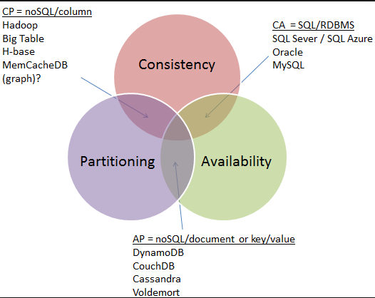
CAP theorem
Consistency Availability Partitioning
Consistency: A read sees all previously completed writes.
Availability: Reads and writes always succeed.
Partition tolerance: Guaranteed properties are maintained even when network failures prevent some machines from communicating with others.

Slide 5

What is CouchBase Server?
Couchbase Server is a distributed, document-based database that is part of the NoSQL database movement.
Couchbase Server is a persistent database that leverages an integrated RAM caching layer, enabling it to support very fast create, store, update, and retrieval operations.
Supports both key-value and document-oriented use cases. All components are available under the Apache 2.0 Public License Obtained as packaged software in both enterprise and community editions

Slide 6
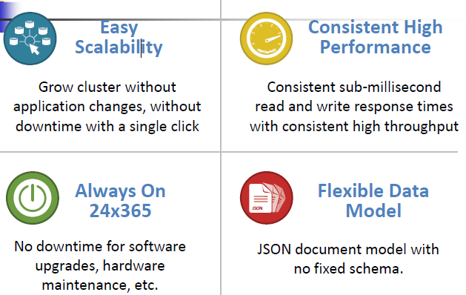

Slide 7
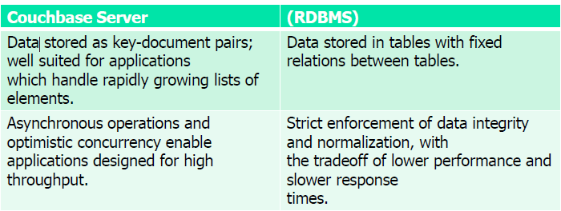
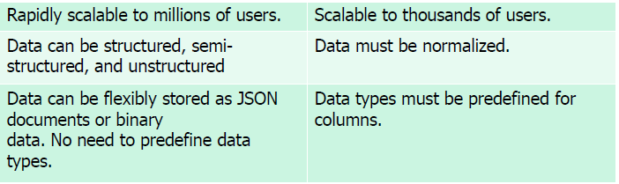
Couchbase Vs RDBMS

Slide 8
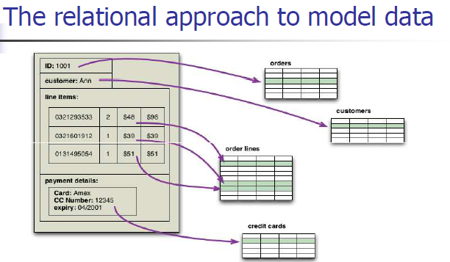

Slide 9
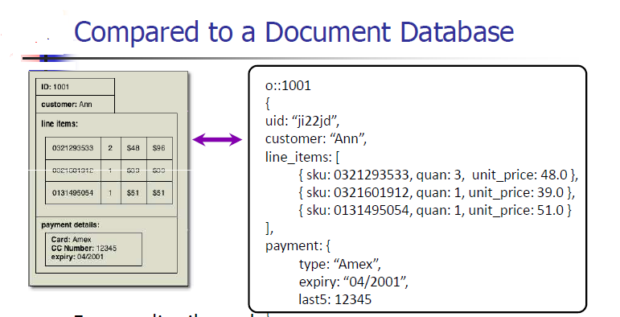

Slide 10
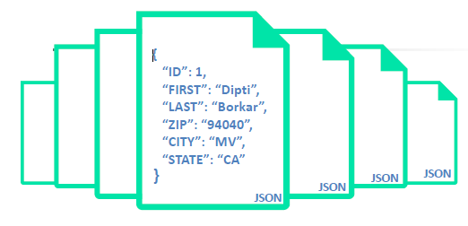
Data Model
Flexible data base Model and no need to worry about the database.
No Fixed schema and records can have different structures.
Allows data model changes for rapid application development.

Slide 11
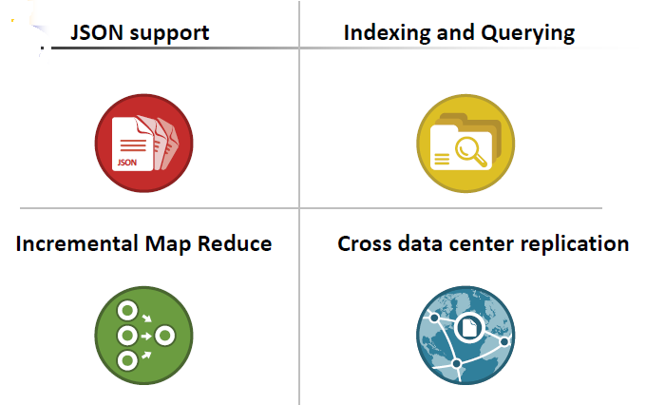
Main Features
JSON support – natively stored as json, when you build an app, there is not conversion required. New doc viewing , editing capability.
Indexing and querying – look inside your json, build views and query for a key, for ranges or to aggregate data Incremental mapreduce – powers indexing. Build complex views over your data. Great for real-time analytics
XDCR – replicate information from one cluster to another cluster.

Slide 12
Additional Feature
All nodes are equal, single node type, easy to scale your cluster. No single
point of failover
Every node manages some active data and some replica data.
Data is distributed across the clsuter and hence the load is also uniformly
distributed using auto sharding.
We have a fixed number of shards that a key get hashed to. 1024 shards,
distributed across the cluster.
Replication within the cluster for high availability. Number of replicas are
configurable with upto 3 replicas.
With auto-failiover or manual failover, replica information is immediately
promoted to active
Add multiple nodes at a time to grow and shrink your cluster.

Slide 13
Mobile Device : - Couchbase lite
embedded JSON database that can work standalone, in a P2P network, or as a remote endpoint for Couchbase Server.
Provides native APIs for the iOS and Android platform Supports replication with compatible database servers.
Supports low-latency and offline access to data.

Slide 14
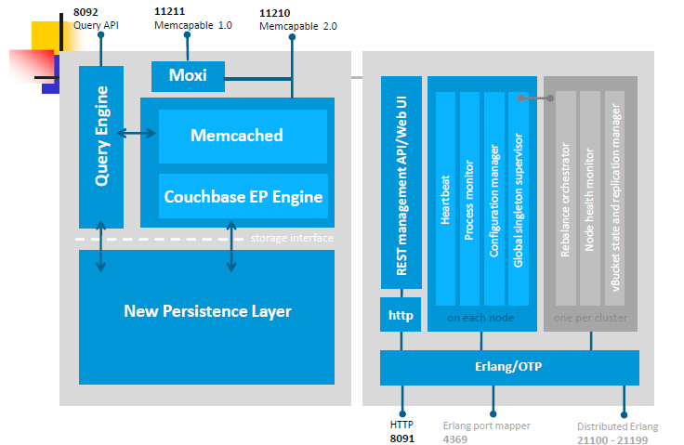
Couchbase architecture

Slide 15
Main Components
Couchbase Server or Node
A single instance of the Couchbase Server software running on a machine, whether a physical machine, virtual machine,EC2 instance or other environment.
Cluster
A cluster is a collection of one ore more instances of Couchbase Server that are configured as a logical cluster. All nodes within the cluster are identical and provide the same functionality.
Caching Layer
  includes a built-in caching layer acts as a central part of the server
  automatically places items that come into the caching layer into disk queue so that it can write these items to disk. The entire process of managing data between the caching layer and data
  persistence layer is handled entirely by
  Server.

Slide 16
ClusterManager
  Every node within a Couchbase Cluster includes the Cluster Manager component. The Cluster Manager is responsible for the following within a cluster:
  Cluster management.
  Node administration.
  Node monitoring
  Data Manager
  manages data storage and retrieval It contains the memory cache layer, the disk persistence mechanism, and the query engine.
  Cluster Mapper
  Couchbase clients use the cluster map provided by the Cluster Manager to discover which node holds the required data and then communicate with the Data Manager on that node to perform database
  operations.

Slide 17
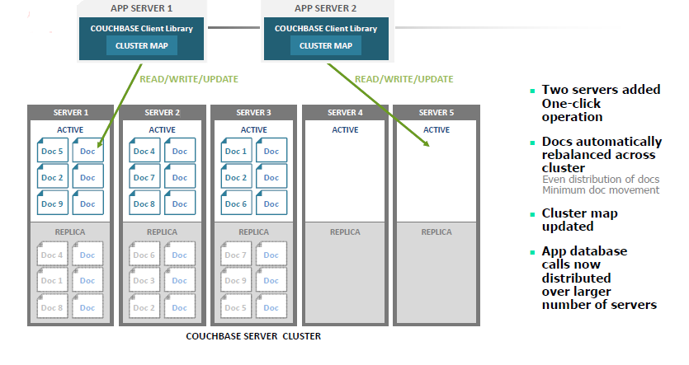
Add Nodes to Cluster

Slide 18
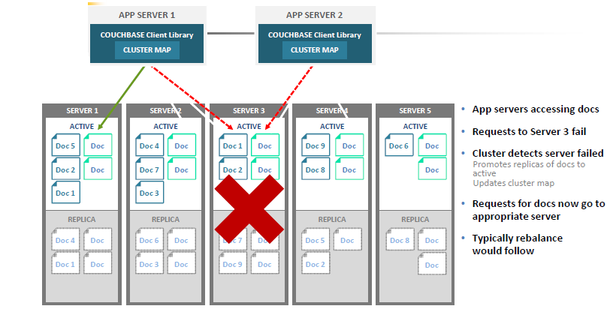
Failover Node

Slide 19
Buckets
  Couchbase Server stores all of your application data in either RAM or on disk.
  The data containers used in Couchbase Server are called buckets.
  There are two bucket types in Couchbase, which reflect the two types of data storage that we use in Couchbase Server.
  Buckets also serve as namespaces for documents and are used to look up a document by key.
  can partition your data into separate buckets with Couchbase Server.
  Couchbase will keep separate storage for different buckets, which enables you to perform operations such as statistics.
  Separating buckets is also a structure you may choose if you have a particular bucket that is reserved for data removal.

Slide 20
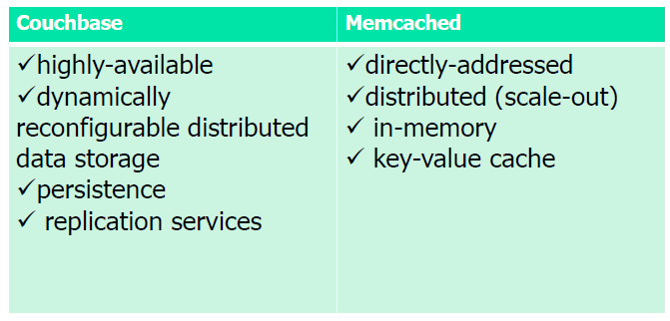
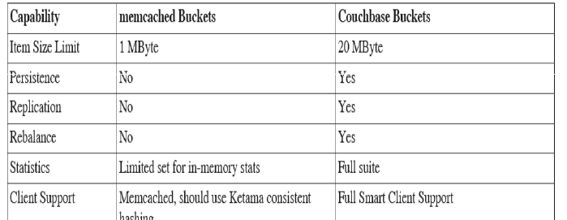
Bucket Types and Comparison

Slide 21
vBucket
  A vBucket is defined as the owner of a subset of the key space of a
  Couchbase cluster. These vBuckets are used to allow information to be distributed effectively across the cluster. The vBucket system is used both for distributing data, and for supporting replicas (copies of bucket data) on more than one node.
  Clients access the information stored in a bucket by communicating directly with the node response for the corresponding vBucket. This direct access enables clients to communicate with the node storing the data, rather than using a proxy or redistribution architecture. The result is abstracting the physical topology from the logical partitioning of data. This architecture is what gives Couchbase Server elasticity

Slide 22
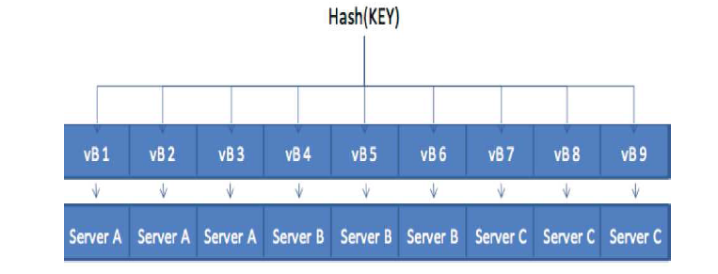
vBucket Mapping

Slide 23
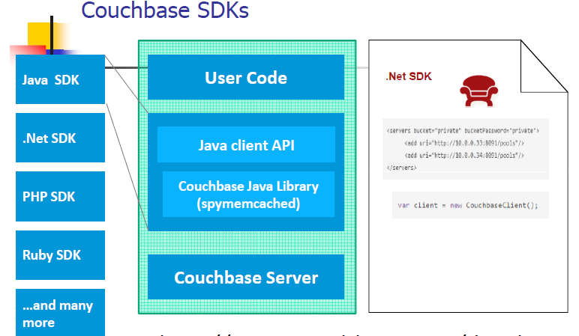

Slide 24
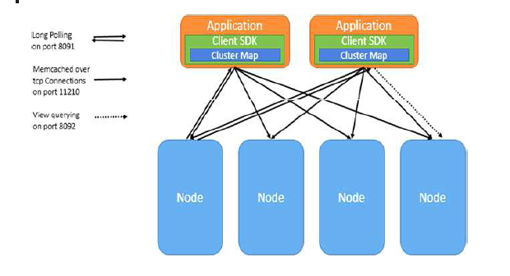
Connection between Client and CouchBase

Slide 25

Couchbase SDK client libraries
  High performance, official client libraries for Java, .NET, PHP, Ruby, C, Python
  The Couchbase .NET SDK 1.3 is the official .NET client library for Couchbase Server. Written entirely in the C# programming language.
  Targets:
  .NET Framework 3.5 and later
  Couchbase Server 2.5 and later.
  Add below reference dlls
  Couchbase.dll,
  Enyim.Caching.dll,
  Newtonsoft.Json.dll

Slide 26
Basic Document Modeling
  One document that contains all related data
    Data is de-normalized
    Better performance and scale
    Eliminate client-side joins
  Separate documents for different object types with cross references
    Data duplication is reduced
    Objects may not be co-located
    Transactions supported only on a document boundary
    Most document databases do not support joins

Slide 27
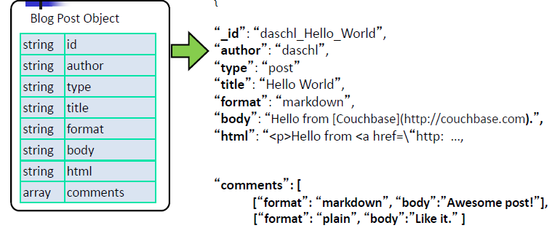
Document design: Document ID/Key selection
    Options
      • UUIDs, date-based IDs, numeric IDs
      • Hand-crafted (human readable)
      •Matching prefixes (for multiple related objects)
    Single Document

Slide 28
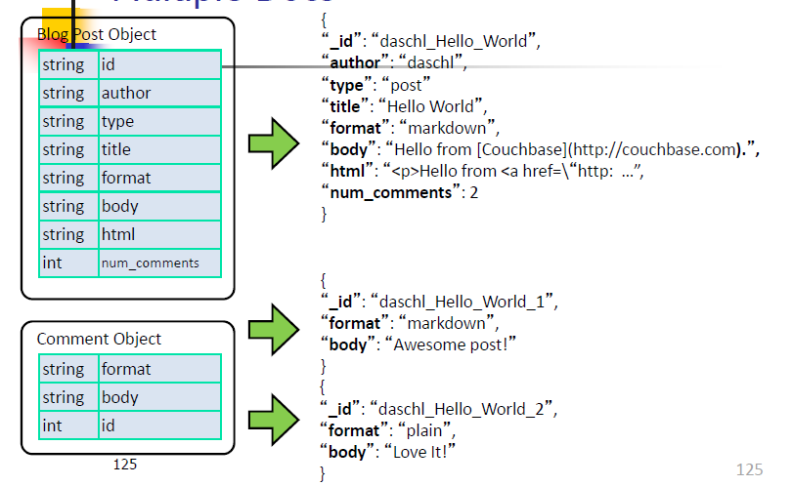
Split into multiple docments

Slide 29
Replication
Replication is required for two reasons
  High availability
  Disaster recovery
you can configure up to 3 replicas. can use bi-directional replication to synchronize data between two different buckets in two different cluster, including clusters in two different locations.
XDCR replicates any changes to data stored on Cluster A to destination buckets on Cluster B, and vice versa.

Slide 30
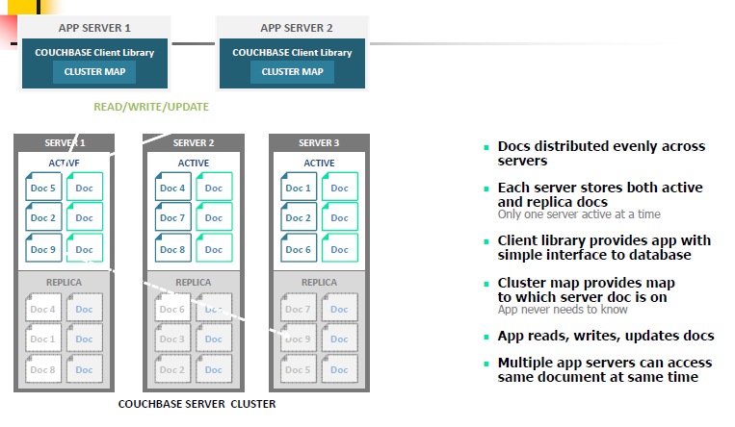
Couchbase server operation basic rules
All operations are atomic
All data operation require a key
No implicit locking
_

Slide 31
Couchbase Basic Operations
get (key)
Retrieve a document.
set (key, value)
Store a document, overwrites if exists.
add (key, value)
Store a document, error/exception if exists.
replace (key, value)
Store a document, error/exception if doesn’t.
cas (key, value, cas)
    Compare and swap, mutate document only if it hasn’t changed while executing this operation.

Slide 32
Storing Data format
Specifying Keys
  Keys are strings, typically enclosed by quotes for any given SDK. No spaces are allowed in a key.
Specifying Values
  Strings, or serialized objects can be stored.
  Documents stored in memcached buckets can be up to 1 MB; values stored in Couchbase buckets can be up to 20 MB.
  Metadata
  used internally by the server to track keys and internally manage documents.

Slide 33
Indexing and Querying
View basics
• Lifecycle of a view
Index definition, build, and query phase
Indexing details
• Replica indexes, failover and compaction
• Primary and Secondary indexes
• View best practices
• Additional patterns

Slide 34
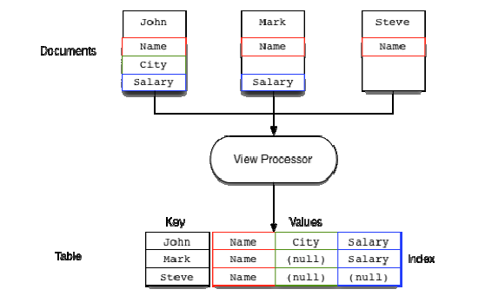
What is View?
Extract fields from JSON documents and produce an index of the selected information.

Slide 35
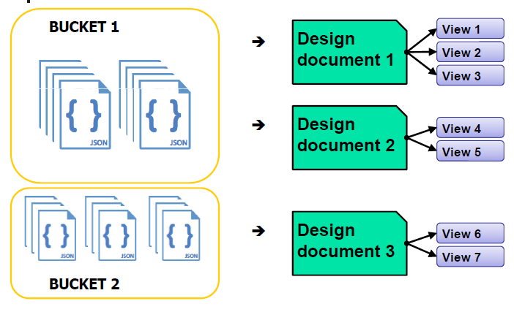
View Life cycle
Create design documents on a bucket
Create views within a design document

Slide 36
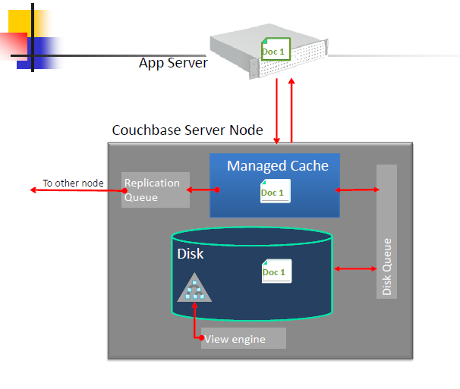
Indexed Views – Data flow

Slide 37
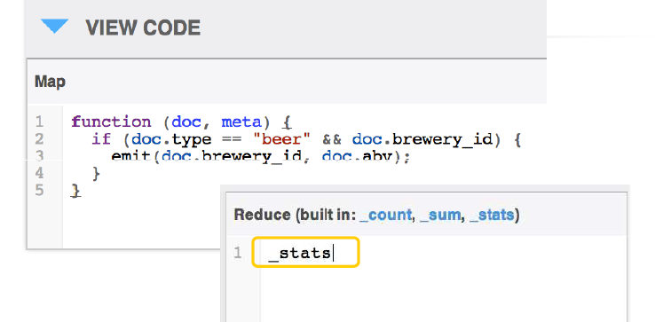
View Creation Code

Slide 38
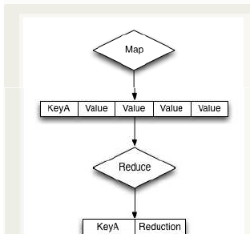
Custom Reduce Functions
A reduce() function must convert the data supplied to it from the corresponding map() function.

Slide 39
Couch DB Exercise
Web Console Walk through
Creating Sample Bucket
Creating Sample Document
Consume from Dot net console application and perform CRUD operations.
Create Index/View and Integrate from .net to show the result.

