Slide 1
Database Applications
Teamwork Project | Level #3
Team Watson| Software University

Slide 2
GitHub
https://github.com/
TeamWatson-DatabaseAppsTeamwork

Slide 3
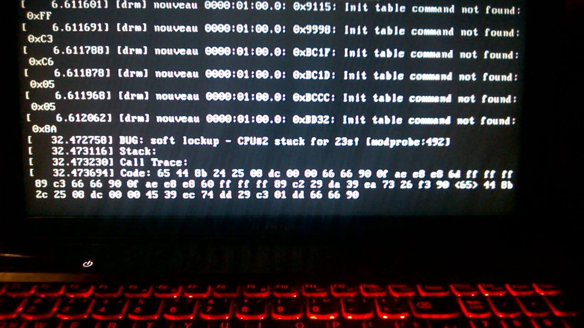
TeamWatson
Gabriela Burlakova| G.Burlakova
Yana Slavcheva | jabalka
Kristiyan Petrov | zontak
Zhivko Angelov | JiVeNcE
Kristiyan Ivanov | Chris

Slide 4
WayOfWork
Meeting with the Mentor | 4 of 5
Coding on everyday bases | 2 of 5
Separate problems solved in test projects by separate team member
Then the solution is integrated in the main project (via engine command)

Slide 5
Technologies
C# | .NET | Entity Framework
ITextSharp | JSON .NET | ByteScout | Xml.Serialization
All the lovely tools to make the Oracle run ☺
All it took to make MySQL run
And, of course, MongoDB

Slide 6
Advantages
Well Structured Architecture
Separation of Concerns
Completely Separate UI
Exception Handling
Engine

Slide 7
Advantages
Data Layer
Data Transfer Objects
Model
Scalability
One client runs all the databases

Slide 8
DesignPatterns
Singleton
Repository
Unit of Work

Slide 9
Demo
engine.Run();

Slide 11
AllItTakes
#connectionString

Slide 12
Questions
?????

Slide 13
ThankYou
For the great Teamwork Assignment

