Slide 1
Bill Drescher
Brady Randall
Justin Hickey
Seth Schoming
Casino Games
-Team Wu
Notes:
<number>

Slide 2
Description
Casino Games
A user chooses between different games
utilizing a common bank roll
Python code
Java was used on a game in the 2nd iteration
Allocated Tasks
We all worked on user stories, but divided the work into sections

Slide 3
Organization and Communication
Git repository
Stored documents and source code
Email
Dropbox
In/after class discussions

Slide 4
Planned Work on Iterations
Functioning Code (i.e. command line interface)
Menu
Switch between games
GUI
Click options and navigate windows
Multiple Players
Involve multiple players and opponents

Slide 5
Actual Work on Iterations
Poker Dice
Got game running with multiple opponents and computer opponent logic in Java
Roulette
Implemented GUI and logic with only one bet per round
Slots
Implemented GUI and basic game play
Blackjack
Implemented GUI and game play minus a few features

Slide 6
Future Work
Poker Dice
Write a Wrapper to run with Python
Roulette
Multiple bets and multiple players
Slots
More options for different bets
Blackjack
Split and buy insurance with multiple players

Slide 7
Challenging Design Features
Adding graphics and GUIs to games.
Integrating four separately written games into one program.
Adding intelligent play for the opponent in Poker Dice.
Using different Operating Systems Linux & Windows & Mac for development

Slide 8
SE Components
User Stories
UML Diagrams
Unit Test
Blackjack & Roulette were refactored for logic cleanup.

Slide 9
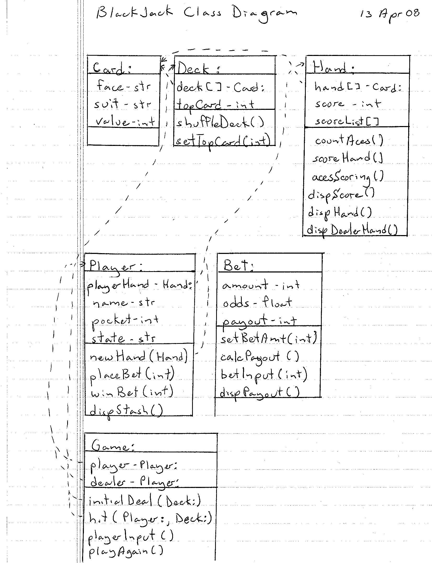
UML Diagrams

Slide 10
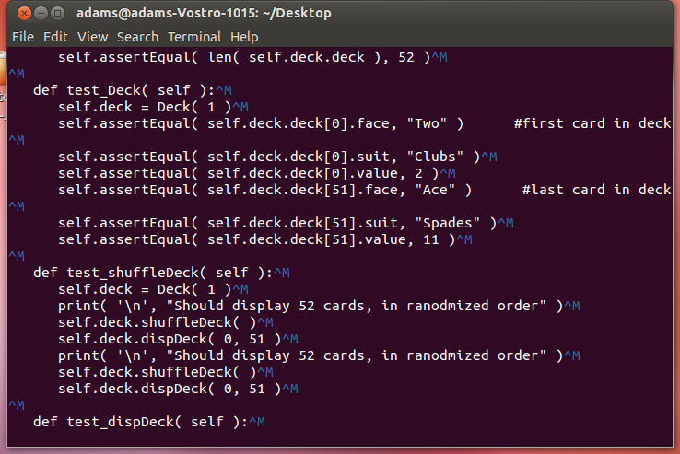
Unit Tests

Slide 11
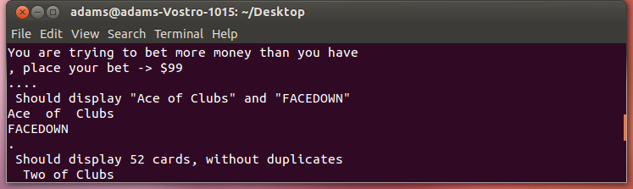
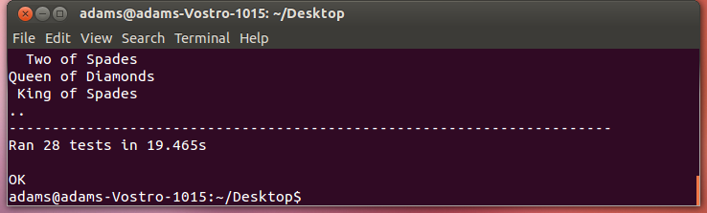
Unit Tests

Slide 12
Lessons Learned
What was useful and what wasn’t?
User Stories were useful
Used Github instead of Git b/c didn’t have to maintain central server’s copy of repository
If redone, what would be different?
Keep all code in one language so wrappers or porting code isn’t needed
We now know how to use the Tkinter GUI package, unit tests, UML diagrams.

Slide 13
Thank you
...and good luck!
Team Wu

