Slide 1

Bill Drescher
Brady Randall
Justin Hickey
Seth Schoming
Casino Games
-Team Wu

Slide 2
Description
Casino Games
  A user chooses between different games
  utilizing a common bank roll
Python code
  Java was used on a game in the 2nd iteration
Allocated Tasks
  We all worked on user stories, but divided the work into sections

Slide 3
Organization and Communication
Git repository and Github
  Stored documents and source code
Email
Dropbox
In/after class discussions

Slide 4
Planned Work on Iterations
Functioning Code (i.e. command line interface)
Menu
  Switch between games
GUI
  Click options and navigate windows
Multiple Players
  Involve multiple players and opponents

Slide 5
Actual Work on Iterations
Poker Dice
  Got game running with multiple opponents and computer opponent logic in Java
Roulette
  Implemented GUI and logic with only one bet per round
Slots
  Implemented GUI and basic game play
Blackjack
  Implemented GUI and game play minus a few features

Slide 6
Future Work
Poker Dice
  Write a Wrapper to run with Python
Roulette
  Multiple bets and multiple players
Slots
  More options for different bets
Blackjack
  Split and buy insurance with multiple players

Slide 7
Challenging Design Features
Adding graphics and GUIs to games.
Integrating four separately written games into one program.
Adding intelligent play for the opponent in Poker Dice.
Using different Operating Systems Linux & Windows & Mac for development

Slide 8
SE Components
User Stories
UML Diagrams
Unit Test
Blackjack & Roulette were refactored for logic cleanup.

Slide 9
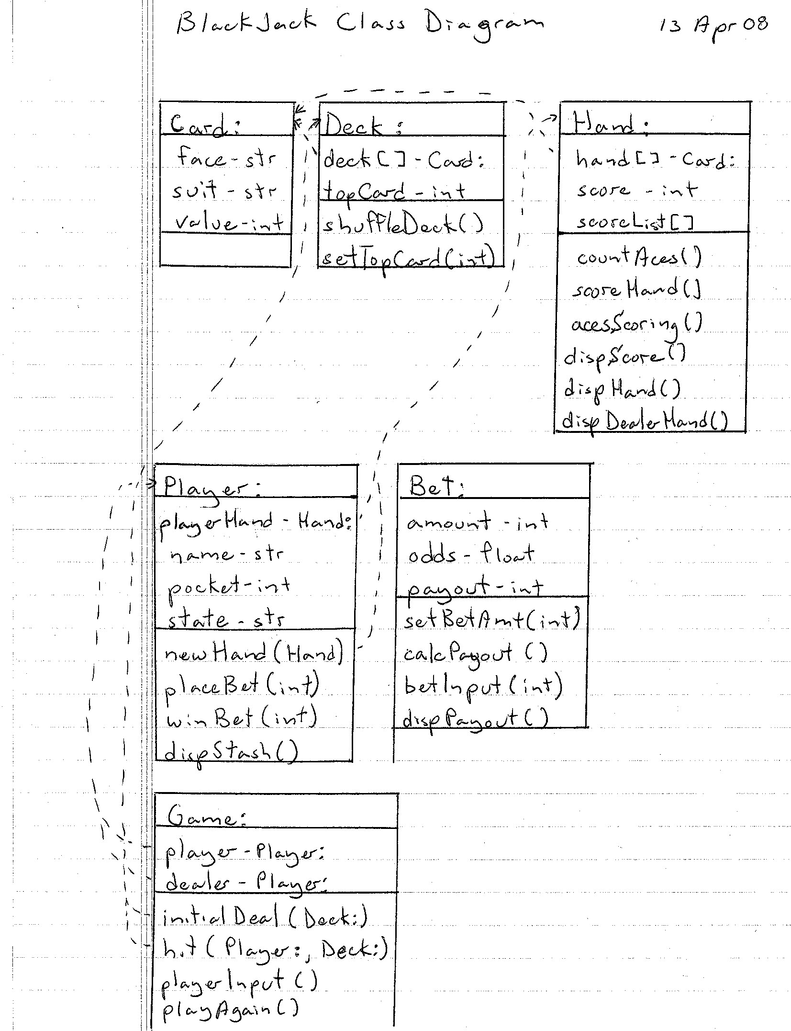
UML Diagrams

Slide 10
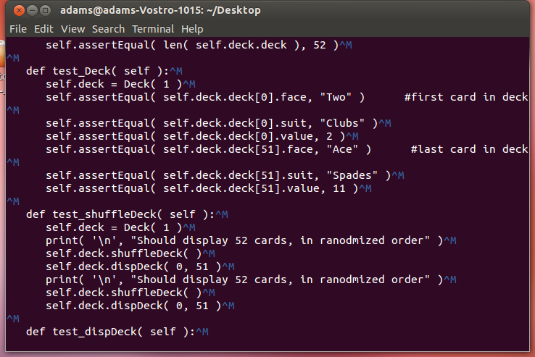
Unit Tests

Slide 11
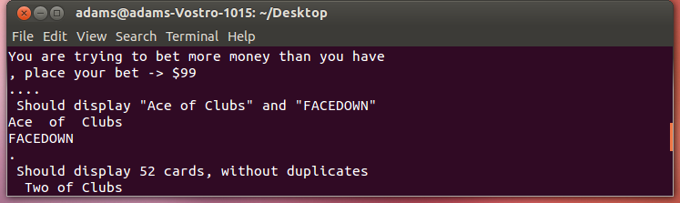
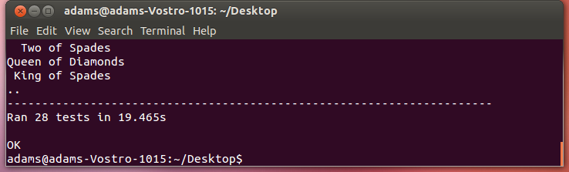
Unit Tests

Slide 12
Game Demos

Slide 13
Lessons Learned
What was useful and what wasn’t?
  User Stories were useful
  Used Github instead of Git b/c didn’t have to maintain central server’s copy of repository
If redone, what would be different?
  Keep all code in one language so wrappers or porting code isn’t needed
We now know how to use the Tkinter GUI package, unit tests, UML diagrams.

Slide 14
Thank you
...and good luck!
Team Wu

