Slide 1
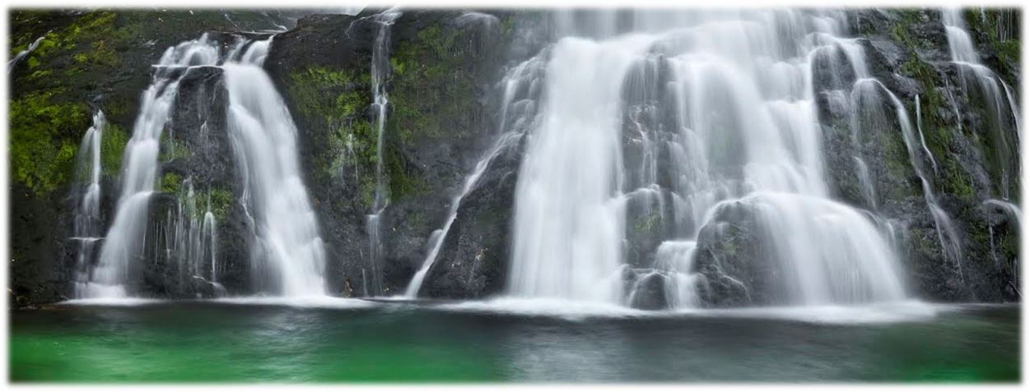

PHP Basics Teamwork
November 2014
TEAM "YOSEMITE"
„A blog about beautiful Bulgaria “
Software University
http://softuni.bg

Slide 2

Table of Contents
About our blog
Team members
Technical description

Slide 3
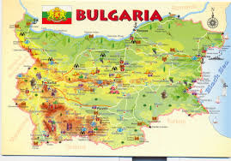
About blog
We are young patriots (and programmers), inspired by beautiful nature and landmarks of Bulgaria. This blog is created by SoftUni students for their PHP teamwork project.

Slide 4

Team “YOSEMITE” members
Ivan Zahariev - @GitHub
Anton Pavlov - @GitHub
Yanko Aleksandrov - @GitHub
Salih Alishov - @GitHub
Georgi Marinov - @GitHub
Veselin Velichkov - @GitHub

Slide 5



Technologies that we used

