Slide 1


RecyCraft
Team Name : codeARC
Problem Statement Title : Open Innovation
Team Leader Name : Chirag Nahata
Institute Name : JIS College of Engineering 123, Kalyani
1

Slide 2
The Overview :
Scrap Vendor Listing Platform:
- Connects customers with scrap vendors for easy purchasing of recyclable materials.
- Streamlines the recycling process by facilitating direct contact between waste generators and recyclers.
Marketplace for Recycled Waste:
- Expands beyond connecting vendors and customers to include a marketplace.
- Businesses and individuals can purchase recycled waste and DIY items from the materials available.
- Promotes a circular economy by creating opportunities for buying and selling recycled materials.
B2B and B2C Integration:
- Functions as both a business-to-business (B2B) and business-to-consumer (B2C) platform.
- Catering to the needs of both businesses and individuals enhances the platform's versatility.
AI Chatbot for User-Friendly Interaction:
- Features an AI chatbot that guides users through the recycling process.
- Users can input keywords related to their recyclable item for a seamless experience.
Multifaceted Approach for a Greener Future:
- Aims to unite individuals, businesses, and local authorities in a shared mission for sustainable waste management.
- The platform serves as an ecosystem that transforms waste into opportunities for a cleaner, greener future.
Circular Economy Promotion:
- Encourages businesses and individuals to buy and sell recycled waste, promoting a circular economy.
- Emphasizes the value of waste materials as resources for creating new products.
Sustainability and Eco-Conscious Community:
- Advocates for sustainable practices and fosters a greener, more eco-conscious community.
- Aligns with the goal of turning waste into a valuable resource.
Vision for a Cleaner, Greener Future:
- Invites participants to join in creating a vibrant ecosystem dedicated to sustainable waste management.
- A collaborative effort to turn waste into opportunities for a cleaner, greener future.
By combining the convenience of technology, the principles of a circular economy, and community engagement, your project aims to revolutionize waste management and contribute to a more sustainable and eco-friendly society.
Community Engagement Features:
- Social-media-inspired platform encourages community engagement.
- Users can connect with local municipalities, share recycling tips, and contribute relevant content.
- Fosters a sense of community around sustainable waste management practices.
2

Slide 3
The Problem :
1. Exponential Urban Growth: The rapid urbanization witnessed in recent years has led to a significant surge in waste generation, exacerbating the challenges associated with waste management in urban areas.
2. Disproportionate Focus on Biodegradables: A concerning trend in waste management strategies is the disproportionate emphasis on organic and biodegradable waste, often overshadowing the critical issue of non-biodegradable materials.
3. Neglect of Non-Biodegradable Waste: Non-biodegradable waste, including plastics, metals, and electronic waste, is alarmingly overlooked in many urban waste management systems. These materials, known for their longevity, pose severe environmental threats if not adequately addressed.
4. Long-lasting Environmental Impact: Non-biodegradable substances, when left unattended, contribute to persistent pollution, leading to long-lasting damage to soil, water, and ecosystems. Plastic waste, for example, can take centuries to decompose, resulting in lasting ecological harm.
5. Unsightly Landfills: The ignorance of non-biodegradable waste often translates into inadequately managed landfills characterized by hazardous materials. These sites not only pose immediate risks to nearby communities but also contribute to the leaching of harmful substances into the soil and groundwater.
6. Soil and Water Contamination: Improper disposal of non-biodegradables can result in soil and water contamination, affecting agricultural productivity and threatening the quality of drinking water sources. This, in turn, has direct implications for public health.
7. Need for Comprehensive Strategies: Urgent measures are required to address this critical gap in waste management. Comprehensive strategies should be developed, focusing on efficient recycling methods, responsible disposal practices, and stringent regulations to curb the indiscriminate use and disposal of non-biodegradable materials.
8. Public Awareness and Education: To effect lasting change, public awareness campaigns are essential. Educating the urban population about the environmental impact of non-biodegradable waste and promoting sustainable practices is crucial for fostering a culture of responsible waste management.
In conclusion, the waste management crisis in urban areas must urgently pivot towards a more balanced approach that recognizes and addresses the significant challenges posed by non-biodegradable waste. Only through concerted efforts, regulatory interventions, and public engagement can cities hope to mitigate the environmental impact and build a sustainable waste management framework.
4

Slide 4
The Solution:
Overview:
RecyCraft is a one-stop solution for sustainable waste management. It connects scrap vendors with customers, features a circular economy-driven marketplace, and fosters a vibrant community for knowledge sharing and municipal collaboration.
Key Features:
1. AI based ChatBot:
- User-Friendly Interface: User can know and gain knowledge about how to recycle a product just by either typing the keyword or by taking a picture of it.
2. Marketplace:
- Economic Sustainability: Marketplace for businesses and individuals to buy and sell recycled waste.
3. Community Hub:
- Social-Media-Inspired Interface: Engaging users with direct links to local municipalities and knowledge-sharing forums.
4. Holistic Approach:
- Integrated Ecosystem: Unites individuals, businesses, and local authorities for effective waste management.
5. Implementation:
- Phased Rollout: Gradual implementation with user feedback.
- Partnerships: Collaborate with local entities for enhanced impact.
6. Scalability:
- Flexible Architecture: Designed for scalability to adapt to evolving needs.
- Regular Updates: Continuous improvement based on emerging technologies.
RecyCraft is more than a platform; it's a sustainable living movement. Join us in transforming waste management for a greener, cleaner future!
5

Slide 5
The Innovation :
Recycraft introduces, a cutting-edge innovation integrating image recognition technology into waste management. With RecyCraft, users can effortlessly identify recyclables by simply scanning them with their smartphone cameras through the Recycraft app.
Key Features:
1. Image Recognition Technology:
- Users capture an image of recyclables via the Recycraft app or the website.
- Advanced AI instantly recognizes material.
2. User-Friendly Interface:
- Simplifies the recycling process for users, eliminating the need for manual sorting and providing instant guidance.
3. Streamlined Transactions:
- Scrap vendors receive accurately sorted materials, enhancing operational efficiency and reducing sorting time.
4. Educational Insights:
- Users receive informative insights on recyclable materials, promoting awareness and sustainable habits.
5. Real-time Feedback:
- Immediate feedback on the recyclability of items, encouraging users to make eco-conscious choices.
Recycraft transforms waste management by leveraging image recognition, empowering users, vendors, and municipalities to contribute seamlessly to a greener environment. Embrace the future of recycling with Recycraft !
6

Slide 6
Technology/Innovation :
1. Image Recognition App:
- Technology: Cutting-edge image recognition technology.
- Innovation: Enables users to scan recyclables through their device cameras, providing immediate identification.
2. Marketplace:
- Technology: Robust e-commerce platform.
- Innovation: Facilitates buying and selling of recycled waste, creating a circular economy and economic opportunities.
3. RecyCraft Hub Platform:
- Technology: Web and mobile application development.
- Innovation: Serves as a comprehensive hub, integrating Image Recognition, Marketplace, Vendor and Community features.
4. Community Engagement Features:
- Technology: Social-media-inspired interface.
- Innovation: Fosters community involvement, providing users with a space for knowledge sharing, municipal connectivity, and collaboration.
5. Educational Resources:
- Technology: Content creation and delivery through our AI chatbot
- Innovation: Delivers informative insights on recyclable materials, promoting awareness and sustainable habits.
6. Transparent Recycling Solutions:
- Technology: Data analytics for real-time feedback.
- Innovation: Enhances user understanding of recycling patterns, aiding municipalities and businesses in informed decision-making.
7. User-Friendly Interface:
- Technology: UI/UX design principles.
- Innovation: Simplifies the recycling process for users, making it accessible and engaging.
Recycraft's technological backbone and innovative features set it apart, providing users with a seamless, educational, and empowering experience in the realm of sustainable waste management.
9

Slide 7
Idea/Approach Details
We’re Trying to solve one of the most concerning problems of modern time by creating a web-based application that will serve as a platform for users to get rid of recycleable such as plastic and e-wastes. Our prototype works as below:
Identifying non bio-degradable through image screening using Artificial Intelligence (AI) and Machine Learning (ML) and make them reusable or recyclable.
User can get ways to reuse or recycle non biodegradable wastes by our AI chatbot powered by OpenAI api just by typing keywords.
User can get information about nearby recycle factory who recycles non biodegradable wastes and waste vendors to collect wastes from household. User can sell that waste in return of money.
User can shop DIY products made from non biodegradable wastes (like e-waste, plastic) from our marketplace.
09

Slide 8

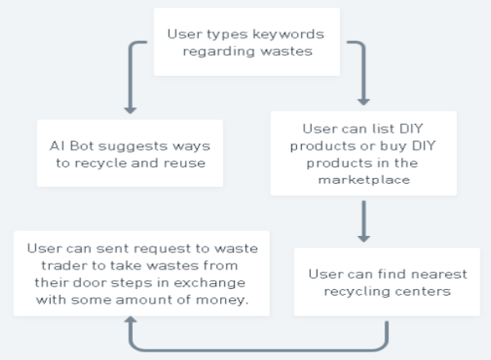





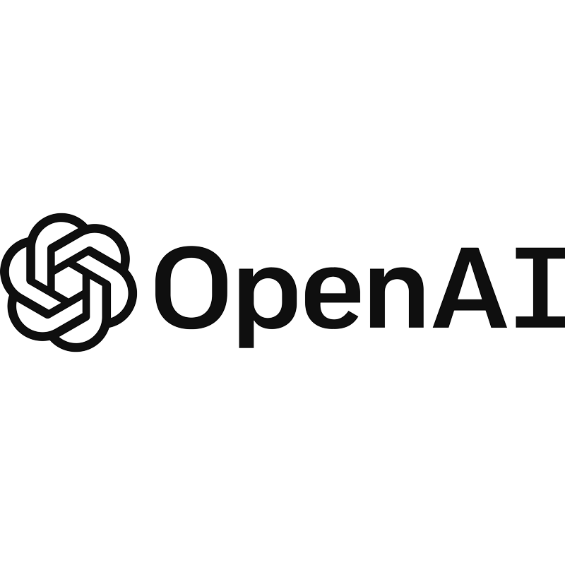
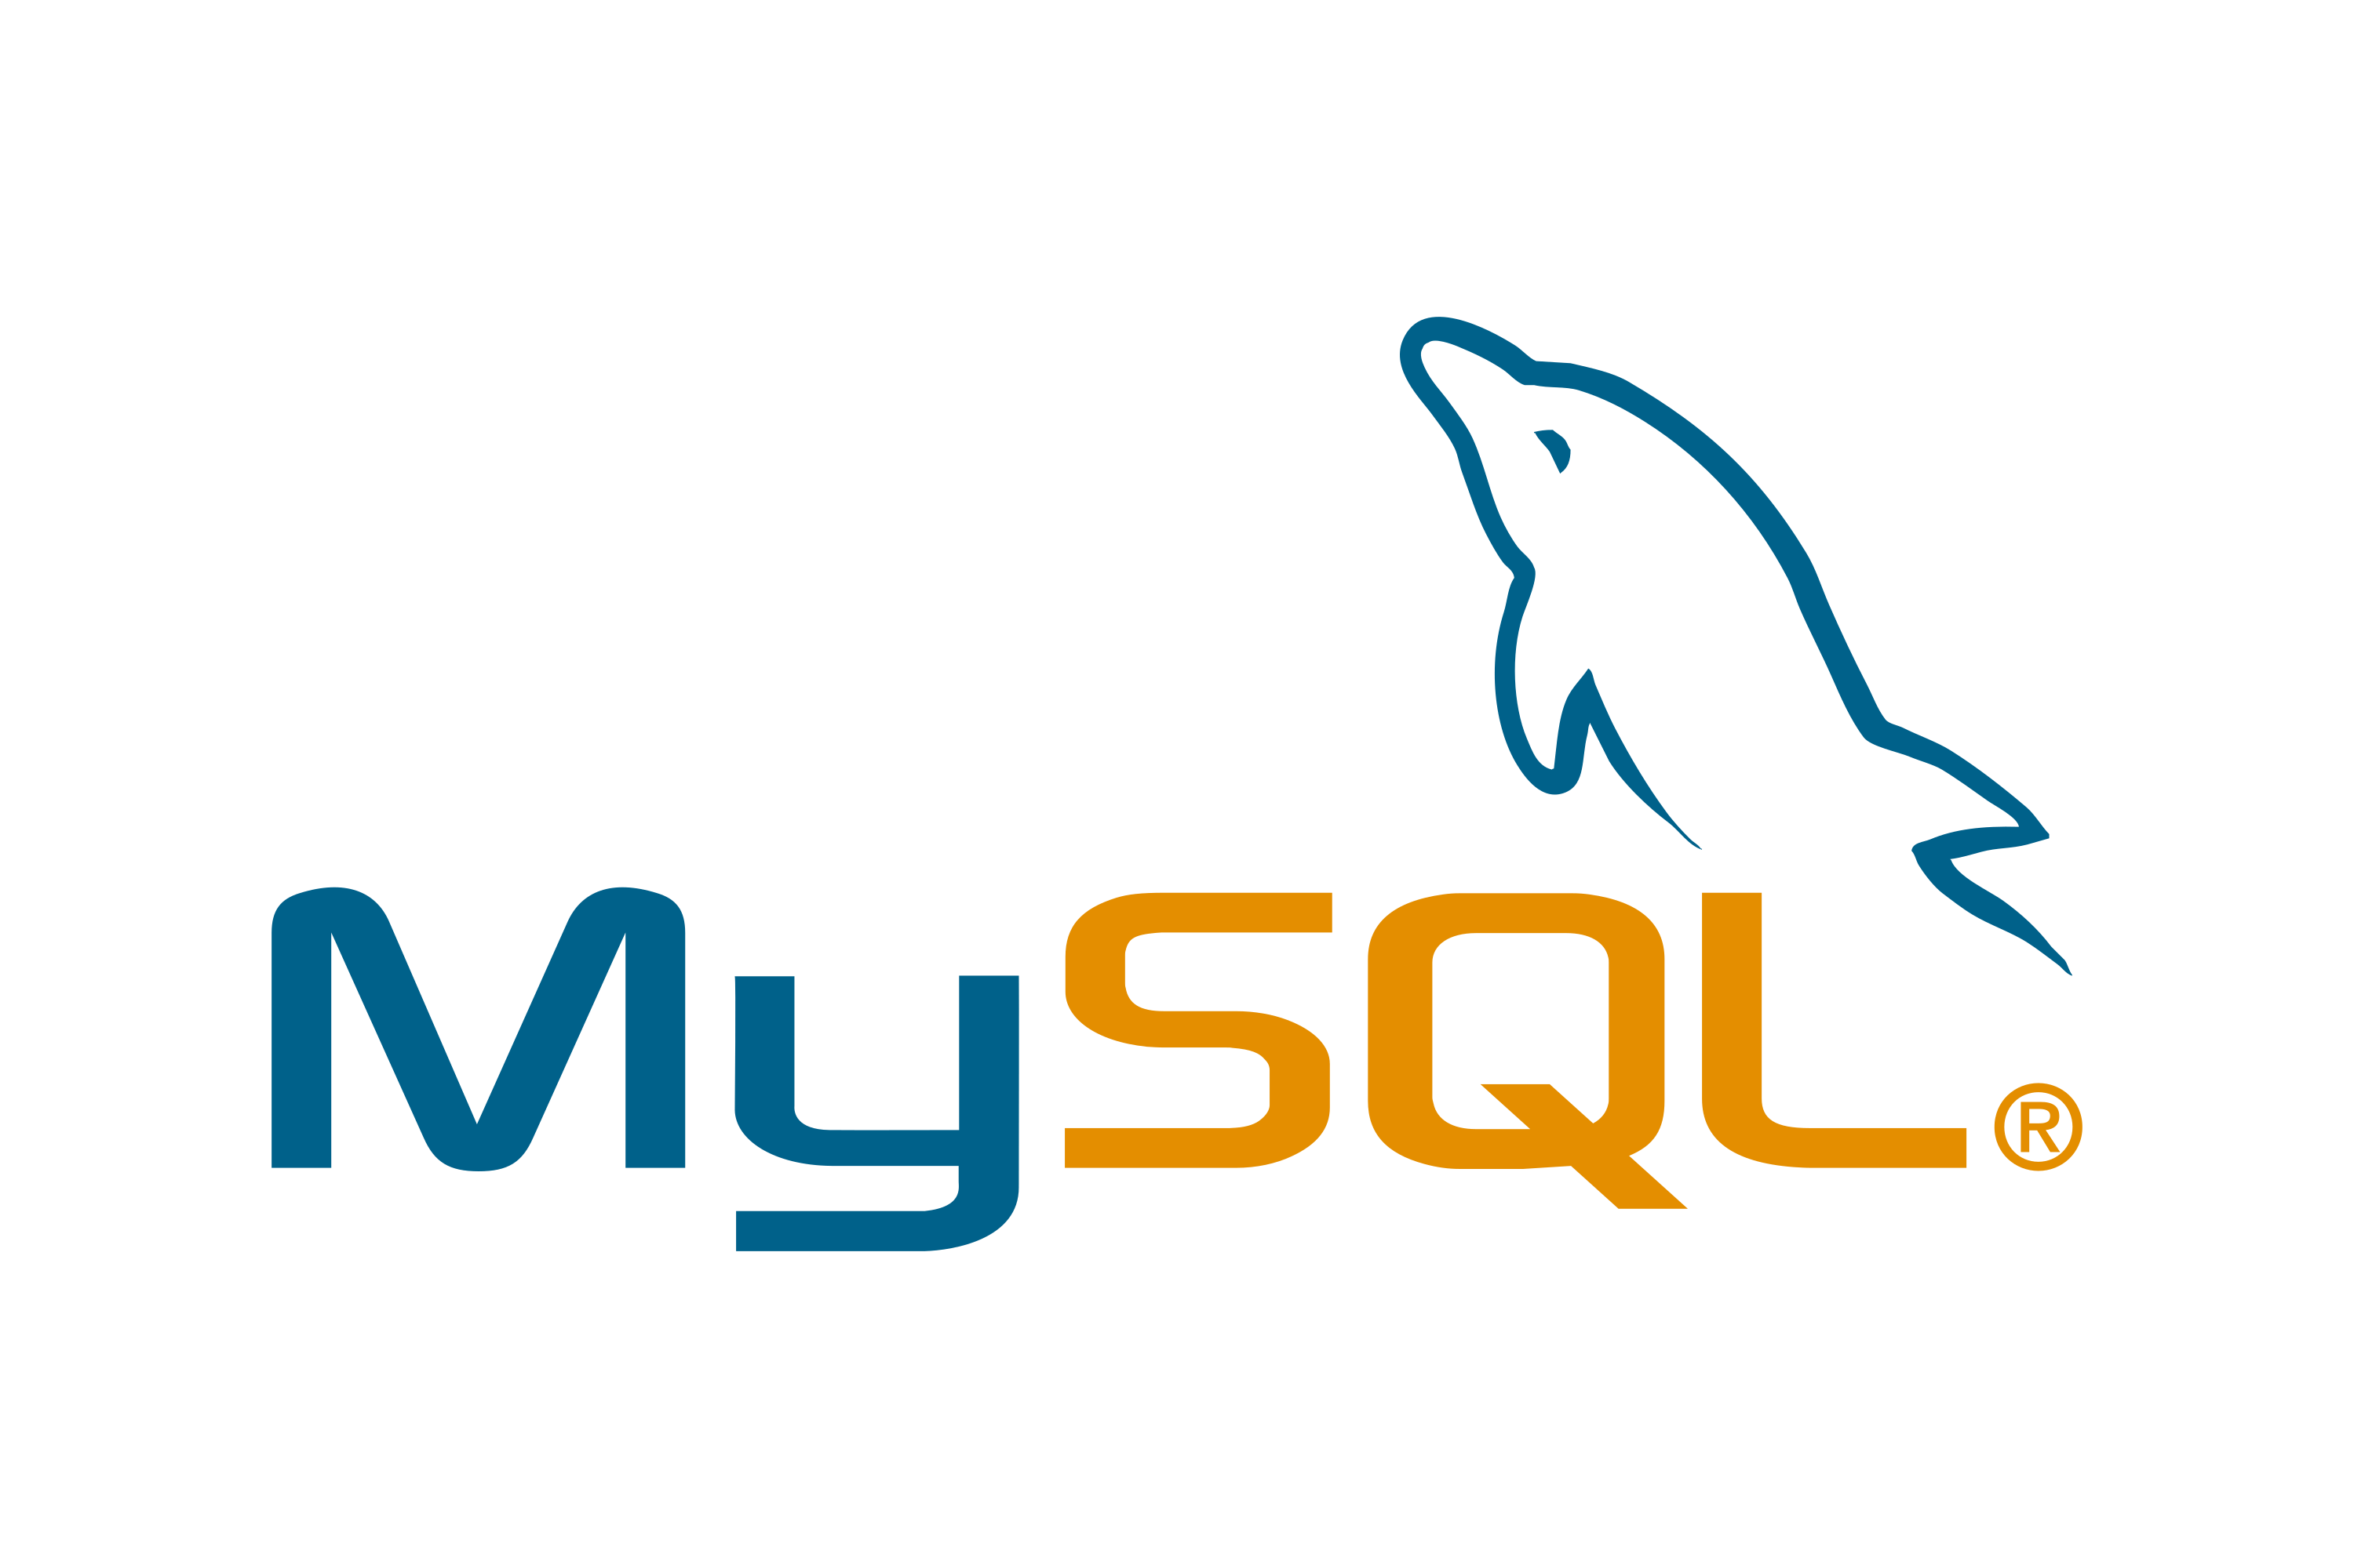

Idea/Approach Details
3
Flow Chart
Technology Stack
10

Slide 9
9
Use Cases
Dependencies
Even also to provide a side source of income to the talents of india who have skills to create DIY products made up from wastes and sell those to our platform.
Users can donate a set amount towards the planting of a tree at the end of each purchase of recycled plastic items, the geographical location of which will be shared with the user later.
Providing a secure employment to those vendors who had unstable sources of income and were collecting recyclables door-to-door.
Environmental Impact: This initiative aims to reduce the environmental impact of excessive waste production in India.
Education: It provides valuable information on waste management and promotes recycling and upcycling practices.
Economic Opportunities: It creates income opportunities for waste vendors and DIY product sellers.
Convenience: Users can easily access services related to waste disposal, recycling, and DIY products in one platform.
Sustainability: Encourages a more sustainable lifestyle by reducing waste and promoting reuse.
11

Slide 10
Value Proposition Canvas :
Customer Segments:
Residential households
Commercial establishments
Municipal waste management agencies
Customer Jobs:
Efficient waste disposal
Environmental sustainability
Compliance with waste disposal regulations
Pains (Customer Challenges):
Inefficient waste collection
Lack of awareness about proper waste disposal
Environmental impact of improper waste management
Gains (Customer Benefits):
Convenient waste disposal solutions
Environmental conservation
Cost savings through efficient waste management
Product & Service Features:
User-friendly waste collection bins
Educational programs on proper waste disposal
Recycling initiatives
Gain Creators (How your product creates gains):
Streamlined waste collection schedules
Recycling incentives for customers
Real-time tracking of waste disposal impact
Pain Relievers (How your product alleviates pains):
Educational campaigns to raise awareness
Technology-driven solutions for efficient waste collection
Collaboration with municipalities for proper waste disposal infrastructure
Unique Value Proposition (UVP):
"Our dry waste management solution provides hassle-free, environmentally conscious waste disposal for households and businesses. Through user-friendly bins, educational programs, and recycling initiatives, we aim to make waste management convenient and sustainable, contributing to a cleaner and greener environment."
7

Slide 11
Market and Oppurtunity :
Market Snapshot:
1. Rising Sustainability Demand: Capitalize on the increasing consumer interest in sustainable practices.
2. Supportive Government Environment: Leverage government initiatives and policies promoting waste management.
3. E-commerce Integration: Align with the growing e-commerce trend for the Circular Marketplace.
Key Opportunities:
1. Untapped Market Potential: Address the significant market segment yet to fully embrace recycling.
2. Educational Gap: Seize the opportunity to educate users on effective waste management.
3. Circular Economy Alignment: Tap into the momentum of the global shift towards circular economy practices.
Target Audience:
1. Individual Consumers: Provide an easy and efficient solution for at-home recycling.
2. Businesses: Offer sustainable practices and a source for recycled materials.
3. Local Municipalities: Enhance communication with residents and optimize waste management.
Revenue Strategies:
1. Transaction Fees: Generate revenue through Circular Marketplace transactions.
2. Premium Features: Introduce premium features for advanced waste management solutions.
3. Partnerships/Sponsorships: Secure partnerships and sponsorships to boost platform visibility.
Competitive Edge:
1. Innovative Technology: Recycraft's Smart Sorting System and EcoScan provide a tech-forward approach.
2. Comprehensive Ecosystem: Position Recycraft as a one-stop solution with a platform, marketplace, and smart sorting.
3. Community Engagement: Foster a sense of collective responsibility and engagement for a unique edge.
Conclusion:
RecyCraft is strategically positioned in a market ripe for sustainable solutions. With untapped segments, educational opportunities, and a comprehensive approach, it is poised to lead in the sustainable waste management space.
8

Slide 12
Business Model:
Our Features/USP:
Our Aim : To Make the whole untapped Scrap Business from unorganized to organized by the help of tech.
We will Mainly Operate on B2B and B2C.
Components of our Business : 1) Chat Bot 2) Community 3)Marketplace 4) Common people and Scrap Vendor Ecosystem.
Target Audience: Peoples from Tire 1 and Tire 2 cities.
Trained and Verified Agents
Weighs with 100% Accuracy
Provides the best value
Automates the whole recycling process
Building a complete ecosystem
Business owners can buy materials directly from us
Different seller can list and consumers can buy scraps and DIY products through our marketplace
Revenue Model:
How we Will Implement/Execute :
Reselling the Scraps to different business
By selling products made by recycling the Scraps. (eg – plastic plates, wigs, etc.. )
Earning commission from the sellers registered on our marketplace.
Data
By connecting different Scrap Vendors and train and certify them
Sending vendors to different household by which common people will get to know about us
Connecting to businesses who makes plastic chairs, cups, hair wigs, etc..
Connecting to Recycling Centers
Bringing different sellers to our marketplace
Registering municipality comities to our community page.
10

Slide 13
Team Details :
Team Leader: Chirag Nahata
Branch: Btech Stream: CSE(AI-ML) Semester : 1st
Team Member 2: Somyadip Ghosh
Branch: Btech Stream: CSE(AI-ML) Semester: 1st
Team Member 3: Snigdha Ghosh
Branch: Btech Stream: CSE(AI-ML) Semester: 1st
Team Member 4: Shamonnoy Halder
Branch: Btech Stream: CSE(AI-ML) Semester: 1st
11

Slide 14
Thank You
12

