Slide 1
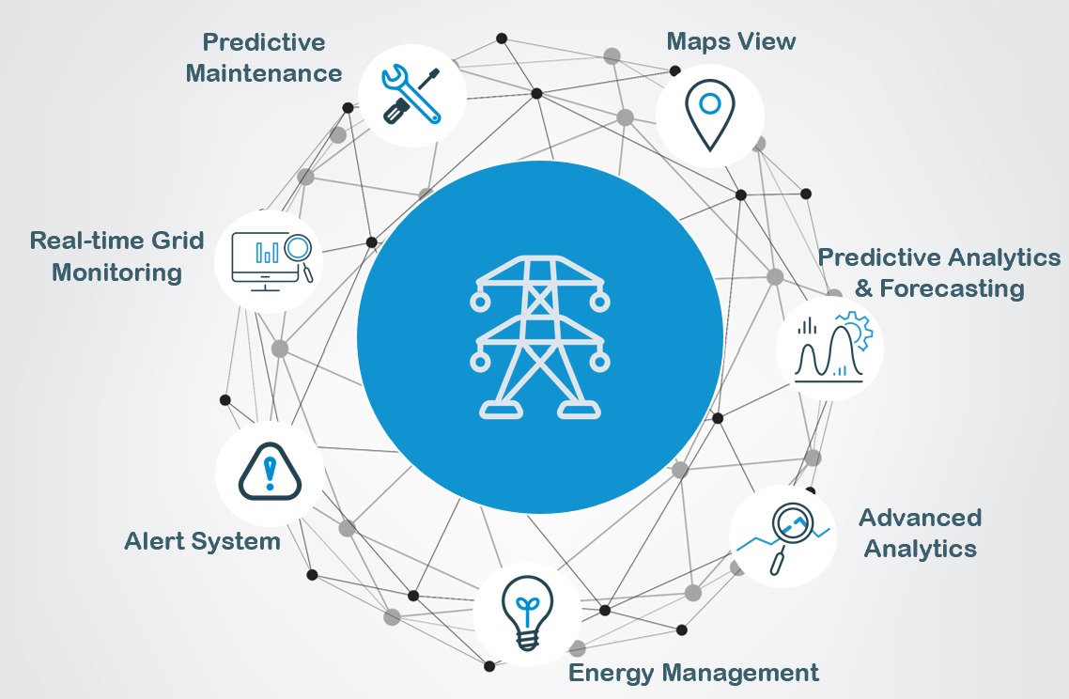

Power Grid Management System
Project Name: Power Grid Management System with AI Insights
Team Name: codeARC
Hackathon: Diversion 2025 MLH Hackathon
Team Members: Chirag Nahata, Snigdha Ghosh, Srijita Saha, Somyadip Ghosh
Tagline: "Revolutionizing Energy Management with AI & Real-Time Insights"

Slide 2
Problem statement
Inefficiency: Power loss due to poor load distribution
Unpredictability: Weather affects renewable energy generation
Maintenance Delays: Unplanned outages due to reactive maintenance
Lack of Insights: Limited AI-driven grid monitoring

Slide 3
Solution Overview
Real-time AI monitoring using Google Gemini 1.5 Flash & custom model
Smart resource optimization & predictive analytics
Weather impact analysis for renewable energy
Automated alerts & efficiency optimization

Slide 4
Unique Selling Propositions (USP)
AI-Powered Insights: Instant analysis & predictions
Real-Time Monitoring: Interactive visualization dashboard
Smart Grid Optimization: AI-driven load balancing & distribution
Weather-Integrated Forecasting: Proactive renewable energy planning

Slide 5
Minimum Viable Product (MVP)
Real-time Monitoring – Track power consumption & grid status
AI-Powered Insights – Predictive load & efficiency analytics
Weather Impact Analysis – Renewable energy optimization
Smart Alert System – Instant notifications & recommendations

Slide 6
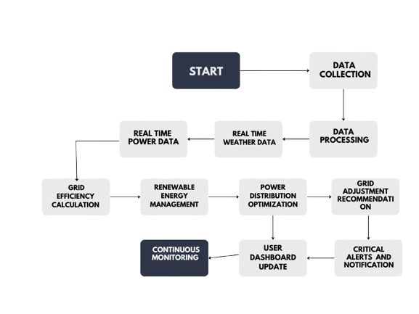
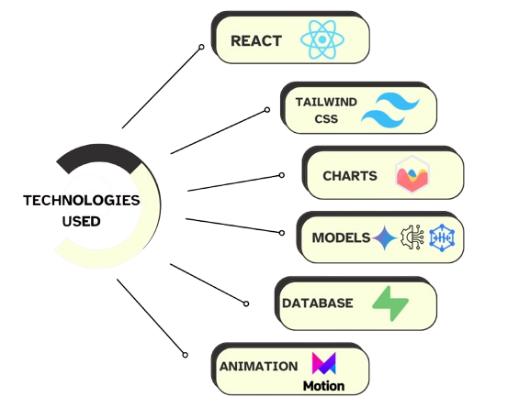
TECHNICAL APPROACH
FLOWCHART

Slide 7
System Architecture
User interacts with the dashboard
Real-time data fetched from the database
AI model processes grid status & predictions
Insights & recommendations displayed in the UI

Slide 8
Demo Walkthrough
Thank you

