Slide 1
NUCLEAR AND QUANTUM PHYSICS

Slide 2
E Nuclear and Quantum Physics
E.1 Structure of The Atom
E.2 Quantum Physics
E.3 Radioactive Decay
E.4 Fission
E.5 Fusion and Stars

Slide 3
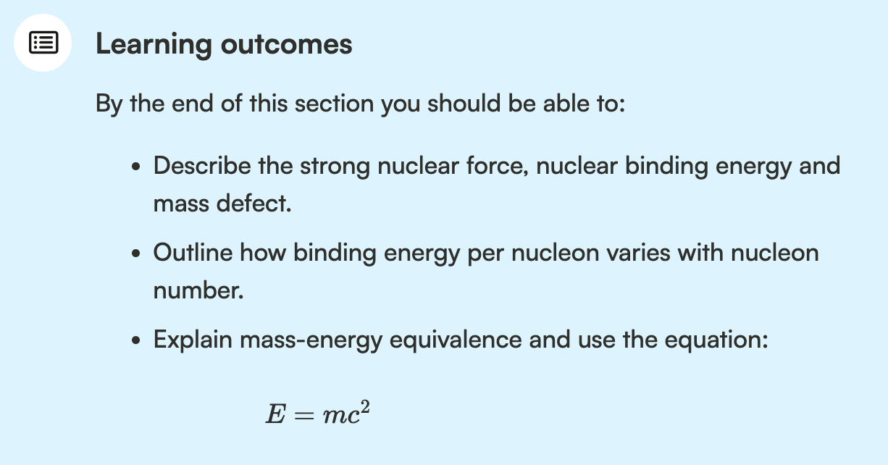
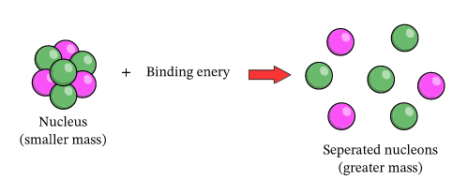
Binding Energy
The binding energy of a nucleus is the amount of energy needed to completely separate all of its nucleons.

Slide 4
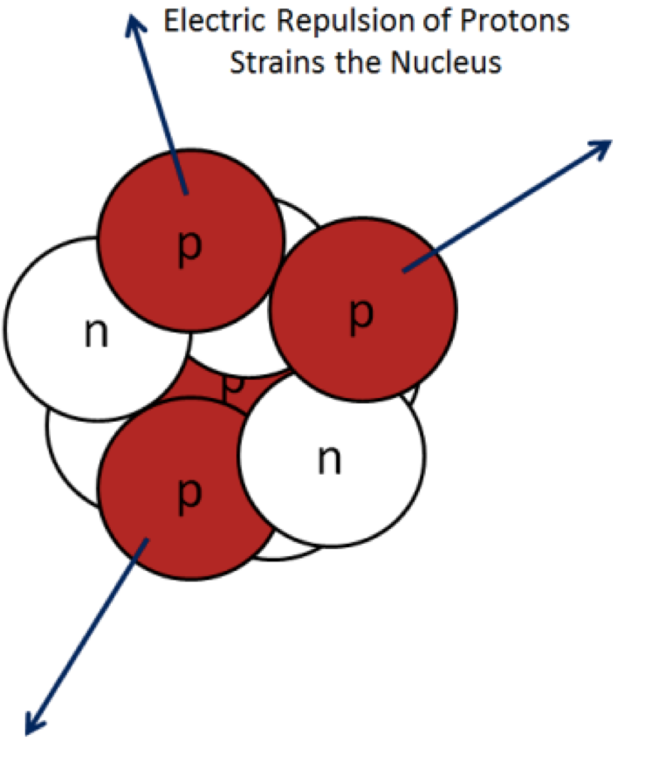
Protons together?
According to Coulomb’s law, protons repel each other.
How is it possible that protons stay closely packed together in the nucleus of an atom?

Slide 5
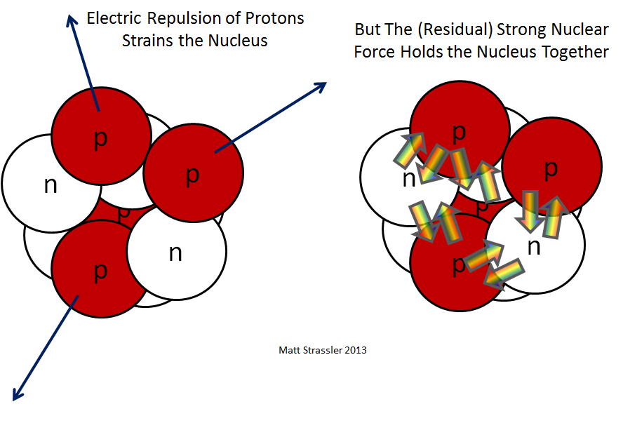
Attraction between the nucleons Strong Nuclear Force

Slide 6
Binding Energy
The binding energy of a nucleus is the amount of energy needed to completely separate all of its nucleons.

Slide 7
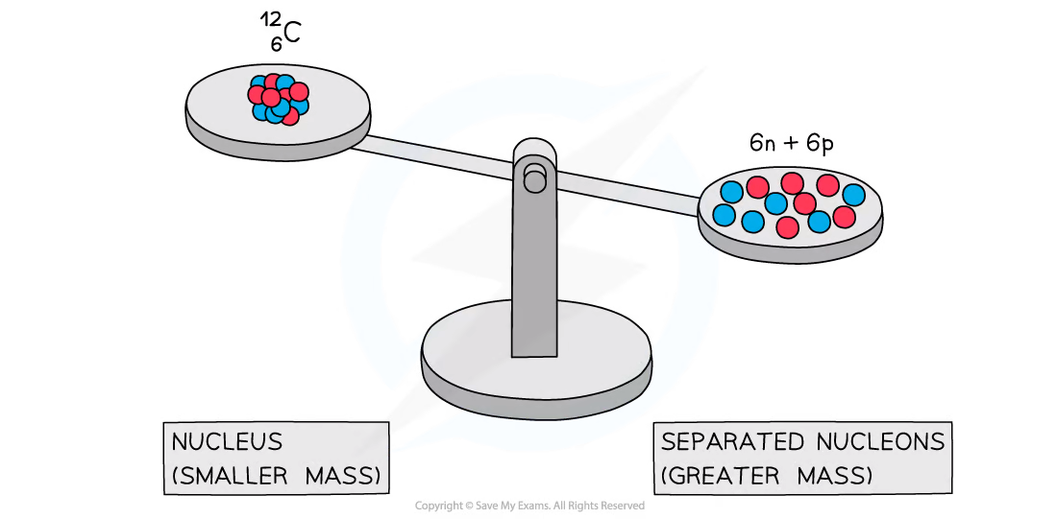
Mass Defect

Slide 8
Mass Defect
Mass of a carbon-12 nucleus (by definition) is 12u.
Mass of 6 protons and 6 neutrons (its nucleons) all together is more than 12u.

Slide 9
Mass Defect
Mass defect of a nucleus is the difference between the mass of the nucleus and the sum of the masses of its nucleons if separated.

Slide 10
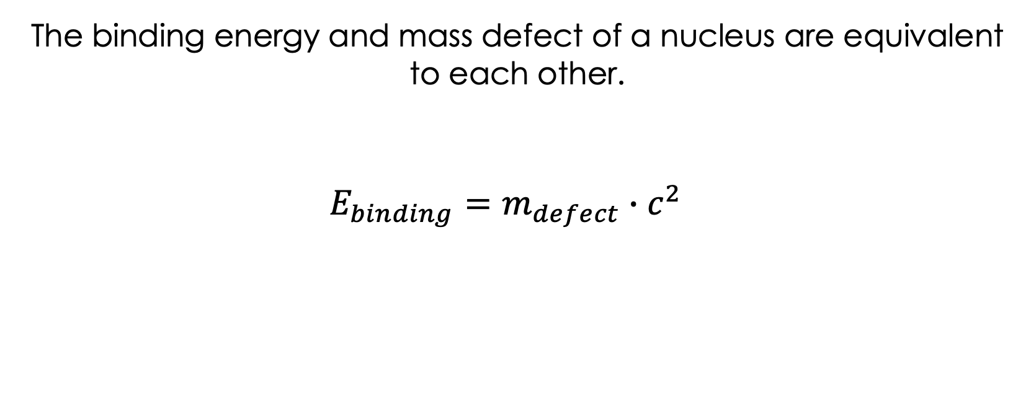
Mass Defect and Binding Energy

Slide 11
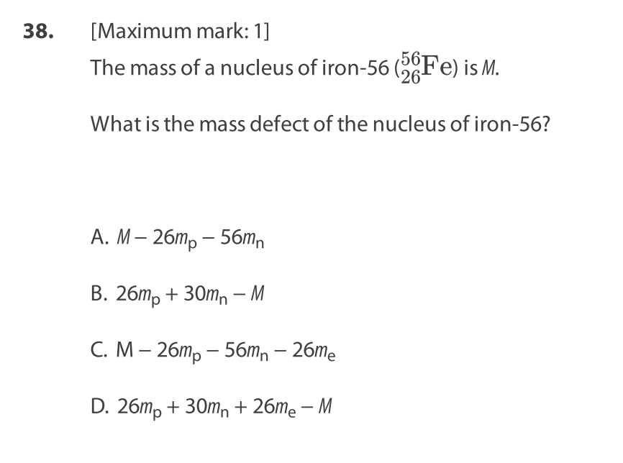

Slide 12
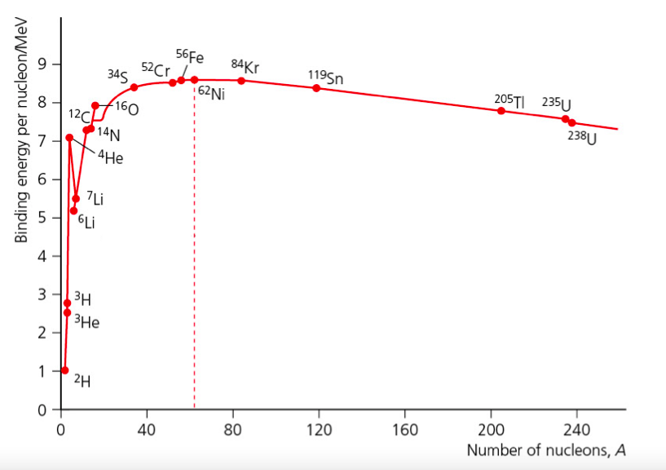
The Binding Energy Curve
The binding energy per nucleon for hydrogen is zero, there is only one particle so nothing to separate.
The curve rises rapidly for low values of A.
Maximum is at A=62 corresponding to nickel, the most stable nucleus.
The curve drops gently from the peak and onwards
Most nuclei have a binding energy per nucleon between 7 and 9 MeV.

Slide 13
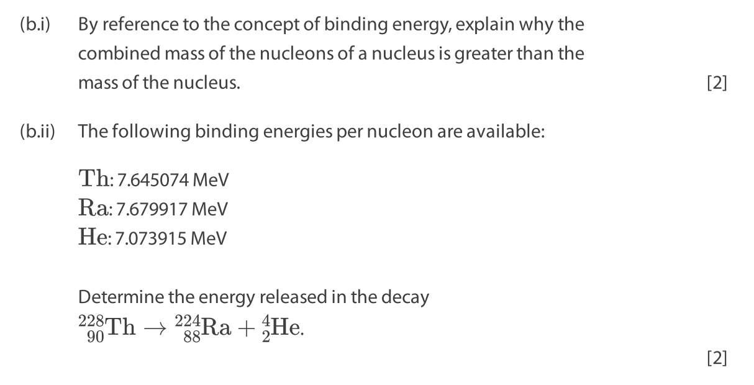
E.3 Paper questions: 11c,d + 12+ 22

Slide 14
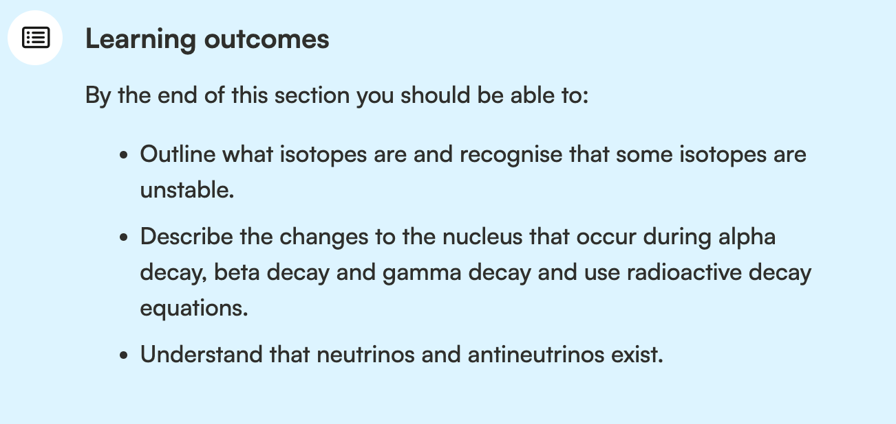
Binding Energy
The binding energy of a nucleus is the amount of energy needed to completely separate all of its nucleons.

Slide 15
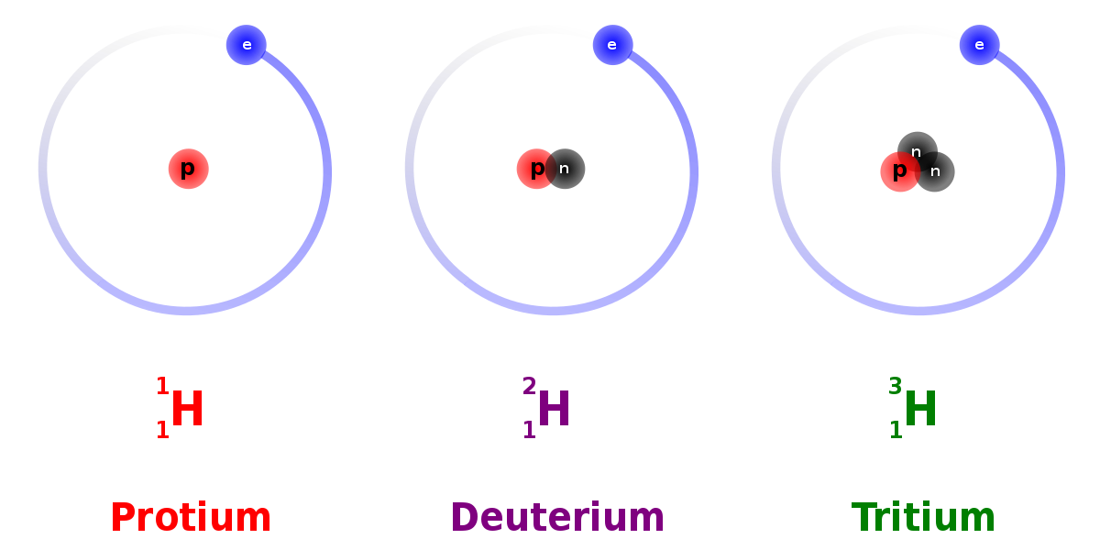
Isotopes
They have identical chemical properties, but different physical properties.

Slide 16
Isotopes
While protium and deuterium are stable, tritium is unstable.
It is unstable because of the proton-neutron ratio in its nucleus.
In an attempt to become more stable, it may release nuclear radiation in the form of particles/rays.
In other words, it may decay.
It decays into helium which takes 12 years.
They have identical chemical properties, but different physical properties.

Slide 17
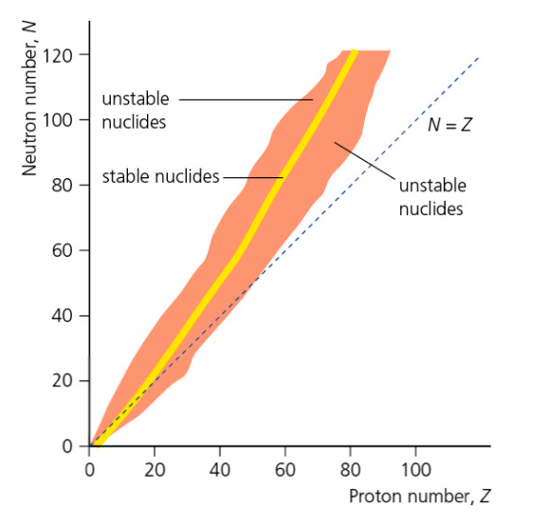
Nuclear Stability
In an attempt to become more stable, unstable nuclei may release nuclear radiation in the form of particles/rays.
As a result, nuclear potential energy decreases.
Based on the graph, does a nucleus need more neutrons or protons for stability? Why?

Slide 18
Energy released through
Radioactive Decay
Nuclear Fission
Nuclear fusion

Slide 19
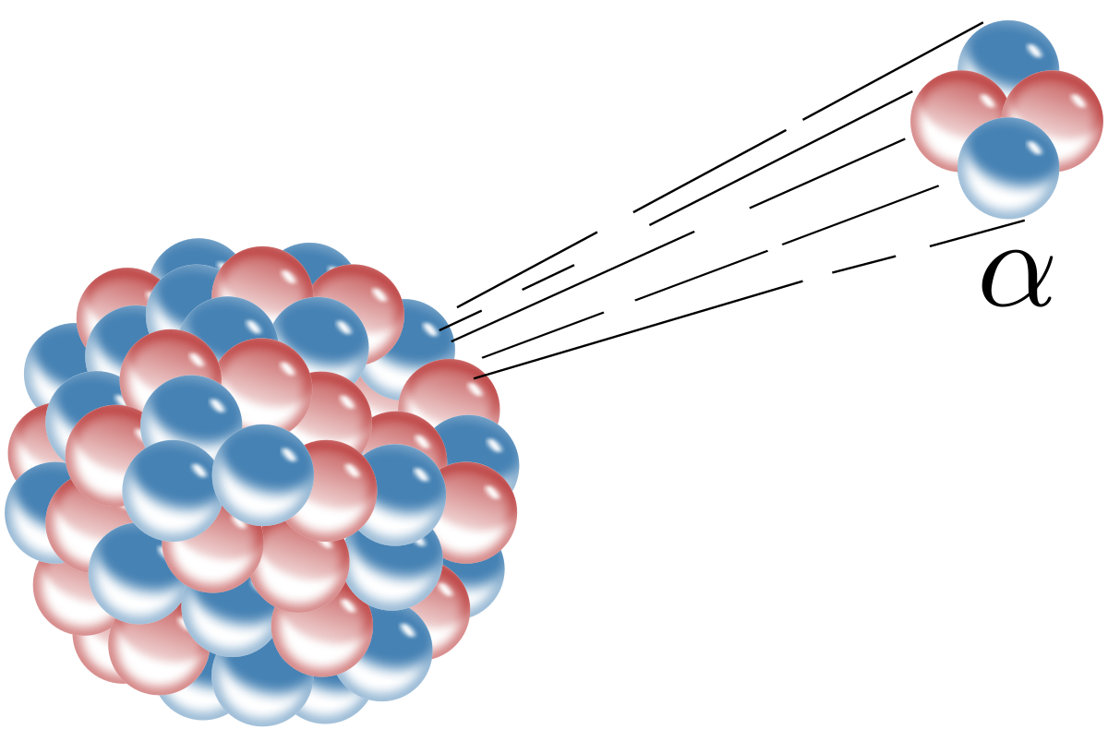
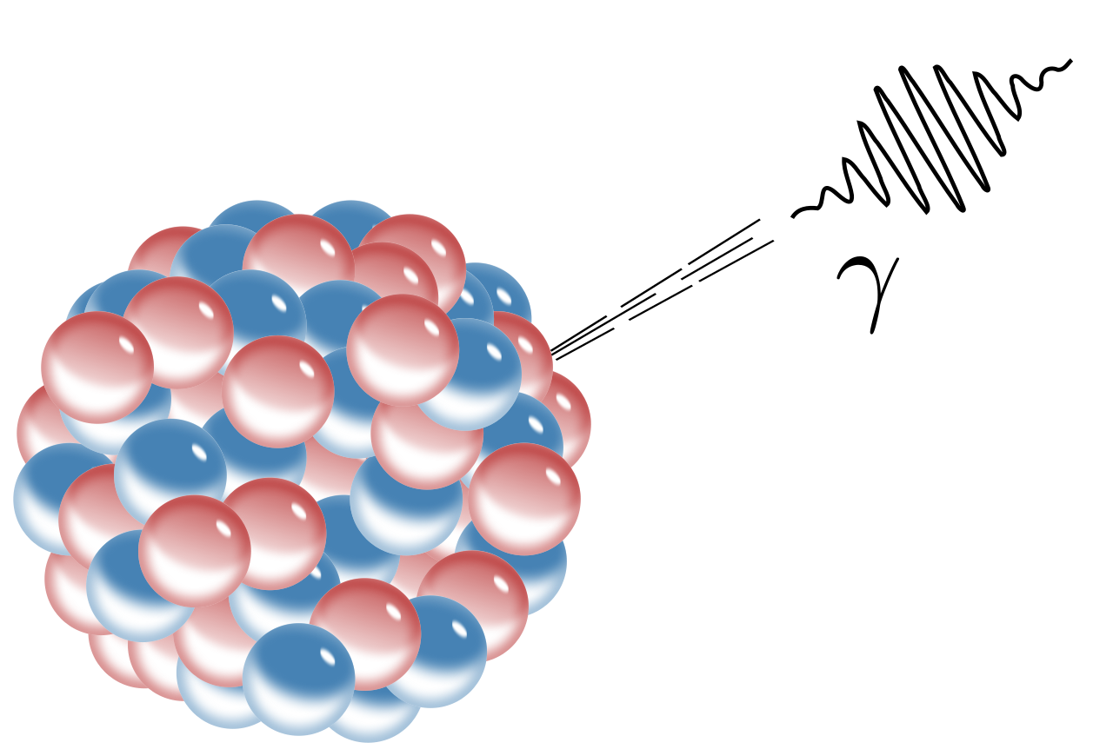
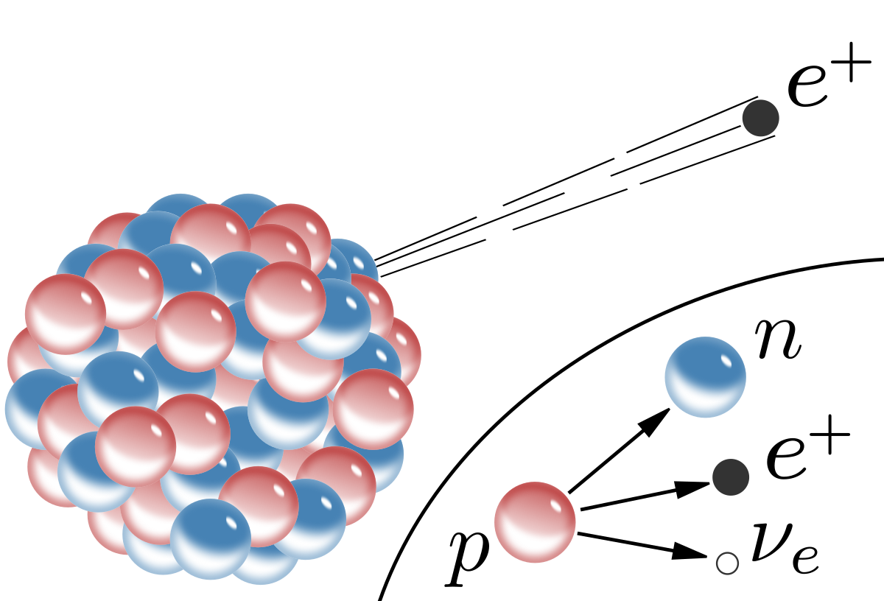
Radioactive Decay
Alpha Decay
Gamma Decay
Beta (Plus) Decay
As a result of being more stable, the nuclear potential energy decreases. It turns into kinetic energy of the particle emitted.

Slide 20



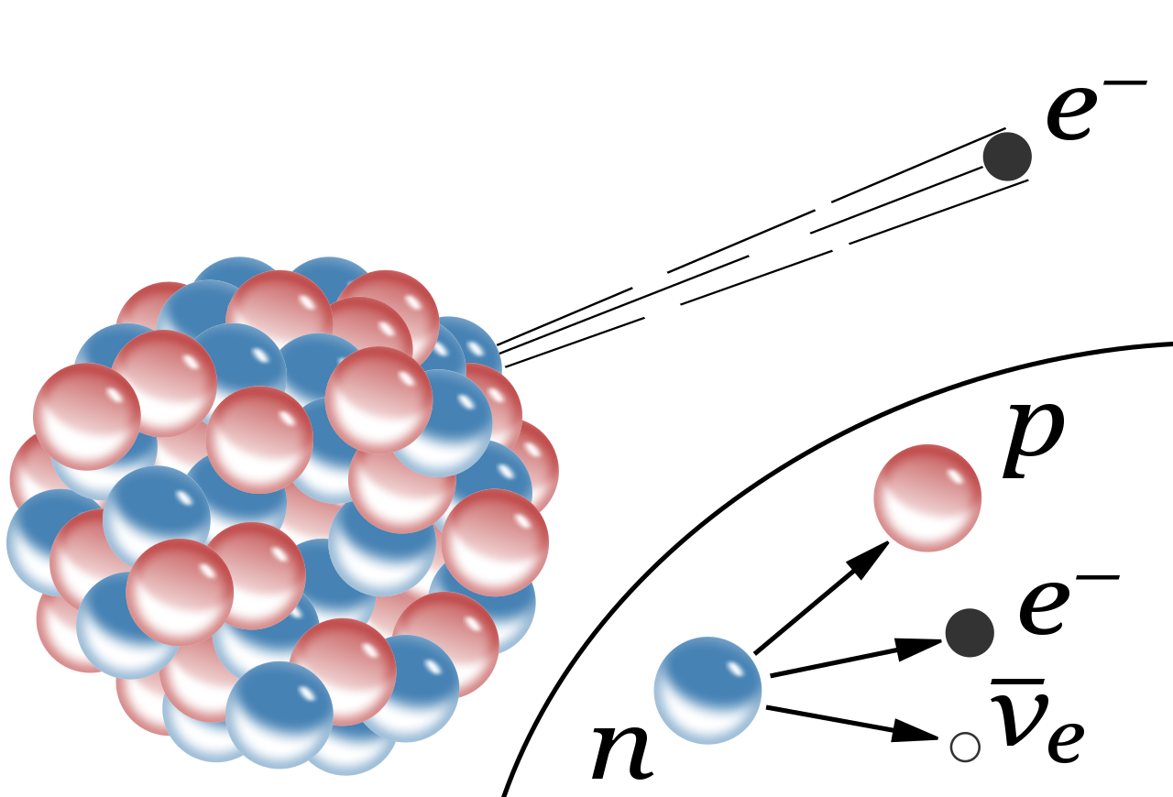

Radioactive Decay
Alpha Decay
Gamma Decay
Beta Minus Decay

Slide 21
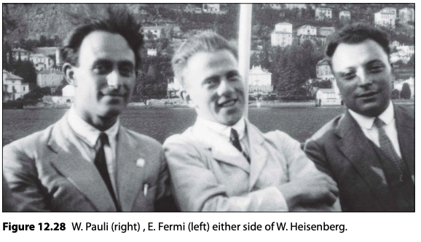

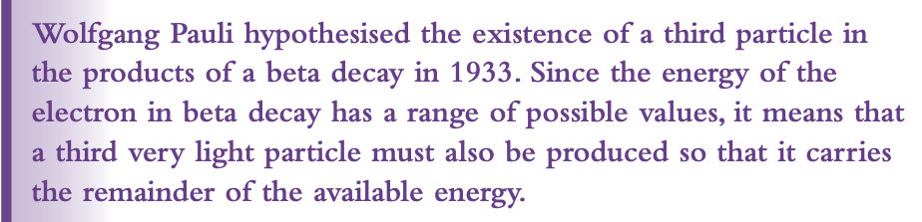
The Neutrino

Slide 22
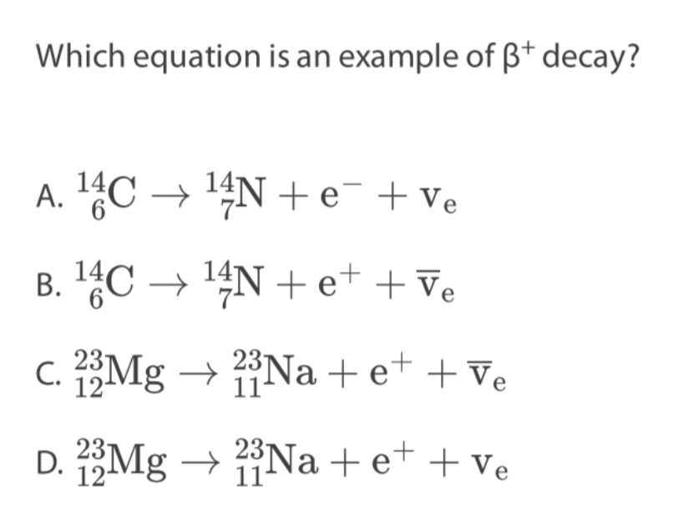
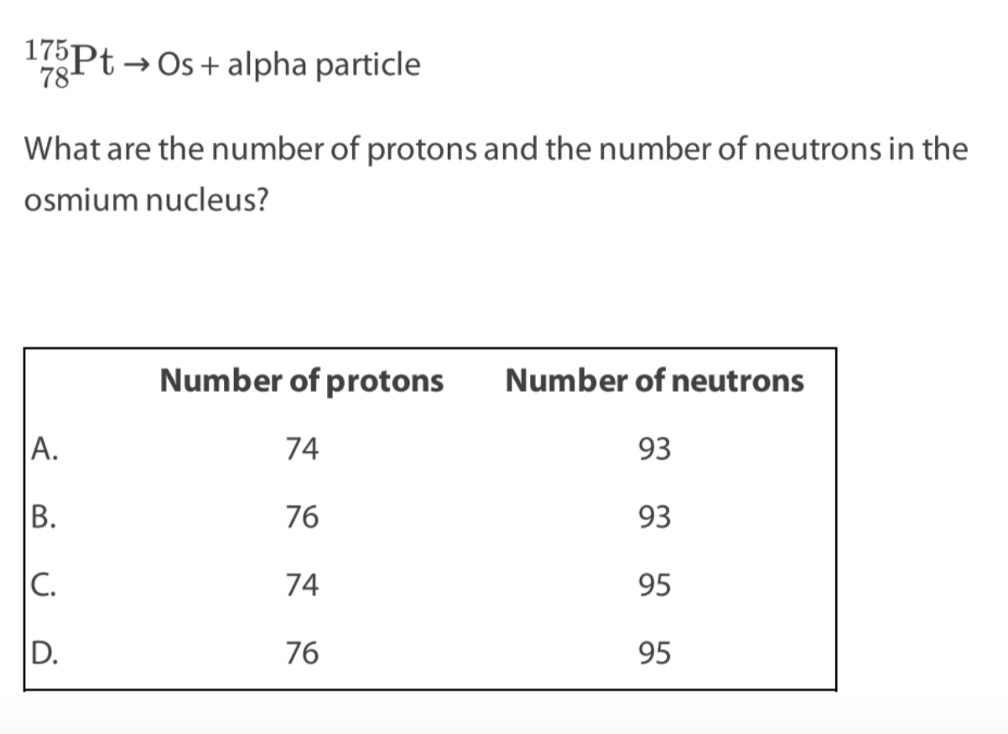
Notes:
A

Slide 23
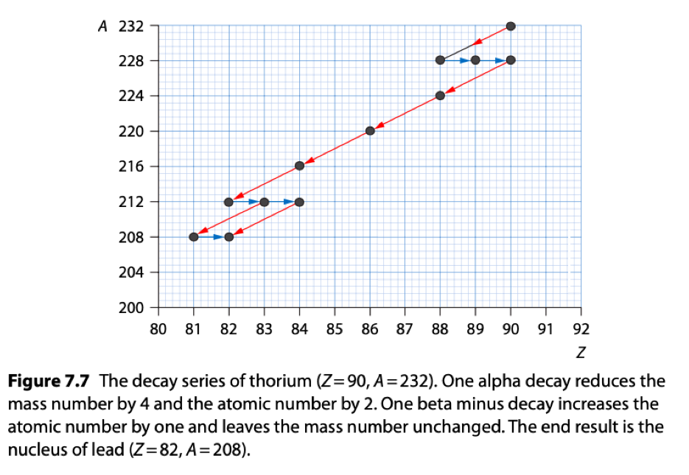
Decay Series

Slide 24
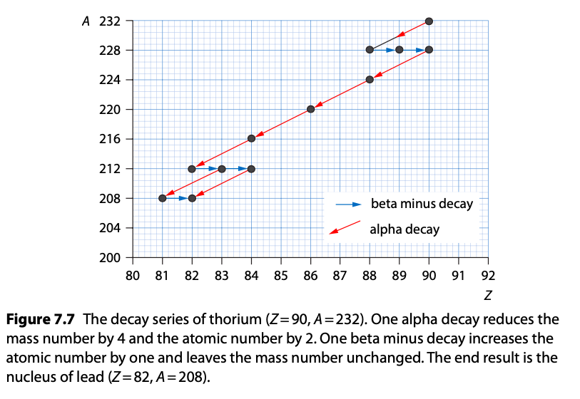
Decay Series

Slide 25
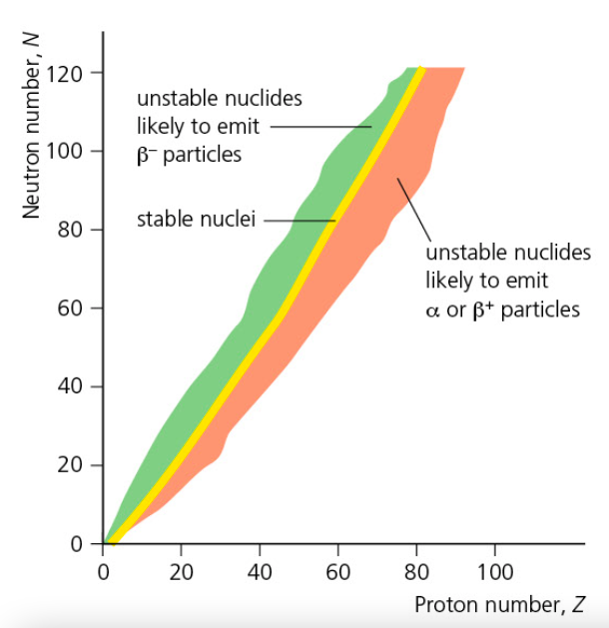
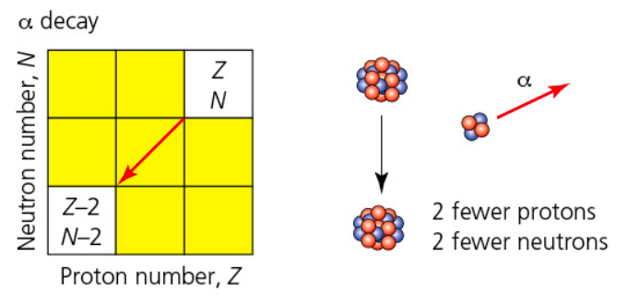
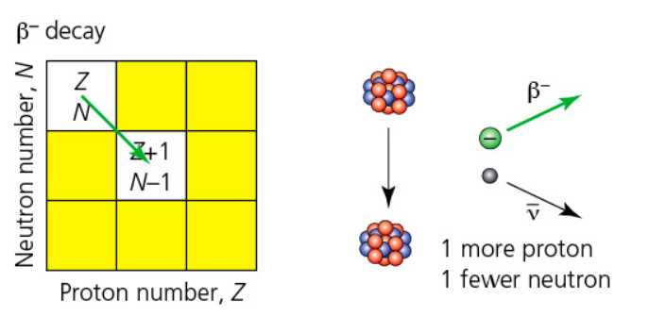
Decay Series

Slide 26
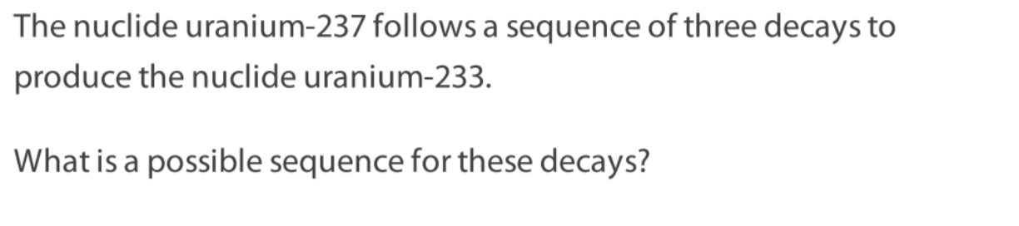
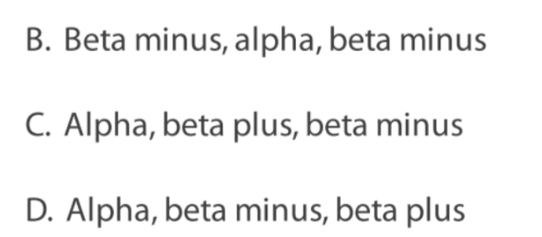
Notes:
A

Slide 27
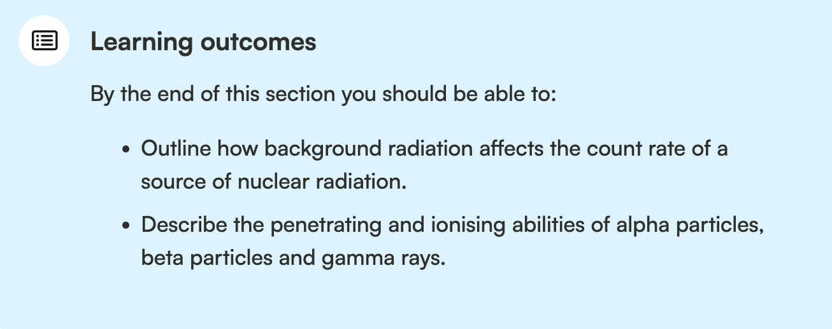
The Neutrino

Slide 28
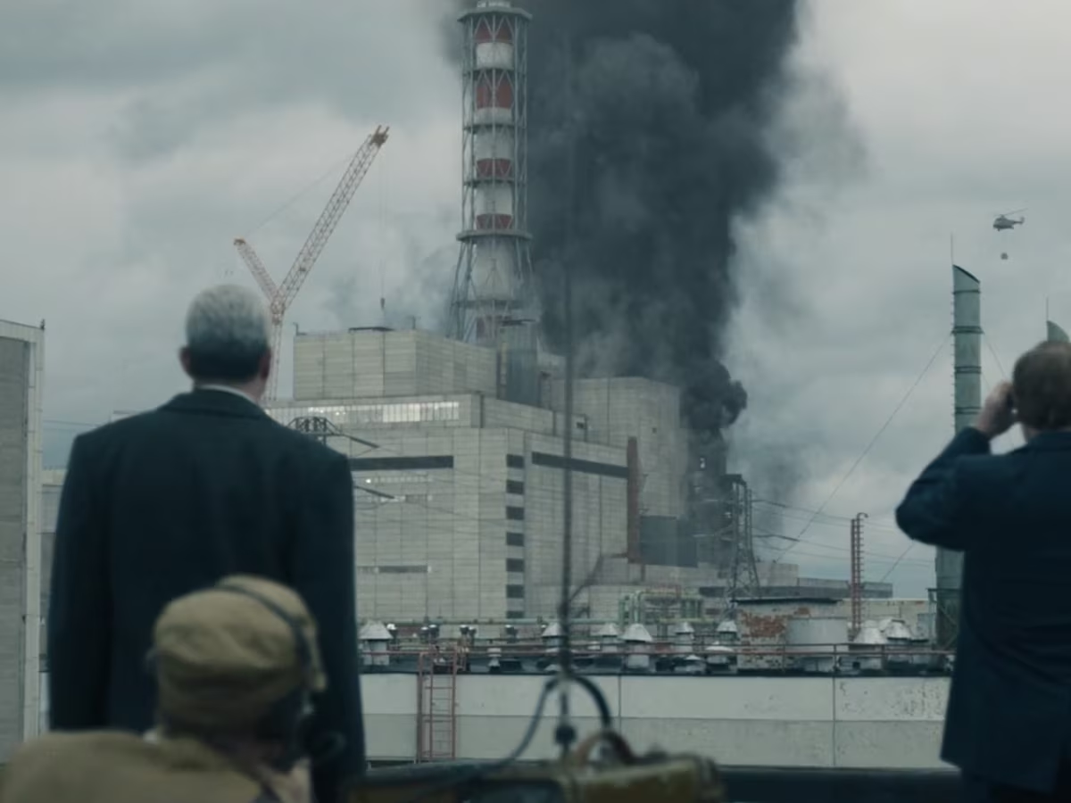
Chernobyl

Slide 29

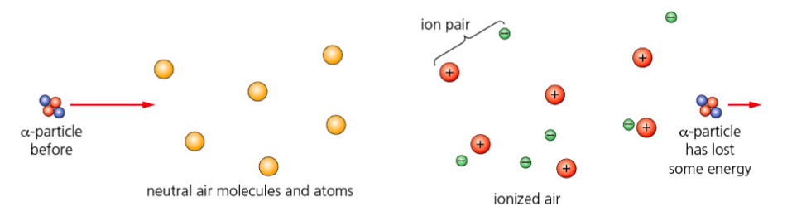

Slide 30
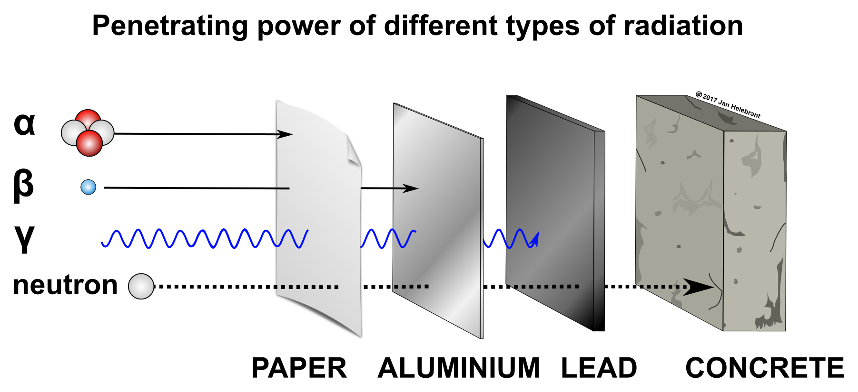
Penetrating Power

Slide 31
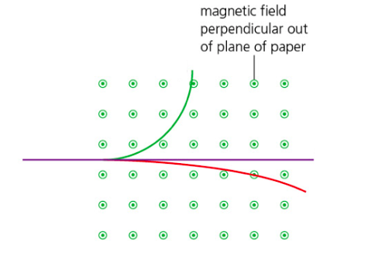
Deflecting Radiation in Magnetic Field
Which color represents the path of gamma, alpha or beta particle?
Is beta particle beta + or -?

Slide 32
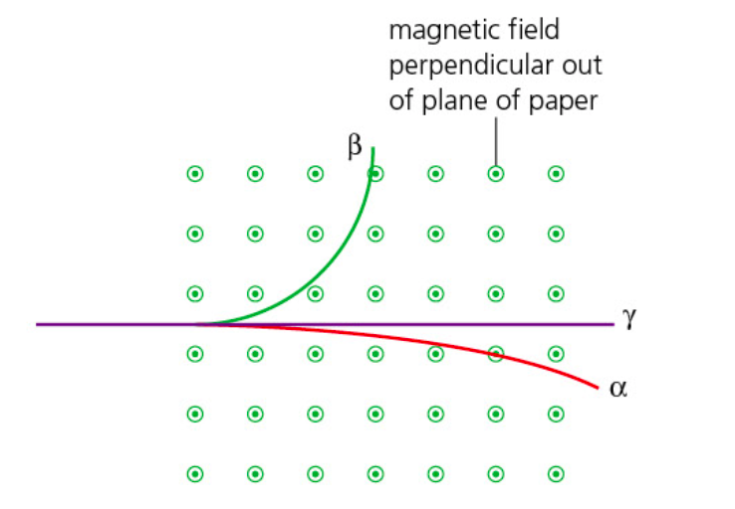
Deflecting Radiation in Magnetic Field

Slide 33
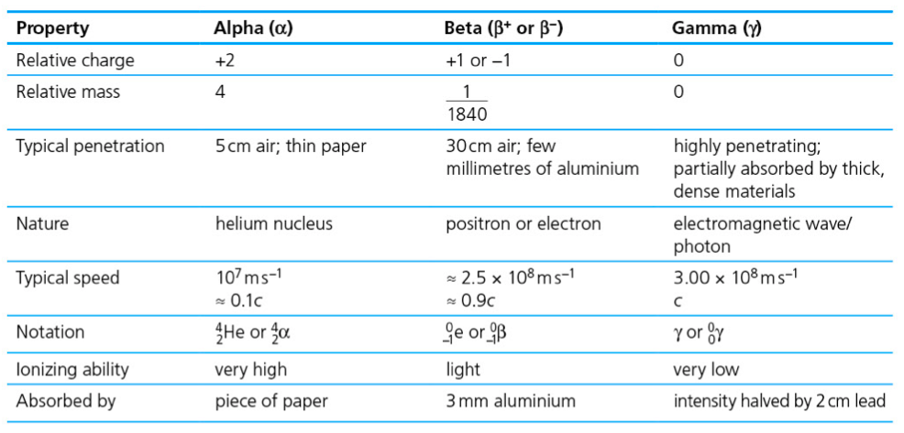
Summary

Slide 34
Paper 2 Question
Do question 3 from E.3 paper questions.
Notes:
A

Slide 35
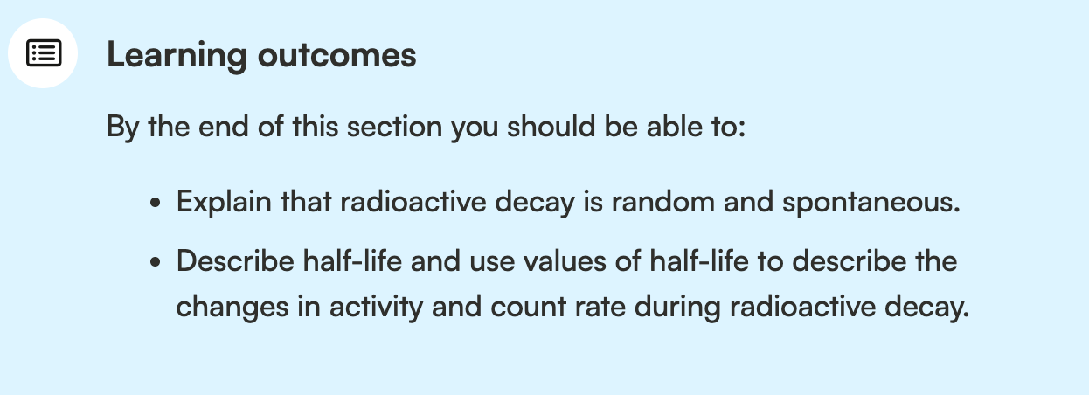
Random: its unpredictable which unstable nucleus will decay
Spontaneous: we can’t affect the rate of decay
The number of decay per second is proportional to the number of nuclei that have not yet decayed.

Slide 36
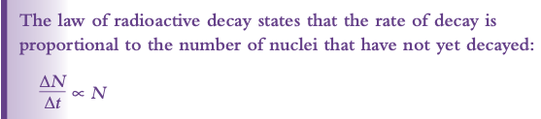
The Law of Radioactive Decay
Random: its unpredictable which unstable nucleus will decay
Spontaneous: we can’t affect the rate of decay
The number of decay per second is proportional to the number of nuclei that have not yet decayed.

Slide 37
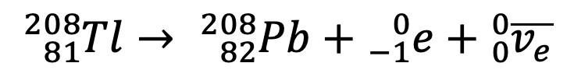
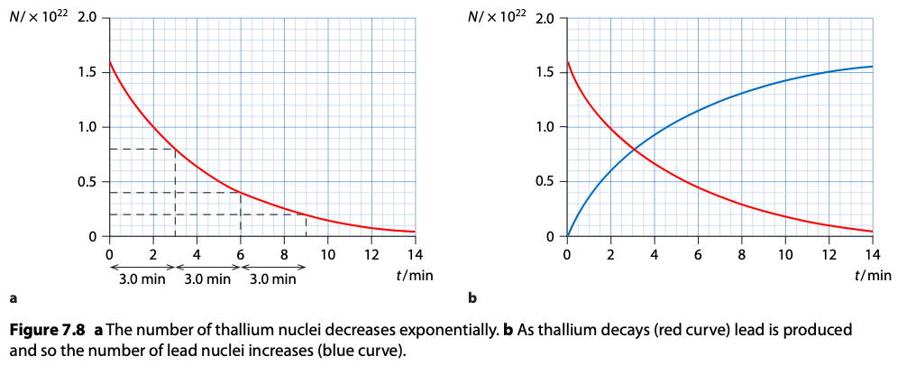
The Law of Radioactive Decay
Thallium 🡪 Lead + Electron + Anti-neutrino

Slide 38
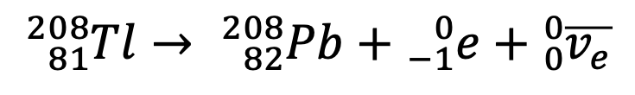
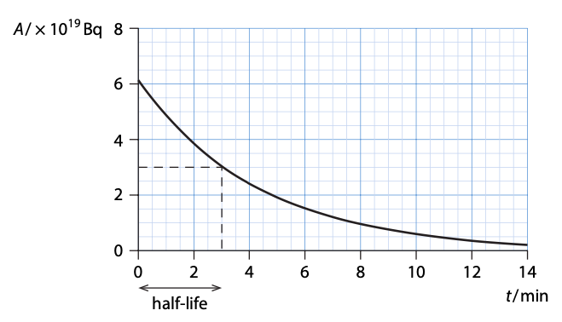
Half – life
Thallium 🡪 Lead + Electron + Anti-neutrino

Slide 39
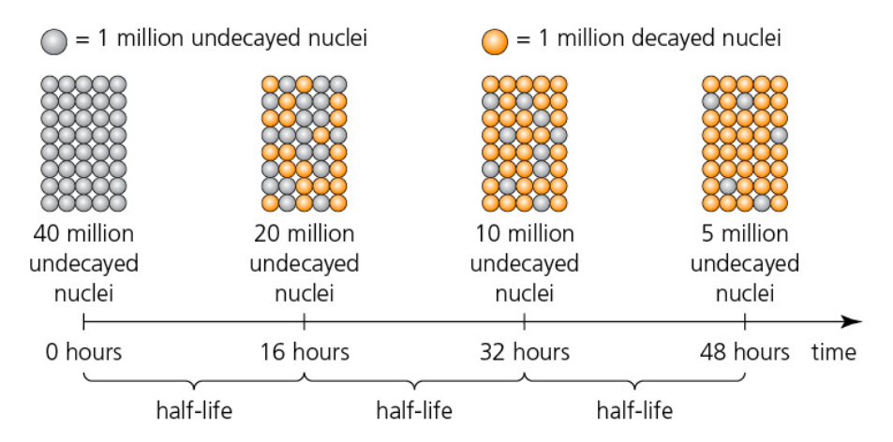
Half – Life

Slide 40
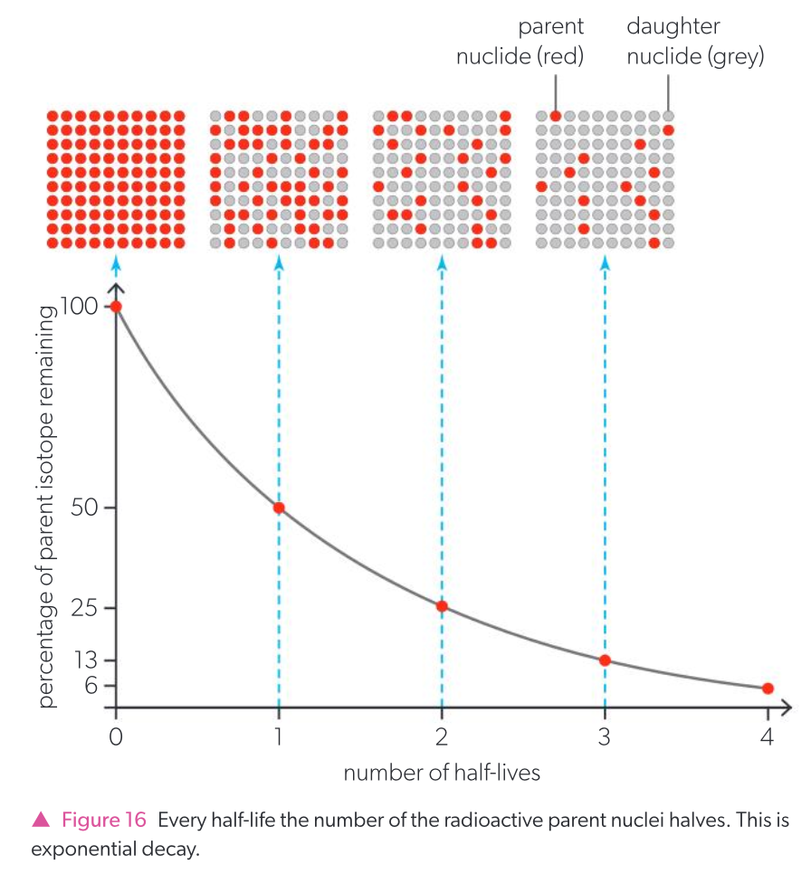

Slide 41
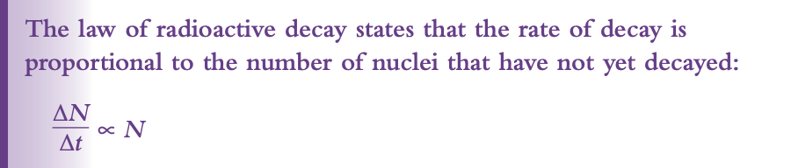

The Law of Radioactive Decay

Slide 42
Activity
Quantity | Definition | Unit
 | Time taken for half of nuclei to decay. | Second (s)
Activity (A) | Number of decay(s) per second. | Becquerel (Bq)

Slide 43
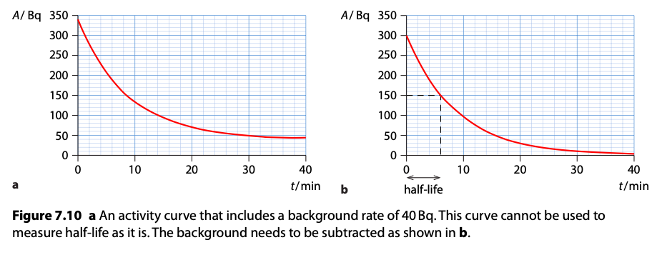
Activity
Click for applet!

Slide 44
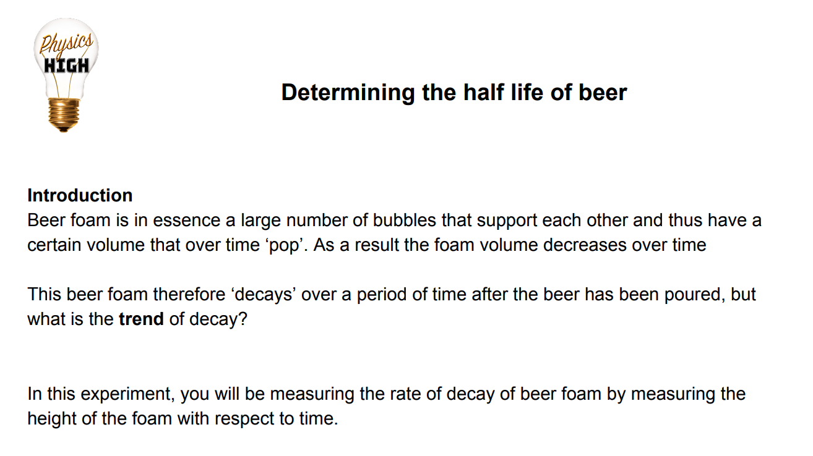
The Law of Radioactive Decay experiment

Slide 45
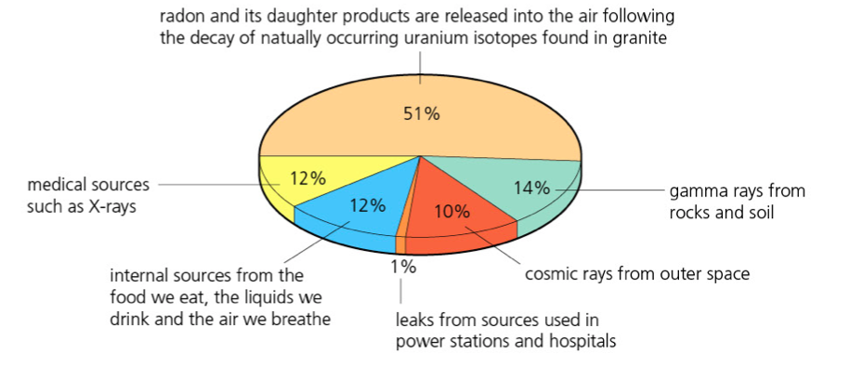
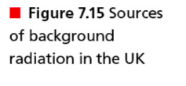
Background Radiation

Slide 46
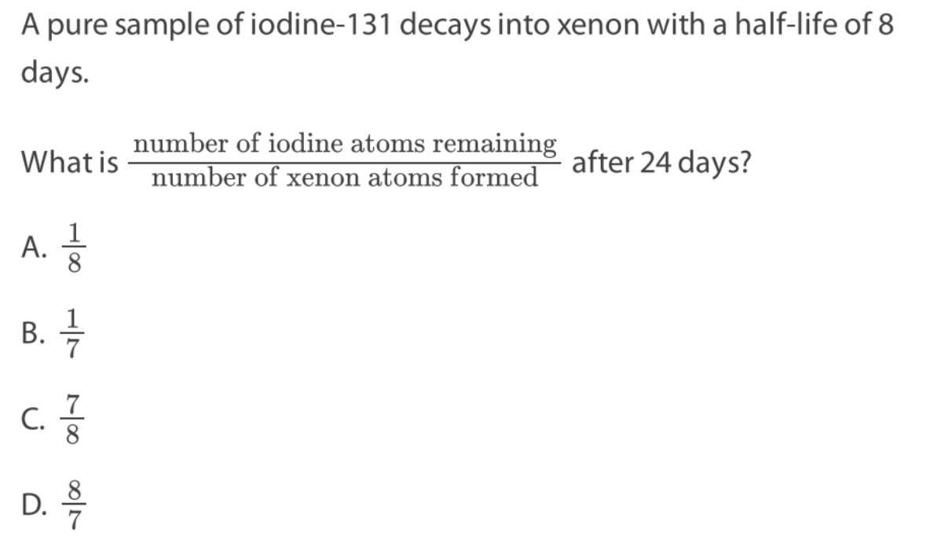
E.3 Paper questions: 31 until 36 +11ab
Notes:
D

Slide 47
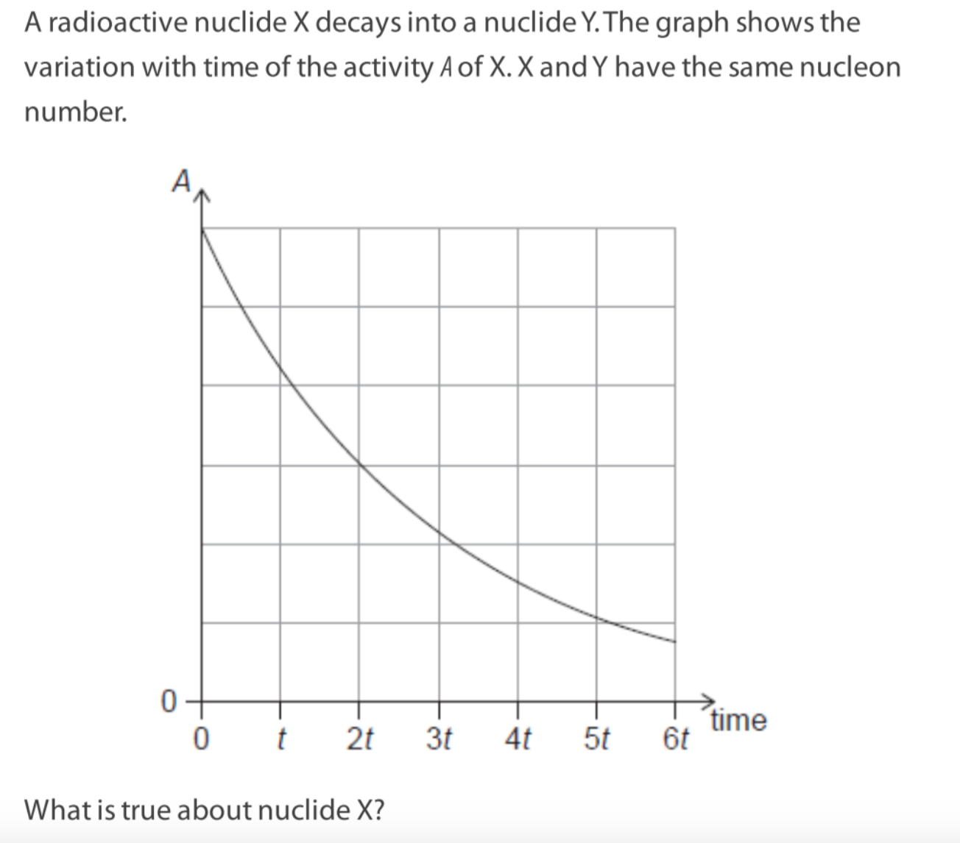
Notes:
D

Slide 48

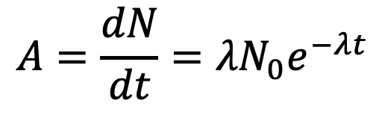



Exponential Decrease

Slide 49


Activity, A
Remember: activity is measured in becquerels, Bq. One becquerel is defined as one decay per second.

Slide 50




Slide 51

Isolate the half life and write an expression for half life!

Slide 52





Slide 53


Paper Questions
Do question 11, 36, 43 from E.3 paper questions.
Notes:
A

Slide 54

Do question 11, 36, 43 from E.3 paper questions.
Notes:
A

