Slide 1
CSCE 1020.002
Binary and Hexadecimal Numbers

Slide 2
Binary Numbers
Computers store and process data in terms of binary numbers.
Binary numbers consist of only the digits 1 and 0.
It is important for Computer Scientists and Computer Engineers to understand how binary numbers work.
Note: “Binary Numbers” are also referred to as “Base 2” numbers.

Slide 3
Review of Placeholders
You probably learned about placeholders in the 2nd or 3rd grade. For example:
1000’s place
100’s place
10’s place
1’s place
3125
So this number represents
3 thousands
1 hundred
2 tens
5 ones
Mathematically, this is
(3 x 1000) + (1 x 100) + (2 x 10) + (5 x 1)
= 3000 + 100 + 20 + 5 = 3125
But why are the placeholders 1, 10, 100, 1000, and so on?

Slide 4
More on Placeholders
The numbers commonly used by most people are in Base 10.
The Base of a number determines the values of its placeholders.
10³ place
10² place
10¹ place
10⁰ place
3125₁₀
To avoid ambiguity, we often write the base of a number as a subscript.

Slide 5
Binary Numbers - Example
8’s place
4’s place
2’s place
1’s place
2³ place
2² place
2¹ place
2⁰ place
1010₂
This subscript denotes that this number is in Base 2 or “Binary”.

Slide 6
Binary Numbers - Example
8’s place
4’s place
2’s place
1’s place
1010₂
So this number represents
1 eight
0 fours
1 two
0 ones
Mathematically, this is
(1 x 8) + (0 x 4) + (1 x 2) + (0 x 1)
= 8 + 0 + 2 + 0 = 10₁₀

Slide 7
Which Digits Are Available in which Bases
Base 10
0
1
2
3
4
5
6
7
8
9
10
Base 2
0
1
10
Base 16
0
1
2
3
4
5
6
7
8
9
A
B
C
D
E
F
10
2 digits
Base 16
Cheat Sheet
A₁₆ = 10₁₀
B₁₆ = 11₁₀
C₁₆ = 12₁₀
D₁₆ = 13₁₀
E₁₆ = 14₁₀
F₁₆ = 15₁₀
Add Placeholder
10 digits
16 digits
Add Placeholder
Note: Base 16 is also called “Hexadecimal” or “Hex”.
Add Placeholder

Slide 8
Hexadecimal Numbers - Example
256’s place
16’s place
1’s place
16² place
16¹ place
16⁰ place
3AB₁₆
Note:
16² = 256
This subscript denotes that this number is in Base 16 or “Hexadecimal” or “Hex”.

Slide 9
Hexadecimal Numbers - Example
256’s place
16’s place
1’s place
Base 16
Cheat Sheet
A₁₆ = 10₁₀
B₁₆ = 11₁₀
C₁₆ = 12₁₀
D₁₆ = 13₁₀
E₁₆ = 14₁₀
F₁₆ = 15₁₀
3AB₁₆
So this number represents
3 two-hundred fifty-sixes
10 sixteens
11 ones
Mathematically, this is
(3 x 256) + (10 x 16) + (11 x 1)
= 768 + 160 + 11 = 939₁₀

Slide 10
Why Hexadecimal Is Important
What is the largest number you can represent using four binary digits?
What is the largest number you can represent using a single hexadecimal digit?
Base 16
Cheat Sheet
A₁₆ = 10₁₀
B₁₆ = 11₁₀
C₁₆ = 12₁₀
D₁₆ = 13₁₀
E₁₆ = 14₁₀
F₁₆ = 15₁₀
_ _ _ _
1
1
1
1
_
2³
2²
2¹
2⁰
2
F
= 15₁₀
=
=
=
=
16
8
4
2
1
… the smallest number?
8 + 4 + 2 + 1 = 15₁₀
_
0
= 0₁₀
Note: You can represent the same range of values with a single hexadecimal digit that you can represent using four binary digits!
… the smallest number?
_ _ _ _
16
0
0
0
0
2³
2²
2¹
2⁰
2
0 + 0 + 0 + 0 = 0₁₀

Slide 11
Why Hexadecimal Is Important
Continued
It can take a lot of digits to represent numbers in binary.
Hexadecimal numbers can be used to abbreviate binary numbers.
Example:
51794₁₀ = 1100101001010010₂
Starting at the least significant digit, split your binary number into groups of four digits.
Long strings of digits can be difficult to work with or look at.
Also, being only 1’s and 0’s, it becomes easy to insert or delete a digit when copying by hand.
Convert each group of four binary digits to a single hex digit.

Slide 12
Converting Binary Numbers to Hex
Recall the example binary number from the previous slide:
1100101001010010₂
Base 16
Cheat Sheet
A₁₆ = 10₁₀
B₁₆ = 11₁₀
C₁₆ = 12₁₀
D₁₆ = 13₁₀
E₁₆ = 14₁₀
F₁₆ = 15₁₀
1100 1010 0101 0010₂
C
A
5
2
₁₆
First, split the binary number into groups of four digits, starting with the least significant digit.
Next, convert each group of four binary digits to a single hex digit.
Put the single hex digits together in the order in which they were found, and you’re done!

Slide 13
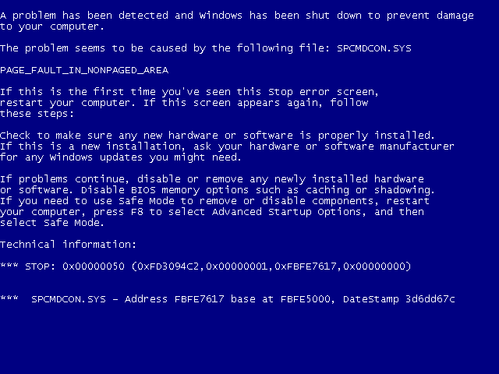
Windows
“Blue Screen of Death”
In many situations, instead of using a subscript to denote that a number is in hexadecimal, a “0x” is appended to the front of the number.
Look! Hexadecimal Numbers!

Slide 14
Converting Decimal to Binary
Example:
We want to convert 125₁₀ to binary.
125 / 2 = 62 R 1
62 / 2 = 31 R 0
31 / 2 = 15 R 1
15 / 2 = 7 R 1
7 / 2 = 3 R 1
3 / 2 = 1 R 1
1 / 2 = 0 R 1
125₁₀ = 1111101₂

Slide 15
Converting Decimal to Hex
Example:
We want to convert 125₁₀ to hex.
Base 16
Cheat Sheet
A₁₆ = 10₁₀
B₁₆ = 11₁₀
C₁₆ = 12₁₀
D₁₆ = 13₁₀
E₁₆ = 14₁₀
F₁₆ = 15₁₀
125 / 16 = 7 R 13
7 / 16 = 0 R 7
125₁₀ = 7D₁₆

