Slide 1
Lab-3

Slide 2
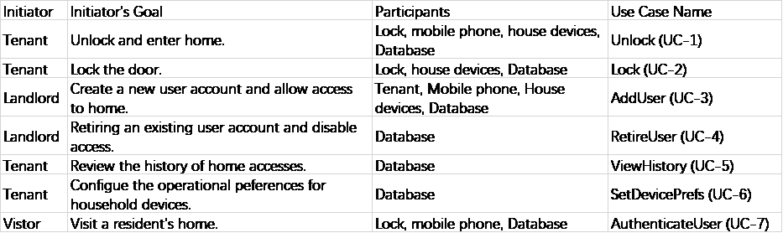
Deriving Use Cases from System Requirements

Slide 3
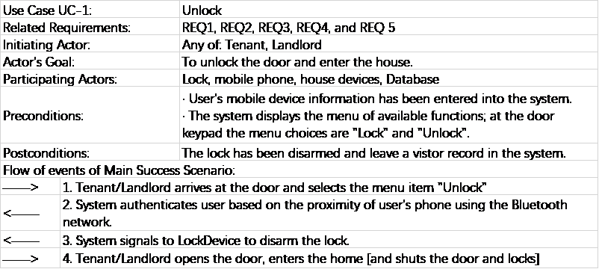
Use Case Schema of UC-1

Slide 4
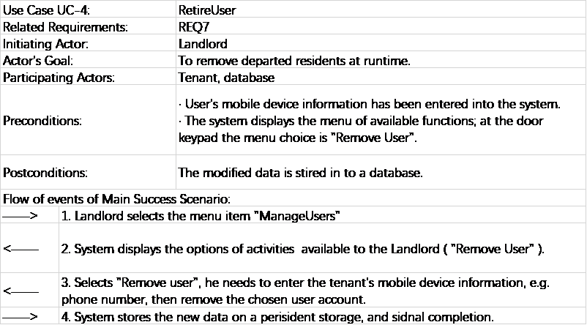
Use Case Schema of UC-4

Slide 5
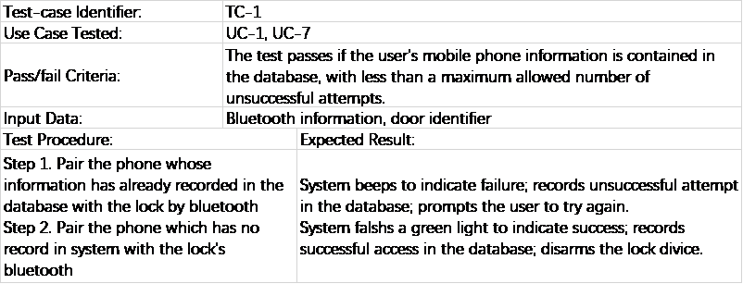
Acceptance tests for UC-1

Slide 6
Acceptance tests for UC-4

