Slide 1
Voice-To-Text Analysis Web User Guide

Slide 2
Versions
Version | Change Date | Change By | Description
0 | 2022.06.09 | Tongtong | Initial

Slide 3
Contents
Login
Main
Upload
History
Report
About

Slide 4
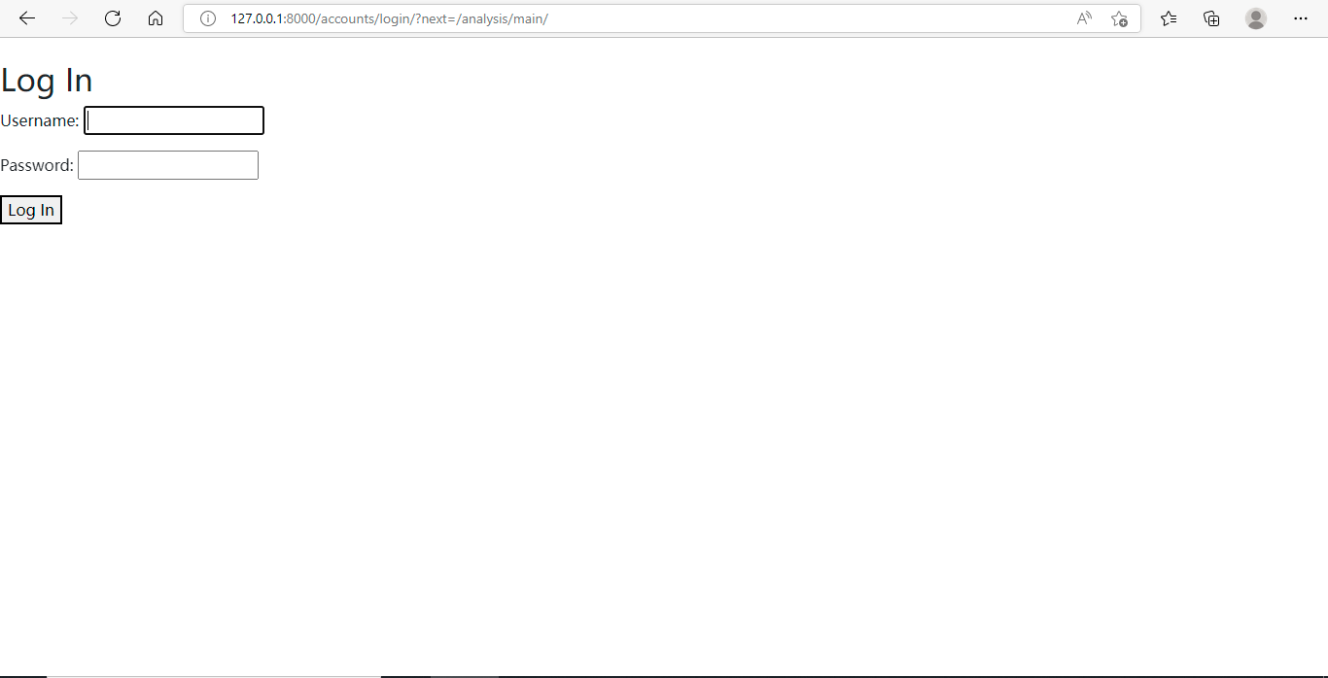
Login
User can login with his/her username and password.

Slide 5
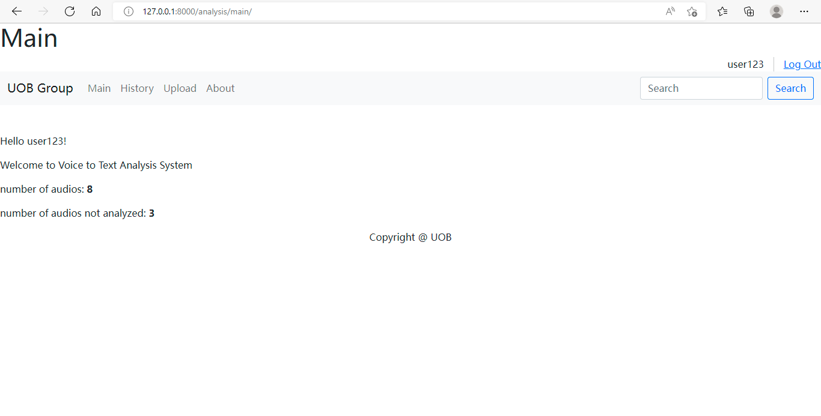
Main
This is designed as a dashboard to show summary information of current user.

Slide 6
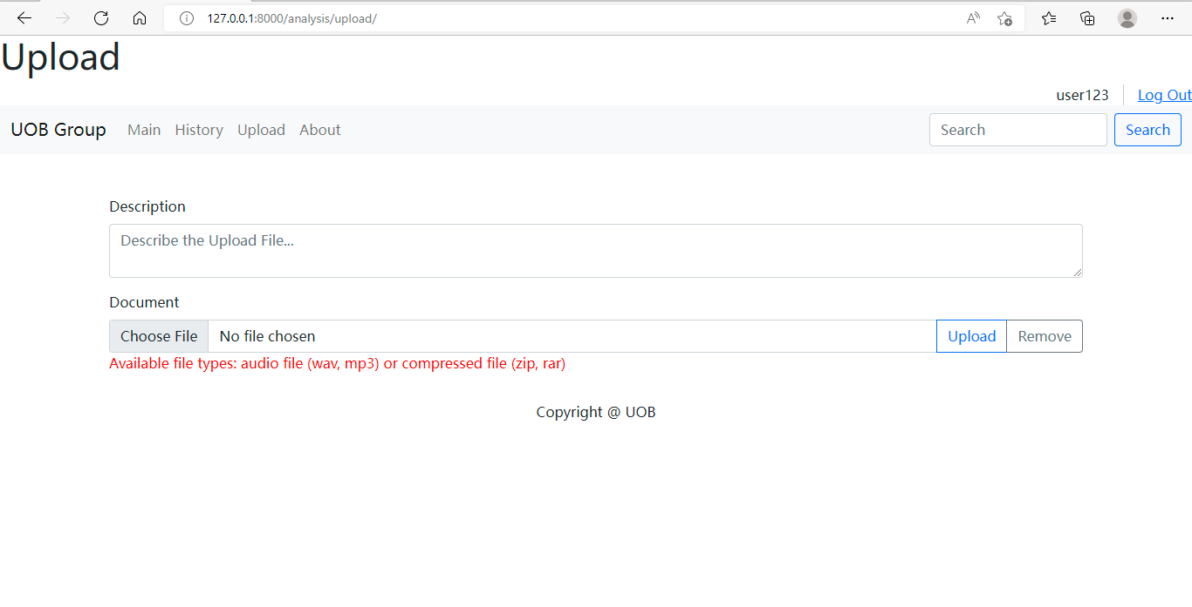
Upload (1/2)
2. [Optional] Input Description for the upload file.
1. Click here to choose the file to upload
3. Click here to upload your chosen file
4. Click here to clear the field for choosing file

Slide 7
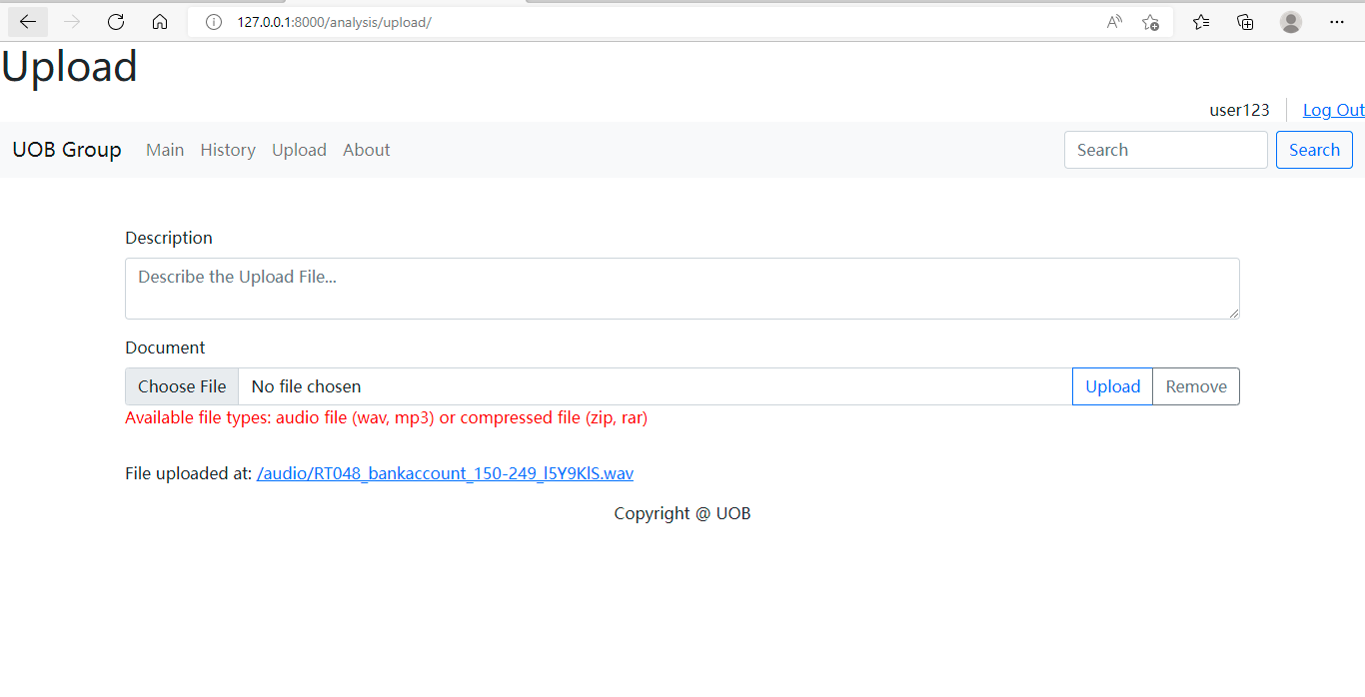
Upload (2/2)
After upload is done, it will show this message.

Slide 8
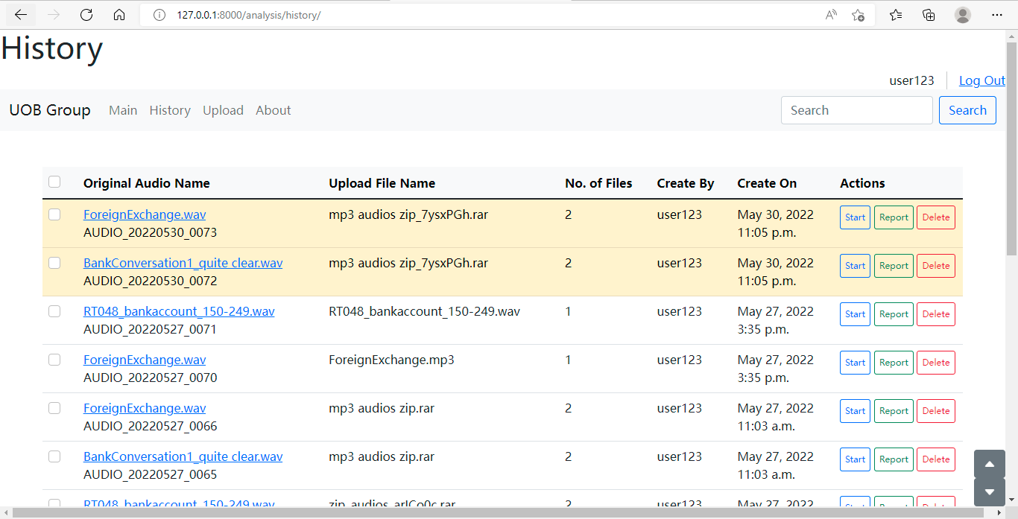
History (1/7)
“Yellow” highlight means the audio has not been performed any analysis.
Single Action on individual audio
There is no highlight on the audio that has been performed all available analysis.

Slide 9
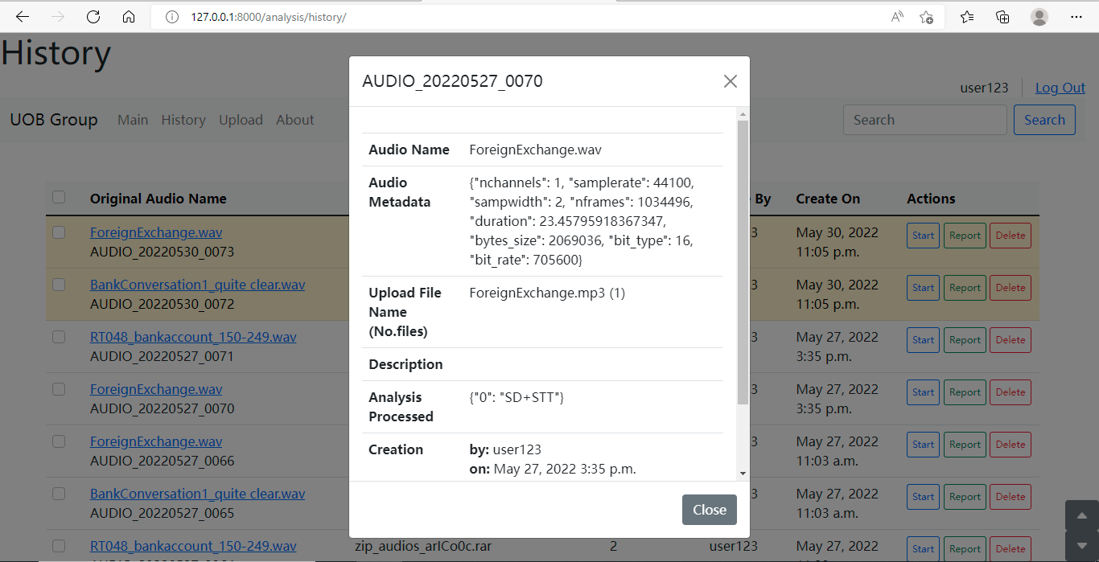
History (2/7)
Click on the Audio Name, it will show the audio information.

Slide 10
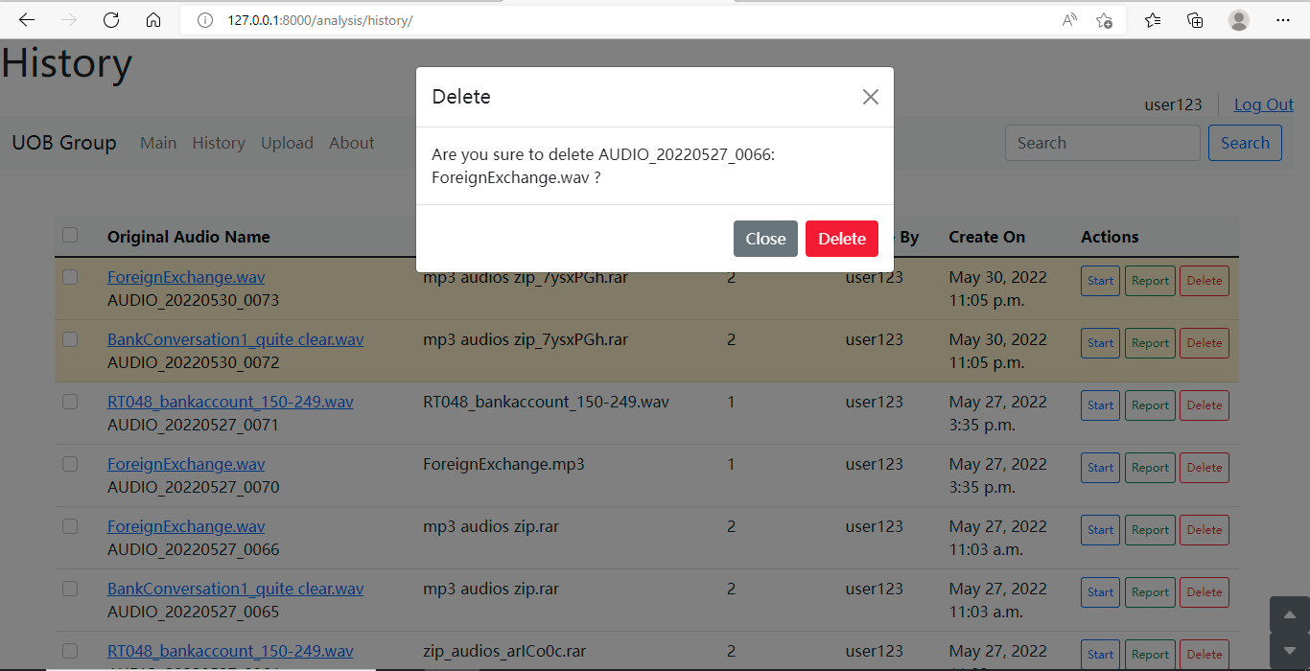
History (3/7)
2. Click “Delete”, the audio will not be shown in the list;
3. Click “Close” to cancel the action.
1. Click on the “Delete” button, system will popup a Confirm window.

Slide 11
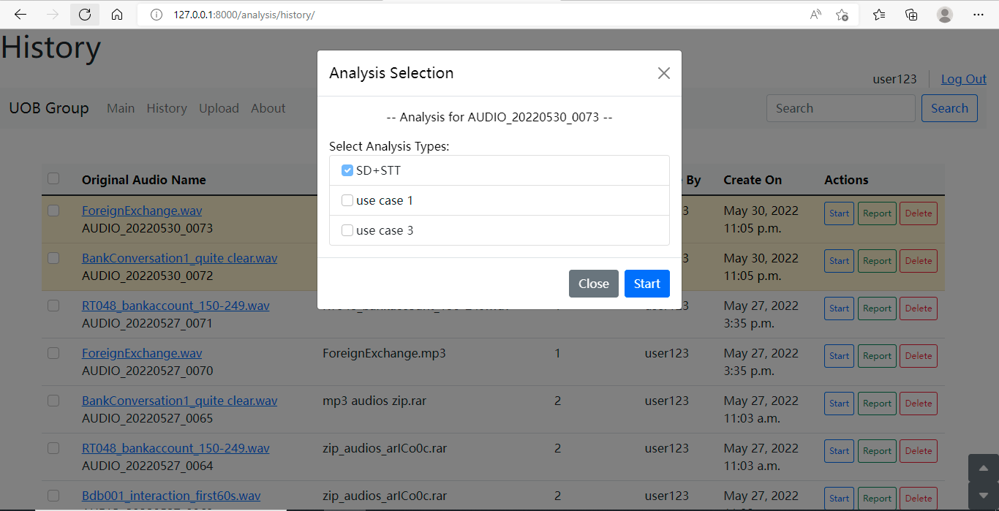
History (4/7)
2. Tick the checkbox to select the analysis you want to perform on the audio.
1. Click on the “Start” button, system will popup an Analysis Selection window.
3. Click “Start” to start the analysis in backend;
4. Click “Close” to cancel the action.

Slide 12
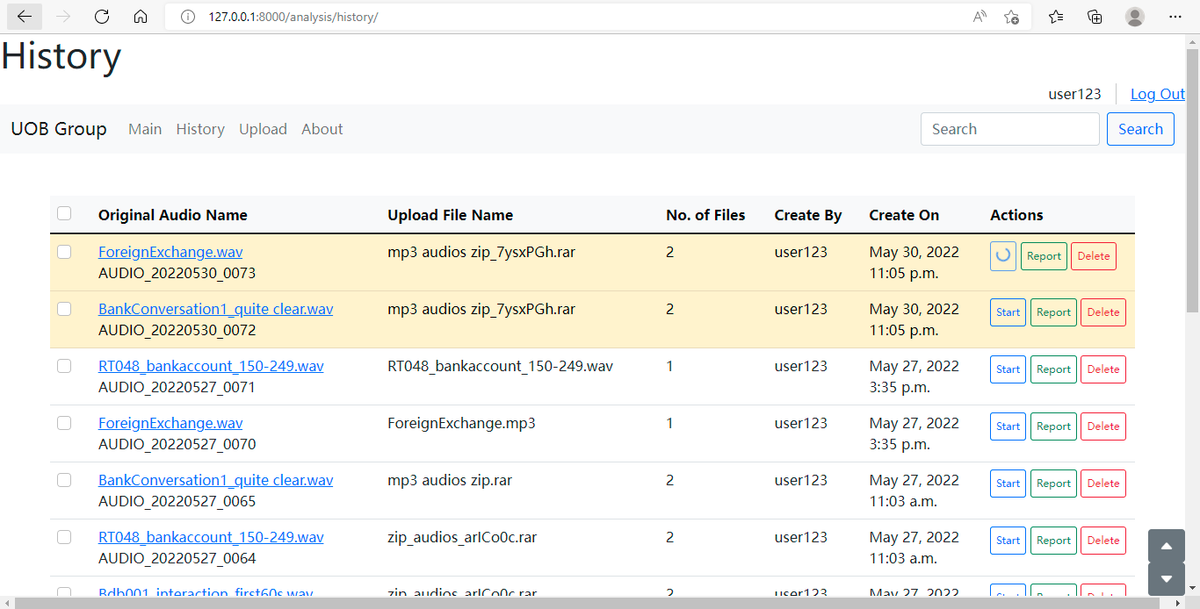
History (5/7)
5. The spinning circle means this audio is being processed in backend. It may take a long time if your audio is long.

Slide 13
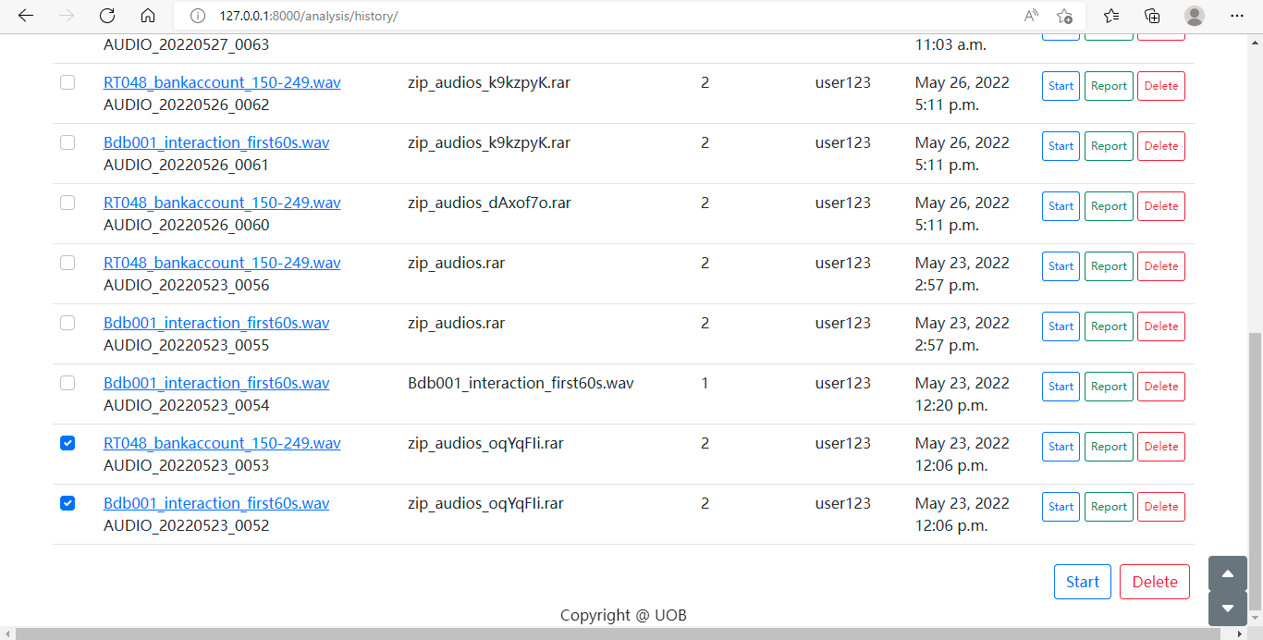
History (6/7)
1. Select multiple audios
2. Perform analysis/deletion action on selected audios together

Slide 14
History (7/7)
Go to the Report page to view analysis result
Scroll up to the top
Scroll down to the bottom

Slide 15
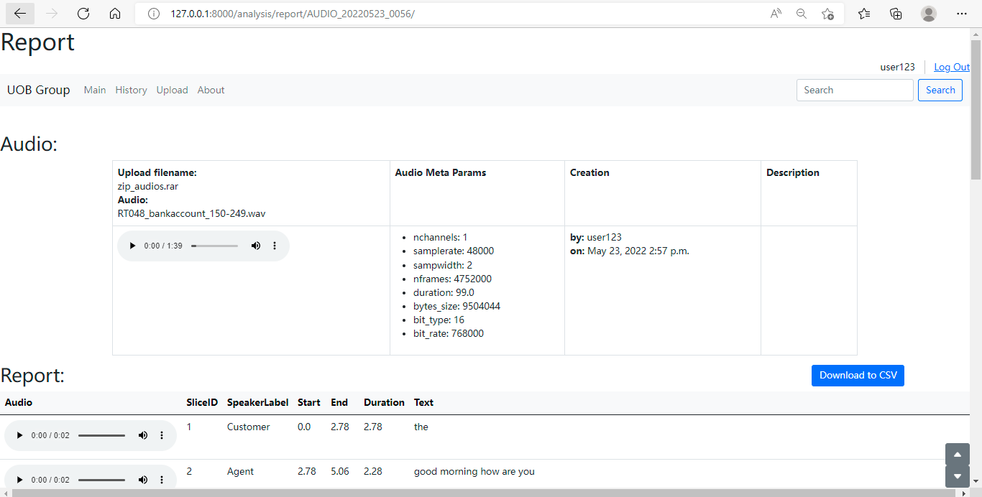
Report (1/3)
Audio Info Section
Report Section

Slide 16
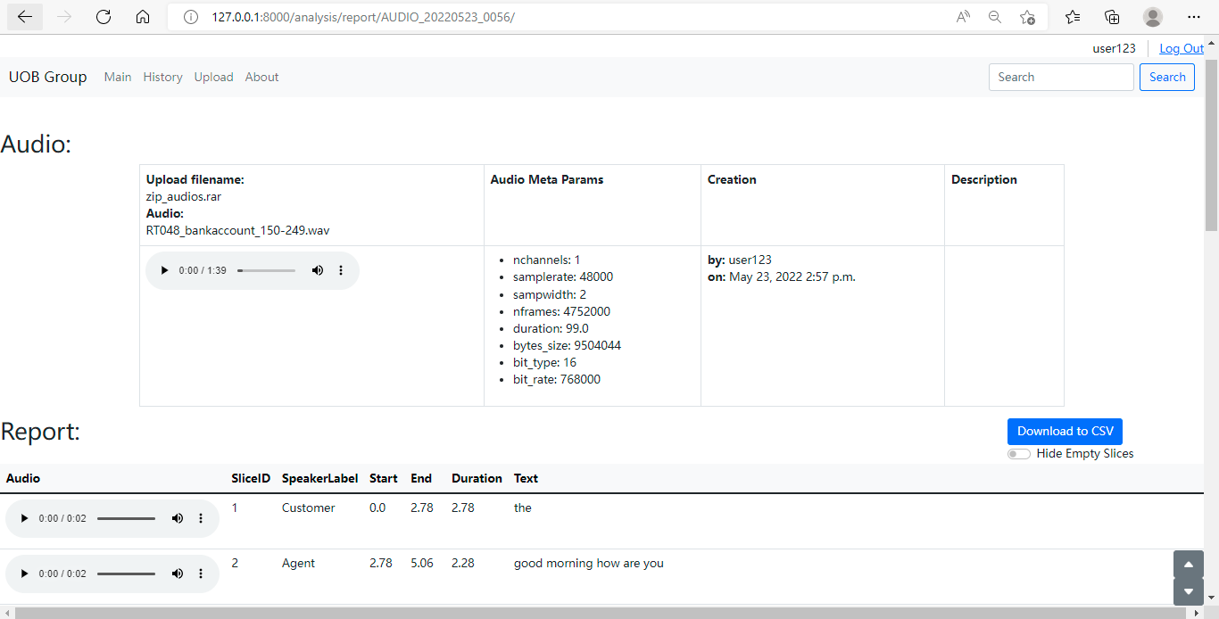
Report (2/3)
Audio Players
Original Audio
Sliced Audio
Download the report as a csv file
Switch on/off hiding empty text rows

Slide 17
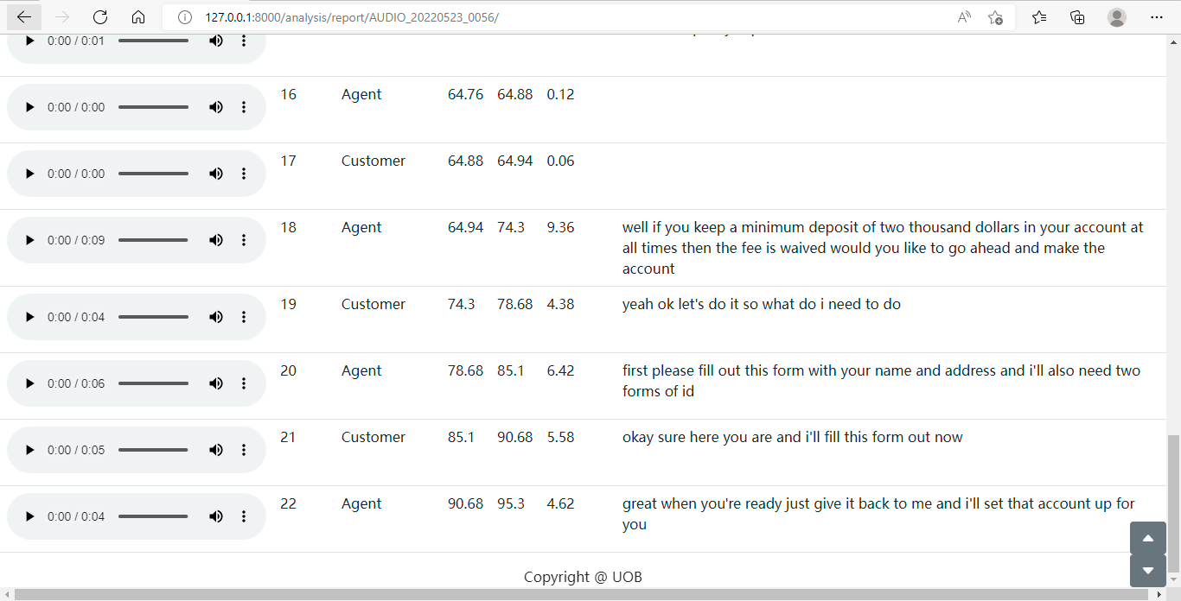
Report (3/3)

Slide 18
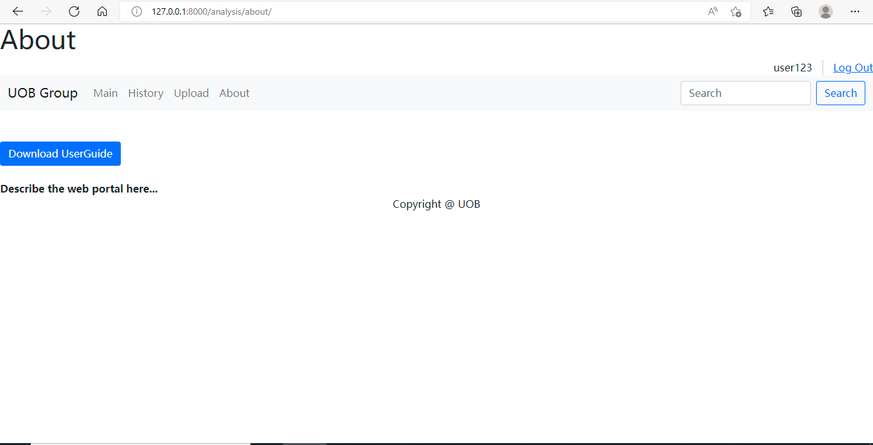
About
Download the user guide
Log out the web portal

