Slide 1




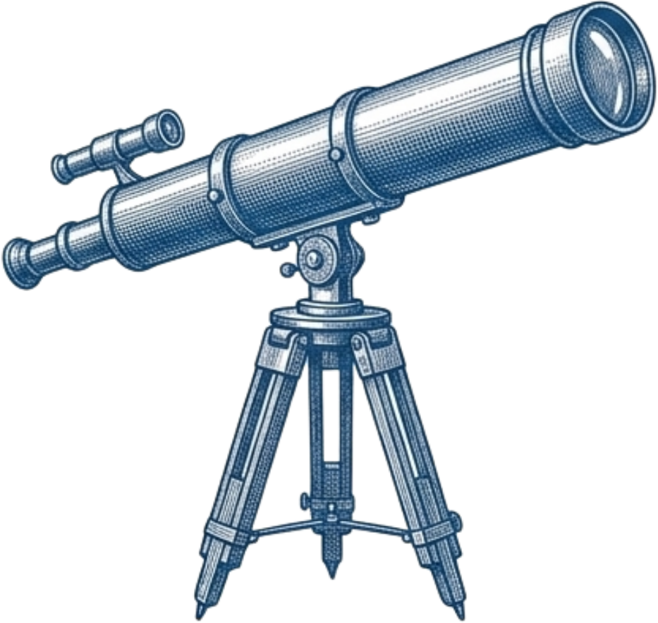
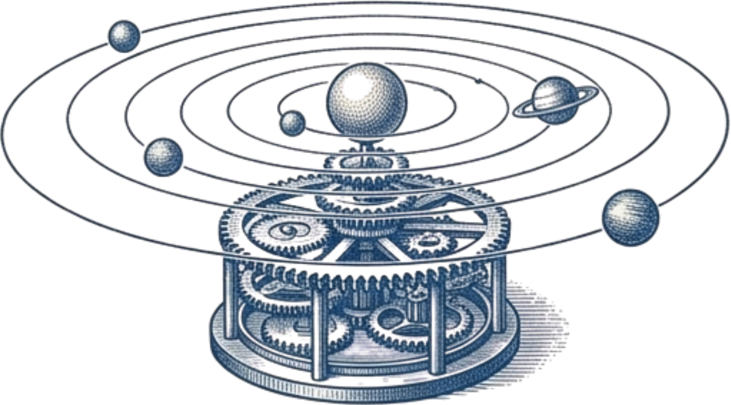



GENERAL PHYSICS 1 - S261 - CLASS GROUP: CC01
14.2 - SPACE DEBRIS IMPACT ON SOLAR PANELS
TOPIC 14 - CONSERVATION OF LINEAR MOMENTUM IN COLLISIONS
Instructor: Dr. Gary
Notes:
[~10 s] Good morning. We are group CC01 of General Physics 1. Our project is 14.2: Space Debris Impact on Solar Panels, under conservation of linear momentum in collisions.

Slide 2

GROUP MEMBERS
No. | Name | Student ID | Contribution | Percentage
1 | Nguyễn Khánh Hưng (Leader) | 2352435 | Report
2 | Tăng Nguyễn Minh Duy | 2651233 | Report
3 | Diệp Phú Thành | 2653138 | Slide
4 | Nguyễn Lâm Chí Tường | 2651313 | Slide
5 | Nguyễn Lê Anh Tuấn | 2651311 | Report
6 | Châu Kiến Toàn | 2353192 | Slide
7 | Nguyễn Duy Thành | 2353101 | Code
8 | Phạm Anh Minh | 2651271 | Report
9 | Vũ Hồng Quân | 2453083 | Code
2 / 20
Notes:
[~5 s] Members and roles. Do not read the table; just introduce the team.

Slide 3


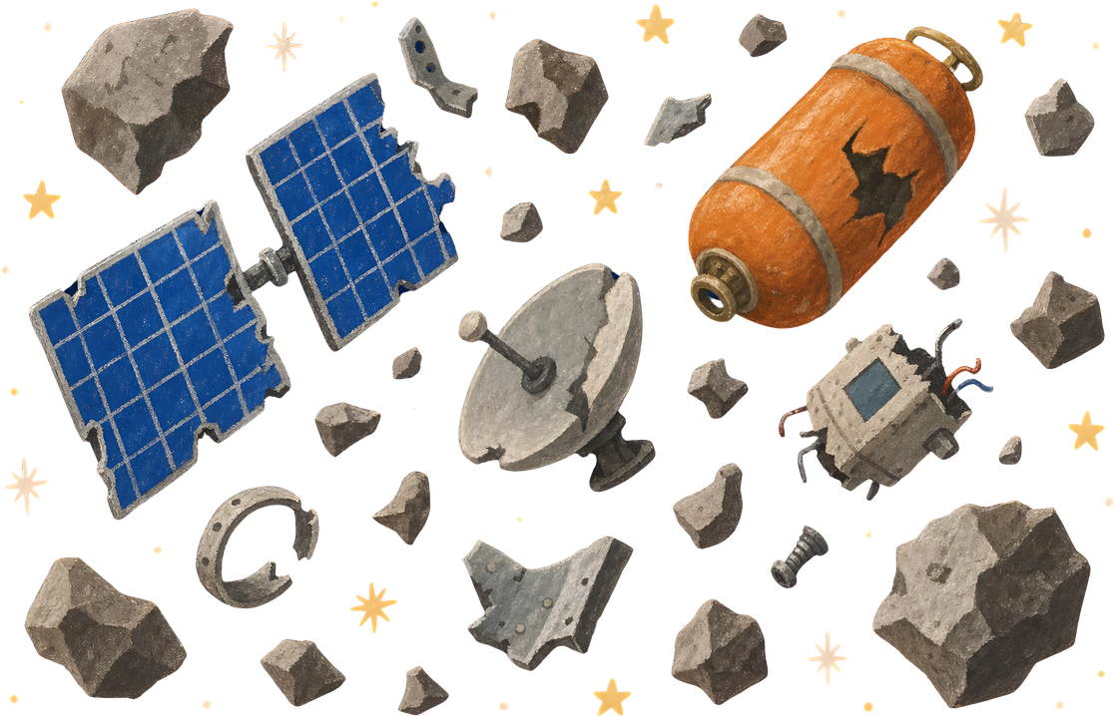
TABLE OF CONTENTS
  Abstract
1. Introduction
2. Hypothesis
3. Basic physics
4. Computational & Python Methods
5. Data and Results
6. Discussion and Conclusion
7. References
4
5
6
7
11
12
17
19
3 / 20
Notes:
[~5 s] Outline: abstract, introduction, hypothesis, basic physics, Python methods, data and results, discussion and conclusion.

Slide 4


ABSTRACT
Topic: conservation of linear momentum in collisions
Problem: a debris fragment hits a satellite solar panel
Goal: impulse, velocity change, spin and energy lost
Physics: impulse–momentum, angular momentum, energy
Model: 2-D, point-mass fragment, rigid satellite, instant hit
Cases: elastic and completely inelastic collision
Python: 3 scenarios + sweeps of m, v₀, θ, m/M
Result: ΔV = 20.0 mm/s, spin 1.65°/s, 99.999 % energy lost
4 / 20
Notes:
[~30 s] Debris hits a satellite solar panel at km/s. We want four things: the impulse, the velocity change, the spin and the energy lost. We use impulse-momentum, angular momentum and energy. Model: 2-D, point-mass fragment, rigid satellite, instant contact, two ideal cases (elastic and completely inelastic). Python runs 3 scenarios and sweeps. Key result: DeltaV = 20.0 mm/s, spin 1.65 deg/s, 99.999 % of the energy is lost.

Slide 5

1. INTRODUCTION
Momentum is conserved in every collision:
Orbital debris moves at several km/s
Solar panels are the most exposed surface
Sentinel-1A (2016): a ~1 cm particle hit it
Off-centre hit: velocity change and spin
Checked by conservation laws and 1-D formulas
5 / 20
Notes:
[~35 s] Momentum is conserved in every collision, equation on the slide; what changes between collision types is kinetic energy. Debris in low Earth orbit moves at several km/s, and solar panels are the largest exposed surface. In 2016 a particle about 1 cm hit Sentinel-1A: its orbit and orientation changed (Krag et al., 2017). An off-centre hit gives both a velocity change and a spin. We check our code with conservation laws and the textbook 1-D formulas.

Slide 6
2. HYPOTHESIS
ΔV: m v₀/M ≈ 20 mm/s, only ~10⁻⁶ of v_{orb}
Spin: an off-centre hit makes the satellite rotate
Energy: inelastic hit loses almost all K₀, fraction M/(m+M)
~10⁻⁶
ΔV / orbital speed
spin
from torque r × J
M/(m+M)
fraction of K₀ lost
6 / 20
Notes:
[~15 s] Three predictions. First: DeltaV about m v0 / M = 20 mm/s, around 10^-6 of the orbital speed. Second: an off-centre hit makes the satellite spin noticeably. Third: in an inelastic hit almost all kinetic energy, the fraction M/(m+M), is lost.

Slide 7
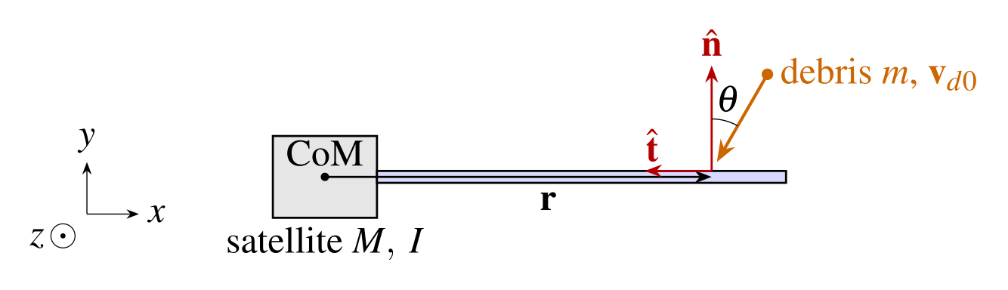
3. BASIC PHYSICS
3.1 PHYSICAL SYSTEM AND REFERENCE FRAME
2-D orbital plane: x radial, y along-track, z spin axis
Satellite: rigid body (M, I); fragment: point mass m
Hit at lever arm r from CoM, angle θ from normal n
Fig. 3.1 Geometry of the impact (θ = 0: head-on, θ → 90°: grazing)
7 / 20
Notes:
[~40 s] 2-D orbital plane: x radial, y along-track, z is the spin axis. The satellite is a rigid body with mass M and moment of inertia I; the fragment is a point mass m. It hits the panel at lever arm r from the centre of mass, at angle theta from the panel normal n. Theta = 0 is head-on, theta near 90 degrees is grazing. Equation: the velocity of the fragment and its normal component v_n = v0 cos(theta).

Slide 8
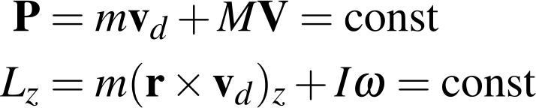
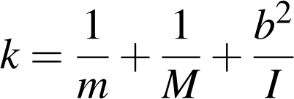
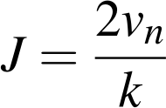
3. BASIC PHYSICS
3.2 CONSERVATION AND ELASTIC COLLISION
P and L_{z} conserved
Impulse J, lever arm b
Speed change per unit J
Elastic: speed reverses
Through CoM (b = 0): 1-D collision
8 / 20
Notes:
[~45 s] The contact lasts microseconds, so total momentum P and angular momentum L_z about the CoM are conserved. In the elastic case there is no friction, so the panel pushes only along n with impulse J; the satellite gets minus J. The lever arm b turns the impulse into torque, so I change-in-omega equals minus J b. One unit of impulse changes the relative normal speed by k = 1/m + 1/M + b squared over I. Elastic means the relative normal speed reverses, so J = 2 v_n / k. For a hit through the CoM (b = 0) this becomes the textbook 1-D collision.

Slide 9
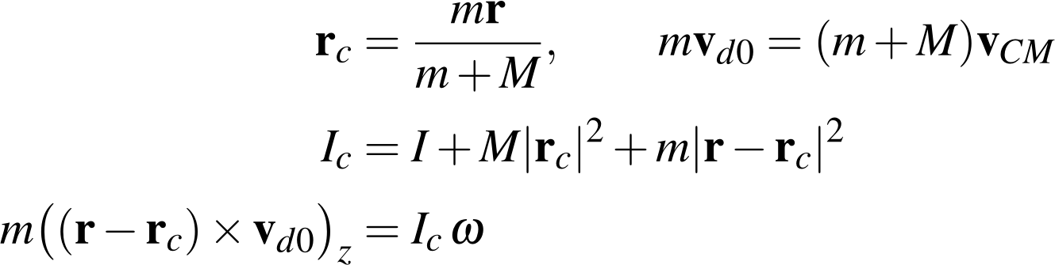
3. BASIC PHYSICS
3.3 COMPLETELY INELASTIC COLLISION
Fragment sticks: one rigid body after the hit
Momentum gives v_{CM}; the CoM moves to r_{c}
Parallel-axis theorem gives I_{c} about the new CoM
Angular momentum about the new CoM gives ω
Sideways momentum is absorbed too (unlike elastic)
9 / 20
Notes:
[~40 s] Now the fragment sticks, so we have one rigid body. The CoM moves to r_c = m r / (m+M); momentum gives its velocity v_CM. The parallel-axis theorem gives I_c about the new CoM. Angular momentum about the new CoM gives the spin omega. Unlike the elastic case, the sideways momentum is absorbed too, so the satellite gets all of the fragment's momentum.

Slide 10
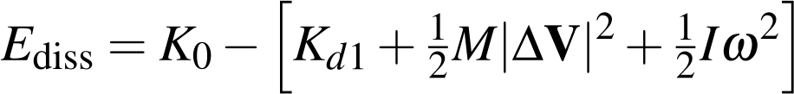
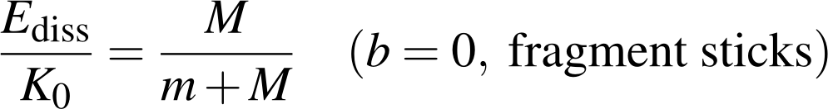
3. BASIC PHYSICS
3.4 ENERGY: WHERE THE KINETIC ENERGY GOES
K₀ = ½ m v₀² is not conserved in general
The lost part becomes heat and damage
Elastic: E_{diss} = 0
Inelastic: fraction M/(m+M) of K₀
99.9988 %
of K₀ = 50 kJ lost (baseline)
baseline: 1 g at 10 km/s, 30°
10 / 20
Notes:
[~30 s] Kinetic energy K0 = 1/2 m v0 squared is not conserved. What is not left as motion of the fragment, translation or rotation of the satellite becomes heat and damage: E_diss. Zero for elastic. For an inelastic hit through the CoM the fraction is M/(m+M). In our baseline, 99.9988 percent of 50 kJ is lost.

Slide 11
4. COMPUTATIONAL METHODS
PYTHON CODING METHODS
Method: exact closed-form formulas, no time stepping
Assumptions: instant contact, 2-D, rigid body, point fragment
Cases: frictionless elastic or completely inelastic
Steps: n, t → J or r_{c}, I_{c} → ΔV, ω → energies
Orbit: v_{orb} = √(μ_{E}/(R_{E}+h)), for scale only
Checks: relative errors of P, L_{z} and energy
Code: Python 3.12, NumPy, pandas, Matplotlib
Input: JSON per scenario + CSV material table
Output: summary and conservation CSV, figures
11 / 20
Notes:
[~35 s] No time stepping: the program plugs the inputs into the exact formulas. Assumptions: instant contact, 2-D, rigid satellite, point fragment, two ideal collisions. Steps: build n and t, compute J or r_c and I_c, then DeltaV and omega, then the energies. The orbital speed is only used for scale. We check relative errors of P, L_z and energy. Code: Python 3.12 with NumPy, pandas, Matplotlib. Inputs are JSON files; outputs are CSV tables and figures.

Slide 12
5. DATA AND RESULTS
5.1 INPUT DATA
Small Earth-observation satellite, 1 g aluminium fragment
Quantity | Symbol | Value
Satellite mass | M | 500 kg
Moment of inertia (CoM) | I | 1200 kg m²
Impact point from CoM | r | (4, 0) m
Debris mass, material | m | 0.001 kg, Al
Debris density | ρ | 2700 kg/m³
Relative impact speed | v₀ | 10 000 m/s
Orbit altitude | h | 550 km
Earth radius | R_{E} | 6 378 137 m
Scenario | θ | Collision
Baseline | 30° | inelastic
Head-on | 0° | inelastic
Grazing | 80° | elastic
The three scenarios
7585 m/s
orbital speed at h = 550 km
Table 5.1 Input data shared by the three scenarios
12 / 20
Notes:
[~35 s] Table 5.1: a 500 kg satellite with I = 1200 kg m^2, impact 4 m from the CoM; a 1 g aluminium fragment at 10 km/s; orbit altitude 550 km, so orbital speed 7585 m/s. Three scenarios: baseline 30 degrees inelastic, head-on 0 degrees inelastic, grazing 80 degrees elastic.

Slide 13
5. DATA AND RESULTS
5.2 SCENARIO RESULTS
Output quantity | Baseline | Head-on | Grazing
Impulse M|ΔV| (N s) | 9.99988 | 9.99985 | 3.47291
|ΔV| (mm/s) | 19.9998 | 19.9997 | 6.94582
ω (rad/s) | −0.02887 | −0.03333 | −0.01158
|ω| (°/s) | 1.654 | 1.910 | 0.663
Satellite K_{R} (J) | 0.500 | 0.667 | 0.0804
E_{diss}/K₀ | 0.999988 | 0.999985 | 0
|ΔV| / v_{orb} | 2.64×10⁻⁶ | 2.64×10⁻⁶ | 9.16×10⁻⁷
ε_{P}, ε_{L}, ε_{E} | ~10⁻¹⁶ | ~10⁻¹⁶ | ~10⁻¹⁶
Table 5.2 Results of the three scenarios (ω < 0: clockwise spin)
Sample: ω = m(r−r_{c})×v_{d0} / I_{c} = −0.02887 rad/s
13 / 20
Notes:
[~50 s] Table 5.2. Baseline: impulse about 10 N s, DeltaV = 20 mm/s, which is 2.6e-6 of the orbital speed. Spin is -0.0289 rad/s, 1.65 deg/s, clockwise. About 99.9988 percent of the energy is lost. Conservation errors are about 1e-16, i.e. round-off. Sample calculation: omega = m (r - r_c) x v_d0 / I_c = -0.02887 rad/s.

Slide 14
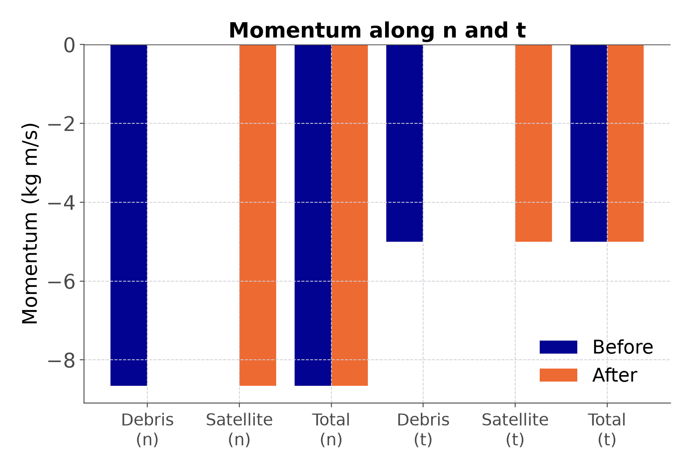
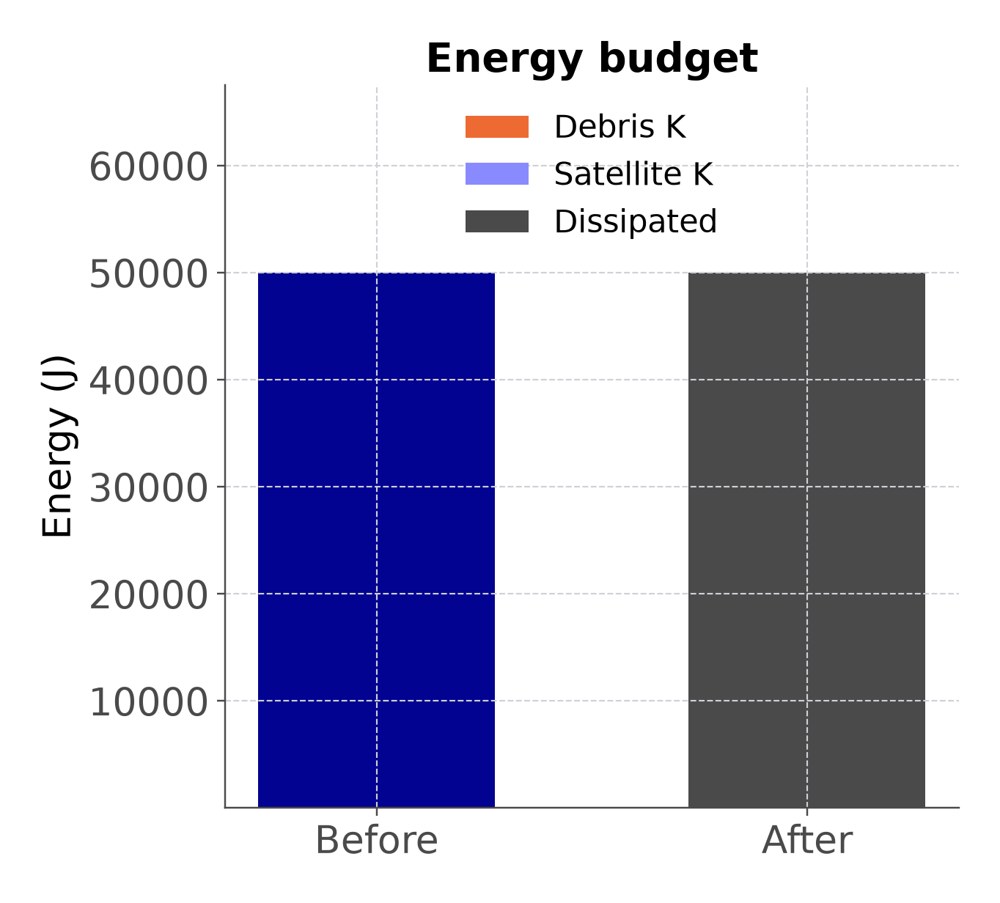
5. DATA AND RESULTS
5.2 MOMENTUM AND ENERGY BUDGET
Baseline: satellite gets all momentum, normal and sideways
Almost all of K₀ = 50 kJ is lost as heat and damage
Fig. 5.1 Baseline (30°, completely inelastic): momentum components (left), energy budget (right)
14 / 20
Notes:
[~40 s] Fig 5.1, baseline. Left: the momentum along n and t. The satellite gets all of the fragment's normal and sideways momentum, so the totals before and after are equal. Right: the energy. 50 kJ before; after, almost all of it is dissipated and the satellite gets less than 1 J.

Slide 15
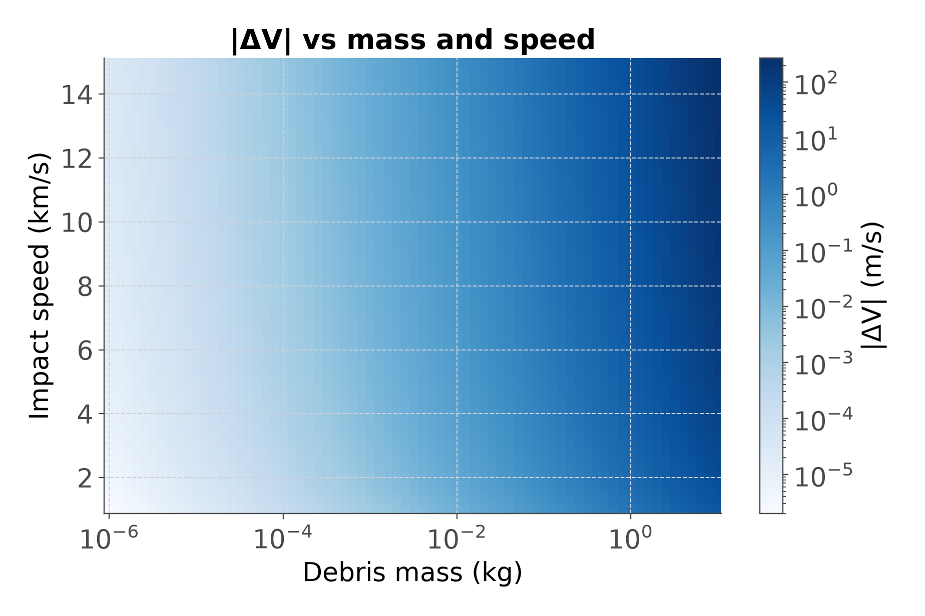
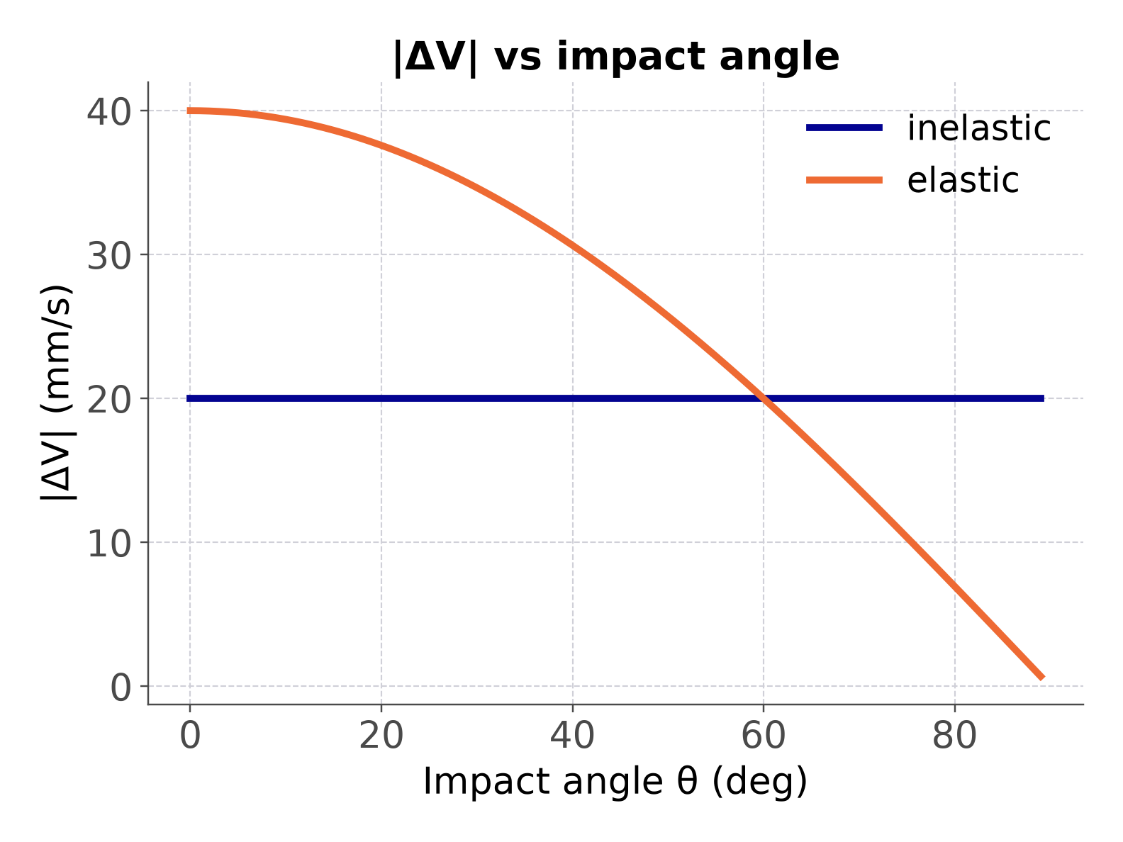
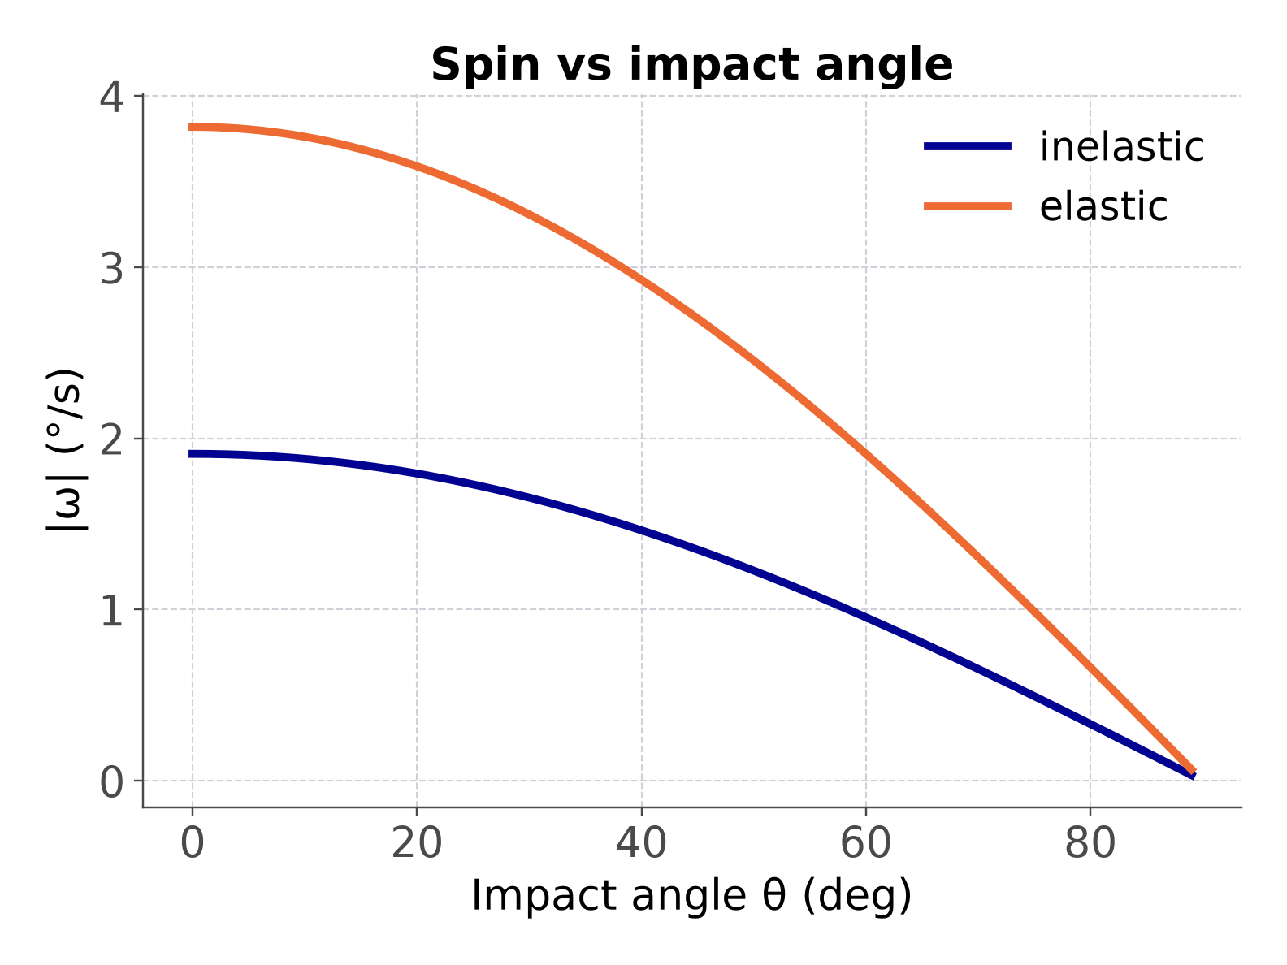
5. DATA AND RESULTS
5.3 PARAMETRIC STUDY
|ΔV| ≈ m v₀/M: grows with m and v₀
Inelastic: 20 mm/s at every θ; elastic: 2m v₀cosθ/M
Fig. 5.2 |ΔV| vs mass and speed
Fig. 5.3 |ΔV| (left) and spin (right) vs impact angle; curves cross at 60°
15 / 20
Notes:
[~50 s] Parametric study. Fig 5.2: |DeltaV| grows with mass and speed, about m v0 / M when m is much smaller than M. Fig 5.3: for the inelastic case DeltaV is 20 mm/s at every angle; for the elastic case it is 2 m v0 cos(theta) / M, falling from 40 to 0.7 mm/s. The curves cross at 60 degrees. The spin depends only on the normal part, so it follows cos(theta).

Slide 16
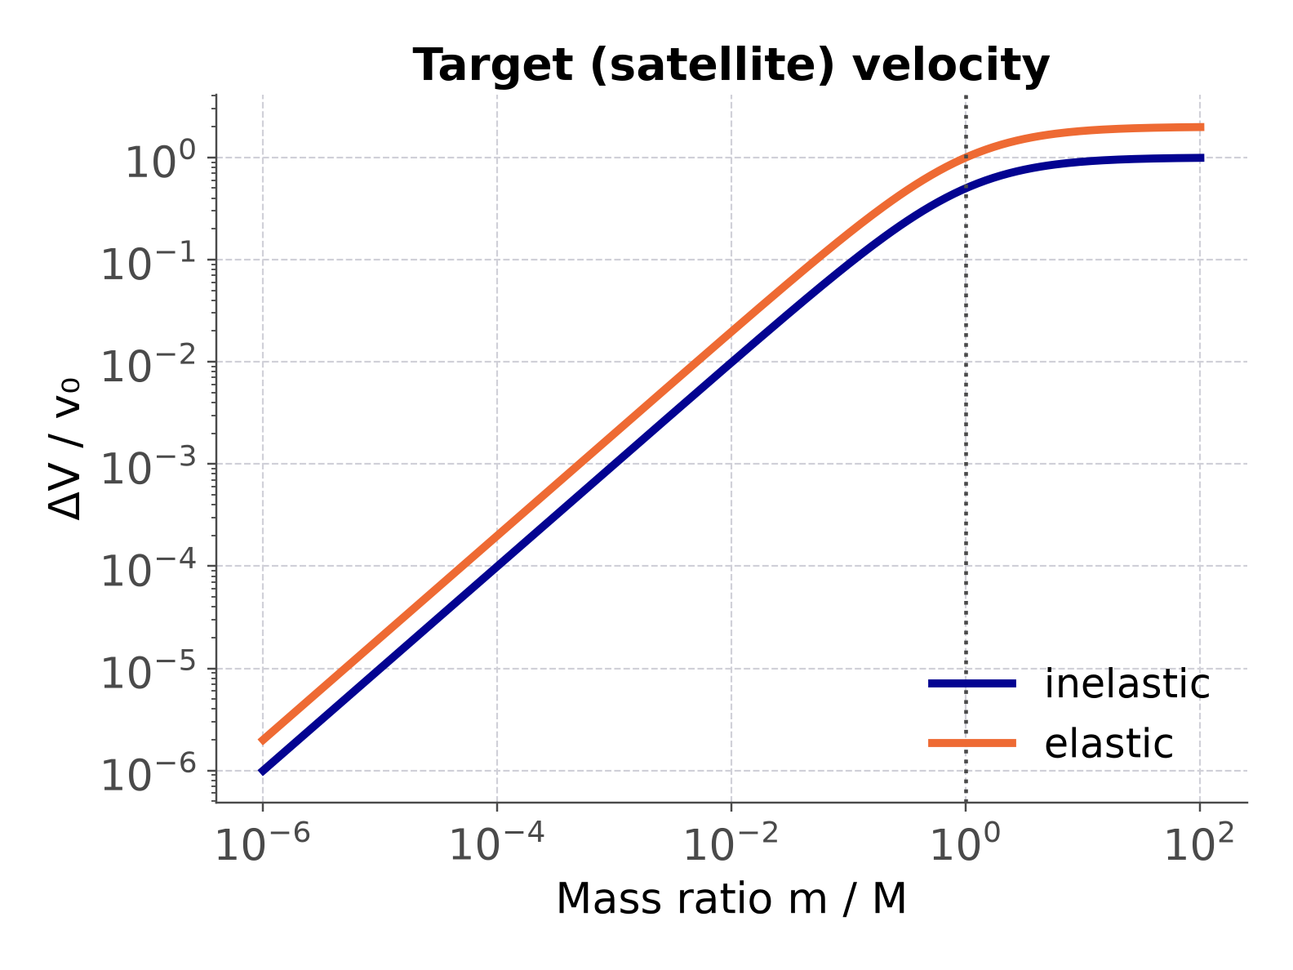
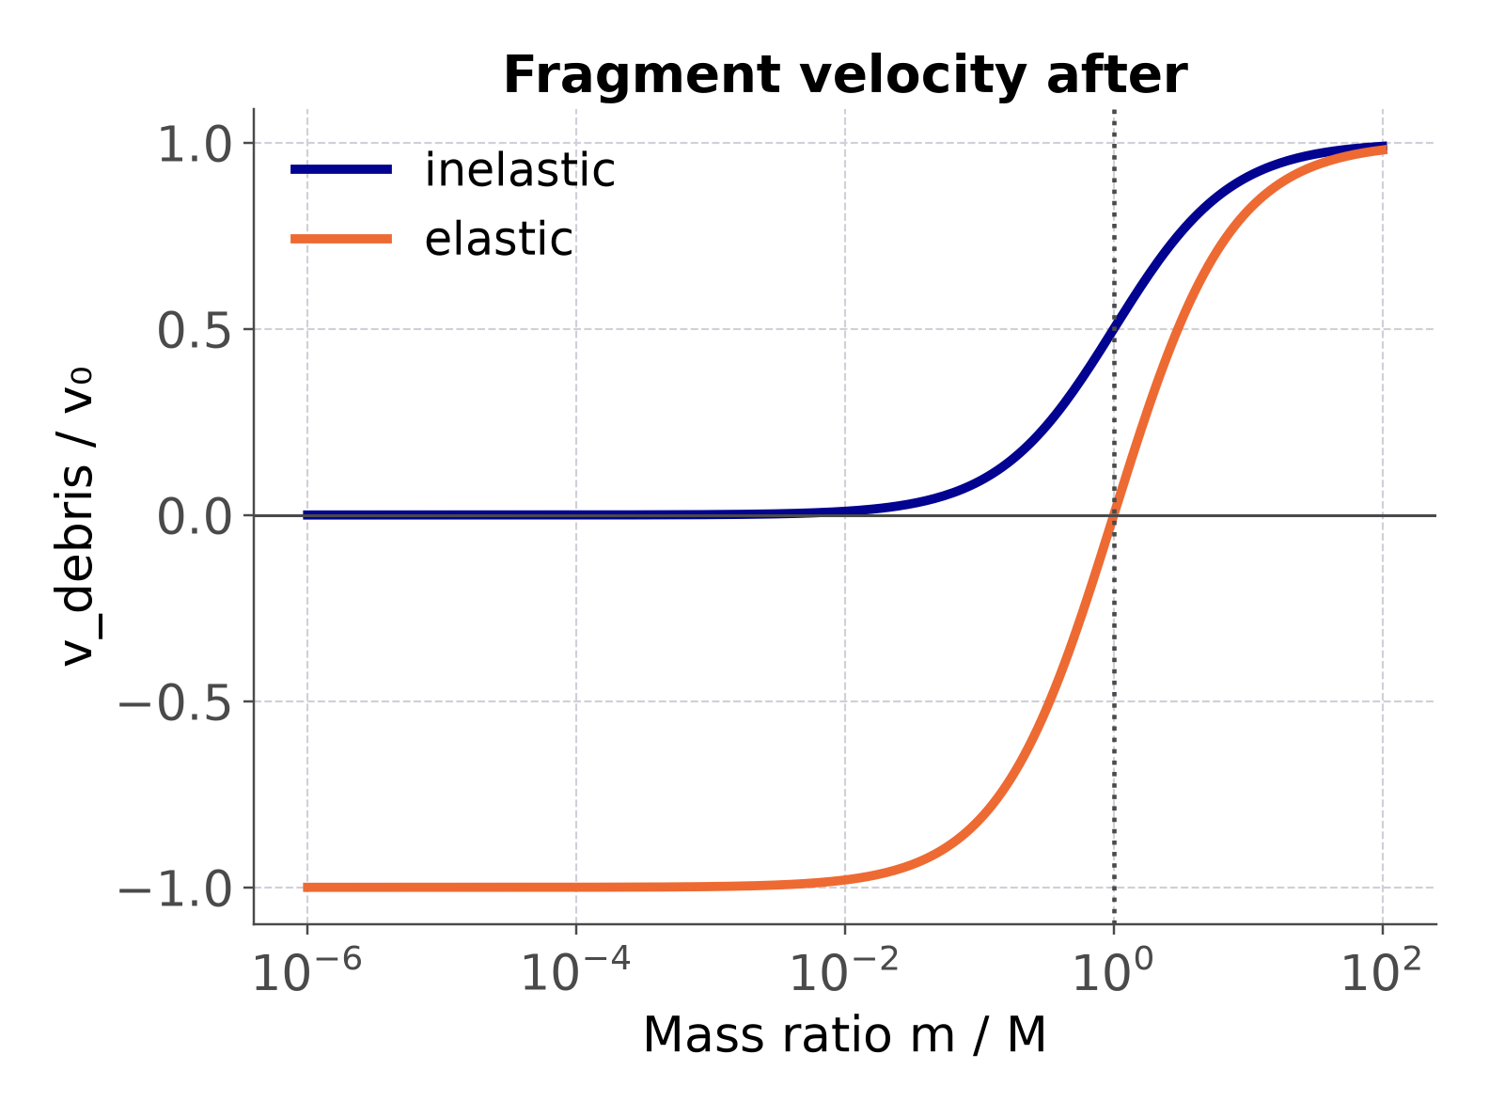
5. DATA AND RESULTS
5.4 CHECK WITH THE 1-D COLLISION
Head-on through the CoM: matches the 1-D formulas
Largest difference over 482 points: 6.7×10⁻¹⁶ v₀
Case | |ΔV| (m/s) | E_{diss}/K₀
m = M, elastic | 10 000 | 0
m = M, inelastic | 5000 | 0.5
m = 100M, elastic | 19 801.98 | 0
Grazing 89° | 0.0200 | 0.999998
Hit at the CoM | 0.0200 | 0.999998
Table 5.3 Limiting cases (selected)
Fig. 5.4 Satellite (left) and fragment (right) velocity vs mass ratio m/M
16 / 20
Notes:
[~40 s] Validation. Head-on hit through the CoM: our results match the 1-D collision formulas; the largest difference over 482 points is 6.7e-16 times v0. Fig 5.4: for m much smaller than M the satellite hardly moves; for m much larger than M it reaches 2 v0 (elastic) or v0 (inelastic). Table 5.3 lists limiting cases.

Slide 17
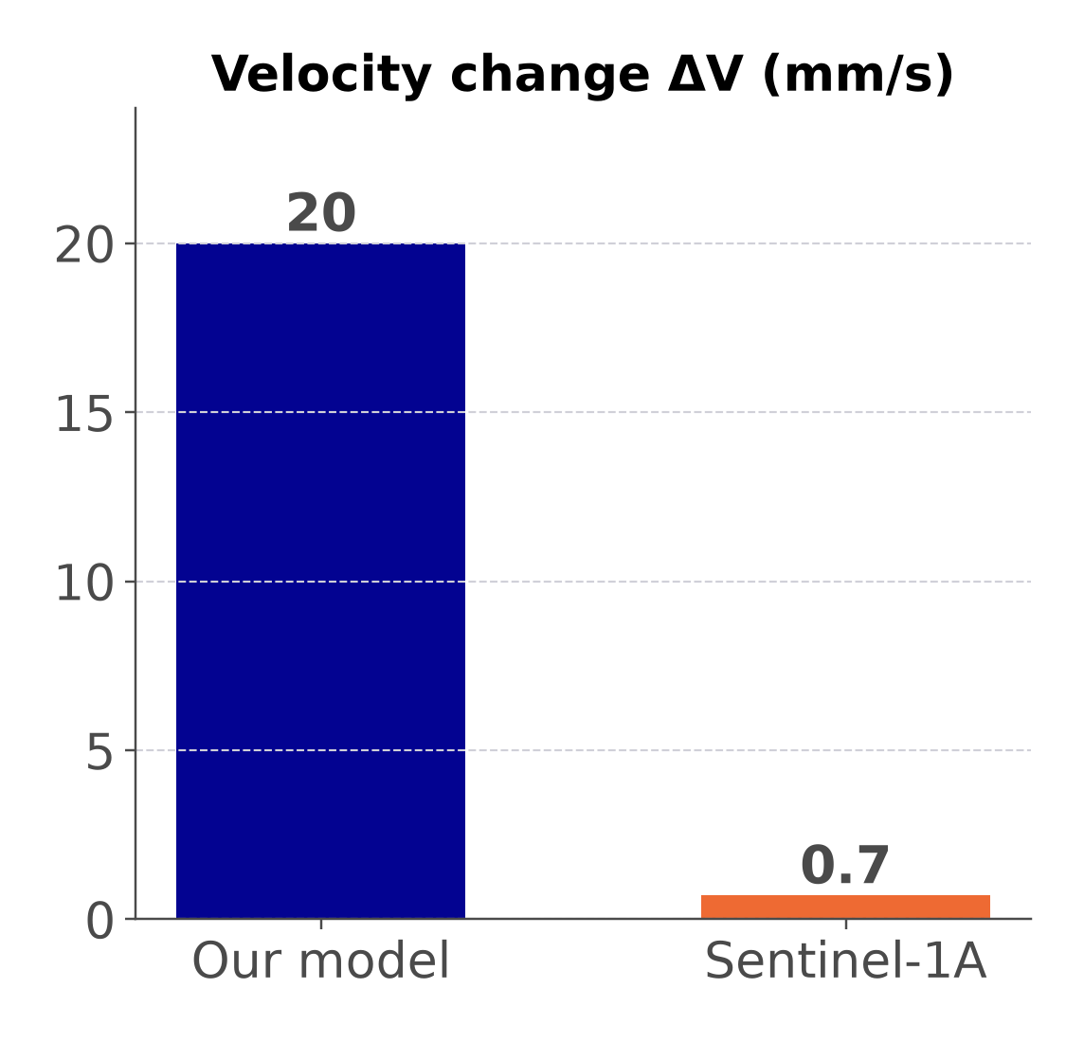
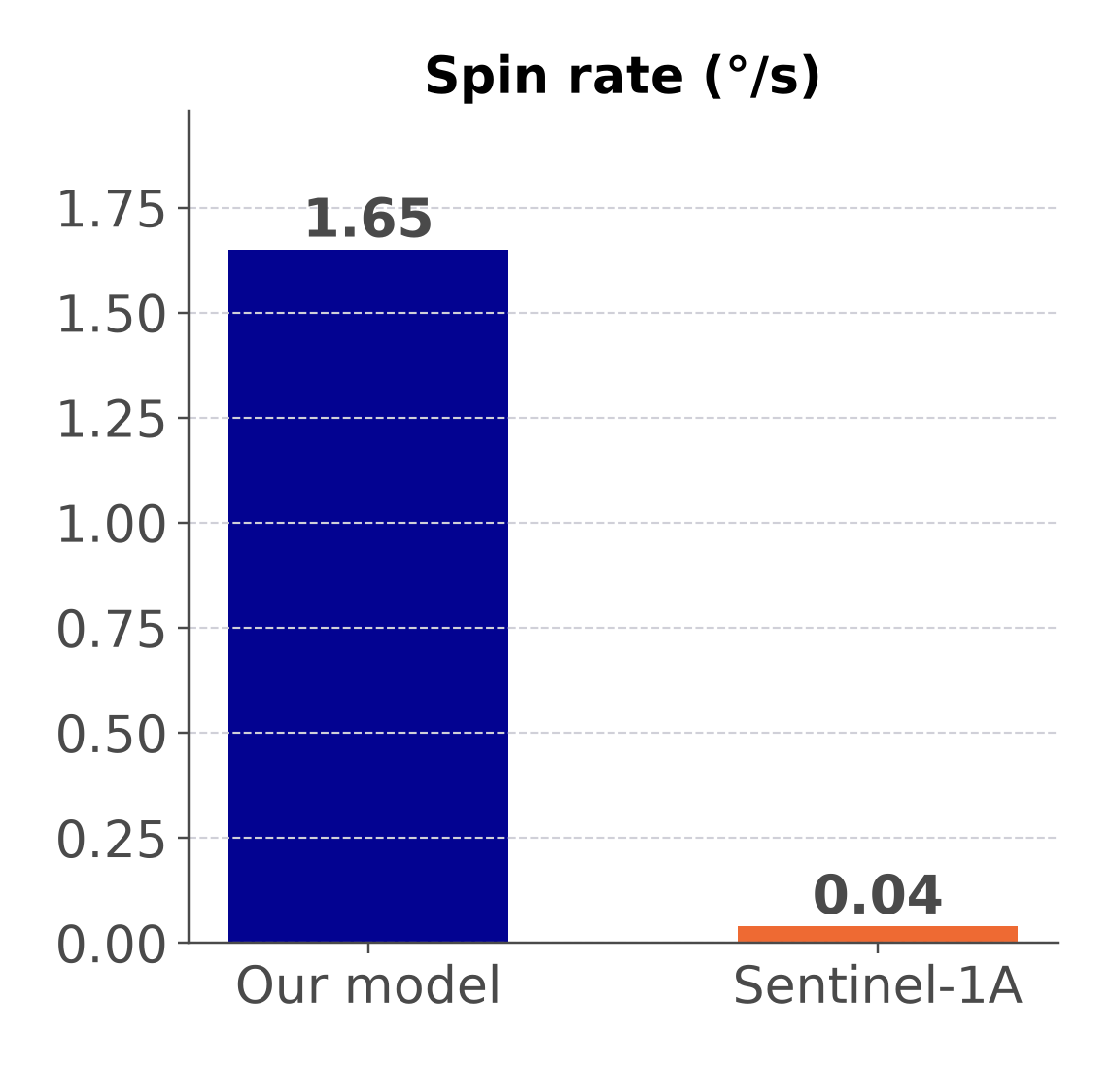
6. DISCUSSION AND CONCLUSION
6.1 DISCUSSION
Hypothesis | Result (baseline)
ΔV ≈ 20 mm/s, ~10⁻⁶ v_{orb} | 20.0 mm/s = 2.6×10⁻⁶ v_{orb}
Noticeable spin | 1.65°/s: full turn in < 4 min
Loses ~M/(m+M) of K₀ | 99.9988 % (M/(m+M) = 99.9998 %)
Tiny ΔV, visible spin
Lighter satellite here
Rigid body, no ejecta
Our model vs Sentinel-1A (Krag et al., 2017)
17 / 20
Notes:
[~25 s] All three hypothesis parts are confirmed. The Sentinel-1A hit gave about 0.7 mm/s and 0.04 deg/s: the same pattern, a tiny velocity change but a visible spin. Our numbers are larger because our satellite is lighter and we chose the fragment ourselves. The model is a rigid body and does not include crater ejecta.

Slide 18
6. DISCUSSION AND CONCLUSION
6.2 APPLICATIONS AND CONCLUSION
20 mm/s
ΔV of a 500 kg satellite
1.65°/s
spin from an off-centre hit
99.999 %
of 50 kJ lost as heat
Small debris: spin matters more than orbit change
Uses: attitude control, orbit keeping, shielding
Hypothesis confirmed; checks at ~10⁻¹⁶
Next: measured momentum transfer, orbit after hit
18 / 20
Notes:
[~25 s] Conclusions: DeltaV is 20 mm/s, spin is 1.65 deg/s, 99.999 percent of 50 kJ is lost. For small debris, the spin matters more than the orbit change. Uses: attitude control, orbit keeping, Whipple shields. Next steps: a measured momentum-transfer value and the orbit after the hit.

Slide 19
REFERENCES
Halliday, D., Resnick, R., & Walker, J. (2014). Fundamentals of physics (10th ed.). John Wiley & Sons.
Kessler, D. J., & Cour-Palais, B. G. (1978). Collision frequency of artificial satellites: The creation of a debris belt. J. Geophys. Res.: Space Phys., 83(A6), 2637–2646.
Krag, H., et al. (2017). A 1 cm space debris impact onto the Sentinel-1A solar array. Acta Astronautica, 137, 434–443.
Ling, S. J., Sanny, J., & Moebs, W. (2016). University physics volume 1. OpenStax, Rice University.
19 / 20
Notes:
[~5 s] Four references, APA style. No need to read them.

Slide 20



THANK YOU ALL
Any questions?
Notes:
[~5 s] Thank you for listening. We are happy to answer questions.

