Slide 1


Software Engineering |
Alpha sprint presentation
队长：王奕凯
队员：张智洋 程宇浩 兰龙睿 叶宇桓
2021.11.22

Slide 2

Content
01
Task allocation and planning
02
The actual progress and curve
03
Problems and Solutions
04
Technology
05
Members’experience

Slide 3

01
Task allocation and planning

Slide 4
Coordination
Software Engineering |
Zhang Zhiyang ,Ye Yuhuan
Lan Longrui ,Wang Yikai ,Cheng Yuhao
Responsible for front-end design and code implementation, and cooperate in the later software testing and improvement
Responsible for backend design and code implementation, and cooperate in the later software testing and improvement

Slide 5

Plan
Software Engineering |
The mini program we designed is a learning mini program for beginner of learning open source. We plan to program and develop the project code in the stage of Alpha Sprint. And then we will test and optimize the project after the development. We will use Python+Django to realize our goal. This mini program can be used to search, rank, classify and push the articles.
Expected Plan

Slide 6
02
The actual progress and curve

Slide 7
Software Engineering |
Actual Progress
Due to our ability, we have made every effort to realize our plans. At the present, we have applied for a domain name, but it can be used locally. We have constructed the server structure by using Django and this structure can be used. We have created interfaces of searching, ranking and classifying.

Slide 8
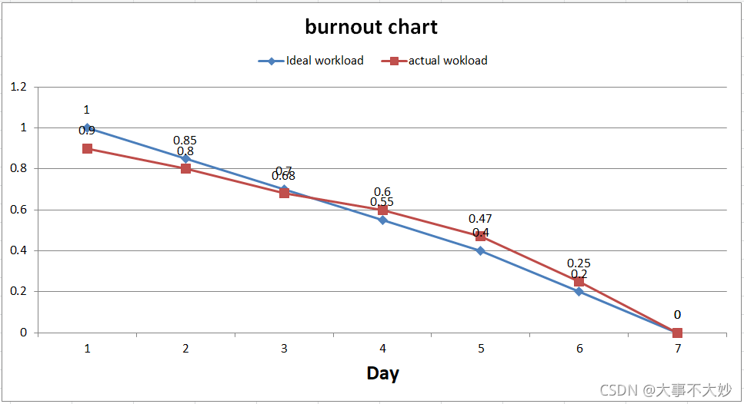
BurnOut Diagram:
Software Engineering |
The mini program we designed is a learning mini program for beginner of learning open source. Users can search, share, like, and download articles in various categories. Users can learn about information of other people. And users will read their own published articles and others’ articles in their homepage.

Slide 9
03
Problems and Solutions

Slide 10

Problems and Solutions
Software Engineering |

Slide 11
04
Technology

Slide 12
Technology
Software Engineering |
We chose to use JavaScript, WXSS, CSS, AND WXML to create the front end. Use Python + Django to build the back end
Process deployment: First of all, we advanced the design of the front end, completed the general page layout, gradually improved each local page, and began to try to add some functions, and then started the development of the back end, and finally began to connect the front end and the back end of the data and try to optimize.

Slide 13
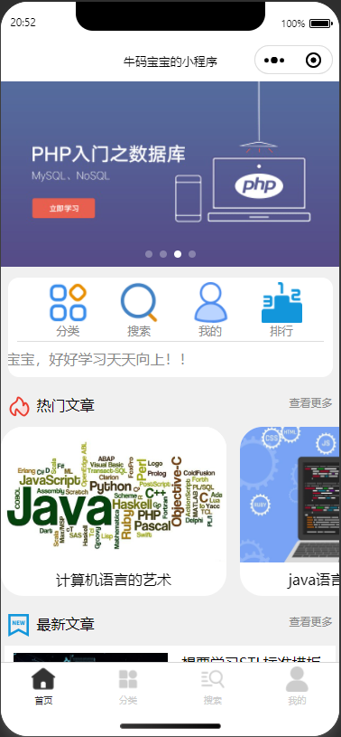
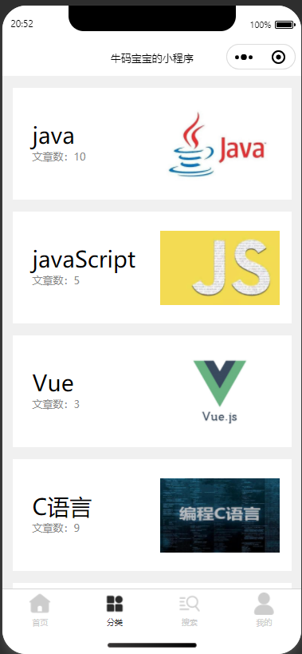
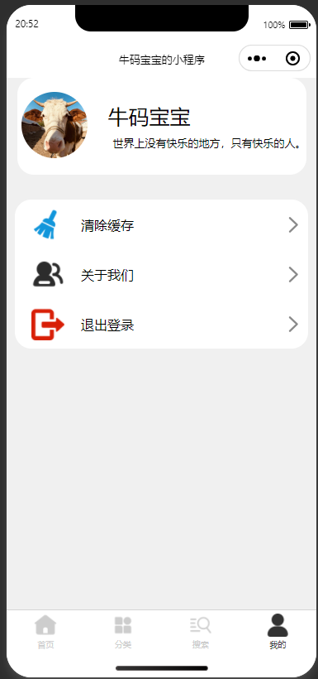
Some pictures of mini program
Software Engineering |

Slide 14
04
Members’experience

Slide 15

Members’experience
Software Engineering |
Experience of front-end members
We think studying the corresponding knowledge makes us happy because it may help us complete the knowledge reserve for the future work. Where there is a will, there is a way. We strongly believe our leader and we are ready to step into the next stage.

Slide 16
Members’experience
Software Engineering |
Experience of back-end members
We feel very tired to acquire the corresponding knowledge but we think what we experience will be a treasure for the rest of our life not only physically but also psychologically. Completing a project is like climbing a mountain. When you climb all the mountains, you can see the sea.

Slide 17
Software Engineering |
Thanks to the ta for your guidance
Thanks for watching

