Slide 1
Experiment
Character level model
Word level model
2.1 Multiple undirectional LSTM
2.2 Single bidirectional LSTM
2.3 Multiple bidirectional LSTM
02/02/2020
<number>

Slide 2
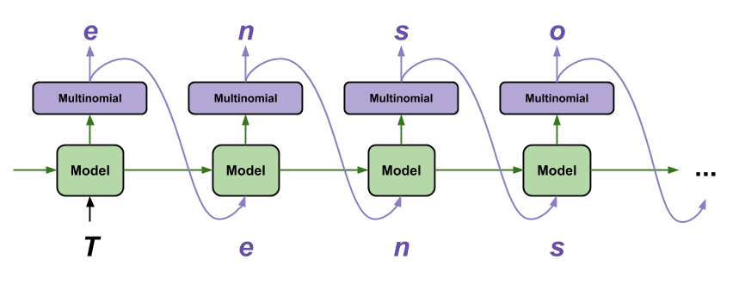
1. character level model
02/02/2020
<number>

Slide 3
1. Character level model
Seed :
``i just realized that if you listen to ca''
Generated text :
``nt beloels like scobous dveb ! vote selffiending up. #fitn graham of his tonight dominater wsa an ands. comfuntstaheos,''

Slide 4
2. Word level model 2.1 Multiple undirectional LSTM 2.2 Single bidirectional LSTM 2.3 Multiple bidirectional LSTM
02/02/2020
<number>

Slide 5
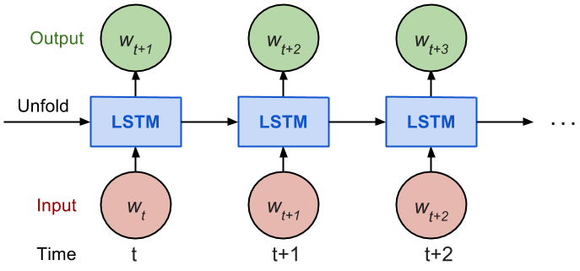
2.1 Multiple undirectional LSTM
02/02/2020
<number>

Slide 6
2.1 Multiple undirectional LSTM
Seed :
``and how innocent she is , ask her to read peters insurance policy text , to her , just in case hillary loses . also , why were the lovers text messages scrubbed after he left mueller . where are they lisa ? ; the republican party has never been so''
Generated text :
``easy to gain. They are entrapping people with china. They have gone bonkers, and I havent seen millions of americans!''
<number>

Slide 7
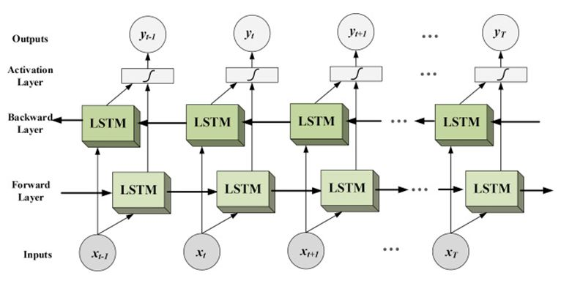
2.2 Single bidirectional LSTM
<number>

Slide 8
2.2 Single bidirectional LSTM
Seed :
``co-founder of greenpeace: the whole climate crisis is not only fake news , its fake science . there is no climate crisis , theres weather and climate all around the world , and in fact carbon dioxide is the main building block of all life . @foxandfriends wow ! ; jewish''
Generated Text :
``people are leaving the democratic party. The fires lost in favor of our seniors. Presidential world''

Slide 9
2.3 Multiple bidirectional LSTM
Seed :
``fraudulent speech knowingly delivered as a ruthless con , and the illegal meetings with a highly partisan whistleblower \& lawyer . @60minutes forgot to report that we are helping the great farmers of the usa to the tune of 28 billion dollars , for the last two years , paid for''
Generated Text :
``the democrats . the democrats are a very good of the democrats . the democrats are a very good of the democrats . the democrats are a very good of''
<number>

Slide 10
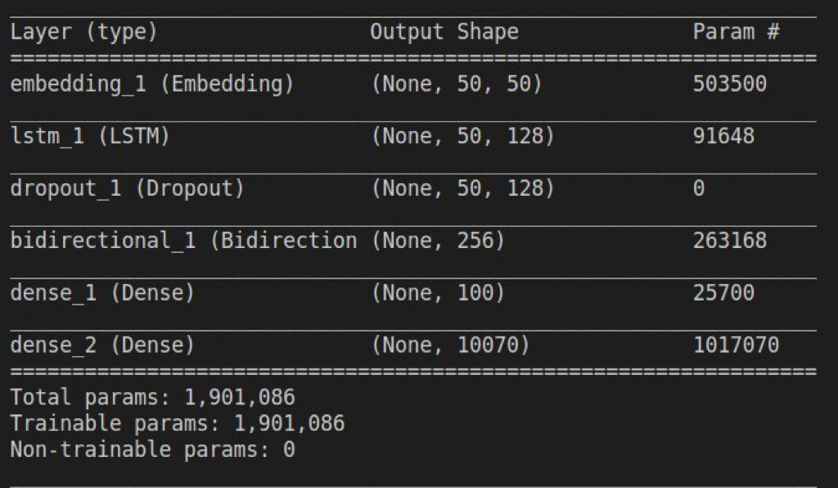
Suggested Model :
02/02/2020
<number>

