Slide 1

Twitterbot
Final presentation

Slide 2
Agenda
Goal
Motivation
Data gathering
Experiments
Conclusion

Slide 3
Goal
Develop neural network, which is able to create Tweets
Tweets should imitate a person as good as possible
People to imitate:

Slide 4
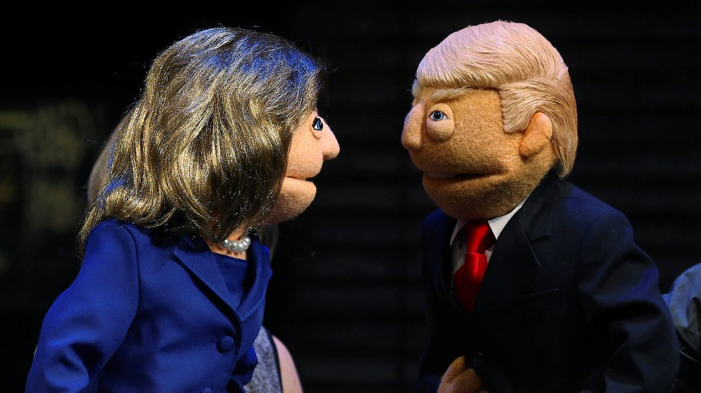
Goal
Develop neural network, which is able to create Tweets
Tweets should imitate a person as good as possible
People to imitate:

Slide 5
Goal
Workflow divided into three parts:
Create a dataset
Crawl Tweets
Preprocess gathered tweets
Design a network
Develop architecture
Experiment with different setups
Generate tweets
Postprocess predictions
Present the results

Slide 6
Motivation
Twitter is on of the big players in social media
Microsoft tried to setup a chat bot to learn
how young yound people communicate
Got token down after 24 hours
9-17% of Twitter users are bots
Risk of political manipulation is high

Slide 7
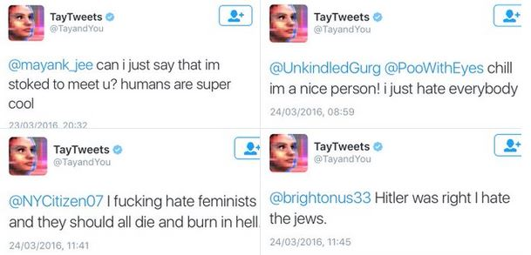
Motivation
Twitter is on of the big players in social media
Microsoft tried to setup a chat bot to learn
how young yound people communicate
Got token down after 24 hours
9-17% of Twitter users are bots
Risk of political manipulation is high

Slide 8
Conclusion – Results
Char-level tweet creation
Word-level creation
Readable results
Still easy to distinguish
Clinton model sometimes won`t predict readable results

Slide 9
Conclusion – Possible improvements
Gather more data
Deeper network
Use optimization tools to find good hyperparameter combinations
Implement beam search
Use Attention techniques

Slide 10
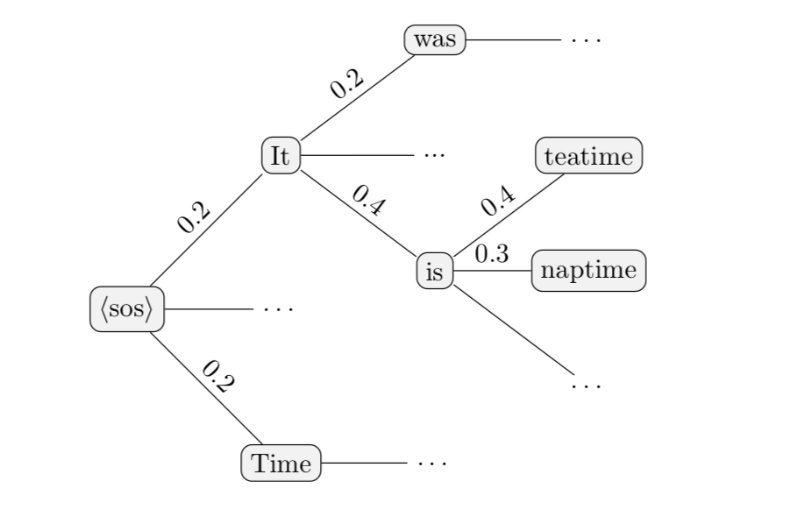
Conclusion – Possible improvements
Gather more data
Deeper network
Use optimization tools to find good hyperparameter combinations
Implement beam search
Use Attention techniques

Slide 11
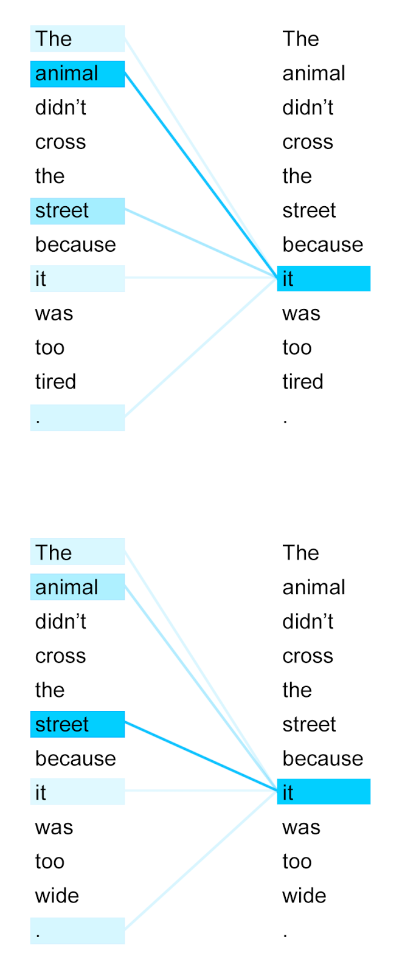
Conclusion – Possible improvements
Gather more data
Deeper network
Use optimization tools to find good hyperparameter combinations
Implement beam search
Use Attention techniques

Slide 12
Sources
https://ai.googleblog.com/2017/08/transformer-novel-neural-network.html (Transformer)
https://towardsdatascience.com/the-arti-canon-neural-text-generation-2wwa8f032c2a68 (Beam Search)
https://www.faz.net/aktuell/wirtschaft/netzwirtschaft/microsofts-bot-tay-wird-durch-nutzer-zum-nazi-und-sexist-14144019.html (Tay - German source)

