Slide 1

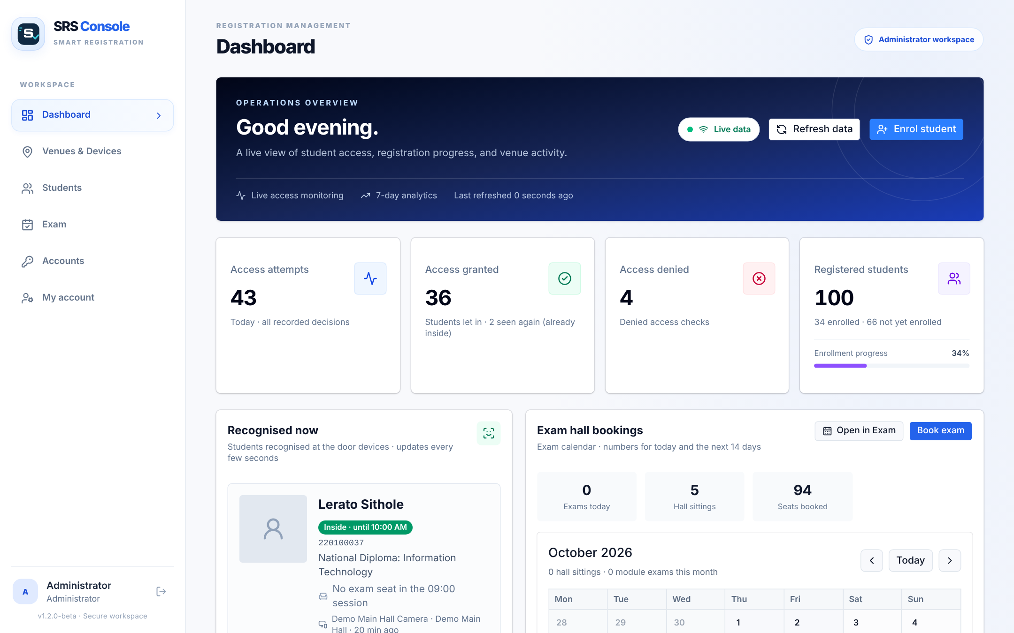
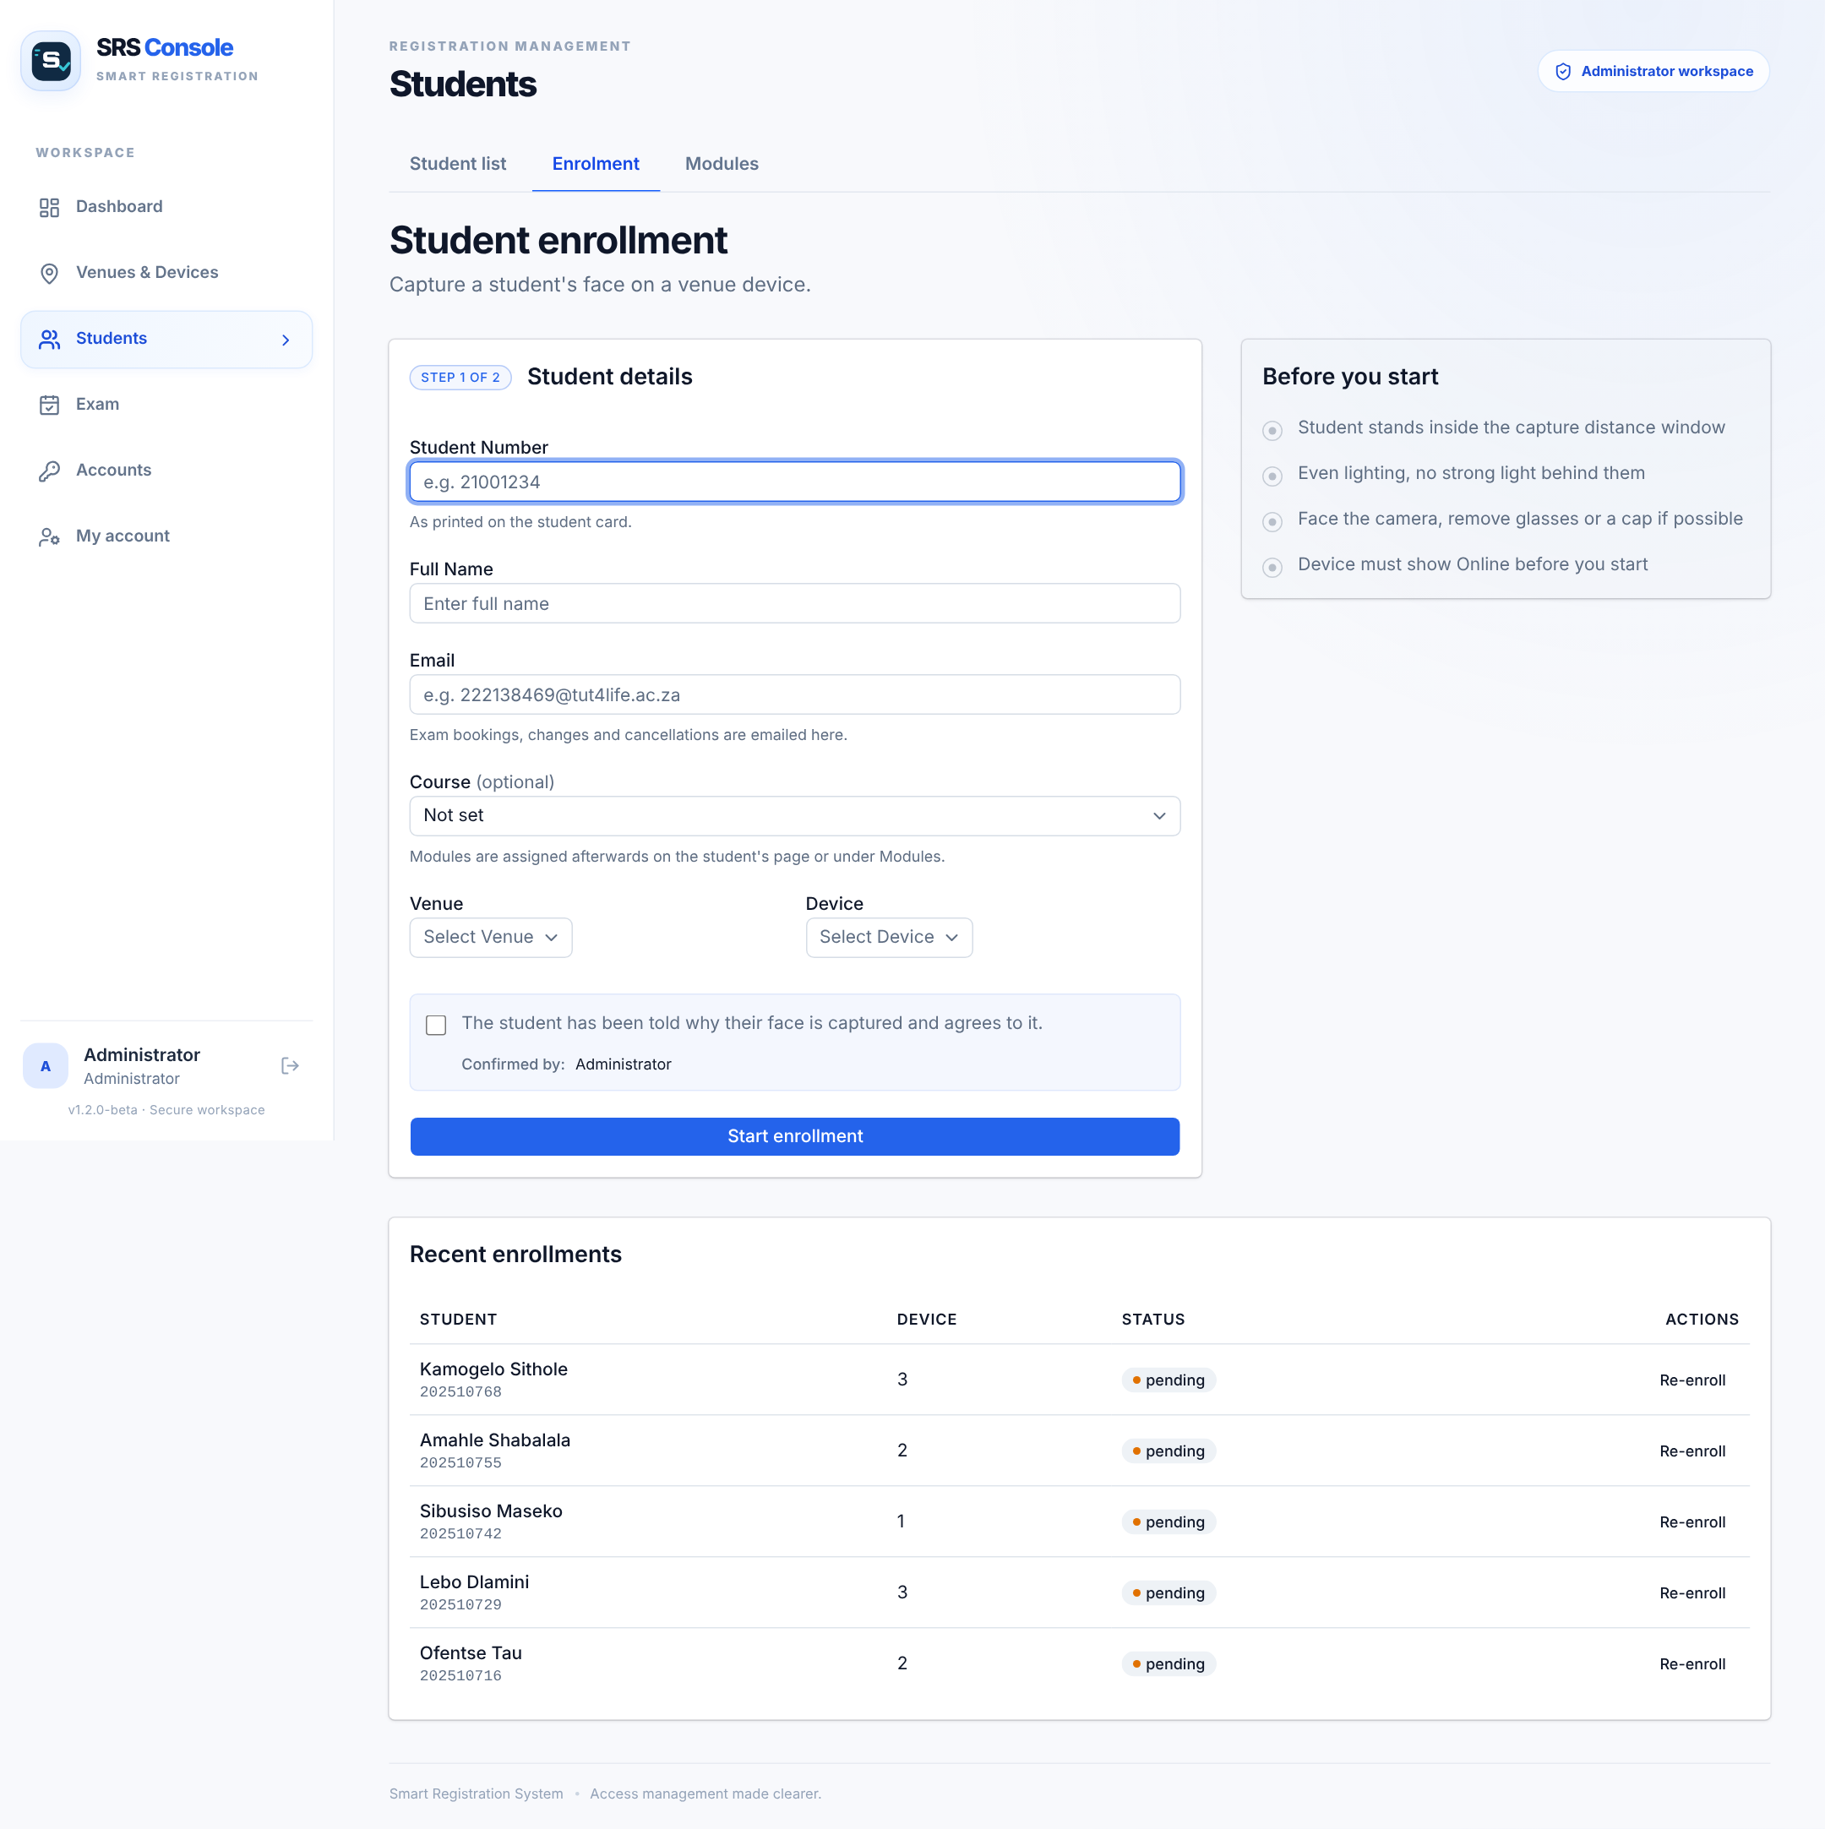
Smart Registration System
Face-recognition access control for university exam venues
TC Mance · 222138469 · Project Design 376 (PD2316D)
Lecturers: Mr M. Muwanguzi Ntume and Prof C. Du · 5 November 2026
Notes:
Good morning. My name is Tebogo Mance, student number 222138469. My project is the Smart Registration System: a door unit that recognises students by their face at the entrance of an exam venue, linked to a web console where staff enrol students, book exam halls and watch every entry live. In the next ten minutes I will cover the problem, the design, the change I had to make to the hardware, the results, and what I would do next.

Slide 2




Checking identity by eye is slow and easy to fool
Slow at the door
Every candidate is compared with a register and a student card
The aim
Verify every candidate automatically at the venue door
Show each student's seat and session at the door
Keep the invigilator in charge of every refusal
Interrupts writing
Checks are repeated during the exam, disturbing students
Impersonation slips through
A convincing look-alike passes a quick visual check
No reliable record
Paper ticks give no time-stamped audit trail
Notes:
Today invigilators check identity by eye. They compare the student card and the register with the person in front of them. It is slow, it interrupts students during the exam, a look-alike can get through, and there is no time-stamped record afterwards. My aim was to verify every candidate automatically at the door, show each student’s seat and session, and still leave the final decision on any refusal with the invigilator.

Slide 3




Four objectives from the proposal – all met
Fast, distance-gated recognition
MET
Low FAR and FRR
MET
Goal: Face verified within 2 s at 90%+ accuracy
Goal: Keep both error rates acceptable
≈1 s hold at 25–50 cm, then the face is matched
Strict 0.40 match threshold · one face per student
Log every attempt, live dashboard
MET
Manual override
MET
Goal: Time, student and decision for each entry
Goal: Backup when recognition fails
Every decision stored; live console for all venues
Override button records who and why
Notes:
The proposal set four measurable objectives. One: verify a face within two seconds at over ninety percent accuracy, with ultrasonic gating. The student holds still for one second at 25 to 50 centimetres, and the PC then matches the face. Two: keep the false acceptance and false rejection rates low. The door uses a strict match threshold of 0.40, and a face that matches two students is never accepted as either. Three: log every attempt and show it live, which the web console does for any number of venues. Four: a manual override, which records who let a student in and why.

Slide 4
Face recognition exists – exam-aware access does not
Commercial products
Smart Registration System
Facephi · SmartVisitor · Navon · Openitem
Built for TUT exam venues
Offices, estates, events and visitors
Shows each student's seat; flags "No seat" for the invigilator
No idea of exam timetables or seats
Once per session; automatic sign-out at 12:00 / 16:00
Face templates usually kept in the cloud
Face templates stay on the door PC (POPIA)
Subscription – about R480 per month
About R1 225 of hardware, free hosting tiers
Notes:
Face-recognition access is already sold: Facephi, SmartVisitor, Navon and Openitem. But they are built for offices, estates and events, they are subscription based, and they know nothing about exams. What is new in my system is that recognition is tied to exam administration: the door shows the student’s seat and module, flags students with no seat in the current session, lets each student in once per session, and signs everyone out automatically when the session ends. Face templates never leave the door PC.

Slide 5
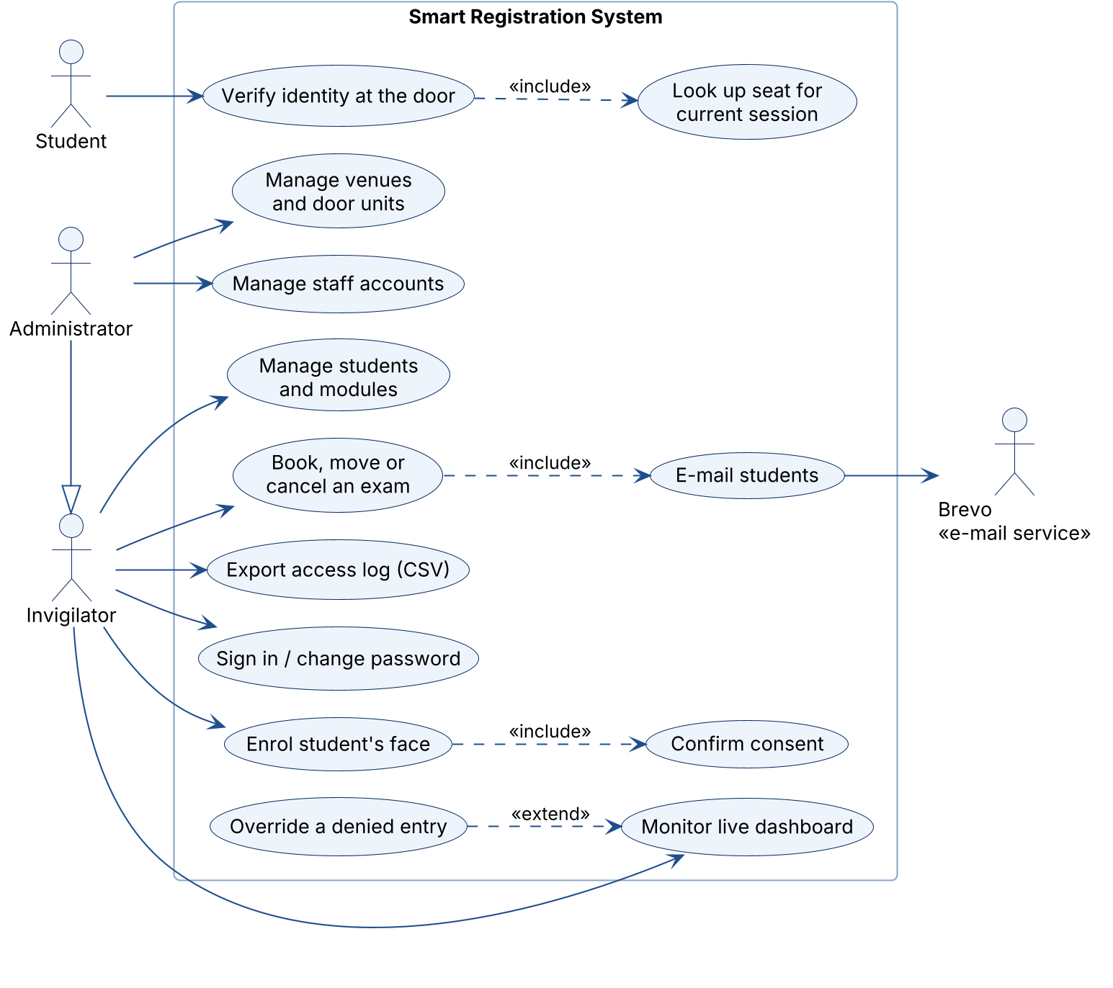
Who uses the system: UML use case diagram
How to read it
Stick figures are actors: Invigilator, Administrator, Student and the Brevo e-mail service
Ellipses are what the system lets them do
Hollow triangle: an Administrator can do everything an Invigilator can, plus venues, devices and accounts
«include» always happens as part of another use case; «extend» only sometimes (an override)
Notes:
This use case diagram shows who uses the system. Invigilators enrol students, book exams and watch the dashboard; the administrator can do all of that and also manages venues, door units and staff accounts. The student only interacts with the door. Booking an exam always includes e-mailing the students, and an override extends monitoring the dashboard.

Slide 6
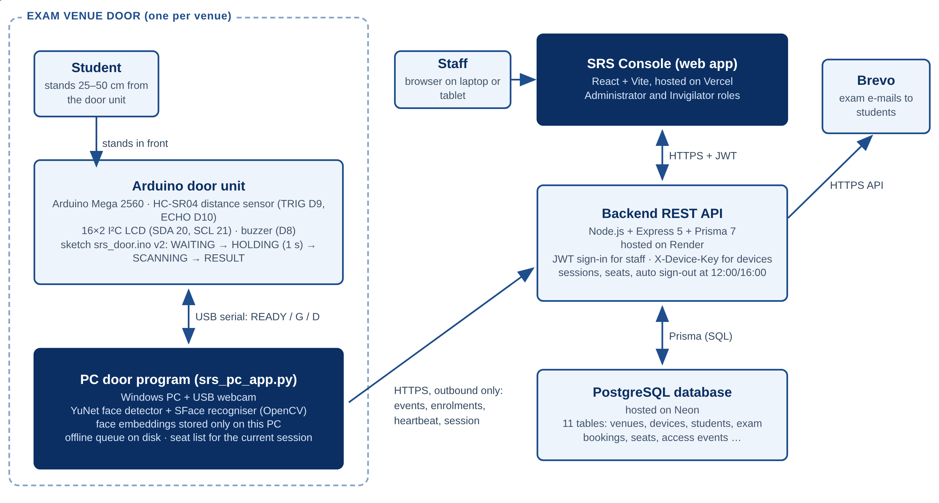



Four parts, connected only through the backend
Door unit
PC + webcam recognises; Arduino measures distance, shows the result
Backend
Node.js + Express on Render; decides sessions, seats, sign-out
Security
Staff sign in (JWT); doors use a secret device key; outbound HTTPS only
Notes:
The system has four parts. The door unit at each venue: a PC with a webcam that recognises faces, and an Arduino that measures distance and shows the result. The backend, a Node.js and Express REST API on Render, which owns all the rules. A PostgreSQL database on Neon with eleven tables. And the SRS Console web app on Vercel. The door only makes outbound HTTPS calls, so it works behind any router, and the console never talks to the door directly.

Slide 7



The hardware change: ESP32-CAM to PC + Arduino
Planned
Final
ESP32-CAM with OV2640 camera
USB webcam on a Windows PC
ESP-WHO recognition on the board
OpenCV YuNet + SFace recognition
Battery pack + buck converter
USB power – no batteries
LED and buzzer only
Arduino Mega: distance sensor, LCD, buzzer
Why: hardware problems with the ESP32-CAM could not be solved in time. The new design removed its memory, power and pin limits – and the new door unit uses the same backend API.
Notes:
The biggest change from my proposal is the door hardware. I planned an ESP32-CAM board running Espressif’s ESP-WHO recognition on batteries. I ran into hardware problems with that board that I could not solve in time, so I redesigned the door unit: a USB webcam on a PC running OpenCV’s YuNet and SFace models, and an Arduino Mega for the distance sensor, LCD and buzzer. Because the door talks to the backend through the same API, the server did not have to be rebuilt for the new hardware.

Slide 8
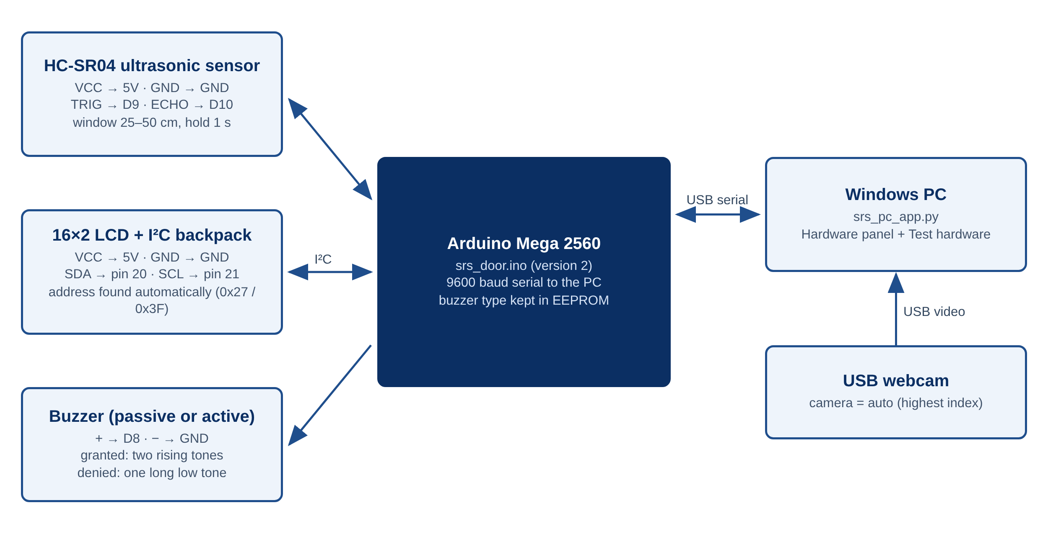
The door unit waits for the student to hold still
25–50 cm
distance window (HC-SR04)
1 s
hold before the picture
G / D / A
answer on LCD + beep
d = 343 m/s × t ÷ 2 → 25–50 cm = 1.45–2.9 ms echo
Notes:
Here is the door unit. The HC-SR04 sensor measures distance from the echo time: distance equals the speed of sound times the time, divided by two, so my 25 to 50 centimetre window is an echo of about 1.5 to 3 milliseconds. Only when the student has stayed in that window for one second does the Arduino send READY to the PC. The PC answers G, D or A, and the Arduino shows the result on the LCD with a beep pattern. The program also has a built-in hardware test.

Slide 9







From face to decision: match first, then session rules
1. Hold
2. Detect
3. Match
4. Session
5. Decide
Student holds still 1 s at 25–50 cm
YuNet finds the largest face
SFace: 128 numbers, compared with ALL faces, ≥ 0.40
Already inside? Session over? Seat looked up
Let in with seat N (or "no seat" flag); unknown face DENIED
Offline? Decisions continue; events are queued on disk and uploaded once, never twice
Face templates stay on the door PC; the backend only gets the result and one enrolment photo
Notes:
This is what happens at the door. The student holds still; YuNet finds the face; SFace turns it into 128 numbers, which are compared with every face on that PC, and the best match must reach 0.40. Only then does it check the session list from the backend: is the student already inside, or is the session over? Otherwise the student is let in and the PC shows their seat and module, or flags that they have no seat in this session. Comparing with all faces first means a stranger can never be accepted as the closest seated student; unknown faces are denied. If the Wi-Fi drops, decisions continue and are uploaded later without duplicates.

Slide 10
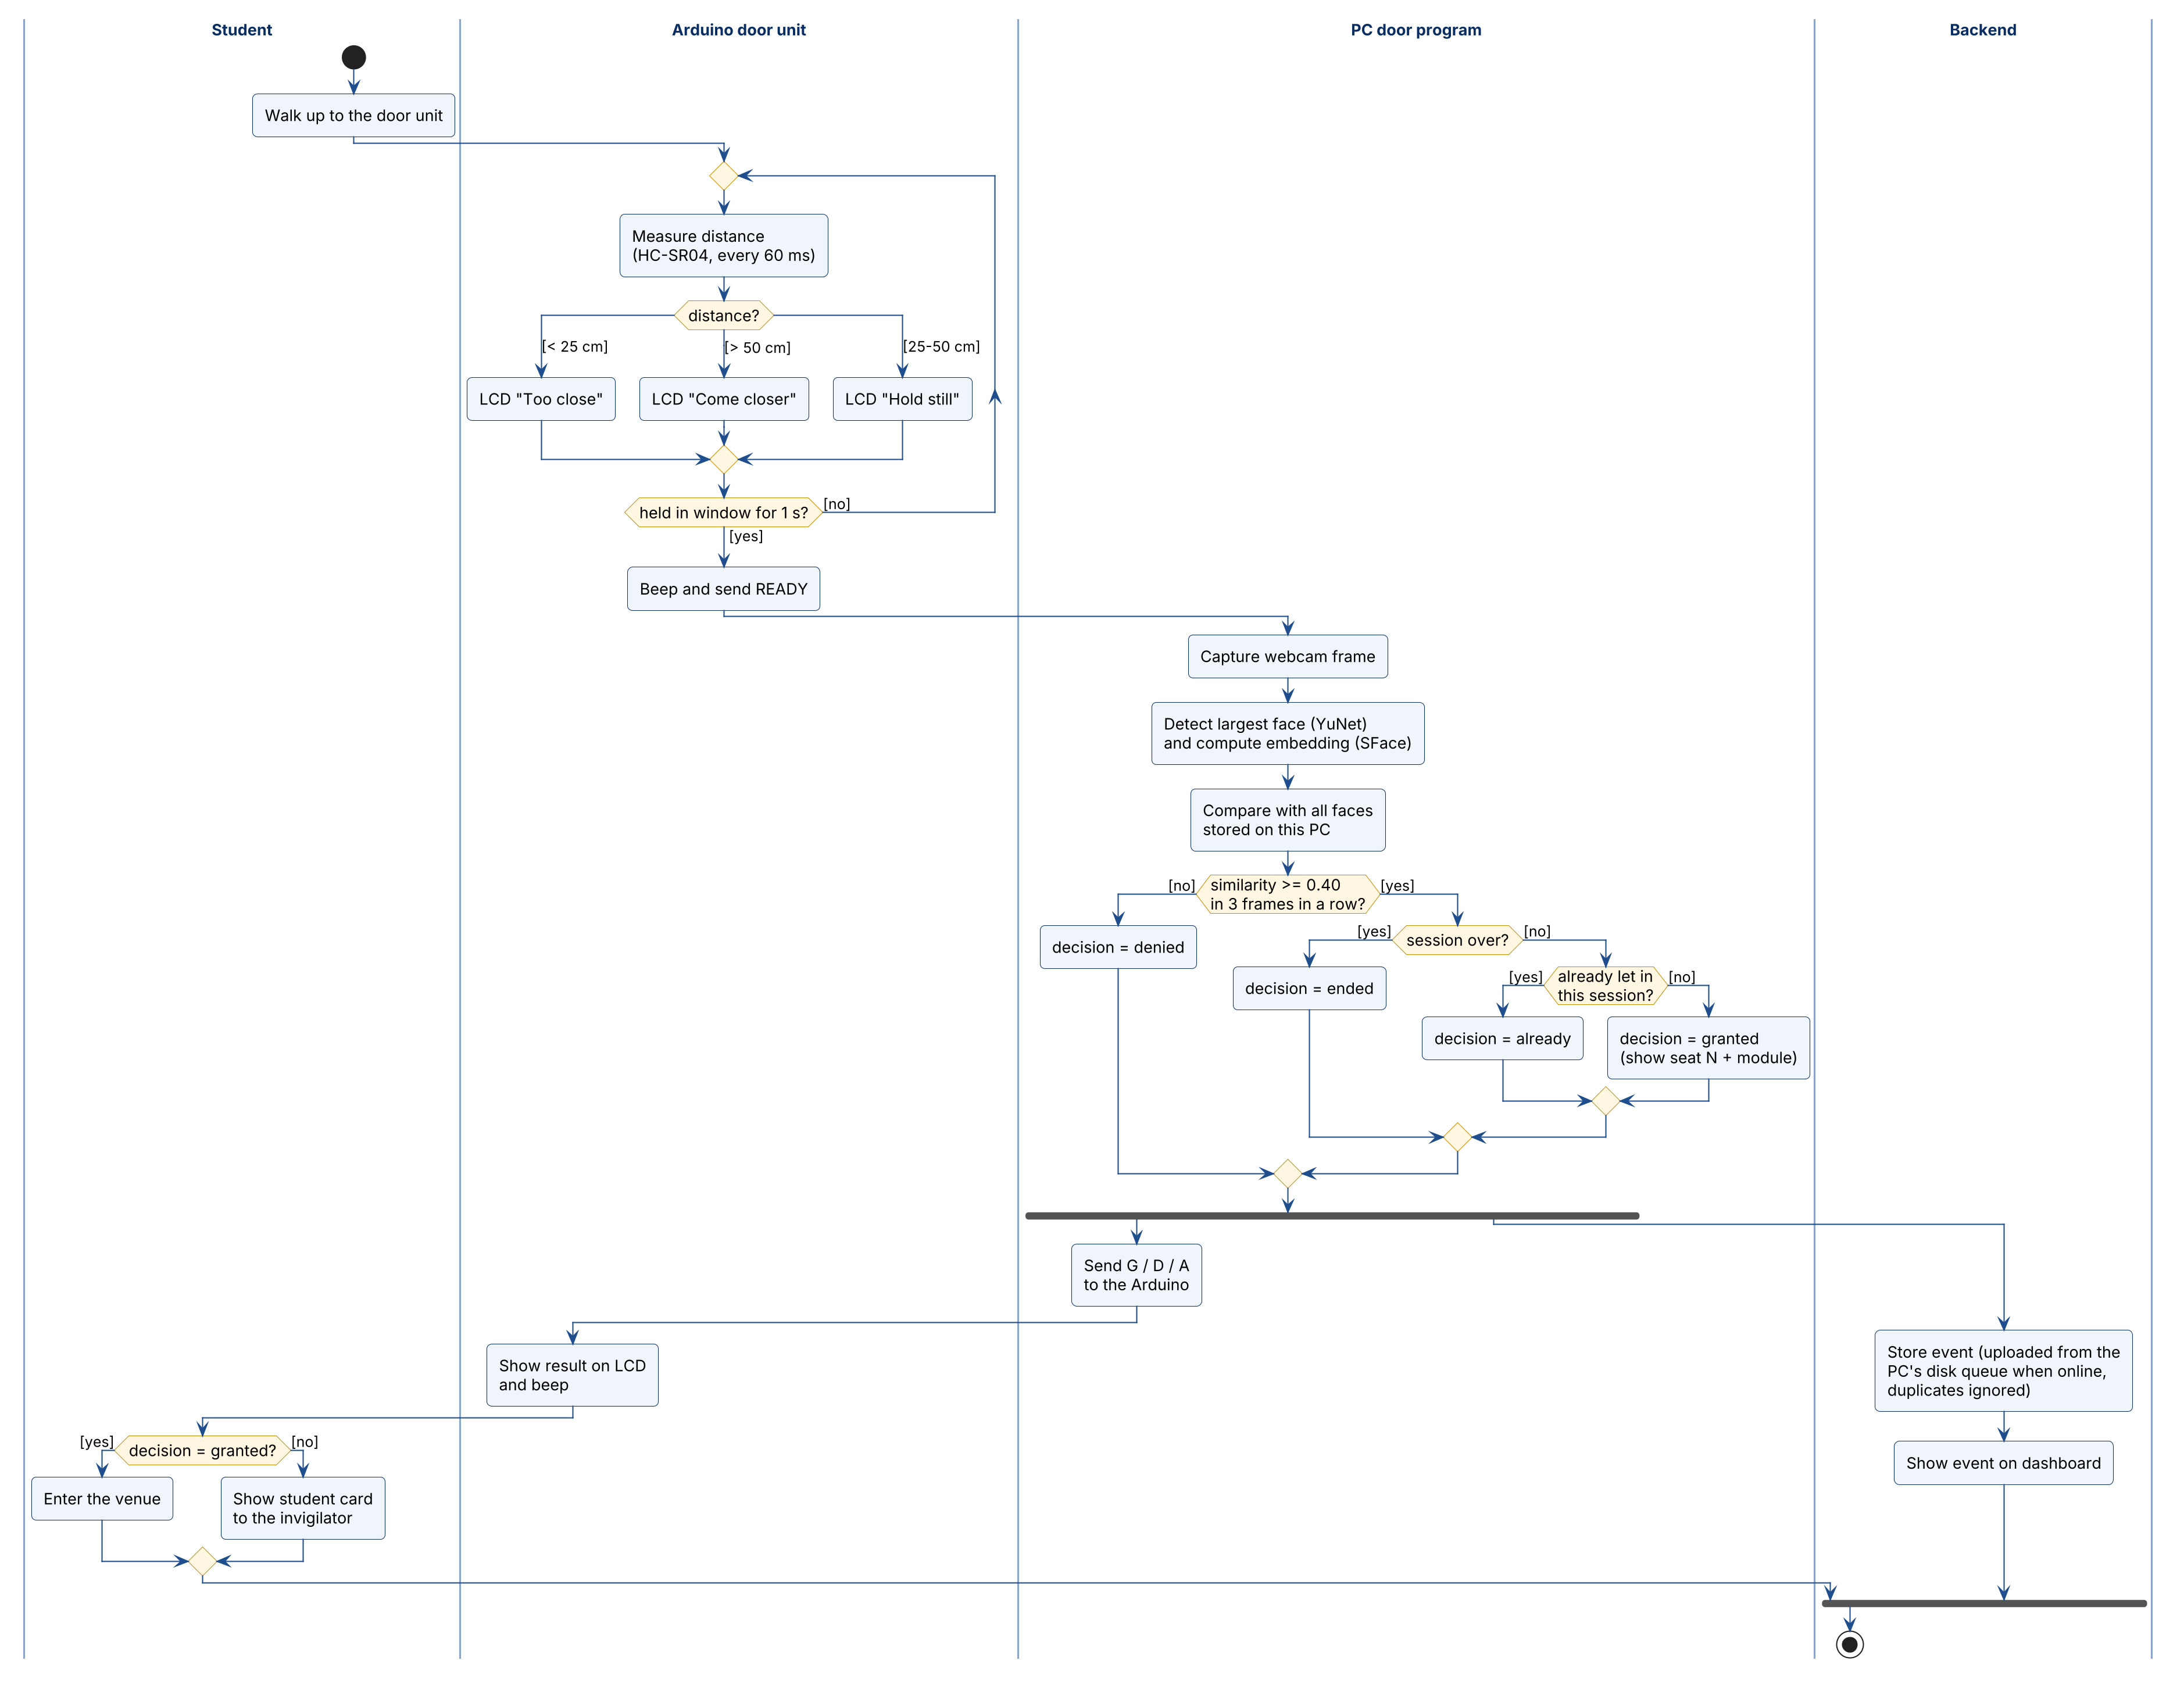
Access verification: UML activity diagram
How to read it
One swimlane per part: Student, Arduino, PC door program, Backend
Black dot = start, ringed dot = end
Diamonds are decisions; the condition for each path is in [square brackets]
Thick bars: the LCD result and the upload run at the same time (fork), then join
Notes:
This is the same door flow as a UML activity diagram, split into swimlanes. The Arduino waits for the one-second hold, the PC matches the face against every stored face and then applies the session rules, and two things happen in parallel: the result goes to the LCD and the event is uploaded, or queued if the internet is down.

Slide 11
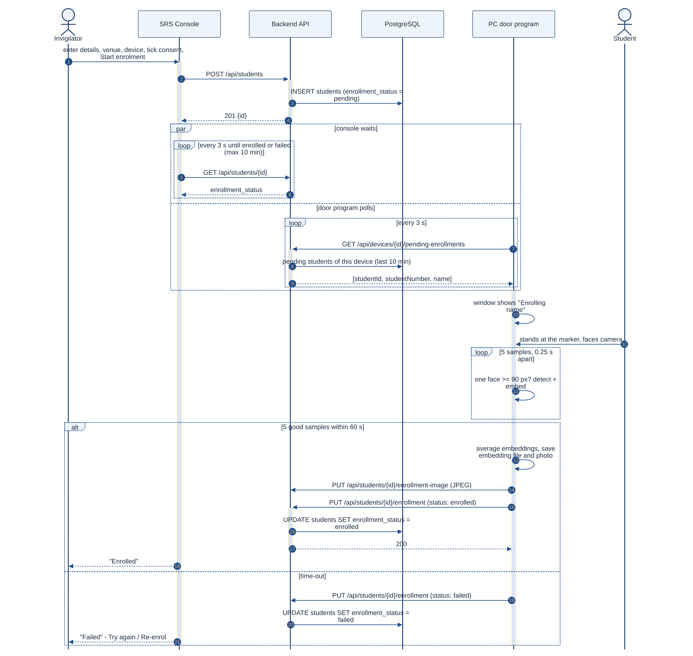
Enrolment: UML sequence diagram
How to read it
Each participant has a lifeline; time runs downwards
Solid arrows are requests, dashed arrows are replies
par: the console and the door program both poll every 3 s
loop: five face samples; alt: enrolled or time-out after 60 s
Notes:
Enrolment as a UML sequence diagram. The invigilator saves the student as pending; the console and the door program both poll the backend every three seconds; the door captures five samples, keeps the embedding on the PC and reports enrolled, or failed after sixty seconds.

Slide 12
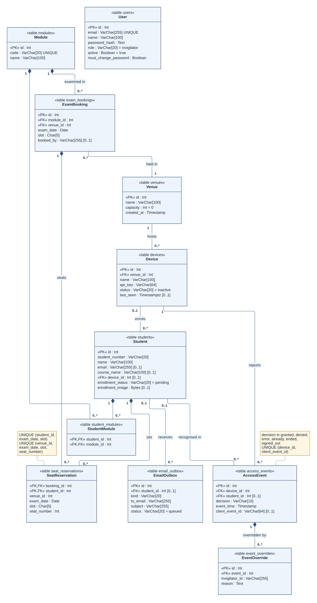
Database: UML class diagram (11 tables)
How to read it
One class per table: columns and data types; «PK» primary key, «FK» foreign key
Multiplicities on each line: 1, 0..1, 0..* (any number)
Filled diamond = composition: seats, overrides and module registrations are deleted with their owner
Venue → Device → Student → AccessEvent is the path of every entry
User (staff accounts) stands alone: it has no links
Notes:
This class diagram is the database. A venue hosts door units, a door unit enrols students, and every decision is an access event. Modules are booked into venues, and each booking creates seat reservations. Filled diamonds mean the parts are deleted with their owner. Staff accounts stand on their own.

Slide 13


SRS Console: one app for invigilators and admins
Live dashboard
entries, refusals, recognised now
Enrolment
with consent tick box
Exam bookings
seats, capacity, calendar
E-mails
booked, moved, cancelled
Two roles
admin and invigilator
Demo data shown
Notes:
This is the SRS Console. The dashboard shows today’s entries and refusals, the students recognised in the last few minutes and the exam hall bookings. Staff enrol students here, with a consent tick box; they book exam halls, and the system allocates seats within the hall capacity and e-mails each student when an exam is booked, moved or cancelled. Administrators manage venues, devices and accounts; invigilators cannot see the device keys.

Slide 14
Costed in rand
Over budget because two sets of hardware were bought after the ESP32-CAM was dropped.
Notes:
On cost: the final door unit is about 1,225 rand using my own laptop and free hosting, close to the 1,000 rand budget. Including the ESP32-CAM parts I bought first, the total is about 1,751 rand. These are estimated South African retail prices.

Slide 15

Conclusion and next steps
What was achieved
Next steps
All four proposal objectives met
On-site FAR/FRR test with 30+ volunteers
Recognition tied to exam bookings and seats
Liveness check against printed photos
Biometric templates stay on the door unit
Move the door program to a Raspberry Pi 5
Grew to many venues, e-mails and staff roles
Import students from the university system
Thank you – live demonstration and questions
Notes:
To conclude: all four objectives were met. The system ties face recognition to exam bookings and seats, keeps biometric templates on the door unit in line with POPIA, and grew beyond one venue to e-mails and staff roles. My main setback was the ESP32-CAM, which cost time and money. Next I would run an on-site accuracy test with at least thirty volunteers, add a liveness check against printed photos, and move the door program to a Raspberry Pi. Thank you. I will now show the live demonstration and take your questions.

Slide 16
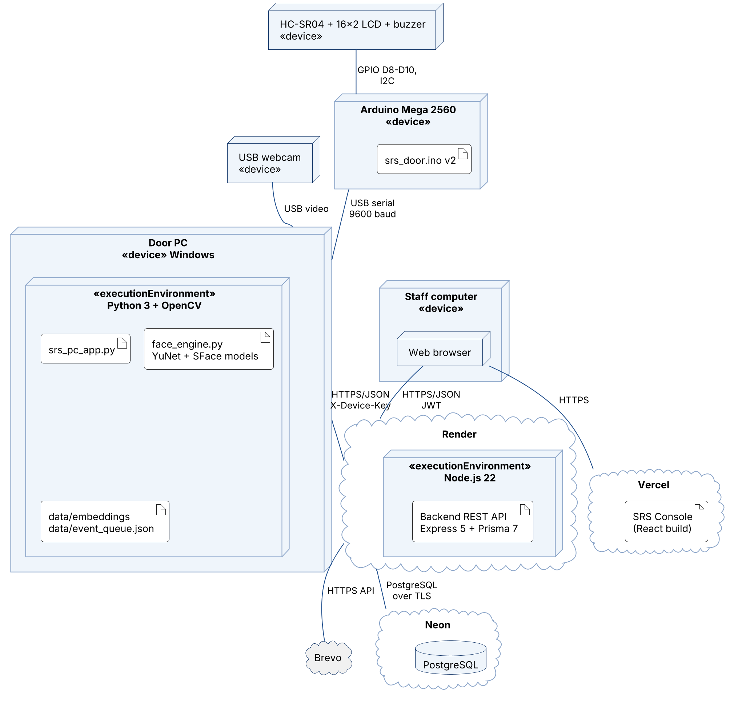
Backup: UML deployment diagram
Notes:
Backup slide. Where each part runs: the door PC with Python and OpenCV, the Arduino over USB, the backend on Render, the database on Neon and the console on Vercel, with the protocol on each link.

Slide 17
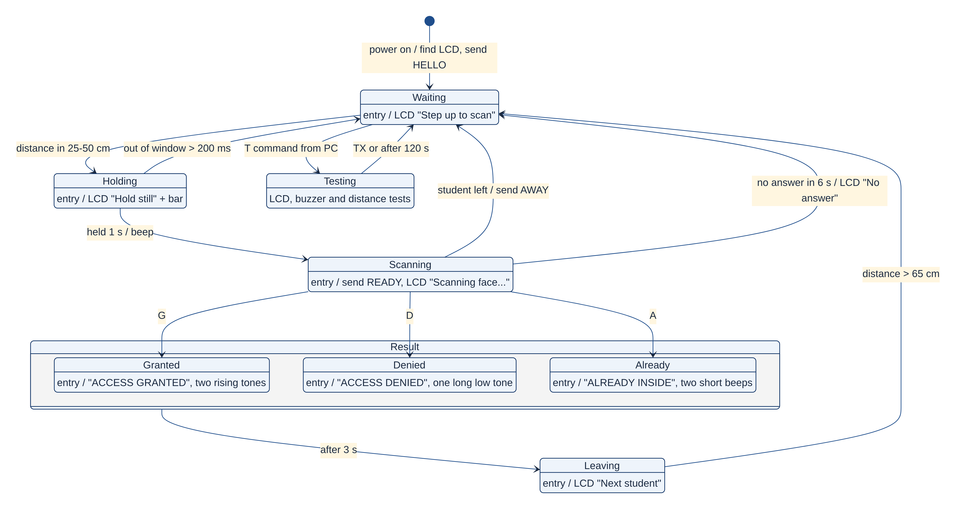
Backup: UML state machine of the door unit
Notes:
Backup slide. The Arduino sketch as a state machine: waiting, holding for one second, scanning, the three results, and leaving; each state shows its LCD text.

Slide 18
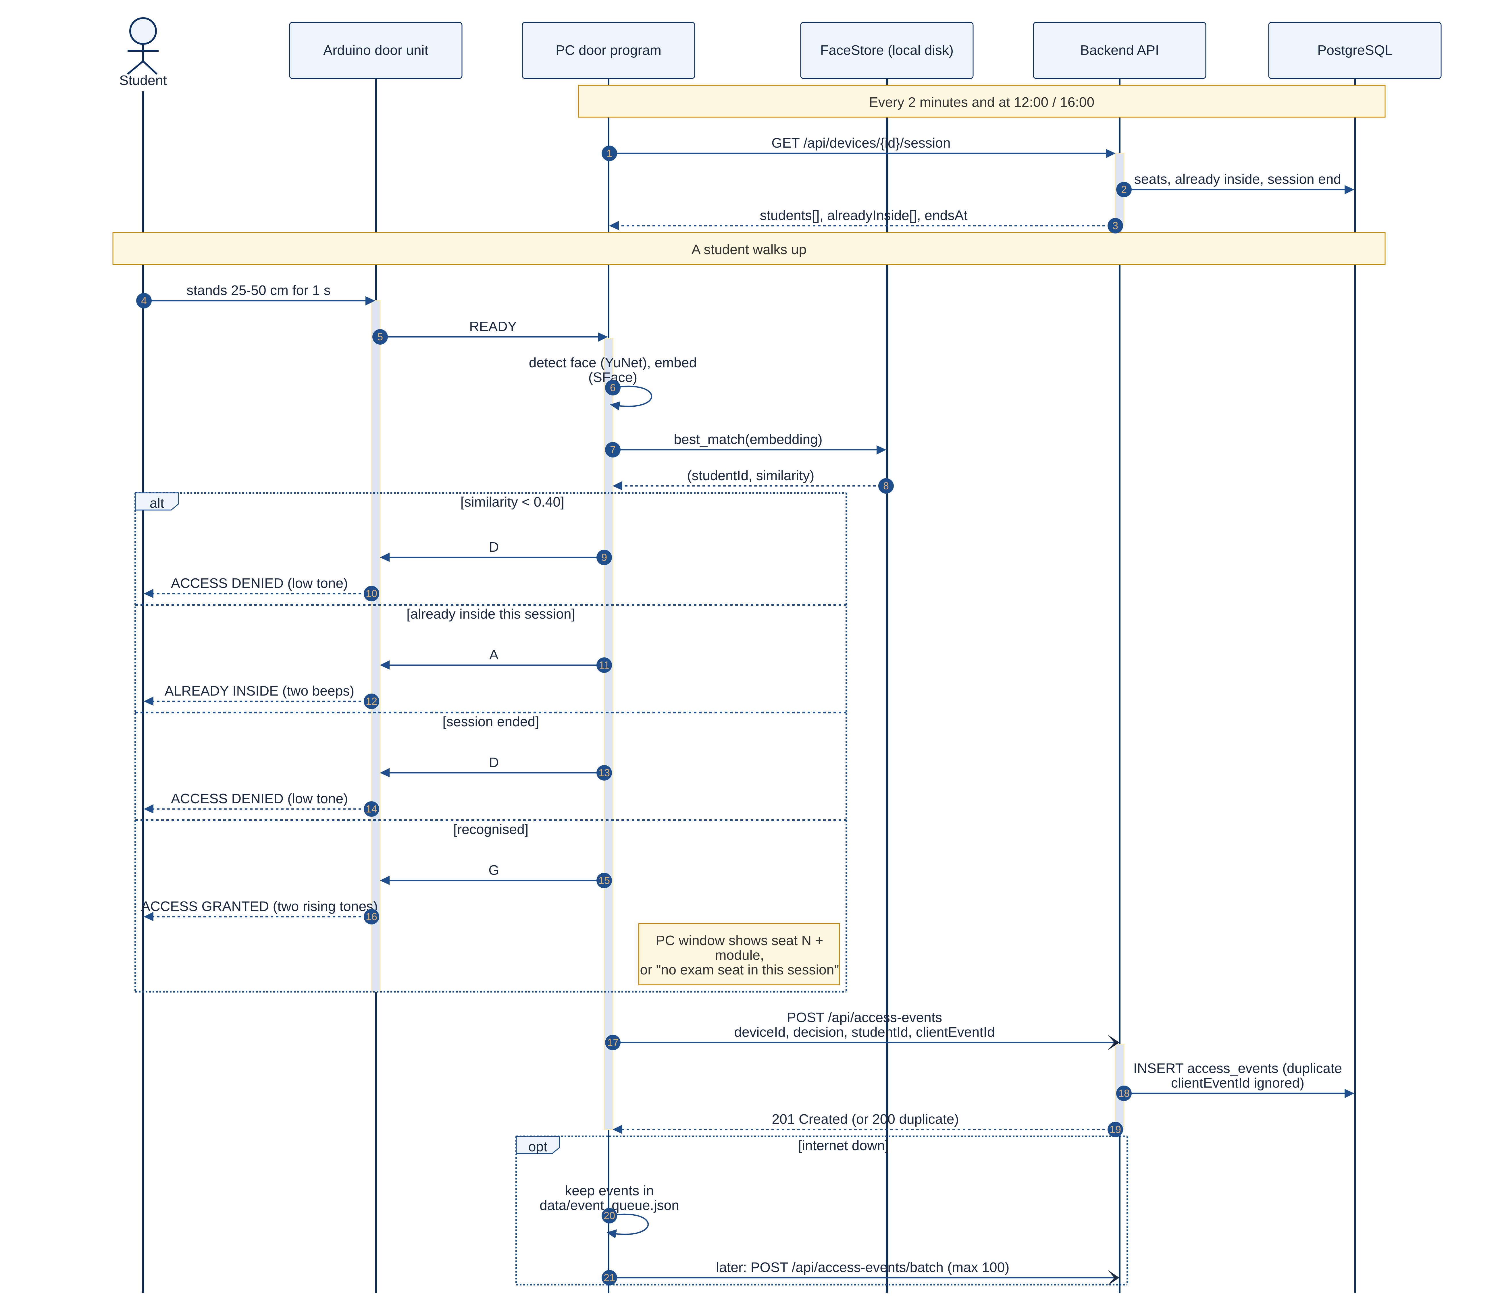
Backup: UML sequence – one access verification
Notes:
Backup slide. One scan as messages: READY from the Arduino, matching on the PC, the G, D or A answer, and the event upload with its duplicate-proof client event id.

Slide 19
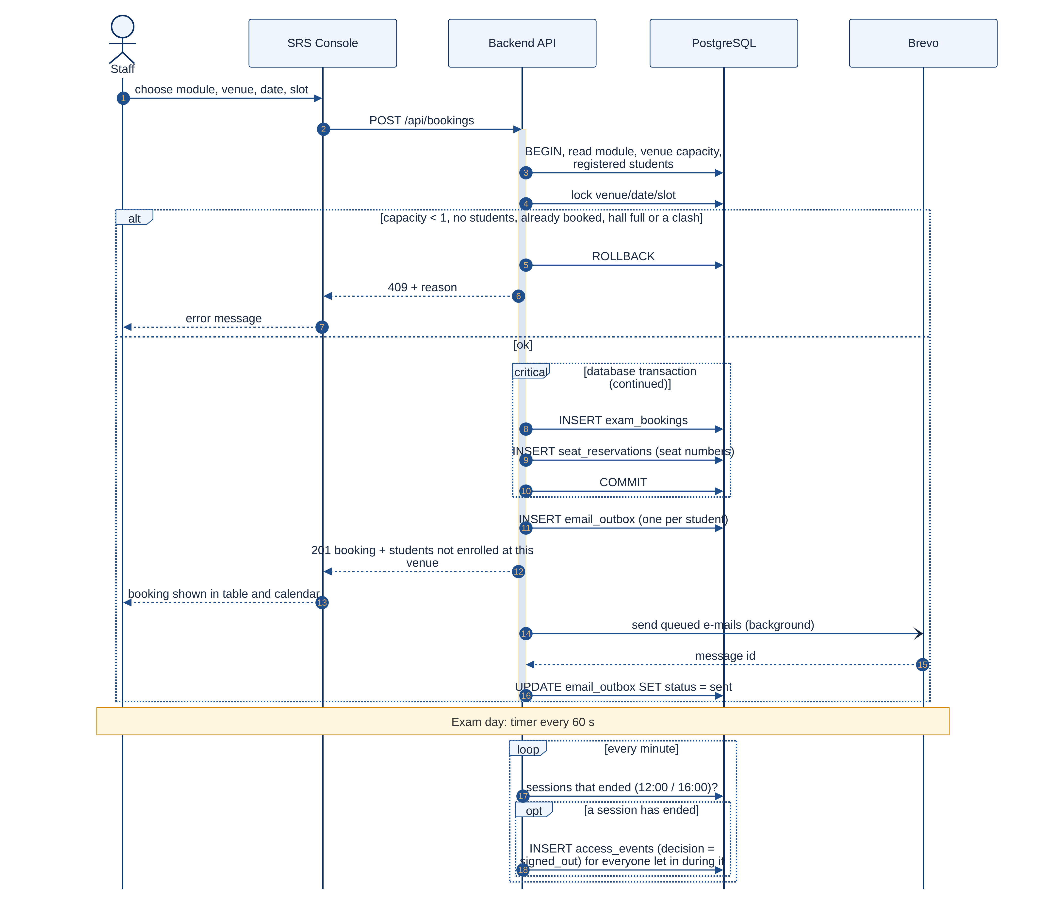
Backup: UML sequence – booking, e-mails, sign-out
Notes:
Backup slide. Booking an exam inside a database transaction, the e-mails sent in the background through Brevo, and the timer that signs students out at 12:00 and 16:00.

