Slide 1
Class and Instance variables

Slide 2
Class and Instance variables
Object-oriented programming allows for variables to be used at the class level or the instance level.
At the class level, variables are referred to as class variables, whereas variables at the instance level are called instance variables.

Slide 3
Class and Instance variables
Class variables are defined within the class construction. Because they are owned by the class itself, class variables are shared by all instances of the class.
They therefore will generally have the same value for every instance unless you are using the class variable to initialize a variable.

Slide 4
Class and Instance variables
Instance variables are owned by instances of the class.
This means that for each object or instance of a class, the instance variables are different.

Slide 5
Class and Instance variables
class employee:
No_of_leaves = 10
pass
emp1=employee()
emp2=employee()
emp1.name= "Ankit"
emp1.city= "Delhi"
emp1.sal= 60000
emp2.name= "Amit"
emp2.city= "Mumbai"
emp2.sal= 80000
print(employee.No_of_leaves)
print(emp1.__dict__)
print(emp2.__dict__)
emp1.No_of_leave = 15
print(emp1.__dict__)
print(employee.No_of_leaves)
employee.No_of_leaves = 15
print(employee.No_of_leaves)

Slide 6
Class and Instance variables
==================== RESTART: C:/Users/Ashish/Desktop/var.py ===================
10
{'name': 'Ankit', 'city': 'Delhi', 'sal': 60000}
{'name': 'Amit', 'city': 'Mumbai', 'sal': 80000}
{'name': 'Ankit', 'city': 'Delhi', 'sal': 60000, 'No_of_leave': 15}
10
15

Slide 7
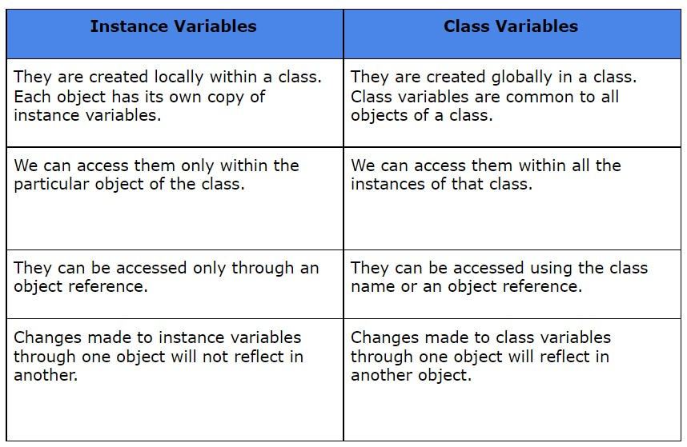
Class and Instance variables

Slide 8
Class and Instance variables
Create a class with your name
Create a class variable named as your city
Create two objects of your class
Create 3-3 Instance variables
Print all 3 variables for both objects using dict
Update class variable & print it
Update 1-1 instance variable in each object & print it using dict.

Slide 9
__init__ () in python
A default constructor of a class in Python is defined using the __init__ method.
The python __init__ is a reserved method in python.
This behaves like any other member function of the class, except the statements written under its definition are used to initialize the data members of a class in Python.
It basically contains assignment statements. This method is automatically called at the time of class instantiation or object creation.

Slide 10
Create a dictionary with five key values pairs
Find value 999 in the dictionary & print 999 is found else print 999 is not found.
Create a dictionary with five key values pairs
Change the key of KV pair as city to location
Create a nested dictionary with nested KV pairs containing information of three students

Slide 11
Use of Self
class employee:
No_of_leaves = 10
pass
def getdetails(self):
return self.name, self.city, self.sal
emp1=employee()
emp2=employee()
emp1.name= "Ankit"
emp1.city= "Delhi"
emp1.sal= 60000
emp2.name= "Amit"
emp2.city= "Mumbai"
emp2.sal= 80000
print(emp1.getdetails())
print(emp2.getdetails())

Slide 12
What is self in python ….>
SELF represents the instance of class.
This handy keyword allows you to access variables, attributes, and methods of a defined class.
Every time I write self , it refer to one of the instance of the class.
When ever I call some function the self will work for the current or referred instance

Slide 13
Use of init()
class employee:
No_of_leaves = 10
pass
def __init__(self, Iname, Icity, Isal):
self.name = Iname
self.city = Icity
self.sal = Isal
def getdetails(self):
return self.name, self.city, self.sal
emp3=employee("Ashish", "Pune", 50000)
print(emp3.getdetails())

Slide 14
What is init() in python… ?
The __init__ method is the Python equivalent of the C++ constructor in an object-oriented approach.
The __init__ function is called every time an object is created from a class.
The __init__ method lets the class initialize the object’s attributes

Slide 15
Question…
Create a class with name your name_section17
Show the use of self to print details (name, city, CGPA & Elective subject of your class object)
Update the city of an object Ashish in class to “Bhopal”.
Update the CGPA of Object Ashish by 2.
Demonstrate the use of init() for the same example given above.

Slide 16
Question 2
In a class named as address take 2 parametrs for object as Street1 & street2.
Print the following output
================ RESTART: C:/Users/Ashish/Desktop/example1.py ===============
My Address is Sector 150
My street is Noida

