Slide 1
From Documents to Continuity: Building a Living Cognition Infrastructure
Preserve Meaning. Connect Knowledge. Enable Operational Wisdom.
THE SHIFT
CORE PRINCIPLES
Human institutions were built for a slower world. Processes, documents, meetings, and approvals created confidence by transferring responsibility through structure, format, and ritual. Today, complexity moves faster than symbolic systems can adapt. The answer is a shift from document-centric operations to continuity-centric cognition.
1. Continuity over snapshots 2. Operational truth over procedural confidence 3. Relationships create value 4. Unknown future relevance 5. Human + Machine cognition 6. Adaptability over rigidity
MAJOR BENEFITS
WHY THIS MATTERS
Durable organisational memory; faster learning; better decisions; earlier drift, risk and opportunity detection; resilience through recoverability; scalable collaboration; future-ready infrastructure.
Information is abundant. Coherence is not. The bottleneck is continuity, context, meaning, alignment, and survivability. Without persistent operational cognition, organisations rediscover the same ideas, repeat mistakes, lose knowledge, misalign intent and execution, and fail to adapt in time.
HOW WE GET THERE
1. Capture continuously 2. Structure meaning 3. Link evidence 4. Surface intelligence 5. Evolve relentlessly
WHAT IS REQUIRED
A living cognition infrastructure continuously captures, connects, and reasons across the operational landscape. It must be persistent, connected, evidence-linked, runtime-aware, interoperable, machine-readable, and human-trustworthy.
THE PURPOSE
Not to replace people, process, or documentation, but to make them effective in a world that moves faster than traditional systems can track.
THE OLD WORLD
Continuous Feedback & Evolution
THE NEW WORLD
Meetings
Operational Awareness
Documents
LIVING COGNITION INFRASTRUCTURE Persistent Memory Relationships Evidence Runtime Truth
Better Decisions
Emails / Chats
Context Lost in Translation
Faster Learning
Spreadsheets
Risk & Drift Detection
Dashboards
Resilience & Recovery
Systems
Cross-Org Collaboration
Reports
Future Discovery
From Process Completion to Outcome Excellence
Template slide: edit headings, bullets, metrics, and diagram labels for each programme.

Slide 2
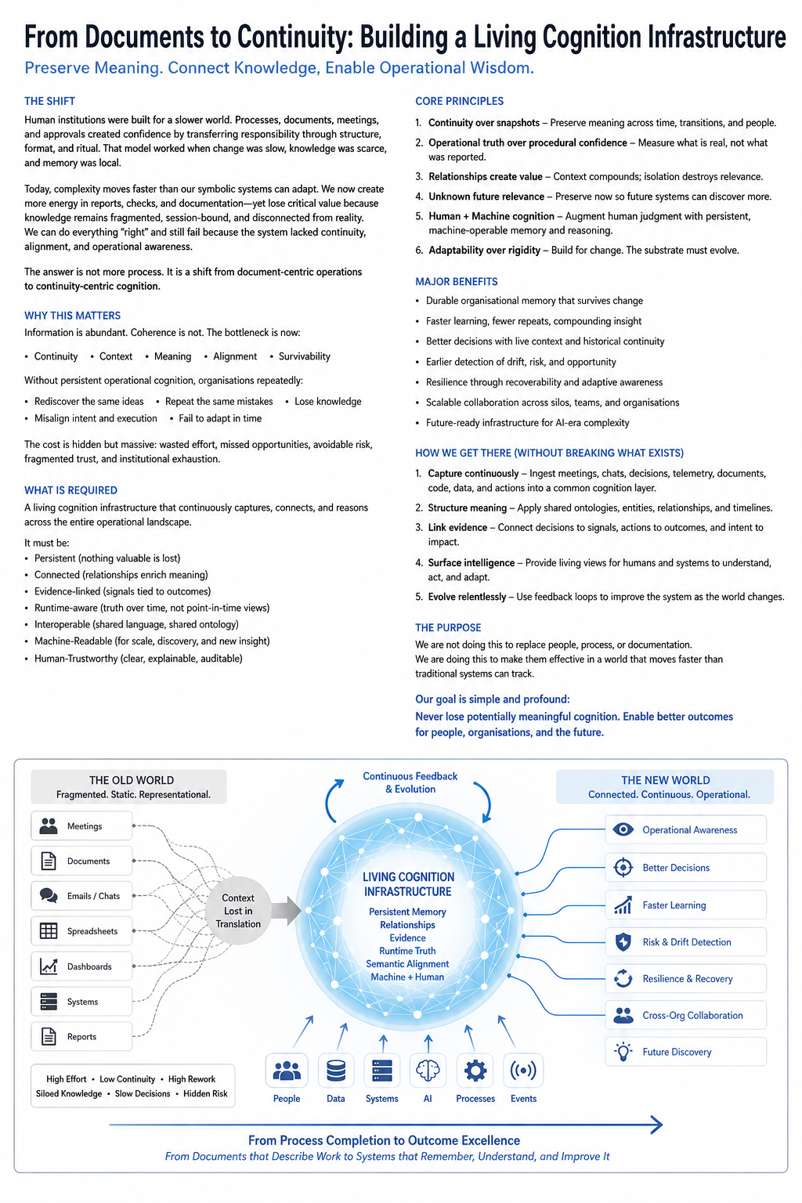
Source reference image

