Slide 1
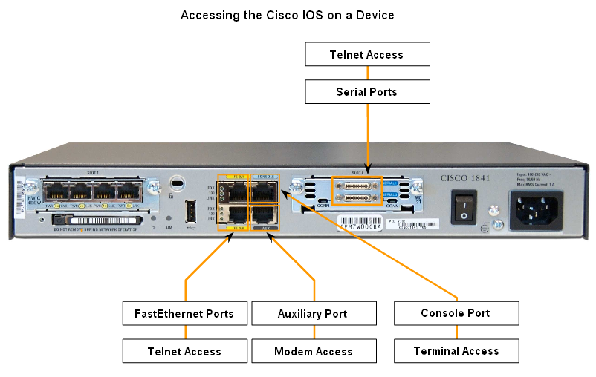
IOS for Cisco Device

Slide 2
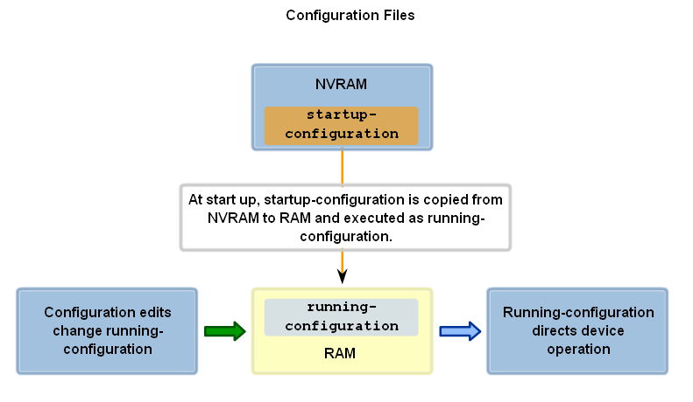
Confiuration Files

Slide 3
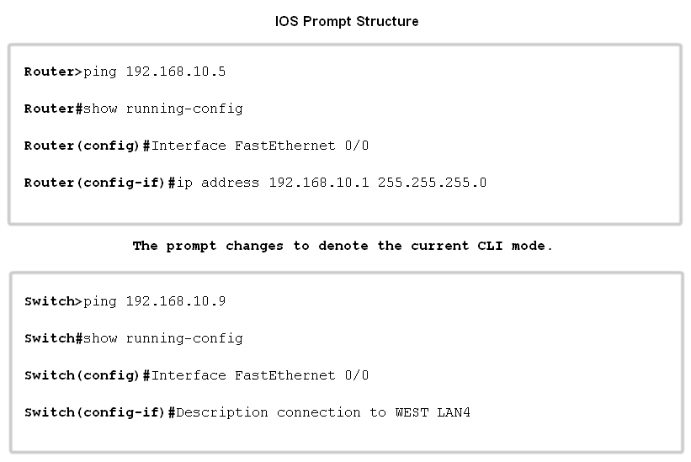
IOS Prompt Structure

Slide 4
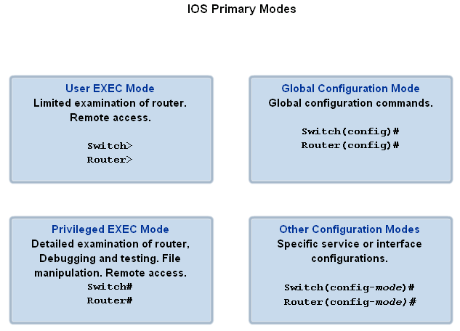
IOS Modes

Slide 5
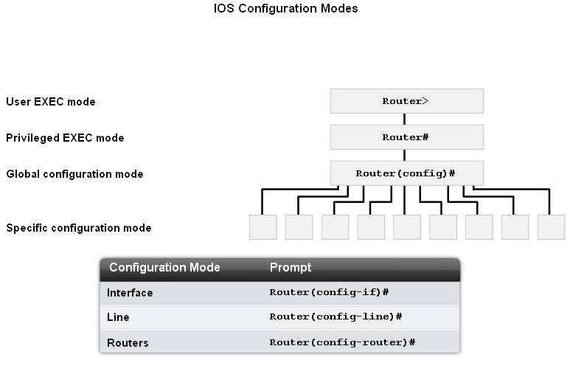
IOS Modes Structure

Slide 6
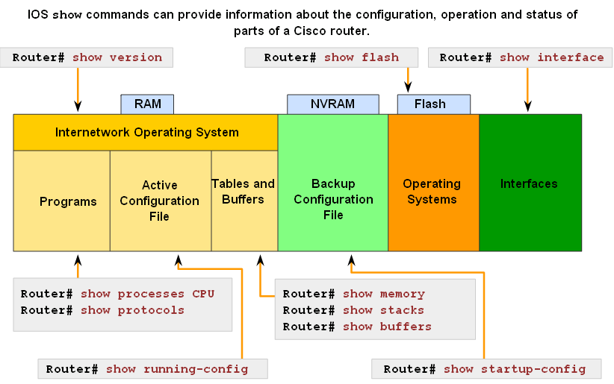
IOS Modes Structure

Slide 7
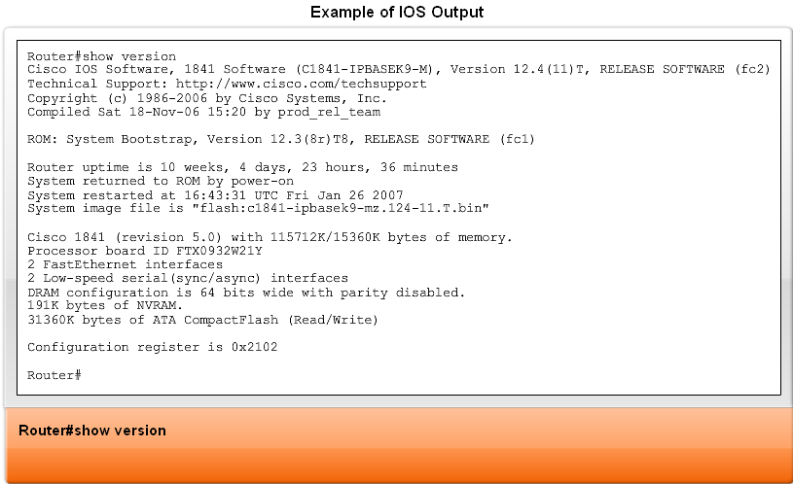
ISO Output

Slide 8
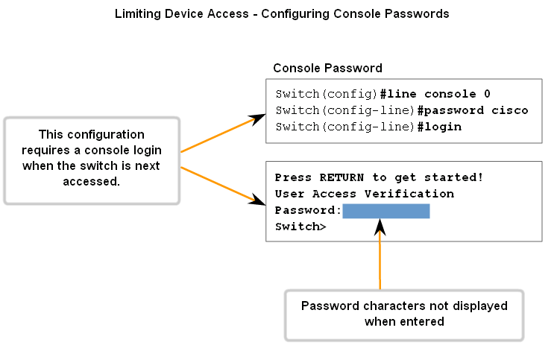
Configure Passwords

Slide 9
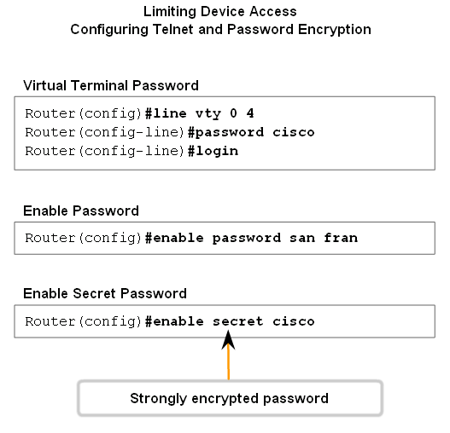
Configure Passwords

Slide 10
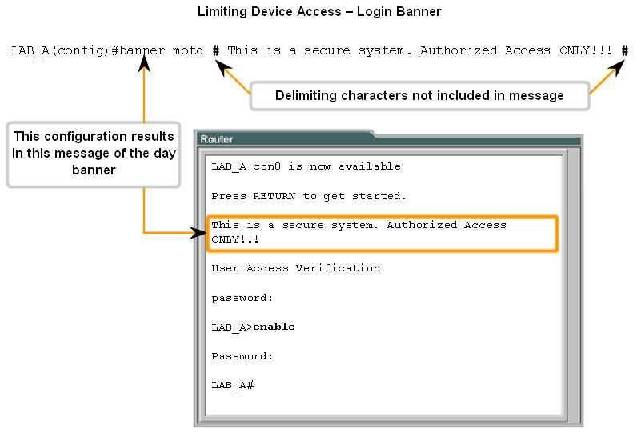
Login Banner

Slide 11
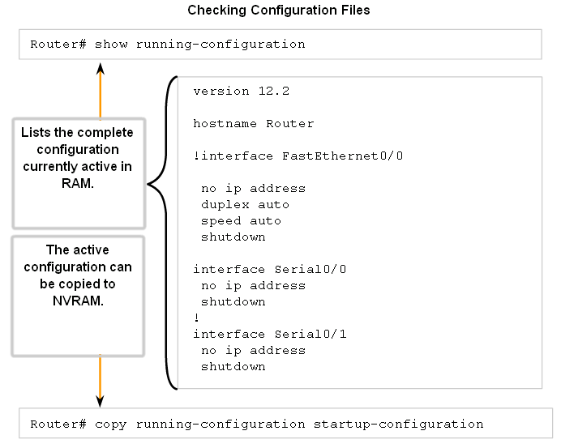
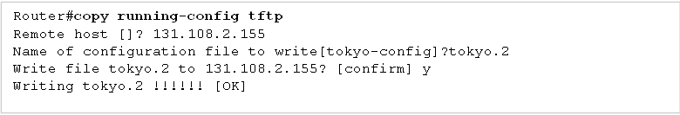

Slide 12
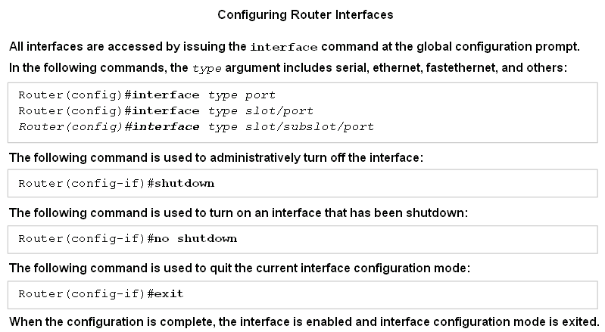
Configure Router Interfaces

Slide 13
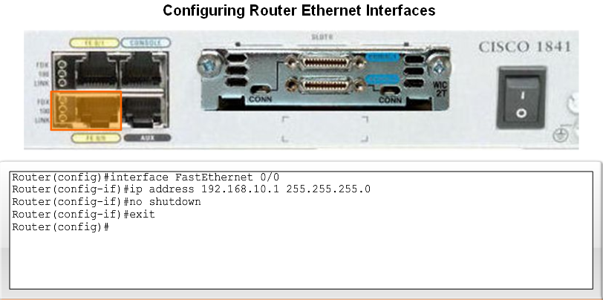
Configure Router Interfaces

Slide 14
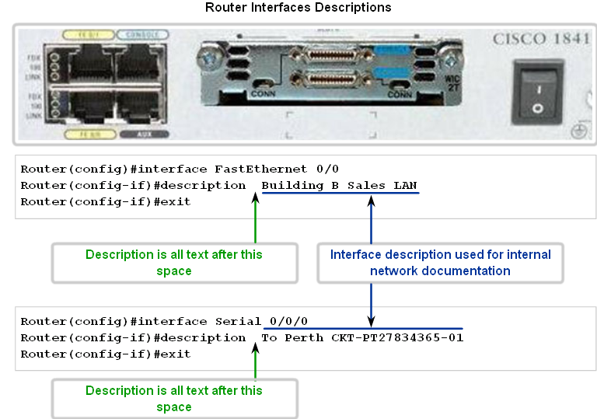
Configure Router Interfaces

Slide 15
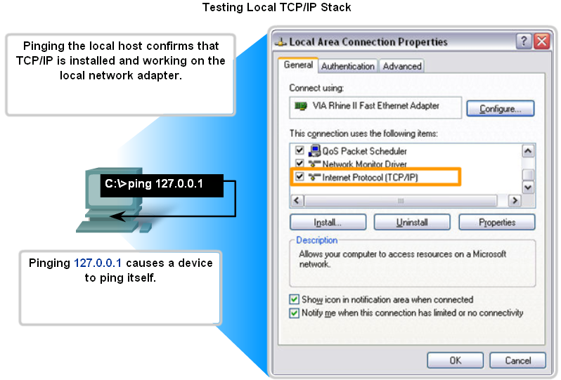
Test Local TCP/IP Stack

Slide 16
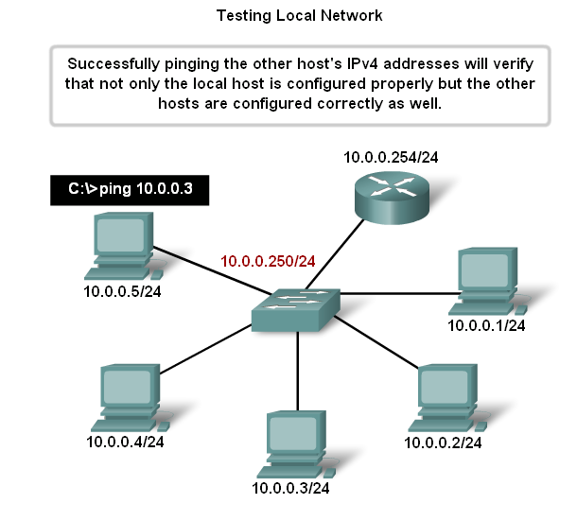
Test Local Network

Slide 17

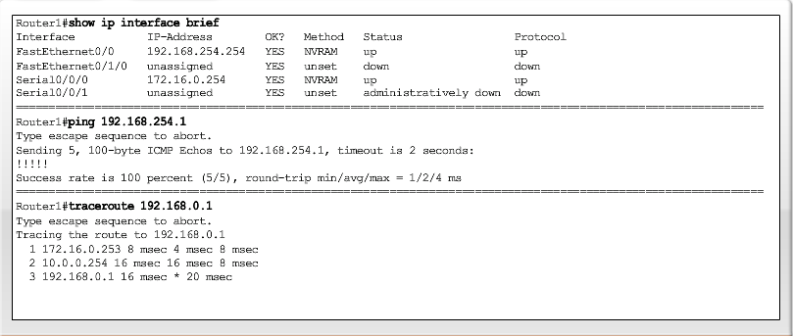
Test Interface

Slide 18
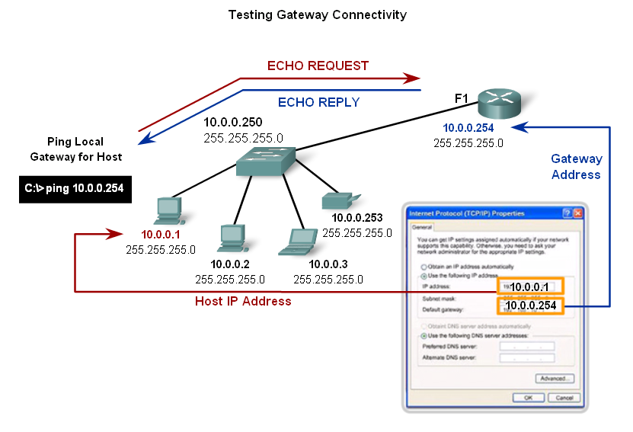
Testing Gateway Connectivity

Slide 19
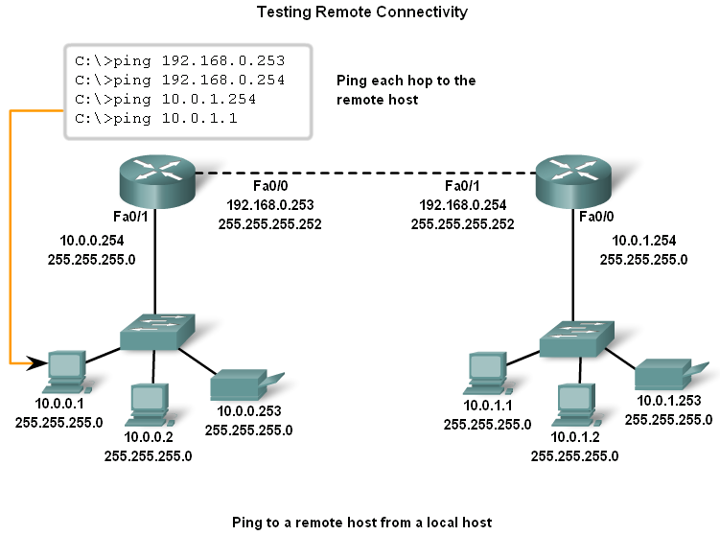
Test Remote Connectivity

Slide 20
Lab: Basic ISO Configure

