Slide 1
Machine Learning
Tech Club

Slide 2
What is it?
Machine Learning (ML) algorithms have the ability to learn patterns from input data, and make predictions without explicitly programmed to do so.
The same ML algorithm can be used for very different use cases.
For instance, you can use “Neural Networks” to predict the possibility of cancer, or use it to see whether an image is a hot dog or not.
The algorithms were built using statistics and probability theories.

Slide 3
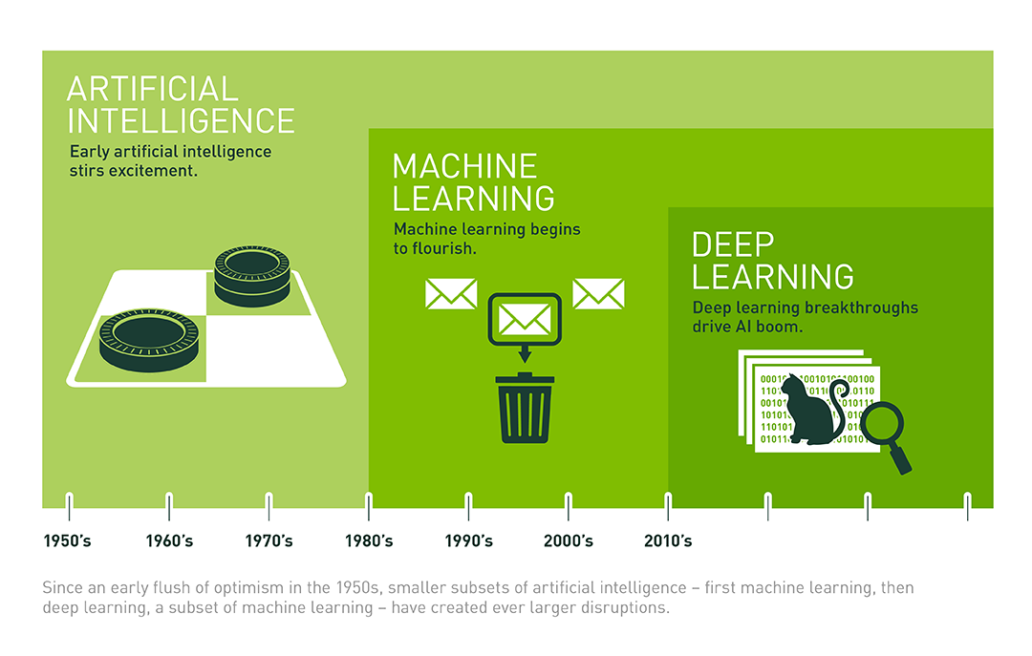
Buzzwords

Slide 4
Buzzwords
Artificial Intelligence: Algorithm + Heuristics
Machine Learning: Algorithm + Heuristics + Statistics
Deep Learning: Algorithm + Heuristics + Statistics + Data-Driven
Data Analysis: Plotting Data + Tabulation + Writing Reports
Data Science: Data Analysis + ML
Big Data: Data Analysis at a large scale

Slide 5
ML in the news
Google Duplex, Lens
OpenAI’s 5v5 Dota Bot
Portrait mode on mobile phones
Prisma and FaceApp
AMD Ryzen 7 (Hardware level AI)
Netflix Recommender System
…and tons more.

Slide 6
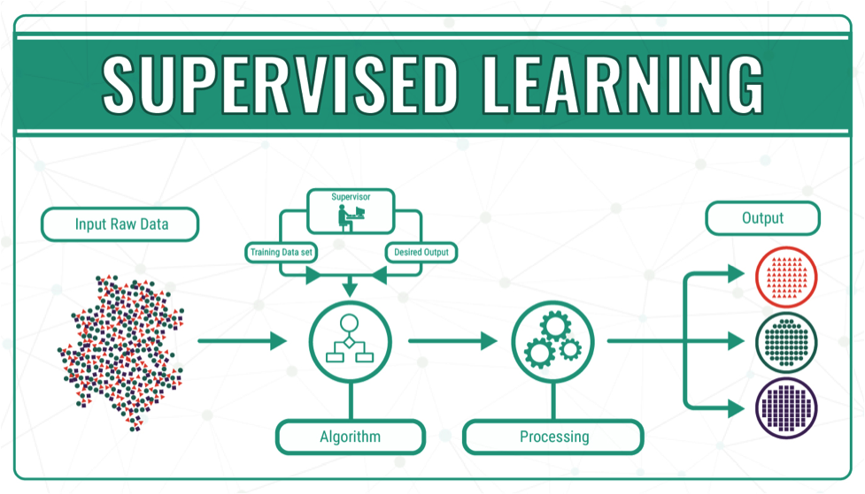
Types - Supervised Learning
Use Cases:
Classification
Regression
Segmentation
Localisation
Translation

Slide 7
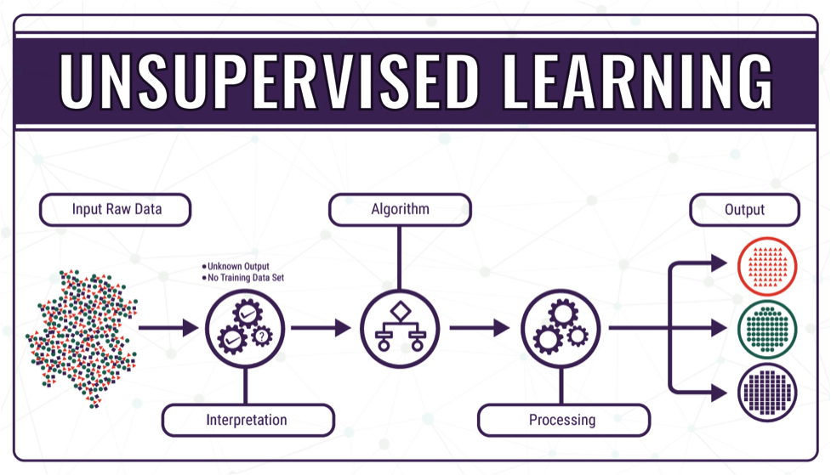
Types - Unsupervised Learning
Use Cases:
Dimensionality Reduction
Pattern Finding
Clustering

Slide 8
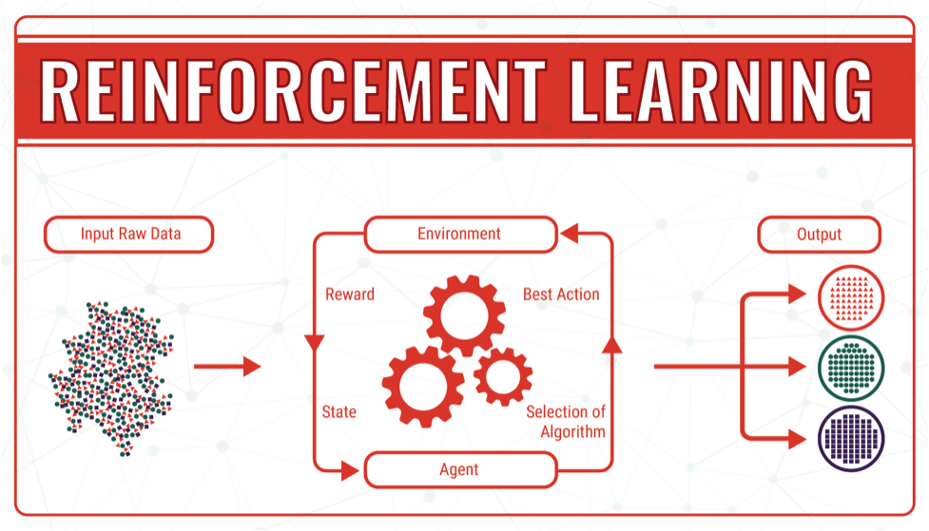
Types - Reinforcement Learning
Use Cases:
Advanced maze solving
Robot movements
Playing games

Slide 9
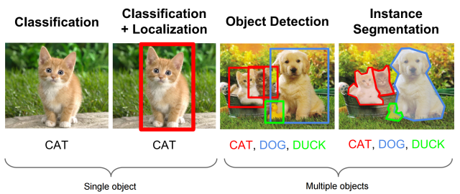
Examples

Slide 10
How2ML
A lot of these algorithms are available in libraries, especially in Python. Python is the most widely supported language (and preferred) for Machine Learning.
As developers, we are interested in using ML for some application. So as much as possible, do not reinvent the wheel. Use the algorithms available in the libraries.
With that being said, it is also important to know the theory and working of the algorithms. Blindly using the algorithms may not give you the best results.

Slide 11
How2ML
The best way to get started is to checkout any popular ML course. You can also gauge your interest level based on the content. The next few slides will list out some popular courses.
Once you are done with the course, implement your algorithm on a toy dataset (Like MNIST or Titanic). If that worked out well, try using it for some unique application.
Courses may not teach you all the useful algorithms. With that in mind, the next few slides will list out some popular algorithms and libraries as well so that you don’t miss out.

Slide 12
Popular ML algorithms
Linear Regression/Classification
k-Means Clustering
Random Forest Regression/Classification
Support Vector Machines
XGBoost and LightGBM (Advanced algorithms)
Neural Networks or Multi Layered Perceptrons (MLP)
Convolutional Neural Networks (CNN)
Recurrent Neural Networks (RNN/LSTM/GRU)
Object Detection and Localisation (Faster RCNN / SSD / YOLO)

Slide 13
Popular Python Frameworks (Libraries)
Data Manipulation
Numpy (For matrices)
Pandas (For tables)
Image Manipulation
OpenCV
Scikit-Image
Plotting data
Matplotlib
Seaborn

Slide 14
Popular Python Frameworks (Libraries)
Machine Learning
Scikit-Learn
Deep Learning
TensorFlow
PyTorch
Keras
Caffe, Theano, Mxnet
Misc
Nltk (For NLP)
os, glob, collections, time, re, argparse, json etc. (Inbuilt libraries)

Slide 15
Popular Courses
Machine Learning - Coursera
https://www.deeplearning.ai/ - Coursera
https://www.fast.ai
CS 231N - Stanford
Udemy Courses - (A-Z, Lazy Programmer etc.)
Read tech blogs on Medium/OReilly or other sources
Note: It’s okay to do free courses without a certificate. The projects you make with the skills you’ve learnt will speak louder than a piece of paper.

Slide 16
Keras or TensorFlow?
Keras is a higher level API that can run on top of other Deep Learning frameworks, including TensorFlow.
Coding in Keras is much much simpler. Popular deep learning algorithms can be implemented with nearly no effort at all.
It is excellent for beginners, and to try out prototypes.
The simplicity of Keras comes at the cost of flexibility. It is hard to experiment with custom algorithms. Hence, it is not recommended for hardcore research or deployment.

Slide 17
Keras or TensorFlow?
Coding in TensorFlow is moderately difficult to start with.
It’s difficult because it uses “symbolic programming” and stuff like sessions, scopes and graphs.
A 100 line code using TensorFlow may only be 20 lines using Keras.
But TensorFlow is widely used for research owing to its great flexibility.
It also has support over different platforms and edge devices (Phones, Raspberry Pi’s etc.)

Slide 18
What to do after the courses?
Try playing with “toy datasets” such as MNIST, Titanic, Iris etc.
Once you’re confident with implementing basic algorithms, try doing a hobby project. It can be as simple as classifying oranges from apples.
Read research papers in ML if it interests you. You can work on more complex problems with professors. If you are confident enough, you can try tackling them yourself too.
Curate a github profile with all your projects.
Attend hackathons and online contests.

Slide 19
Work environment
Usually, software updates are rolled out on Linux systems first, as they are very flexible.
Hence, it is recommended but not mandatory to use Ubuntu for ML purposes.
Deep Learning models are pretty compute intensive, so we often run them on GPUs. If your system does not have a GPU, you can try Google Colaboratory or Kaggle’s kernels. They allow you to use their GPU for 12hrs, free of cost.

