Slide 1
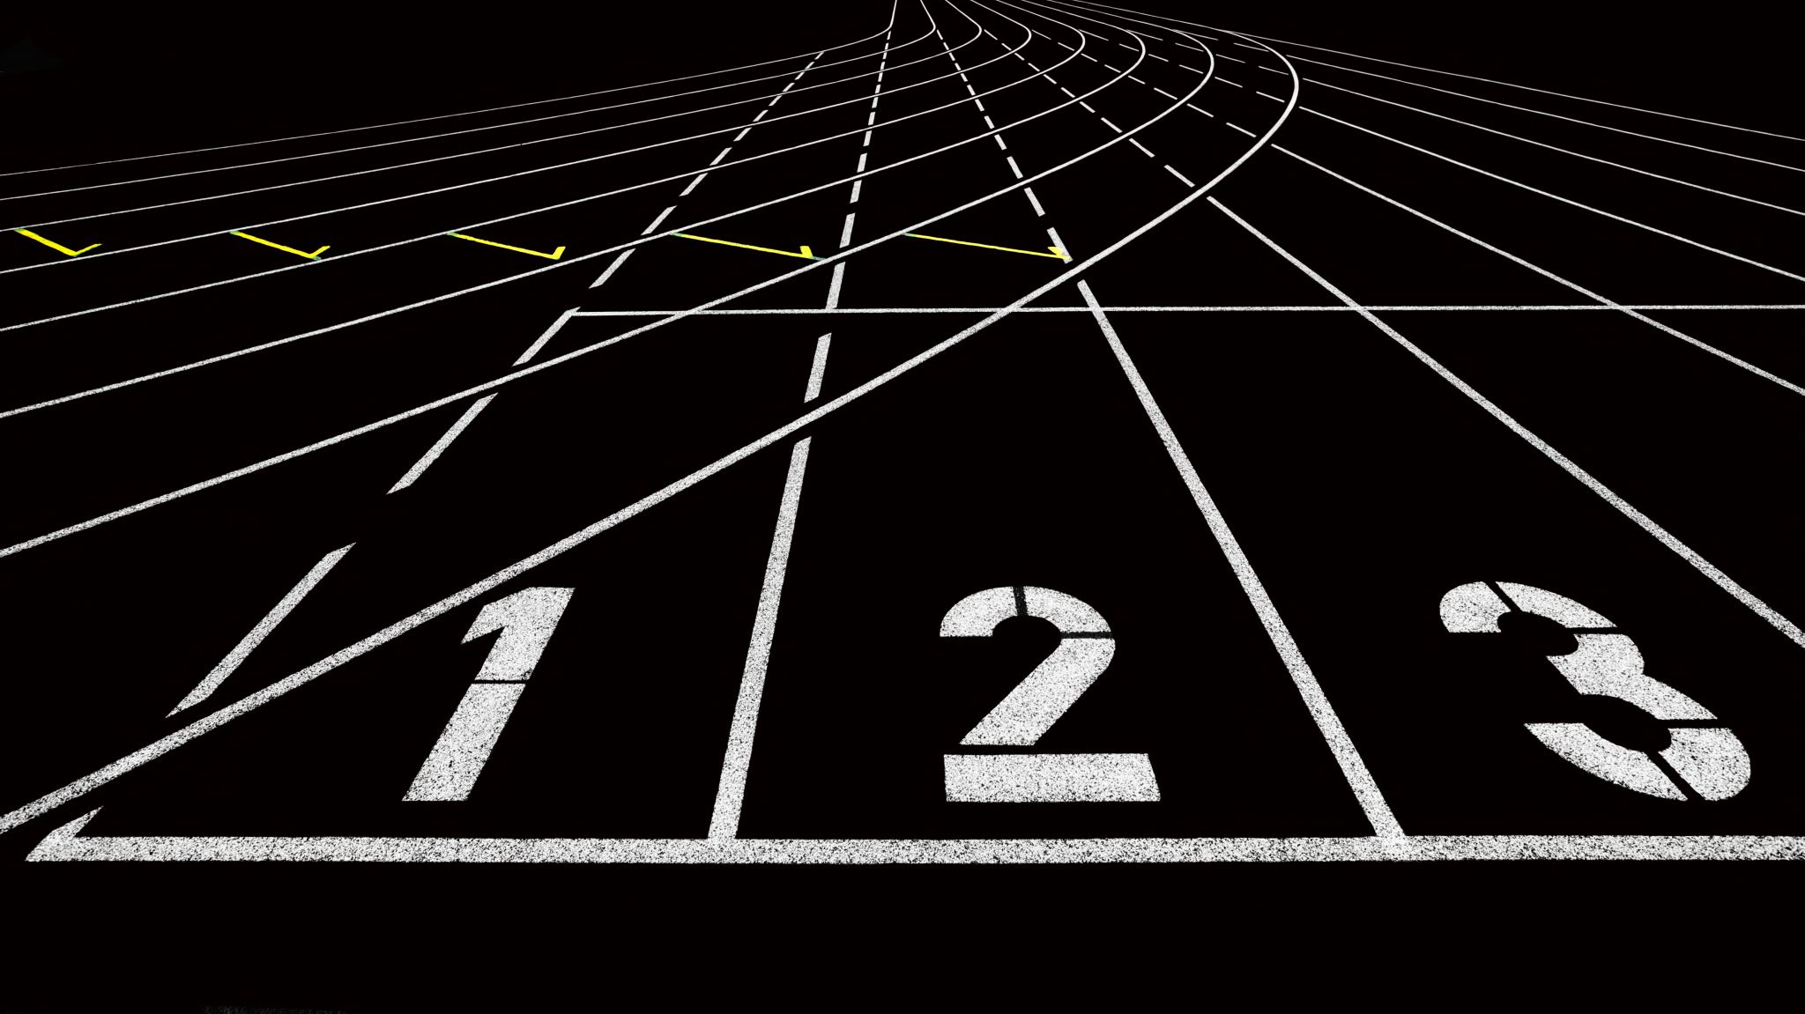
AI-driven Traffic Management Sprint 3 presentation

Slide 2

Agile methods in practice
Subtitle: Applying Agile in AI-driven Traffic Management
Presented by: Staryu

Slide 3

Introduction to Agile
What is Agile?
Agile is an iterative approach to software development
Emphasizes collaboration, flexibility, and continuous improvement
Allows for adapting to changes throughout the development process
Why we used Agile?
Agile focuses on delivering value in small, usable increments
Promotes close collaboration with stakeholders

Slide 4
Agile Framework - Scrum
Scrum Framework in Agile
Roles: Product Owner, Scrum Master, Development Team
Meetings:
Sprint Planning: Deciding what to achieve during the sprint
Regular Stand-ups: Quick regular team syncs
Sprint Review: Demonstrate the work completed
Sprint Retrospective: Reflect on what went well and what could be improved

Slide 5

Our Agile Process in Practice
How we adopted Agile in our project
Sprint-based development
Regular check-ins to adjust to challenges
Iterative improvements based on sprint retrospectives
Sprints: We used sprints to break down the project into manageable chunks
Sprint 1: Focused on building the initial traffic simulation
Sprint 2: Worked on improving UI, graphics, and began planning for optimization

Slide 6
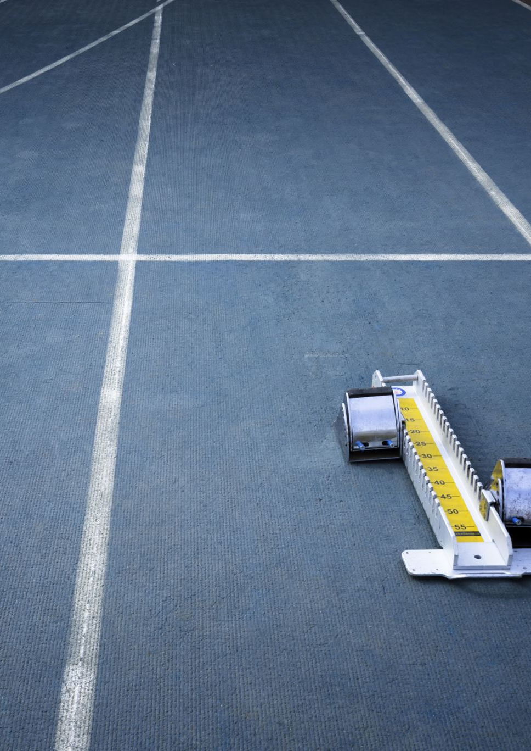
Sprint 1 Recap
Sprint 1 Focus
Developed a basic traffic simulation at one intersection
Used Java and Swing for the frontend and backend integration
Discussed changing to a Java-only solution for simplicity after initial Python setup
Sprint Retrospective Highlights
Improved team communication
Identified the need for more frequent client meetings
Set up regular sprint retrospectives to monitor progress

Slide 7
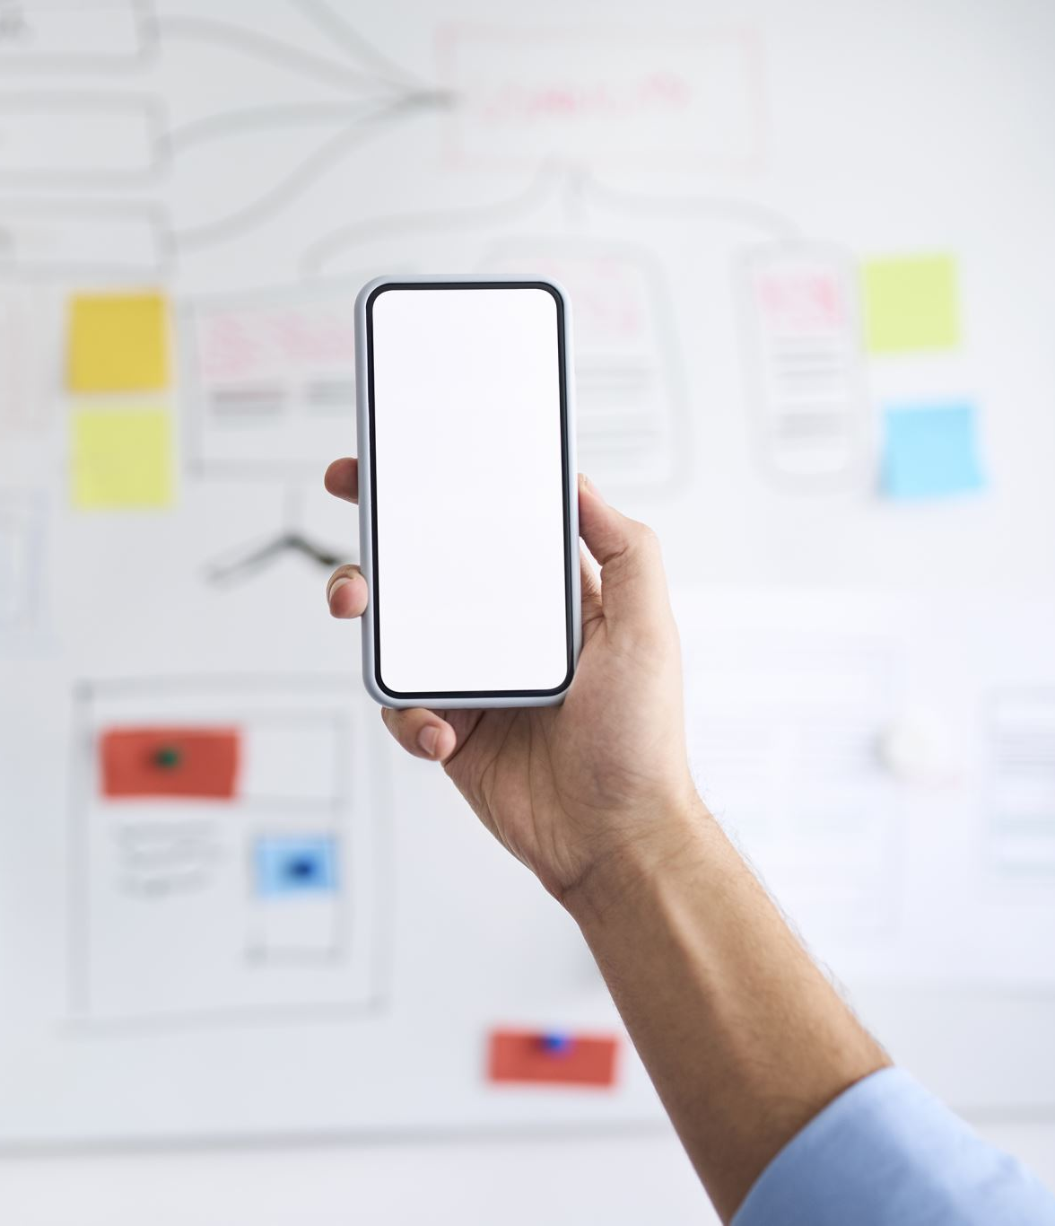
Sprint 2 Recap
Sprint 2 Focus
Major improvements to the user interface and graphics
Made the interface more responsive and adaptable to different screen sizes
Open discussions about issues, improved internal communication
Explored the idea of transitioning to Godot for better performance
Sprint Retrospective Highlights
Identified the need for client feedback to avoid major last-minute changes
Planned for optimization in Sprint

Slide 8
Challenges We Faced
Communication Challenges
Early sprints had difficulties with regular communication
Solution: Improved with more frequent team meetings and open discussions about blockers

Slide 9
Client Involvement
Need for Regular Feedback
Early on, we identified the lack of frequent client feedback as an issue
Regular client input helps ensure alignment with expectations and reduces rework
Action Taken
Scheduling more regular client meetings
Ensuring timely updates to the client when something takes longer than expected

Slide 10

Benefits of Agile for Our Team
Frequent Iteration
Allowed for continuous improvements and feedback-driven changes
Broke down the project into manageable tasks that were adjusted as needed
Transparency and Accountability
Regular stand-ups and sprint reviews kept the team aligned
Retrospectives highlighted areas for improvement, which encouraged accountability

Slide 11

Sprint 3 Focus
Nic- Research and implement CI/CD. Focus on Build and Test stages.
Nicole- Create a class that opens a window for user input.
Brad-Clean up the project and work on grouping traffic lights for easier management.
William- Focus on optimizing the overall performance of the simulation.
Magdalena- Prepare a PowerPoint and Report on Agile

Slide 12
Conclusion
Agile Success
Agile has helped us manage and adapt to changes quickly
Our iterative approach allowed us to improve steadily while staying aligned with our goals

