Slide 1
WASSAN | Internship Project Presentation
IntelliFarm Dashboard
AI-Powered Agricultural Data Analytics Platform
Upload · Clean · Analyse · Visualise · Generate Insights
Internship Organization :
Watershed Support Services and Activities Network (WASSAN)
Reporting Authority :
M Vijay, Program Associate
Presented by :
Himagiri | B.Tech Computer Science
Internship Duration :
2 Months | Assignment-Based
Date :
August 2026

Slide 2
Agenda
What this presentation covers
01
Context & Problem Statement
02
Our Approach & Solution
Why WASSAN needed a smarter data tool for field data
The 3-Phase architecture: Upload → Clean → Dashboard
03
System Architecture
04
Key Features & Capabilities
How the platform is built and what technologies power it
Six core modules built during the internship
05
Live Results & Outputs
06
Conclusion & Next Steps
What the platform produces from real agricultural data
Impact, learnings, and scope for future development
This platform was built as part of the WASSAN internship to help program teams analyse watershed and agricultural field data without needing SQL or data science expertise.

Slide 3
Context & Problem Statement
Challenges in analysing WASSAN field data
Challenges Observed at WASSAN
IntelliFarm's Answer
1
Field data collected across districts arrives as large Excel/CSV files with inconsistencies
✓
One-click CSV / Excel upload with automatic schema detection
2
Program staff manually clean and analyse data in Excel — time-consuming & error-prone
✓
Auto-clean engine: fill nulls, remove duplicates, fix type errors
3
No single tool that can clean raw data AND generate visual summaries for reporting
✓
Natural-language AI query: ask questions, get charts instantly
4
BI tools like Power BI require SQL or data expertise unavailable at field level
✓
No SQL, no coding — designed for domain experts and field staff
5
Researchers cannot query data in plain language without coding knowledge
✓
Runs 100% locally — field data stays private on WASSAN machines
6
Insights are delayed — by the time charts are ready, field cycles have moved on
✓
Insights available in seconds, not hours

Slide 4
System Architecture & Data Flow
How raw field data becomes actionable visual intelligence
PHASE 1
Upload
PHASE 2
Clean & Validate
PHASE 3
Dashboard Studio
CSV / Excel
File Upload
& Validation
Auto-detect
Errors + Fix
Live Editor
AI Query
SQL Engine
Chart Render
Polars Parser
Schema Detect
Health Report
Null Filler
Dedup Engine
Type Caster
Ollama LLM
DuckDB SQL
Plotly Charts
Outputs Delivered
Interactive Charts
Accurate Data Tables
AI Insight Summary
Clean CSV Download
Bar, Pie, Histogram, Scatter, Map
100% queried from uploaded file
Plain-English explanation of results
Processed dataset for reporting
Tech Stack: Python | Streamlit | Polars | DuckDB | Plotly | Ollama | qwen2.5-coder:7b (Local LLM) | Difflib (SQL Auto-Corrector)

Slide 5
Key Features Built During Internship
Six capabilities developed over the 2-month engagement
Smart Upload Engine
Auto-Clean Module
AI Natural Language Query
• CSV & Excel support (up to 100 MB)
• Auto-fill missing values with zero
• Type a question — get a chart instantly
• Polars-powered fast parsing
• Remove duplicate rows automatically
• Powered by local Ollama LLM (offline)
• Instant health report on data quality
• Cast text columns to numeric
• 5 AI-generated dataset-specific suggestions
• Type mismatch & duplicate detection
• Live editable data grid for manual fixes
• No SQL or data science knowledge needed
Dynamic Dashboard Studio
Data Accuracy Layer
Privacy & Export
• Bar, Pie, Histogram, Map visualisations
• DuckDB in-memory SQL execution
• Download cleaned dataset as CSV
• Plotly interactive chart rendering
• Fuzzy column-name auto-correction
• Runs entirely on local machine
• Auto-correcting SQL engine (fuzzy fix)
• Fallback data table if chart fails
• No data uploaded to any cloud
• KPI metric cards for scalar answers
• 100% data read from uploaded file
• No external API calls for data

Slide 6
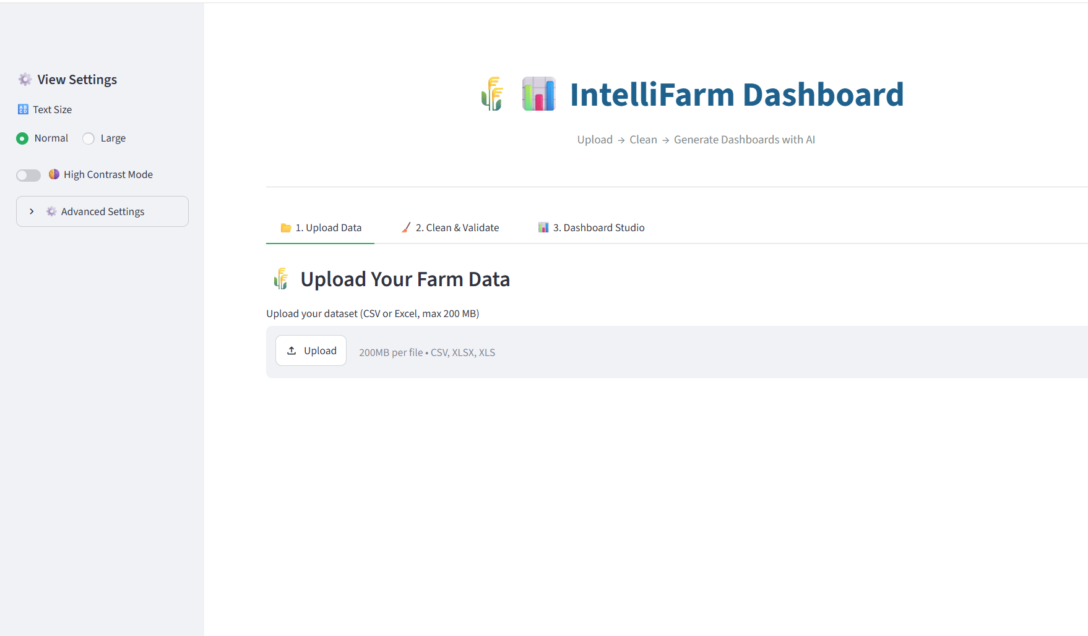
Phase 1: Upload & Health Check

Slide 7
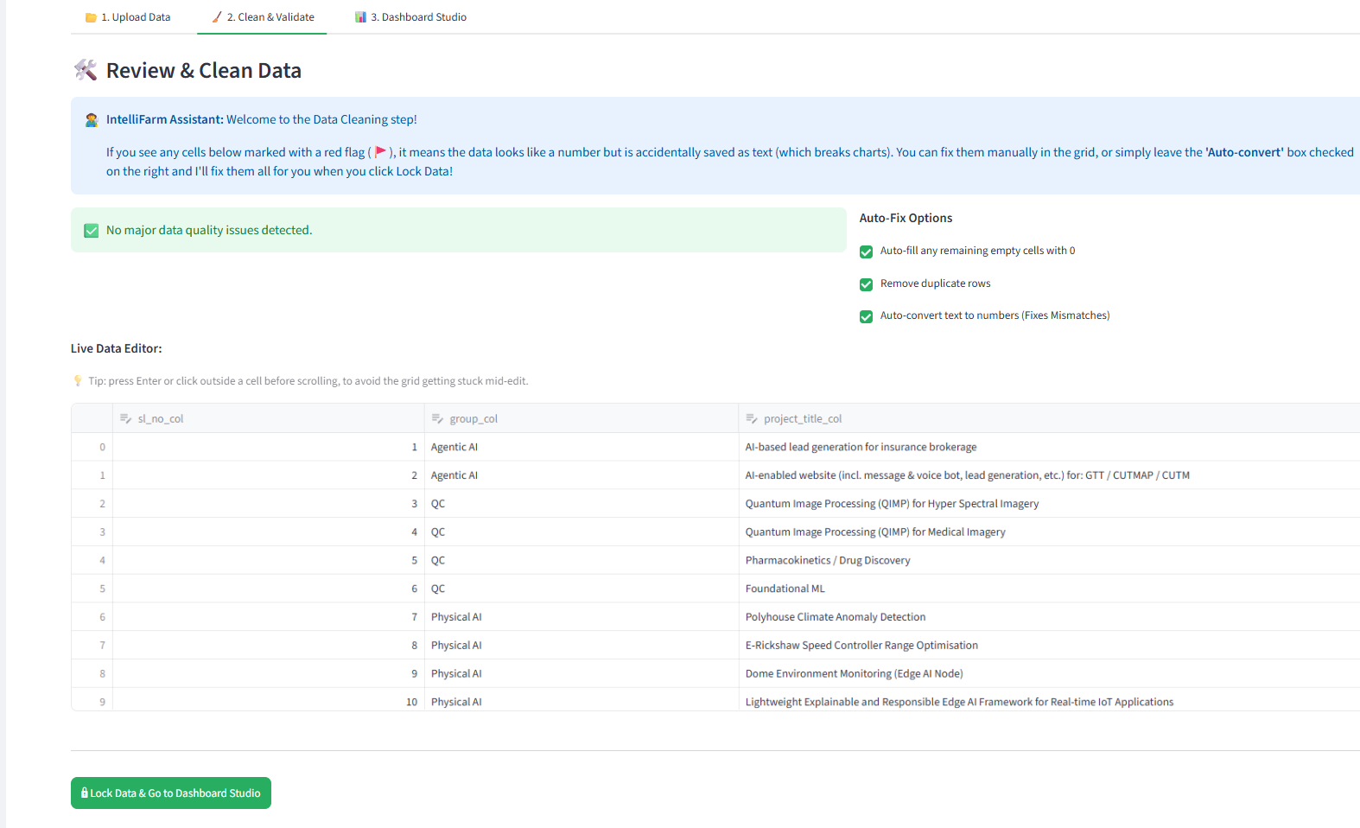
Phase 2: Clean & Validate

Slide 8
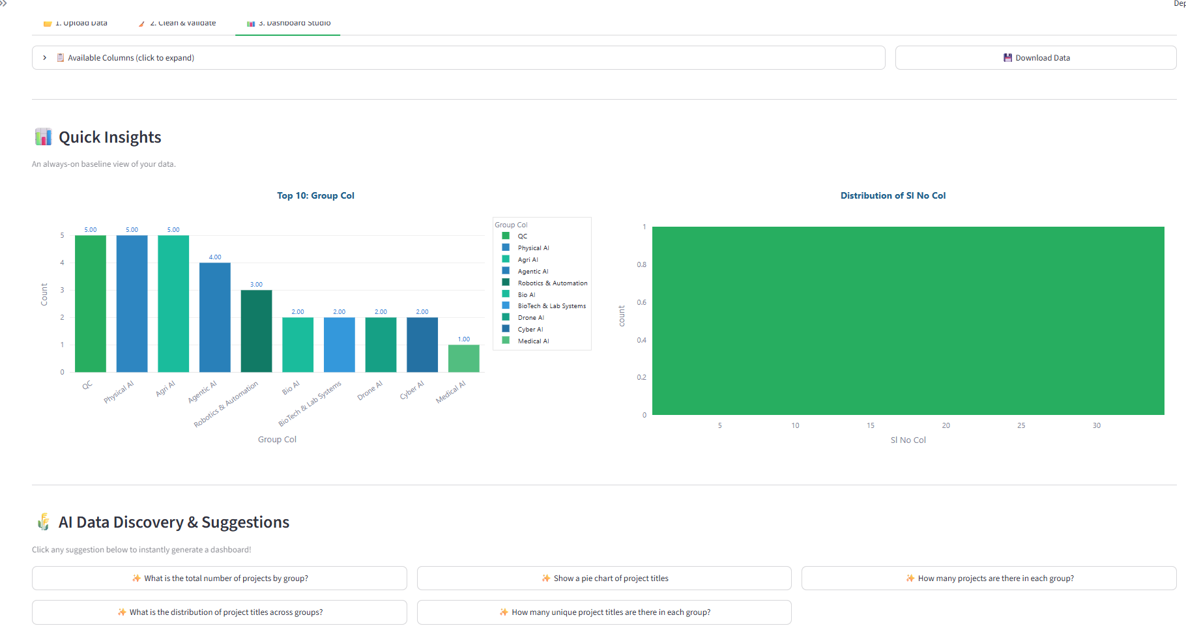
Phase 3: AI Dashboard Suggestions

Slide 9
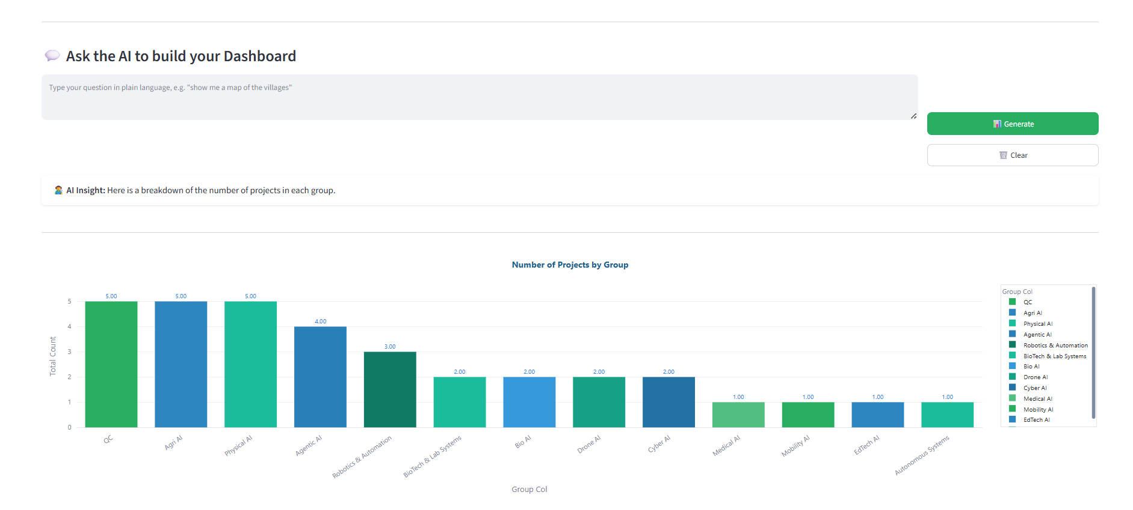
Phase 3: AI Dashboard Generations

Slide 10
Conclusion & Impact
What was delivered and what comes next
What Was Delivered
Future Development Scope
1
End-to-end field data pipeline — upload to insight in one app
->
Multi-file join: analyse across multiple district datasets at once
2
Natural-language AI dashboard requiring zero technical knowledge
->
Voice querying via speech-to-text for field staff without keyboards
3
Auto-data-cleaning engine tested on WASSAN watershed datasets
->
AGMARKNET API integration for live crop price benchmarking
4
Robust fallback: always shows data results even when chart fails
->
GIS layer overlay: map watershed boundaries on field data
5
SQL auto-corrector: fixes AI-generated column name mismatches
->
Role-based login for Program Officers, Associates & Field Staff
6
Professional UI with farm-themed animated loaders & scroll UX
->
Mobile-responsive PWA for tablet use during field visits
"Enabling WASSAN field teams and program associates to transform raw
agricultural data into actionable insights — without writing a single line of code."
Thank You | Himagiri | WASSAN Internship 2026

