Slide 1


Project Phase-1 Synopsis Presentation
Dual Mode Sign Language Communication Module
Team Members:
Adithya R - 4SF20CS094
Sampreeti H - 4SF20CS112
Prakhyath K S - 4SF20CS088
Karthik Nagaraj Naik - 4SF20CS050
Under the Guidance of:
Mrs. Shiji Abraham
Assistant Professor
Dept. of CSE, SCEM
Computer Science and Engineering Department

Slide 2
Contents
Introduction
Motivation
Literature Survey
Problem Statement
Objectives
Proposed Methodology
Hardware/Software Requirements
Expected Outcomes
Conclusion
References

Slide 3
Introduction
What is Communication ?
Why is Communication Important ?
Problems faced by Mute and deaf People – Target Users
Focus on One-Sided Communication
Sign to Speech Conversion using Static dataset of specific language
Our Approach - Application based system
Two modules of the system
sign gestures to speech – CNN + LSTM modal
speech to 3-D animated sign gestures
Dataset Used – Self-created dataset & Kaggle
Real World Applications – Bridging the gap

Slide 4
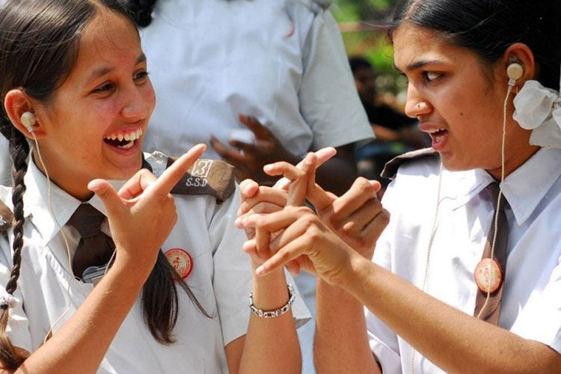
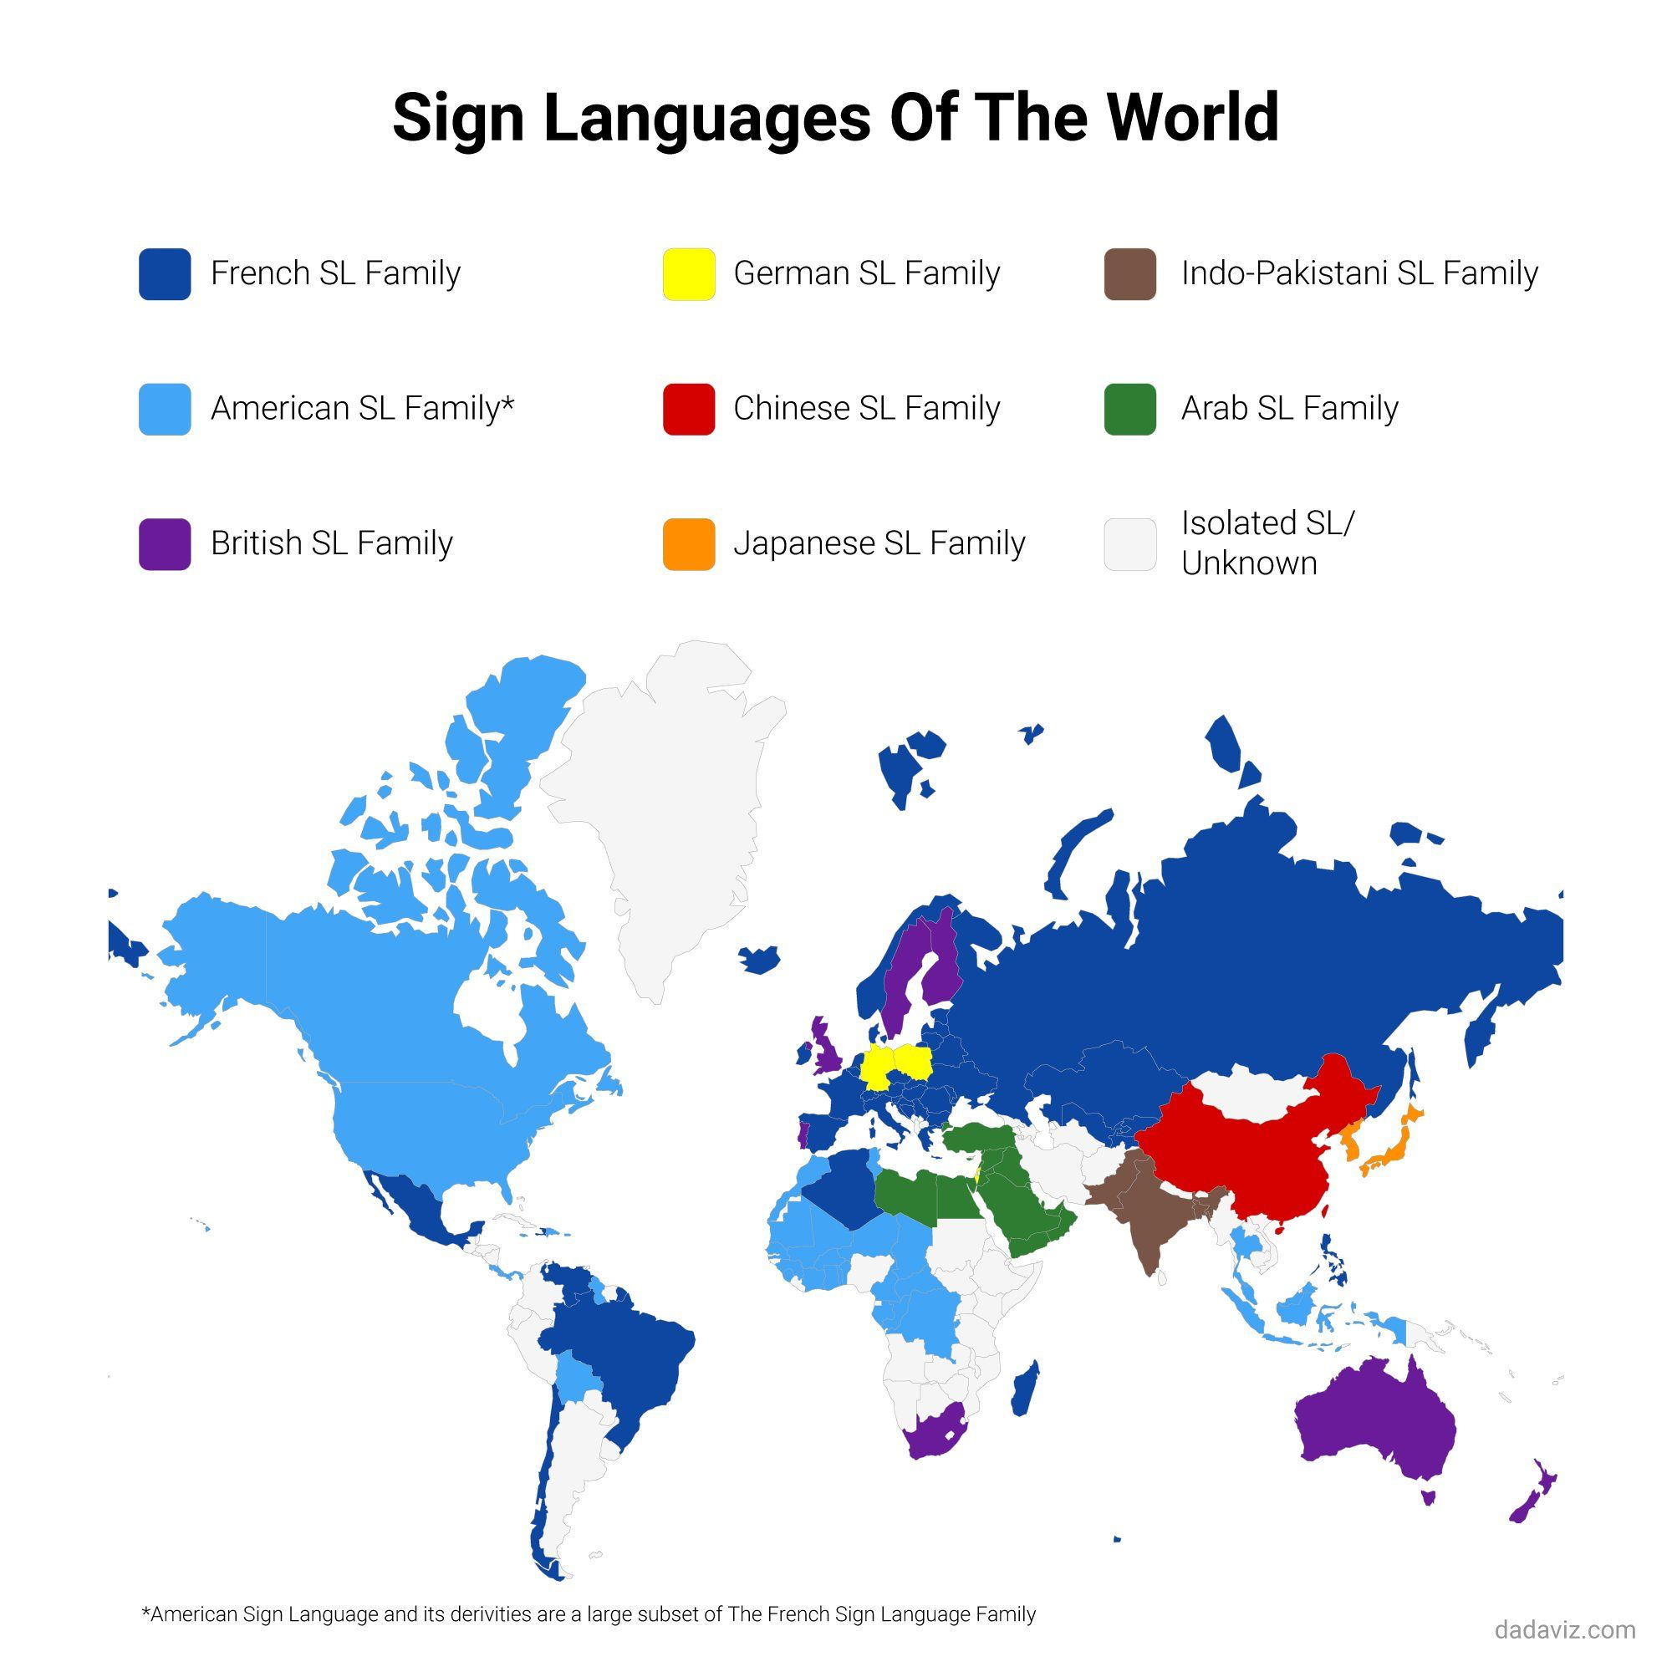
Motivation
5% of world population (430M people) require rehabilitation to address hearing loss – 432M adults and 34M children
By 2050 – over 700M people (1 in 10 people) will have disabling hearing loss
More than 1.5B people worldwide currently affected by hearing loss in atleast 1 ear
Individuals with speaking disabilities – 11,531,913
Half that population is over age 65
Over 500,000 people use American Sign Language
700 High School in US offer ASL as 2nd Language
ASL is 4th most common 2nd Language College Students

Slide 5
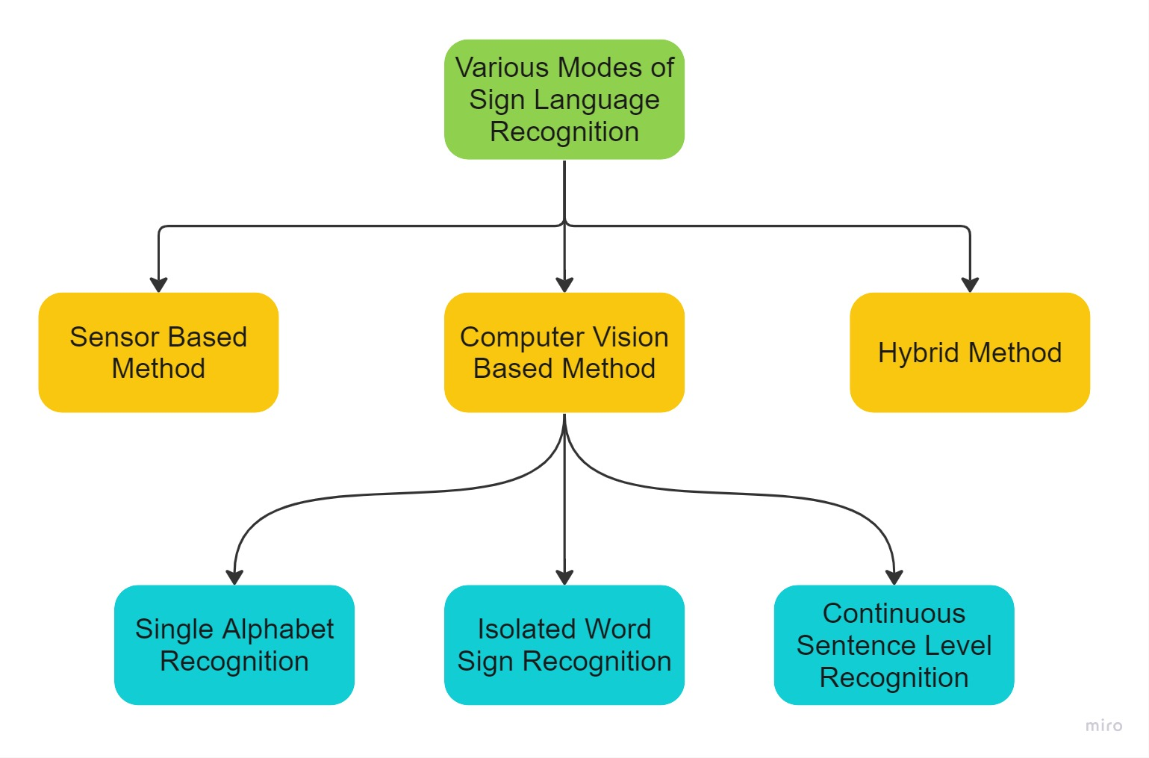
Literature Survey

Slide 6
Literature Survey
Paper Title | Methodology Adopted | Remarks/Conclusions
Dual mode Sign Language Recognizer-An Android Based CNN and LSTM Prediction model [6], May 2023 | Application based system that serves as an interpreter for sign language, enabling 2-way communication Works on 2 modules, sign gesture to speech & speech to 3D animated sign gesture Dataset collected from Deaf & Mute school Sign gesture to speech implemented using CNN+LSTM framework | Bridges the gap between deaf, mute and normal people Achieves an accuracy of 96.04% in continuous real time prediction Marvelous user interface that allows various to navigate through easily
Real Time Sign Language Recognition Framework For Two Way Communication[1], April 2021 | To develop a model converts signs from ASL into English characters using a CNN CNN can be used to extract spatial features from the input video data. LSTM (type of RMM) used to capture temporal dynamics & sequential patterns Features extracted by CNN passed to LSTM for capturing this spatio-temporal info | Able to detect 26 alphabets & 3 additional characters with 99.78% accuracy Propose speech to text models to facilitate seamless 2 way communication

Slide 7
Literature Survey
Paper Title | Methodology Adopted | Remarks/Conclusions
Indian Sign Language Recognition: A Comparative Analysis Using CNN and RNN Models[3], June 2023 | Collected Indian Sign Language dataset Compare and contrast CNN and RNN RNN models used to capture temporal dynamics and sequential patterns of ISL CNN model used to capture spatial aspects of ISL gestures | Both CNN and RNN effective and reliable for recognizing ISL Emphasise need for taking both spatial and temporal information into account when creating precise ISL systems. Proposes an hybrid CNN+RNN architecture for future
Real-Time Sign Language Gesture (Word) Recognition from Video Sequences Using CNN and RNN[4], June 2018 | Used Inception Model (deep CNN) to train model on spatial features of vid seq Used RNN to train model on temporal features CNN model used to make predictions for individual frame to obtain seq of predictions for each video These sequence of features given to RNN to train on temporal features | Used Argentinian Sign Language with 2300 videos belonging to 46 gesture categories Using prediction of CNN as input for RNN 93.3% accuracy achieved Using seq of predictions or pool layer output as input for RNN an accuracy of 95.217% is obtained.

Slide 8
Literature Survey
Paper Title | Methodology Adopted | Remarks/Conclusions
Word Level Hand Gesture Recognition for Deaf and Dumb Using CNN Technique[9], July 2021 | Used vision based method to obtain data from 1080 full HD camera. Capturing only the hands of signer Dataset is built through continuous capturing CNN is used as recognition model | Acquired average accuracy of 90.04% for recognizing ASL alphabet 93.44% accuracy for numbers (from 1 to 10) 97.52% for static word recognition
A Saudi Sign Language Recognition System based on Convolutional Neural Networks[8], August 2020 | Arsl recognition using CNN Uses static dataset of images (mob cam) System recognizes and translates hand gestures into text Used dataset of 40 Arabic signs, each sign having 700 images Various hand sizes,lighting,skin-tone,bg | 1st system meant for saudi people Accuracy of 97.69% for training data & 99.47% for test data Successfully implemented in mobile and desktop application Not all signs in saudi sign dictionary included

Slide 9
Problem Statement
Issues identification with regard to the sign language communication are as follows :-
Communication Barrier – Deaf and Mute often face communication barriers when interacting with people who do not understand sign language.
Lack of Real-Time Translation Tools – Current tools available for sign language to text to speech conversion often lack Real Time capabilities.
Limited Accessibility – Many existing solutions require specific hardware that are not easily accessible to all users.
Lack of Bidirectional Communication – Most existing tools focus on translating sign language to speech or text, but do no offer the reverse.
Need for Customization – Sign language can vary from region to region. There is a need for a solution that can be easily customized to different sign languages.

Slide 10
Objectives
Dataset Collection – Collect the image dataset sufficient for various categories of words.
Supervised Pre Training – Training the model & trying to minimize the cost
Real Time Translation - Try to achieve Real Time sign recognition & translation
3D Modelling – Create various 3D models, suitable for different word categories.
Bidirectional Communication – Achieve a Real Time Two way Communication.
User-Friendly Interface – To create a sophisticated UI which is user friendly
Testing and Validation – Test the model on the Test data to check for performance.
Documentation – Maintain a detailed documentation of all the steps involved.

Slide 11
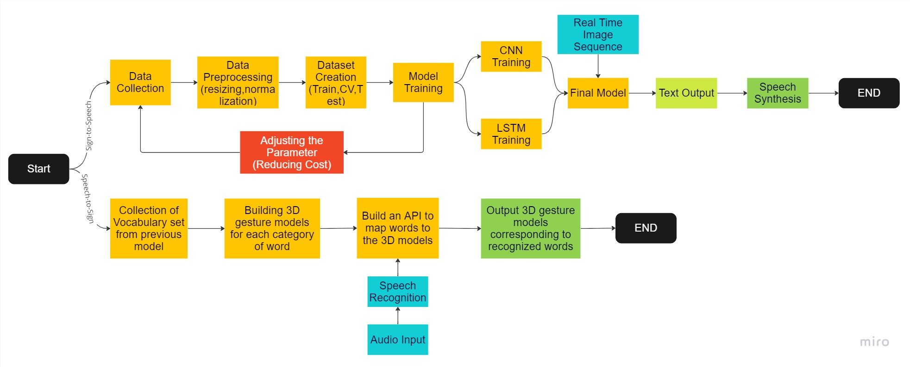
Proposed Methodology
Fig. Block diagram of the proposed model

Slide 12
Proposed Methodology
Data Collection – To collect a large dataset of images/videos of various gestures of ASL.
Data Preprocessing – Preprocess the data to enhance the quality and remove noise. This may involve resizing images, adjusting the lighting, etc...
Model Training – Train a machine learning model using Convolutional Neural Networks (CNN) and Long Short-Term Memory (LSTM) networks on the preprocessed data.
Parameter Tuning – Tune the parameters to resolve underfit or overfit using CV set.
Model Testing – Test the performance of the model using the Test Set
Gesture Interpretation – Use the trained model to interpret sign language gestures in real-time and convert them into corresponding text and speech.
3D Model Generation – Use Blender software to generate 3D models showing the sign language gesture for each word in a sentence based on speech input.
User Interface – Develop a user-friendly interface for the system that allows users to leverage the benefits of the system

Slide 13
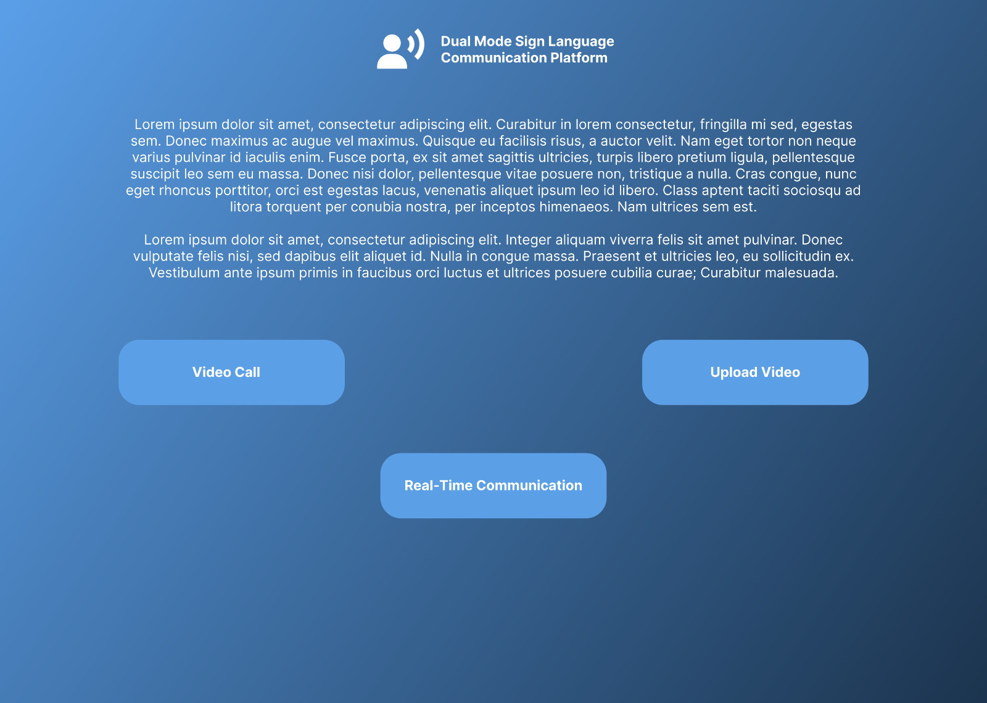
Proposed Software Design

Slide 14
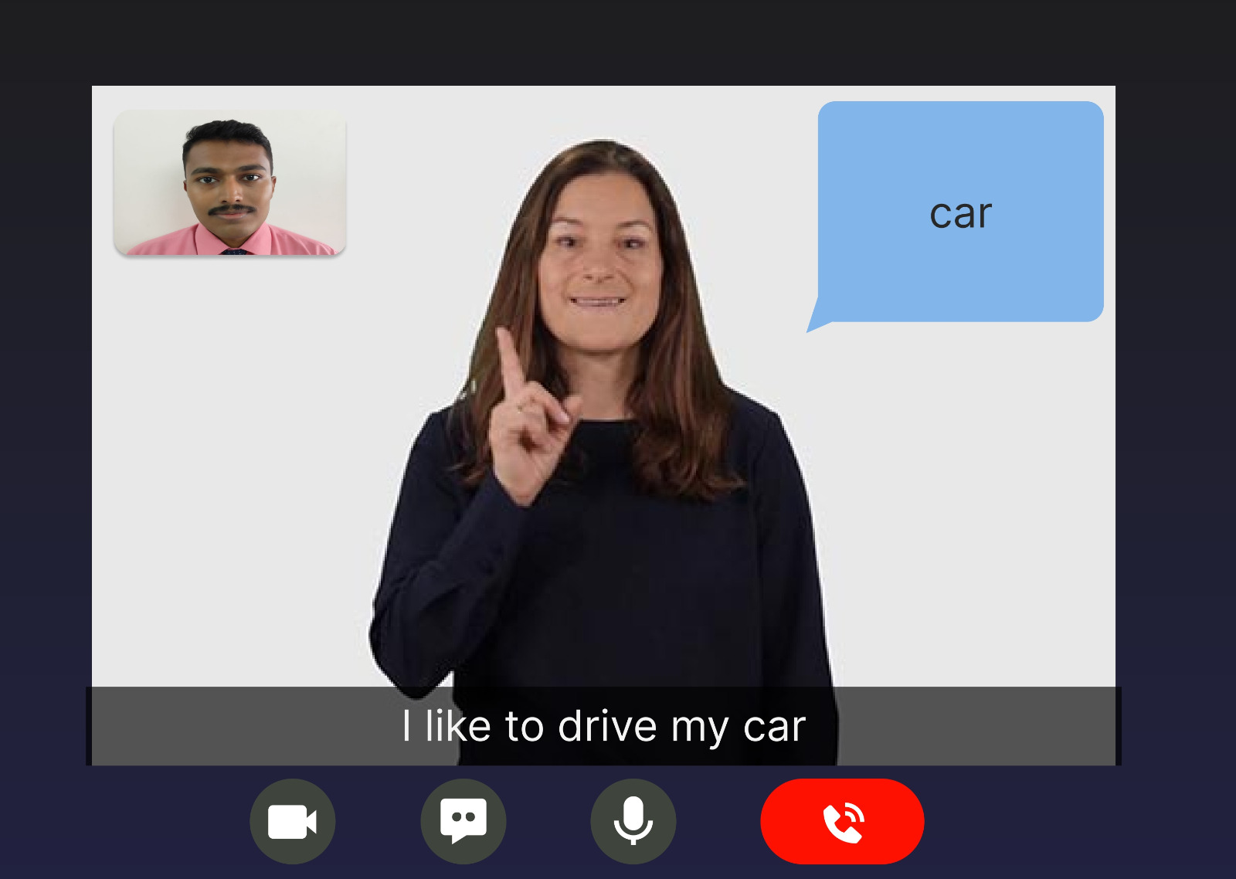
Proposed Software Design

Slide 15
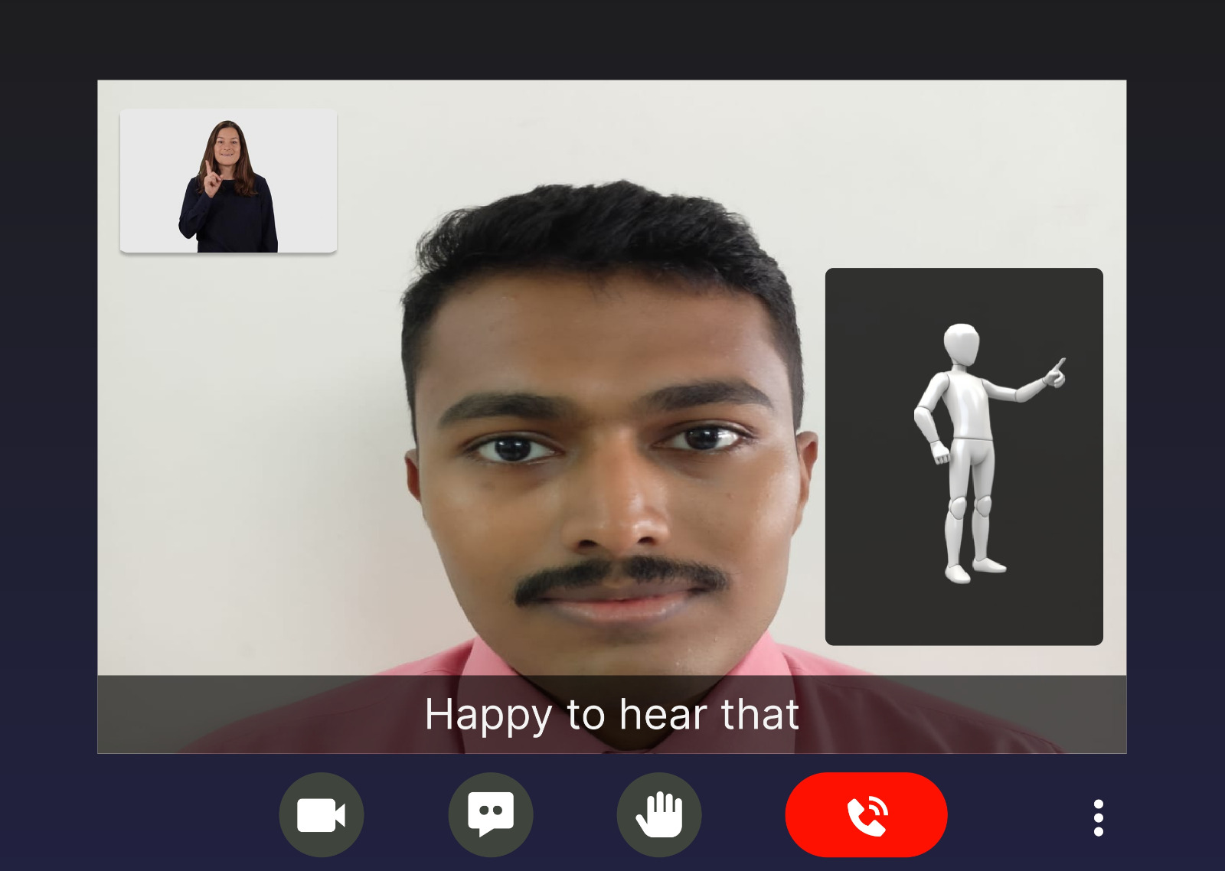
Proposed Software Design

Slide 16
Hardware/Software Requirements
Hardware Requirements:
Processor : Intel i7 or AMD Ryzen 7
GPU : NIVIDIA GeForce RTX 2070
Camera: ESP32/Raspberry pi Camera
Wifi – 25Mbps atleast
Interface computer: Laptop/Desktop
Software Requirements:
Operating System - Windows
Python – Python 3.7 & above
Web Interface – React.js
Web Server – Express.js
Run Time Environment – Node.js
ML Library – Tensorflow (keras)
Image Processing – OpenCv
3D Modelling – Blender Software
IDE – Jupyter Notebook
Database – MongoDB
Version Control System - Git

Slide 17
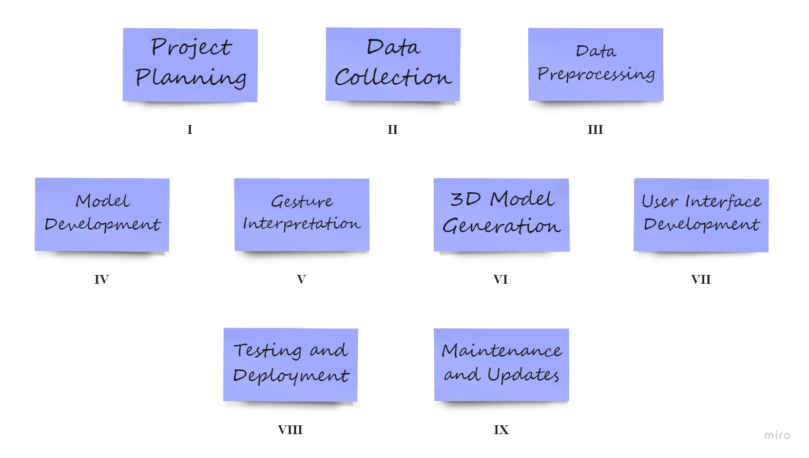
Work Plan – 9 Phases

Slide 18
Work Plan
Phase I :- Project Planning
- Define project scope and objectives
- Identify Key stakeholders and establish a communication plan
- Develop a detailed project timeline with milestones and deadline
Phase II :- Data Collection
- Identify the sign language gestures that will be used in the project (ASL)
- Collect large dataset of images/videos of these gestures
- Ensure dataset is diverse and representative of different individuals performing gestures
Phase III :- Data Preprocessing
- Preprocess the data to enhance the quality and remove noise
- Resize images and adjust lighting if necessary
Phase IV :- Model Development
- Develop an hybrid ML model combining both CNN and LSTM
- Train the model on training set and test it on new data
- Tune the parameters based on the test results to optimize the model

Slide 19
Work Plan
Phase V :- Gesture Interpretation
- Use the trained model to interpret sign language gestures in real time
- Convert the interpreted gestures to corresponding text and speech
Phase VI :- 3D Model Generation
- Develop a system convert speech into corresponding text.
- Use Blender software to generate 3D models showing the sign language gesture for each
word in the sentence
Phase VII :- User Interface Developement
- Develop an user friendly interface for the system
- Ensure that the interface allows the user to easily navigate through the application and
allow them to leverage the benefits of the application
Phase VIII :- Testing and Deployment
- Conduct thorough testing of the entire system to ensure it works as expected
- Fix any bugs or issues that arise during training
- Deploy the system and provide necessary documentation for the users

Slide 20
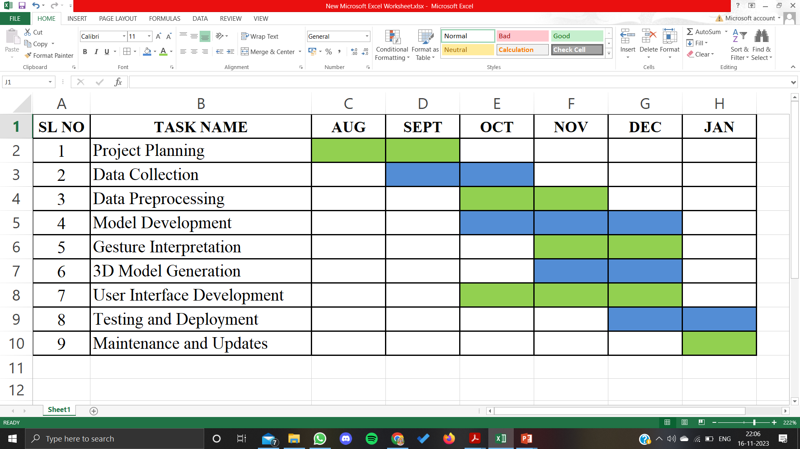
Work Plan - Milestones

Slide 21
Expected Outcomes
Effective Communication: The system will enable effective communication between deaf, mute, and hearing individuals, thereby bridging the communication gap.
Real-time Interpretation: The system will provide real-time interpretation of sign language into text and speech, and vice versa, making conversations smoother and more natural.
User-friendly Interface: The system will have a user-friendly interface that is easy to use, even for individuals who are not tech-savvy.
Increased Accessibility: By converting speech into 3D models showing sign language gestures, the system will make information more accessible to deaf and mute individuals.
Learning Tool: The system could also serve as a learning tool for individuals interested in learning sign language.

Slide 22
Conclusion
The project successfully developed a dual-mode sign language communication software that uses machine learning models to convert sign language to text and speech, and vice versa.
The system effectively bridges the communication gap between deaf, mute, and hearing individuals, making conversations smoother and more natural.
The user-friendly interface and the ability to convert speech into 3D models showing sign language gestures increase the accessibility of information.
The system could also serve as a valuable learning tool for individuals interested in learning sign language.
Overall, the project demonstrates the potential of machine learning and 3D modeling in enhancing communication and accessibility for deaf and mute individuals.

Slide 23
References
Z. Zhang, J. Pu, L. Zhuang, W. Zhou and H. Li, "Continuous Sign Language Recognition via Reinforcement Learning," 2019 IEEE International Conference on Image Processing (ICIP), Taipei, Taiwan, 2019, pp. 285-289, doi: 10.1109/ICIP.2019.8802972
C. Wei, J. Zhao, W. Zhou and H. Li, "Semantic Boundary Detection With Reinforcement Learning for Continuous Sign Language Recognition," in IEEE Transactions on Circuits and Systems for Video Technology, vol. 31, no. 3, pp. 1138-1149, March 2021, doi: 10.1109/TCSVT.2020.2999384.
S. Renjith and R. Manazhy, "Indian Sign Language Recognition: A Comparative Analysis Using CNN and RNN Models," 2023 International Conference on Circuit Power and Computing Technologies (ICCPCT), Kollam, India, 2023, pp. 1573-1576, doi: 10.1109/ICCPCT58313.2023.10245525.
Masood, S., Srivastava, A., Thuwal, H.C., Ahmad, M. (2018). Real-Time Sign Language Gesture (Word) Recognition from Video Sequences Using CNN and RNN. In: Bhateja V., Satapathy S., Satori H., Fong S., Joshi A. (eds) Intelligent Engineering Informatics. Advances in Intelligent Systems and Computing, vol 695.
Y. Tewari, P. Soni, S. Singh, M. S. Turlapati and A. Bhuva, "Real Time Sign Language Recognition Framework For Two Way Communication," 2021 International Conference on Communication information and Computing Technology (ICCICT), Mumbai, India, 2021, pp. 1-6, doi: 10.1109/ICCICT50803.2021.9510094.

Slide 24
References
R. Mandal, D. Patil, S. Gadhe, G. Birari and T. Buwa, "Dual mode Sign Language Recognizer-An Android Based CNN and LSTM Prediction model," 2023 3rd International conference on Artificial Intelligence and Signal Processing (AISP), VIJAYAWADA, India, 2023, pp. 1-5, doi: 10.1109/AISP57993.2023.10134768.
Hakim, N.L.; Shih, T.K.; Kasthuri Arachchi, S.P.; Aditya, W.; Chen, Y.-C.; Lin, C.-Y. Dynamic Hand Gesture Recognition Using 3DCNN and LSTM with FSM Context-Aware Model. Sensors 2019, 19, 5429. https://doi.org/10.3390/s19245429
Al-Obodi, Alaa & Al-Hanine, Ameerh & Al-Harbi, Khalda & Al-Dawas, Maryam & Al-Shargabi, Amal. (2020). A Saudi Sign Language Recognition System based on Convolutional Neural Networks. Building Services Engineering Research and Technology. 13. 10.37624/IJERT/13.11.2020.3328-3334.
S. Vanaja, R. Preetha and S. Sudha, "Hand Gesture Recognition for Deaf and Dumb Using CNN Technique," 2021 6th International Conference on Communication and Electronics Systems (ICCES), Coimbatre, India, 2021, pp. 1-4, doi: 10.1109/ICCES51350.2021.9489209.
Pathan, R.K., Biswas, M., Yasmin, S. et al. Sign language recognition using the fusion of image and hand landmarks through multi-headed convolutional neural network. Sci Rep 13, 16975 (2023)

Slide 25
Thank You

