Slide 1
Real Time OS
Mattia Rizzo
Embedded Software for the Internet of Things

Slide 2
Introduction
The aim of this project is to build a basic real time operating system, capable of scheduling different kind of tasks and to react to time deadlines violations.

Slide 3
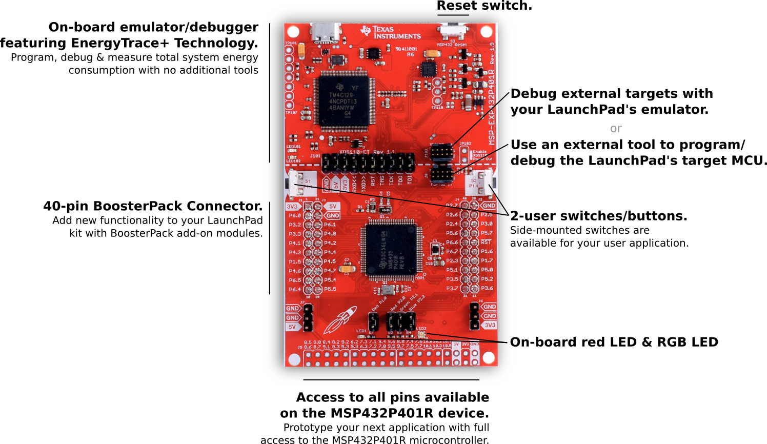
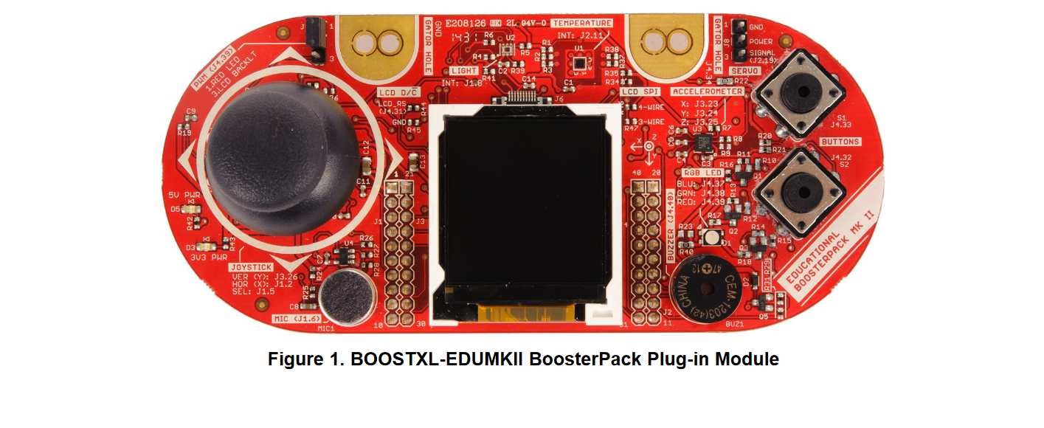

Hardware Setup
MSP432P401R LaunchPad + BoosterPack

Slide 4
Project Structure
main.c
sched.h
sched.c
semaphore.h
semaphore.c
utils.h
utils.c
Define global variables and env
Define Tasks Datatypes and implement scheduling policies
Define and Implement Atomic Semaphores for concurrent access
Define useful functions to use throughout the project

Slide 5
System Overview
Scheduler()

Slide 6
System Overview
Read function pointer
Scheduler()
Task Control Block

Slide 7
System Overview
Read function pointer
Scheduler()
Task Control Block
Call
Task_Function()

Slide 8
System Overview
Read function pointer
Scheduler()
Task Control Block
Call
Task_Function()
SysTick Interrupt

Slide 9
System Overview
Read function pointer
Scheduler()
Task Control Block
Call
Task_Function()
Does it meet the deadlines?
No
SysTick Interrupt
Yes
Resume task

Slide 10
System Overview
Read function pointer
Scheduler()
Task Control Block
Call
Task_Function()
Does it meet the deadlines?
Exception Handler
No
SysTick Interrupt
Yes
Reboot
Resume task

Slide 11
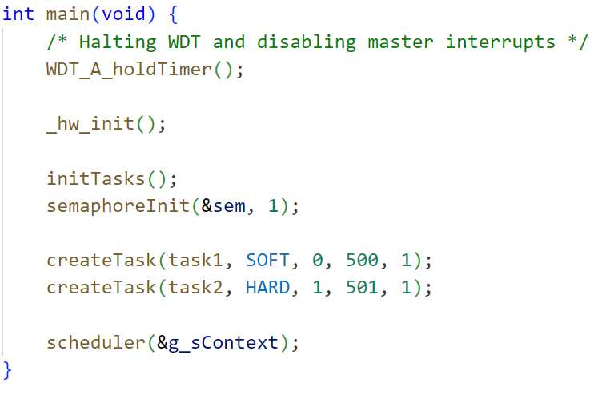
Main

Slide 12
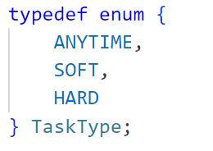
Tasks

Slide 13
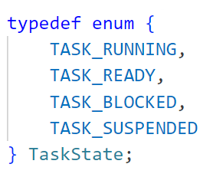
Tasks

Slide 14
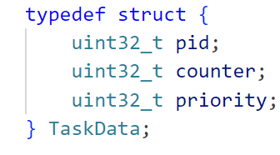
Tasks

Slide 15
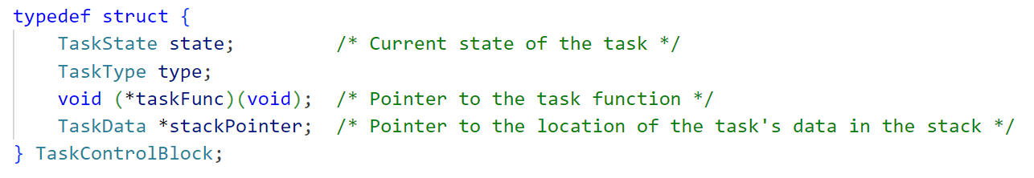
Tasks

Slide 16
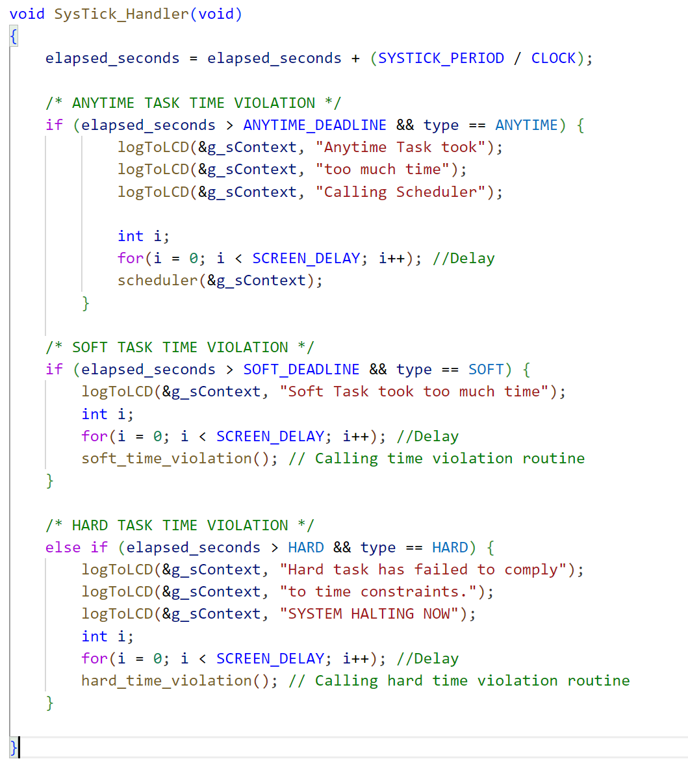
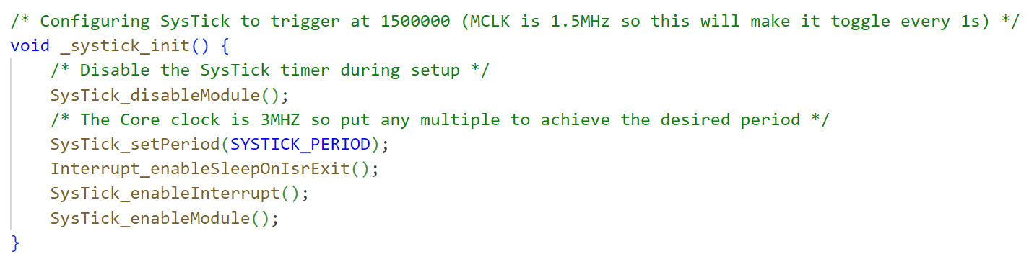
SysTick

Slide 17
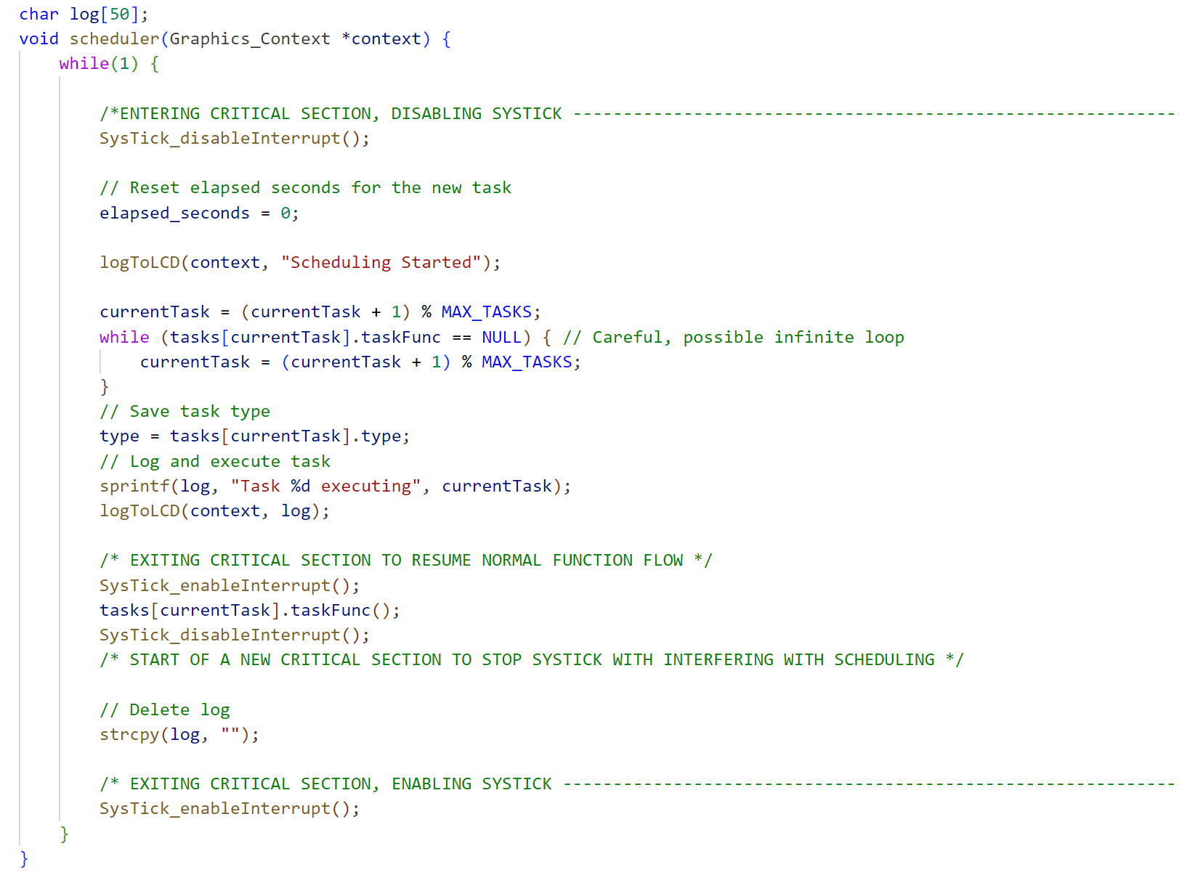
Scheduler

Slide 18
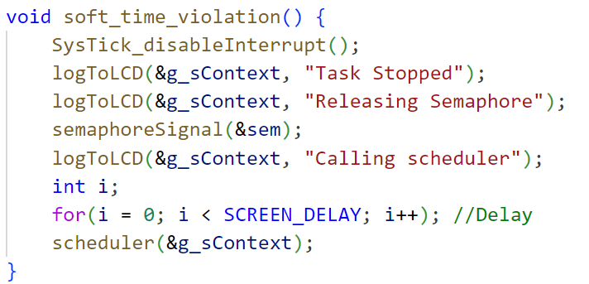
Exceptions

Slide 19
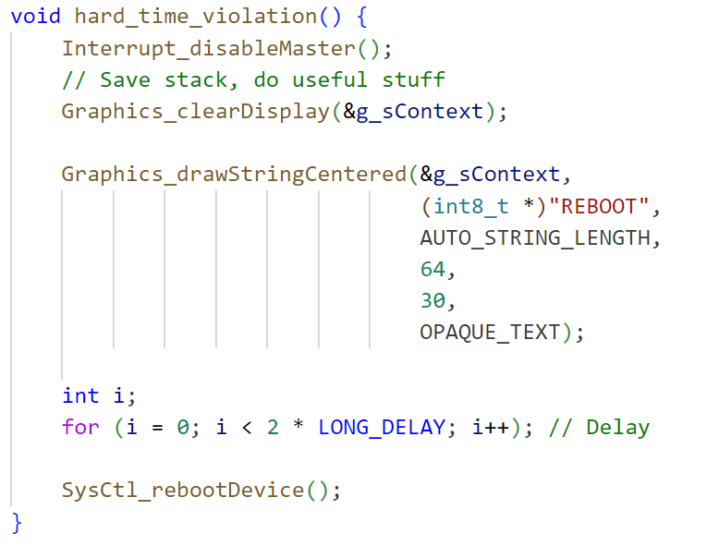
Exceptions

Slide 20

Thanks

