Slide 1
Contact list – Admin panel
Companies
12 580
Emails
70 580
Phone Numbers
90 258
Add company
From Excel
Add company
Manually
COMPANY NAME | ADDED/UPDATED ON | FILLING RATE : 70% | UPDATE | DELETE
Company | 18.08.2020 | 50% | Update | Delete
Company | 18.08.2020 | 95% | Update | Delete
Company | 18.08.2020 | 60% | Update | Delete
Company | 18.08.2020 | 75% | Update | Delete
Company | 18.08.2020 | 50% | Update | Delete
Company | 18.08.2020 | 95% | Update | Delete
Company | 18.08.2020 | 60% | Update | Delete
Company | 18.08.2020 | 75% | Update | Delete
Company | 18.08.2020 | 50% | Update | Delete
Company | 18.08.2020 | 95% | Update | Delete
Company | 18.08.2020 | 60% | Update | Delete
Company | 18.08.2020 | 75% | Update | Delete
Company | 18.08.2020 | 50% | Update | Delete
Company | 18.08.2020 | 95% | Update | Delete
Company | 18.08.2020 | 60% | Update | Delete
Company | 18.08.2020 | 75% | Update | Delete

Slide 2
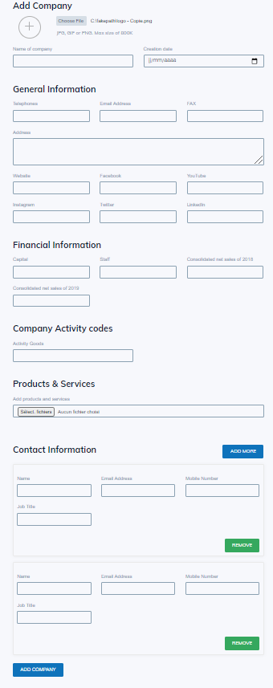
Contact list – Admin panel
Companies
12 580
Emails
70 580
Phone Numbers
90 258
Add a contact

Slide 3
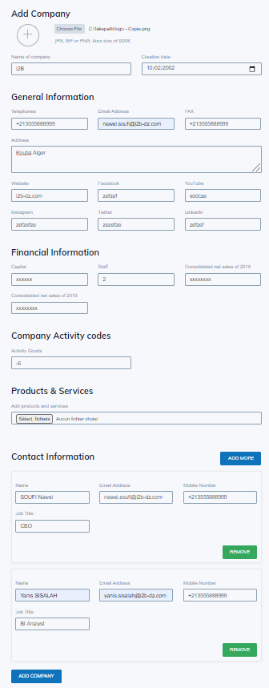
Contact list – Admin panel
Companies
12 580
Emails
70 580
Phone Numbers
90 258
Update a contact

