Slide 1
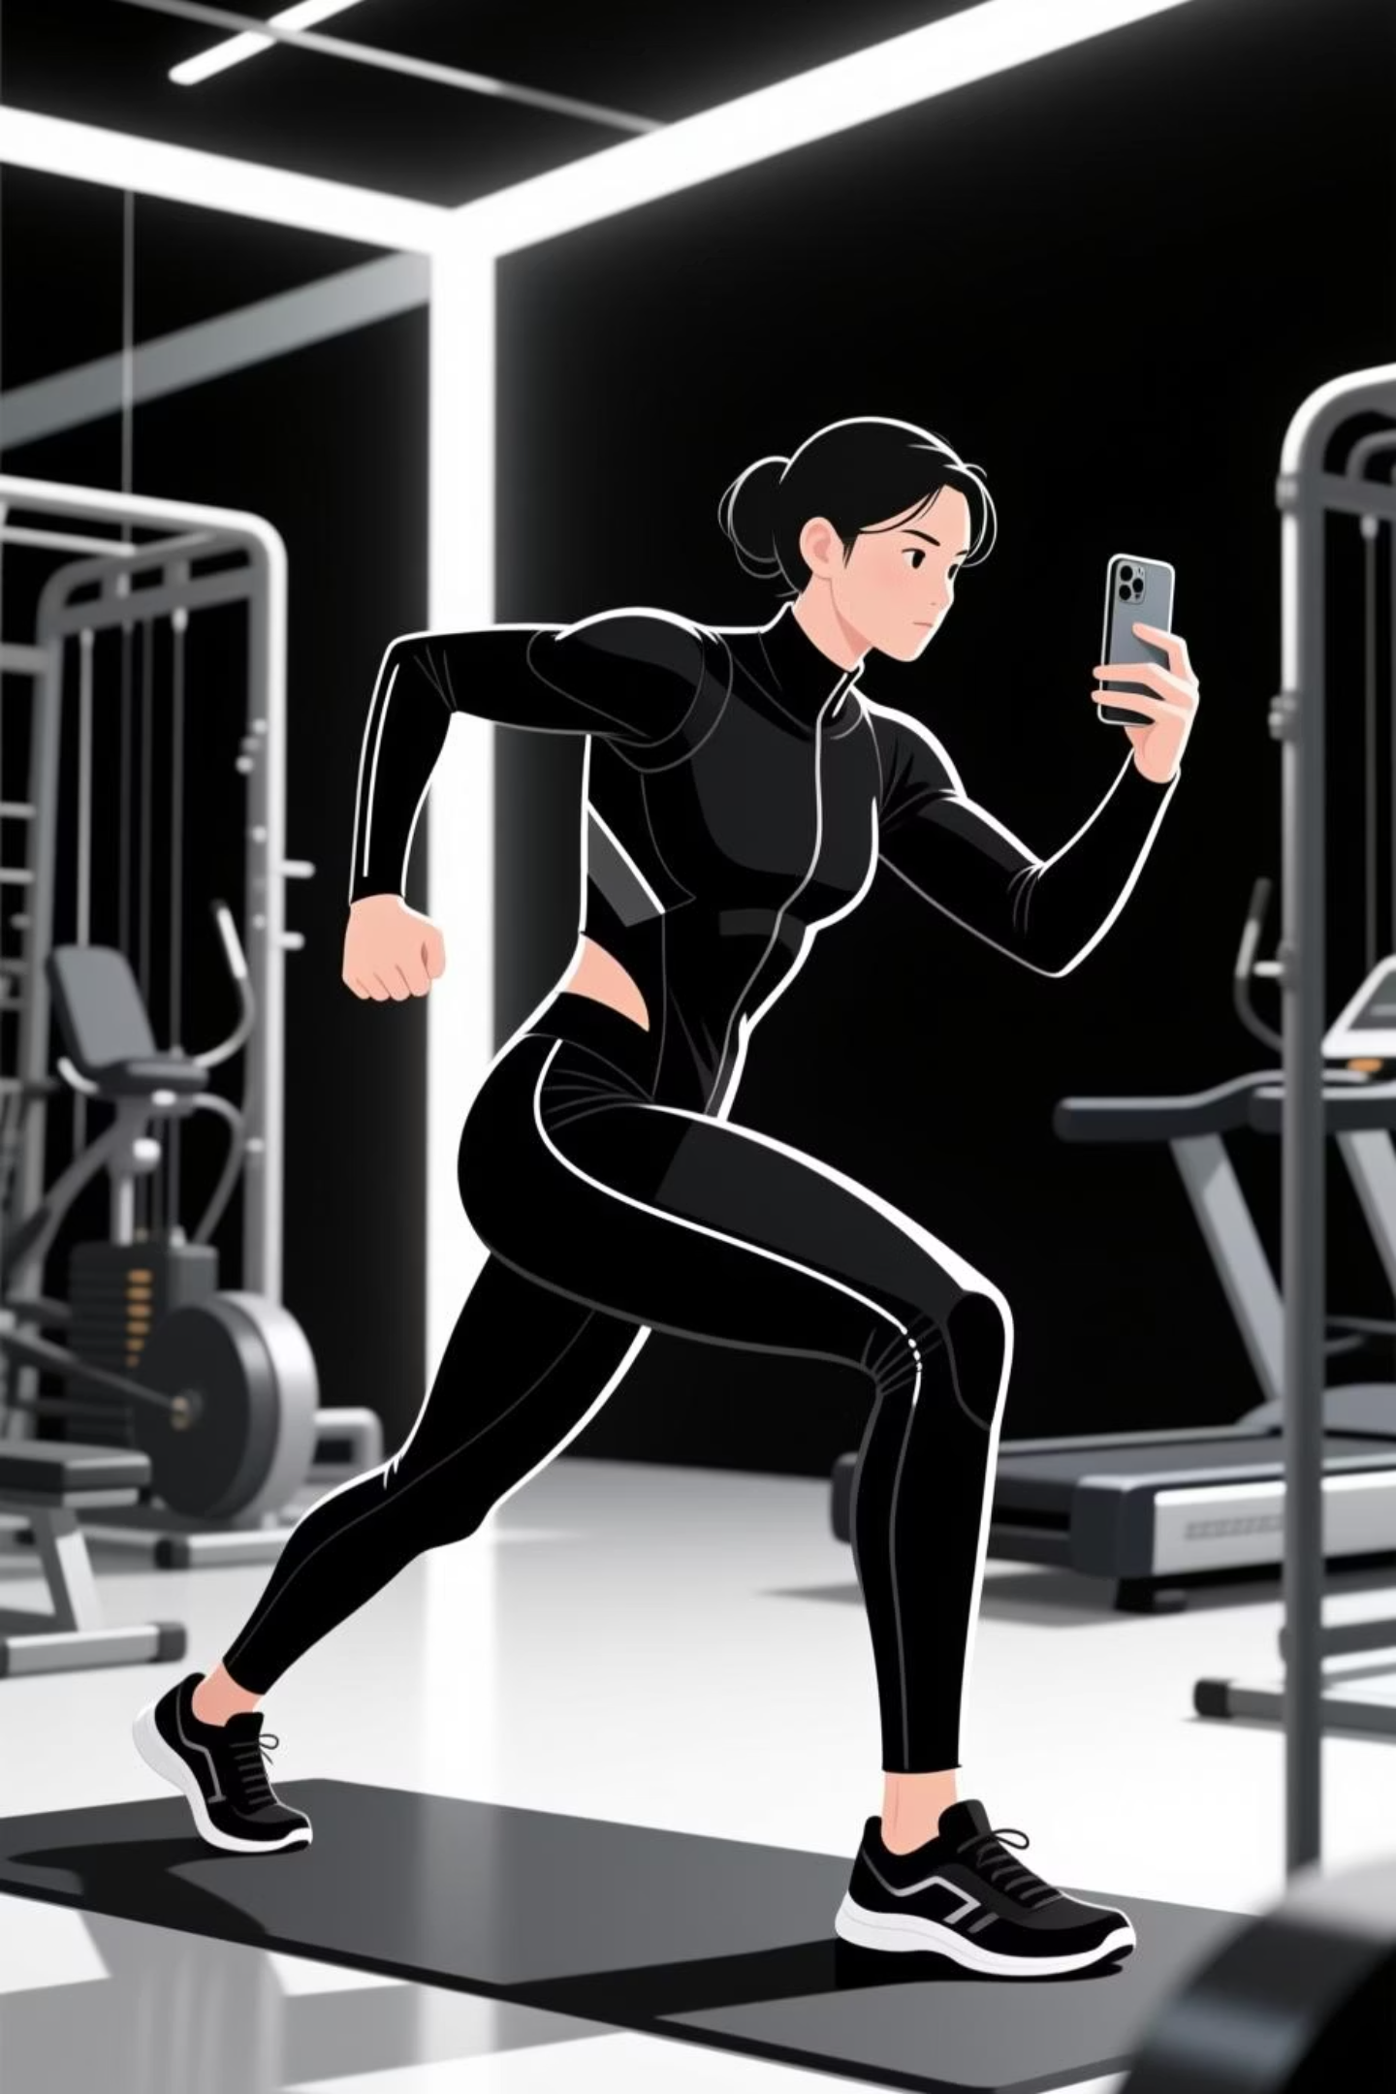
AlphaReps -AI Driven FitnessMonitoring System
Automate workout tracking and deliver real-time AI-powered motion analysis feedback
Team: AlphaReps
Team members: Prawin M (212223060208),
BavanKalyan P V (212223060030)
Dinesh H (212223060056)
Mission: Automate workout tracking and deliver real-time AI-powered motion analysis feedback
`

Slide 2

The Problem We're Solving
Manual Errors
Wearable Dependency
Rep counting by eye is inconsistent, leading to inaccurate workout records and poor progress tracking.
Most fitness apps require expensive sensors or smartwatches, limiting accessibility for everyday users and home workouts.
Limited Feedback
Lack of detailed motion analysis prevents trainers from identifying form issues that reduce effectiveness and increase injury risk.
The Solution: Real-time, camera-based exercise recognition that's affordable, accurate, and universally accessible.

Slide 3
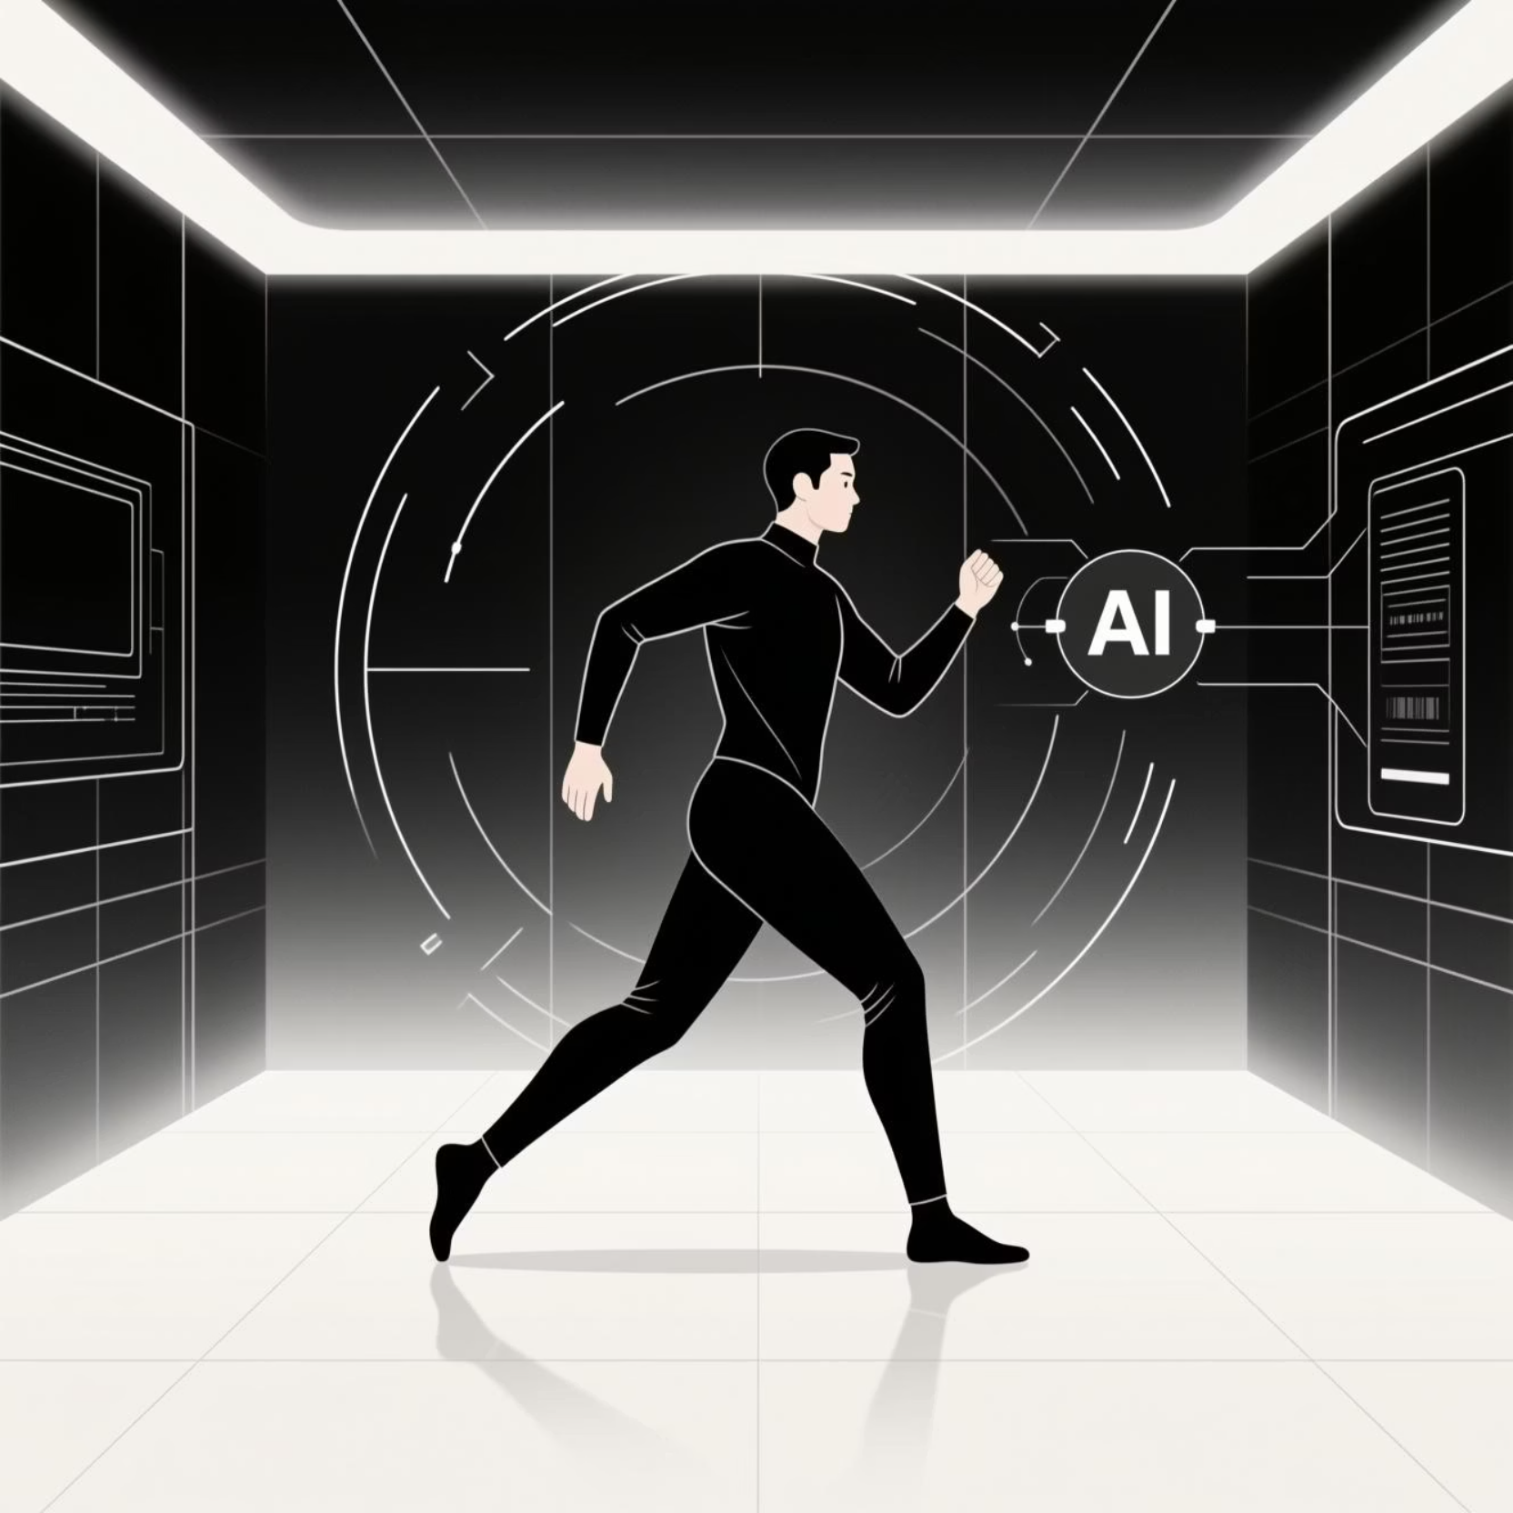
Our Innovation: AlphaReps
AI That Understands Movement
Detects and classifies exercises from live video
Automatically counts repetitions with deep learning
Generates personalized workout insights instantly
What Sets Us Apart
No sensors or wearables needed
Sub-1 second real-time feedback
Works on any device with a camera
Scales from gyms to home users

Slide 4
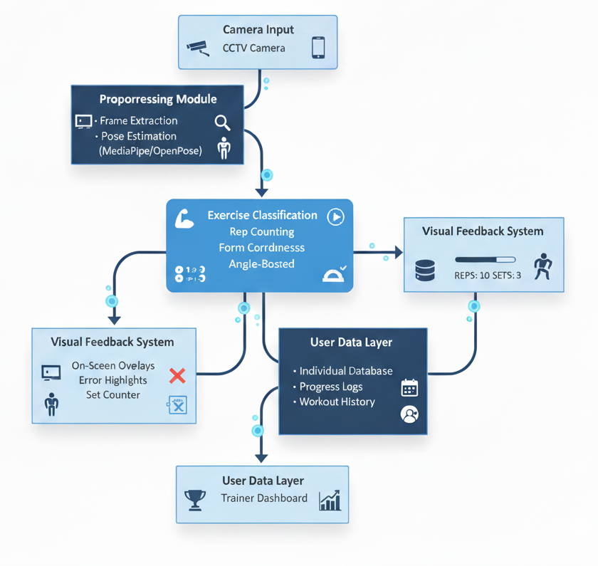





Technical Architecture
Video Capture
Live camera feed from user device
Frame Processing
Extract and preprocess video frames for analysis
Pose Estimation
MediaPipe extracts body landmarks and keypoints
ML Classification
Ensemble models identify exercise and count reps
Real-Time Feedback
Results displayed instantly to user
ML Models Used: Random Forest for stable predictions • Gradient Boosting for error minimization • SVM for precise class separation

Slide 5

Technical Stack
Frontend
Backend
React 18 & Vite
Python 3.12 + FastAPI
TailwindCSS
MediaPipe pose estimation
Open CV Webcam integration
XGBoost & GradientBoosting
OpenCV video processing
ML Pipeline
NumPy & Pandas processing
Multiple classifier models
Real-time inference engine

Slide 6
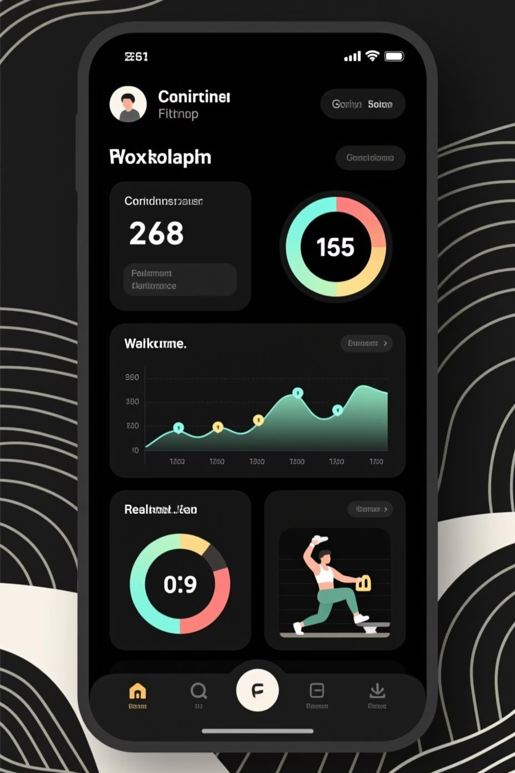
Impact & Performance
90%+
<2s
∞
Accuracy Rate
Inference Speed
Accessibility
Tested on diverse exercise datasets with consistent high performance
Real-time feedback with sub-second latency for seamless user experience
Works on any device with a camera—smartphone, laptop, or gym setup
📈
Training Quality
Automated form analysis and rep tracking improve workout effectiveness and user motivation

Slide 7
Future Applications and Implementations
Integration with CCTV/home gym cameras for automatic exercise tracking
AI voice-based form correction while working out
Personalized diet chart generation based on performance data
Leaderboard system for competition among friends, gyms, or app users
Centralized fitness database for each individual with long-term progress logs.
Automated set detection, performance scoring, and workout recommendations
Cloud-based dashboards for trainers, gyms, and users

