Slide 1
Tech-Driven Solutions for Undertrial Prisoners in India
PIP4004 Capstone Project
Final Review
Batch Number: CSE-G26
Roll Number | Student Name
20211CSE0114 | REDDY MASY TEJA
20211CSE0112 | KASTURI DEEPAK
20211CSE0125 | D PHANI BALA JASWANTH
20211CSE0122 | YAGANTI PRAVEN
Under the Supervision of,
Ms.. ROHINI
Assistant Professor
School of Computer Science and Engineering
Presidency University
Name of the Program: Computer Science and Engineering(CSE)
Name of the HoD: Dr. Asif Mohammed
Name of the Program Project Coordinator: Mr. Amarnath J L
Name of the School Project Coordinators: Mr. Md Ziaur Rahman

Slide 2
Abstract
The Indian prison system faces critical challenges such as overcrowding, slow legal processes, and limited access to legal aid and rehabilitation. Our capstone project aimed to implement a tech-driven prison management system using React, Java, Firebase, and AI to bridge this gap.
The system provides real-time case tracking, legal aid access, appointment scheduling, and rehabilitation support via web and mobile platforms, ensuring improved governance, transparency, and inmate welfare.
This marks the completion and validation of our project objectives, ready for deployment.

Slide 3
Objectives
✔ Develop a centralized digital system for managing undertrial prisoner data ✔ Provide AI-driven legal aid and chatbot-based support ✔ Enable real-time case tracking and appointment management ✔ Improve access to rehabilitation and mental health services ✔ Enhance transparency, communication, and accountability in the prison system

Slide 4
LITERATURE SURVEY
Sl.no | Paper Title | Authors | Proposed Model | Results | Drawbacks | Year
1 | AI-Based Case Management System for Undertrial Prisoners | Sharma R., Kumar P. | AI-powered system that tracks case progress and provides real-time updates on trial status. | Reduced case backlogs and improved case tracking accuracy. | Requires integration with court databases for real-time updates. | 2022
2 | Blockchain for Transparent Prisoner Records | Verma K., Das S. | Blockchain-based system for maintaining tamper-proof prisoner records and legal proceedings. | Enhanced transparency and security in case records. | High implementation cost and requires legal framework adaptation. | 2021
3 | IoT-Based Monitoring System for Undertrial Prisoners | Gupta A., Nair V. | IoT-enabled wearables to track prisoners’ movements and ensure compliance with bail conditions. | Improved prisoner tracking and reduced violations of bail terms. | Privacy concerns and risk of device malfunction. | 2023
4 | Machine Learning for Bail Prediction | Mehta P., Roy D. | ML algorithm analyzing previous court cases to predict bail eligibility for undertrial prisoners. | Faster bail recommendations and reduced judicial burden. | Requires large datasets for accurate predictions. | 2022
5 | Automated Legal Assistance Chatbot for Prisoners | Singh R., Bose T. | NLP-based chatbot to provide legal aid and guide prisoners on their rights. | Increased legal awareness among undertrial prisoners. | Limited understanding of complex legal queries. | 2023

Slide 5
System Architecture
The system is built with a multi-tier architecture:
- Frontend: React.js / React Native (Expo Go)
- Backend: Java Spring Boot
- Database: Firebase / MySQL
- Communication: REST APIs, real-time updates
- Features role-based access for Admin, Lawyers, and Families

Slide 6
Implementation – Web & Mobile
• Web App (React.js):
- Admin manages prisoner records, assigns lawyers, updates case status.
- Secure login and role-based dashboard.
• Mobile App (Expo Go):
- For lawyers and prisoner families
- Appointment booking, legal case updates
- Multilingual support

Slide 7
Final Results & Observations
• Admin successfully manages case records and lawyer assignments • Real-time synchronization via Firebase ensures instant updates • Appointment booking by families is working efficiently • Rehabilitation and legal aid content is accessible through the app • Multilingual support helps inclusivity for diverse users • System has been successfully tested with sample data • Positive feedback received from mock users including law students and legal experts

Slide 8
Challenges & Solutions
1.Issue: Time slot overlaps during appointment booking Solution: Slot-locking mechanism to prevent conflicts
2.Issue: UI confusion between admin and user roles Solution: Role-based interface design with distinct color themes
3.Issue: Firebase database scaling Solution: Structured collections and efficient queries implemented
All major issues encountered during the development cycle have been addressed and resolved.

Slide 9
Outcomes
The final implementation has resulted in: • Increased access to justice for undertrial prisoners • Faster legal case tracking and reduced manual effort • Transparent communication with families and lawyers • Rehabilitation through e-learning and mental health videos • Lawyer directory for better legal representation
Project has reached its final milestone with all modules tested.

Slide 10
Future Scope
• Blockchain integration for immutable legal records
• AI prediction for parole and case progress
• Virtual courtroom module for remote hearings
• Expansion to support refugees, migrants, and juveniles
• Nationwide implementation across prisons

Slide 11
Conclusion
The project demonstrates a scalable, tech-enabled prison management solution aimed at ensuring justice for undertrial prisoners. By digitizing records, automating processes, and offering real-time communication, the system promotes transparency, reduces delays, and ensures inmate welfare. With successful testing completed, it is now ready for pilot deployment.

Slide 12
Github Link
The Github link provided should have public access permission.
Github Link
https://github.com/deepak/Tech-Driven Solutions for Undertrial Prisoners in India

Slide 13
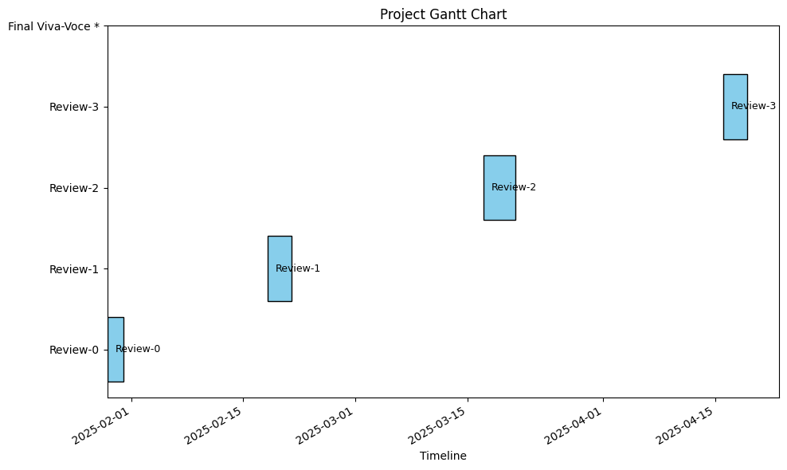
Timeline of the Project (Gantt Chart)

Slide 14
References (IEEE Paper format)
J. Qin, Y. Chen, W. Fu, Y. Kang, and M. Perc, ‘‘Neighborhood diversity promotes cooperation in social dilemmas,’’ IEEE Access, vol. 6, pp. 5003–5009, 2018
J. Reiman and P. Leighton, Rich Get Richer and the Poor Get Prison: Ideology, Class, and Criminal Justice. Evanston, IL, USA: Routledge, 2015.
Y. Li, J. Zhang, and M. Perc, ‘‘Effects of compassion on the evolution of cooperation in spatial social dilemmas,’’ Appl. Math. Comput., vol. 320, pp. 437–443, Mar. 2018. IJCRT2404142 International Journal of Creative Research Thoughts (IJCRT) www.ijcrt.org b264 www.ijcrt.org © 2024 IJCRT | Volume 12, Issue 4 April 2024 | ISSN: 2320-2882
C. Xia, S. Ding, C. Wang, J. Wang, and Z. Chen, ‘‘Risk analysis and enhancement of cooperation yielded by the individual reputation in the spatial public goods game,’’ IEEE Syst. J., vol. 11, no. 3, pp. 1516–1525, Sep. 2016.
Z. Rong, Z.-X. Wu, and G. Chen, ‘‘Coevolution of strategy-selection time scale and cooperation in spatial Prisoner’s dilemma game,’’ EPL (Europhys. Lett.), vol. 102, no. 6, p. 68005, 2013.

Slide 15


