Slide 1
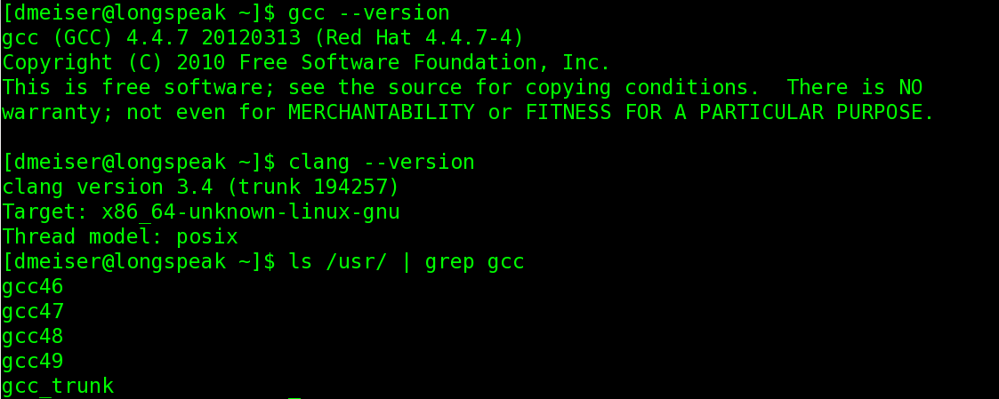

Using latest gcc and clang for great good
Dominic Meiser
7/21/2014
dmeiser@txcorp.com

Slide 2
Compilers do much more than translate source to object code
Compiler eco-system
Libraries (libc, stdlibc++)
Error messages
Source
Optimization
Warnings, lint,
static analysis
Compiler
Runtime analysis
runtime
Debuggers
Profiling
Executable, Library
Other tools
Integration with
external tools
(e.g. IDEs)
Compilation speed

Slide 3
Major C++ compilers have improved their eco-system in key areas
Standards conformance (clang, gcc, and cl mostly conform to C++11 and
C++14)
Faster STL due to move semantics
Error and warning messages:
  Fewer false positives
  Better diagnostics
  Better formatting
“Sanitizer tools”: address sanitizer, thread sanitizer, undefined behavior sanitizer
Link time optimization
C++ specific optimizations (e.g. De-virtualization)
Auto-vectorization
Tools: clang-format, include-what-you-use
IDE integration (clang backend for Visual Studio; QtCreator uses clang for intellisense)
=> There are many reasons for using
latest versions of compilers

Slide 4
Building latest gcc releases
wget http://www.netgull.com/gcc/releases/gcc-4.9.1/gcc-4.9.1.tar.gz
tar xfz gcc-4.9.1.tar.gz
cd gcc-4.9.1
contrib/download_prerequisites
./configure -help
./configure --prefix=/scr_ivy/gcc-4.9.1 \
--enable-languages=c,c++,fortran,lto \
--enable-lto --disable-lib-quadmath --disable-quadmath-support
make -j4
make install

Slide 5
Building gcc trunk
Lots of development occurring between major releases
Also interesting work in branches (e.g. OpenACC)
svn checkout svn://gcc.gnu.org/svn/gcc/trunk gcc_trunk
cd gcc_trunk
contrib/download_prerequisites
./configure -help
./configure --prefix=/scr_ivy/gcc-trunk \
--enable-languages=c,c++,fortran,lto \
--enable-lto -disable-lib-quadmath \
--disable-quadmath-support
make -j4
make install

Slide 6
Building clang trunk
http://clang.llvm.org/get_started.html
I normally use libstdc++ (gcc's stl)
But there is also libc++ (clang/llvm rewrite of stl)

Slide 7
Using non-system compilers
/scr_ivy/gcc-4.9.1/bin/c++ foo.cpp
CC=/scr_ivy/gcc-4.9.1/bin/gcc CXX=... {make,configure}
cmake -DCMAKE_CXX_COMPILER=/scr_ivy/gcc-4.9.1/bin/c++ ...
Must link to correct runtime libraries (libc, stdlibc++)
  Backwards compatible
  Can change LD_LIBRARY_PATH
  Use rpath
  Can clobber old system libraries: cp /scr_ivy/gcc-4.9.1/lib64/* /usr/lib64
  Or create links to new library location
Sometimes need to upgrade gdb to debug executables created with
newer compiler

Slide 8
Address sanitizer
Valgrind as a library (static or dynamic)
Much faster than valgrind (about 2x slower than uninstrumented code)
Very few false positives
Terminates process upon encountering first error

Slide 9
Clang-format
Tex for source code
Build on libtooling (full c++ understanding)
Simple specification of coding standards
More than just indentation
Easy to integrate into vim and emacs
Apply to diffs (e.g. svn commits)

Slide 10
Include-what-you-use
http://code.google.com/p/include-what-you-use/
Include dependencies are a major cost for compiling large C++ code basis
Include-what-you-use detects unneeded includes
Helps finding superficial includes by showing which symbols come from which header
Replaces includes with forward declarations
Build on libtooling

