Slide 1
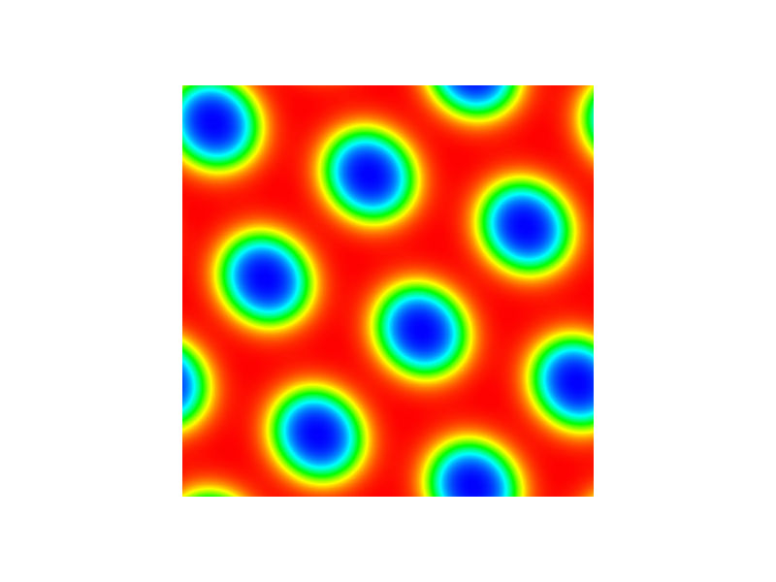
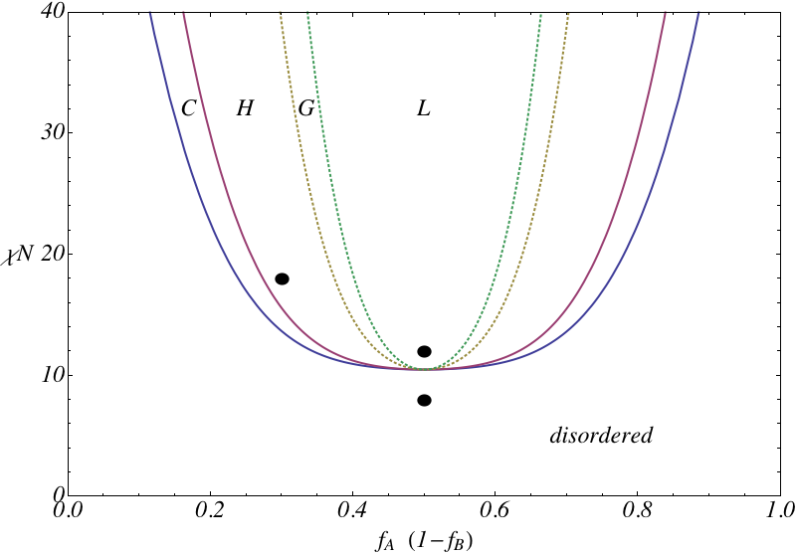
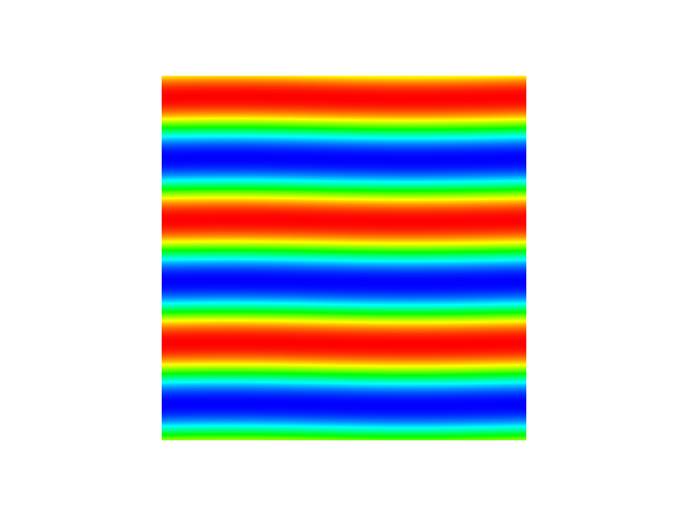
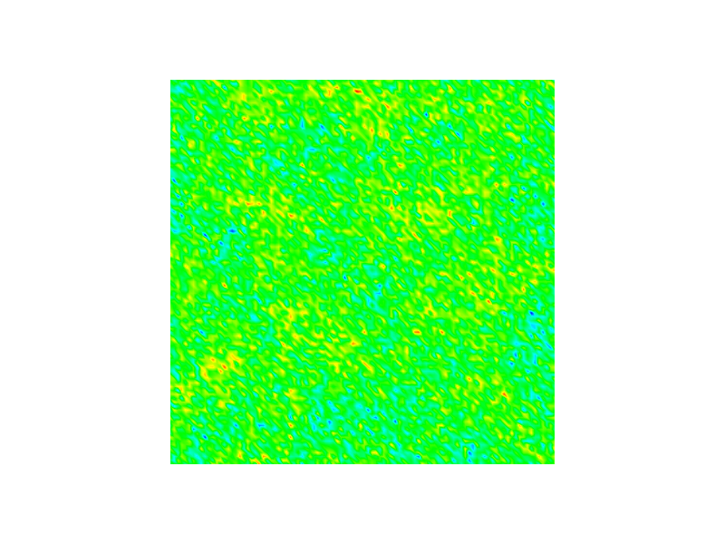
hexagonally packed cylinders
Schematic of phase diagram for linear 2-component copolymer
2D simulation
results for
density profiles
lamellar layers
homogenous (disordered)

Slide 2
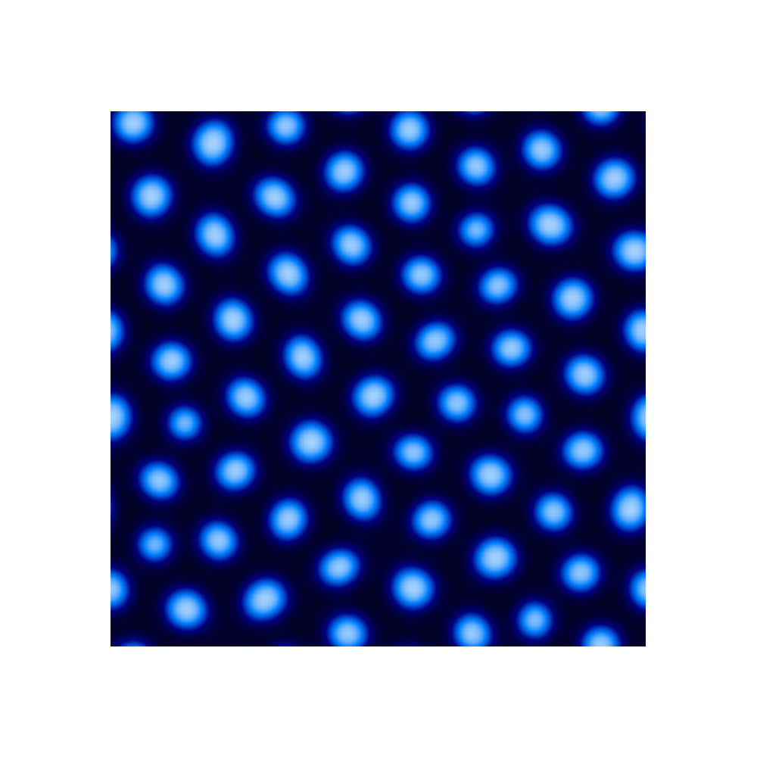
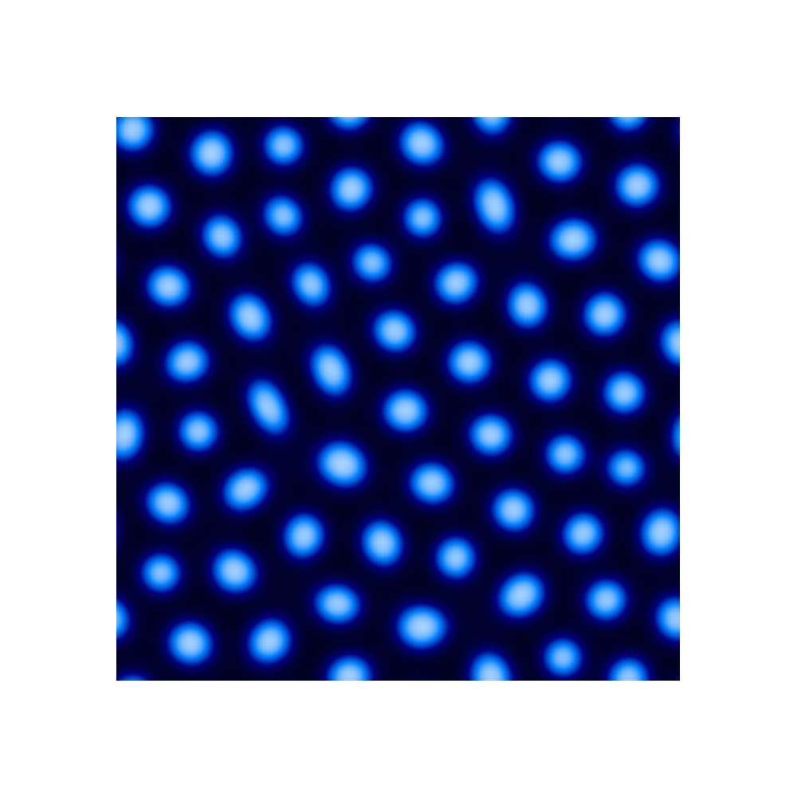
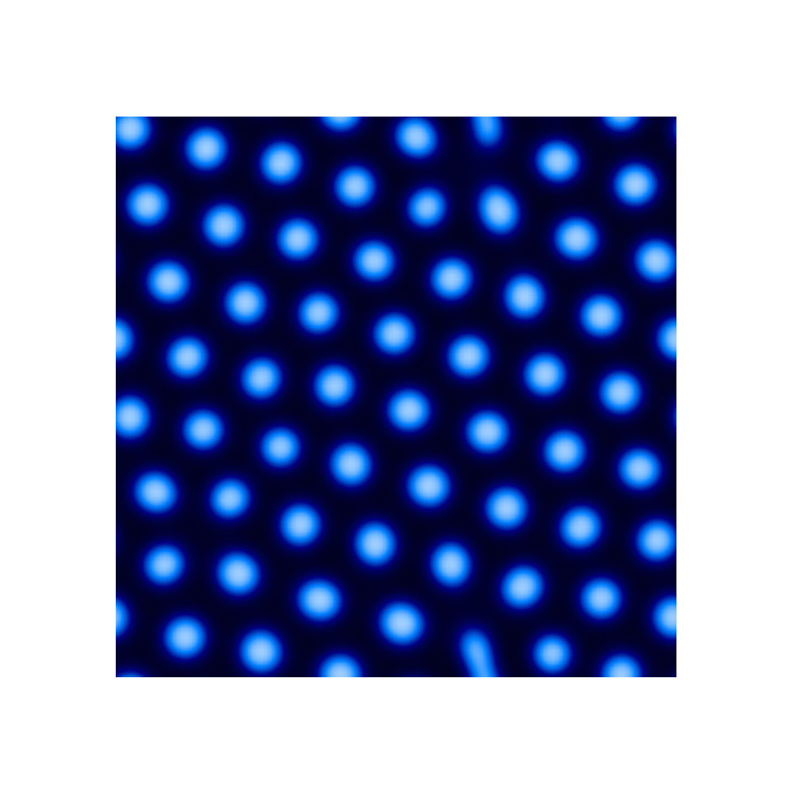
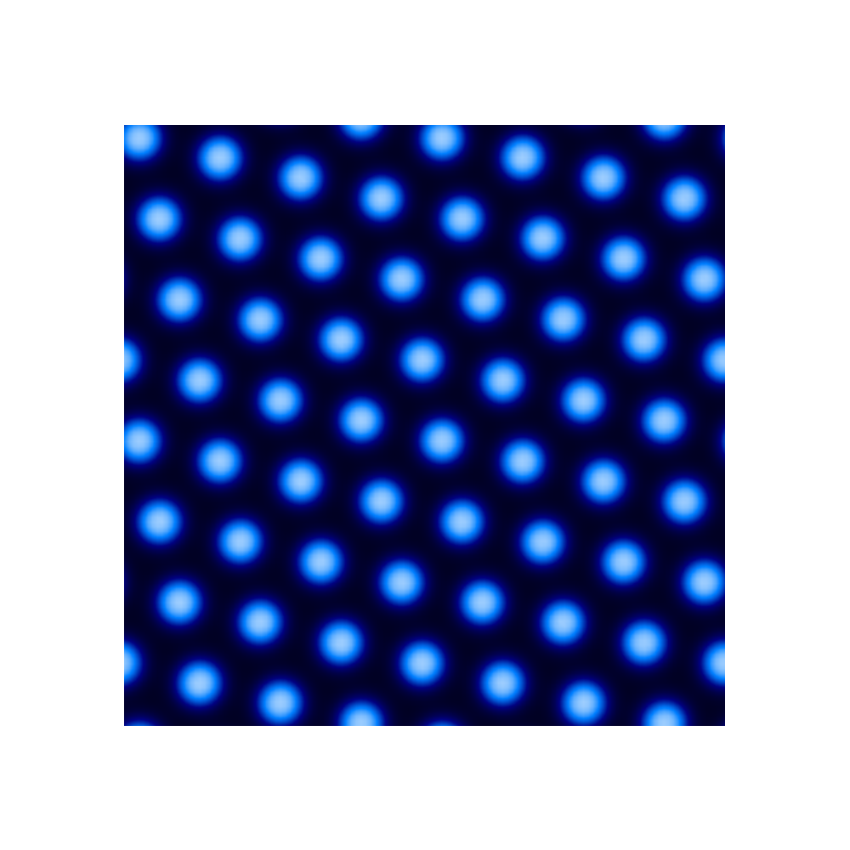

Slide 3
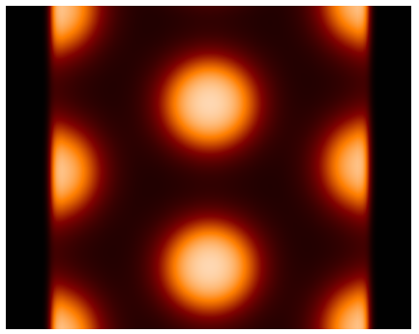
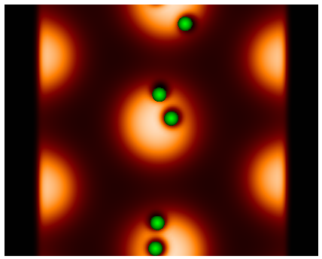
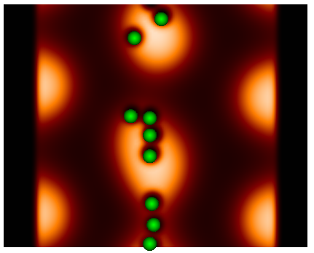
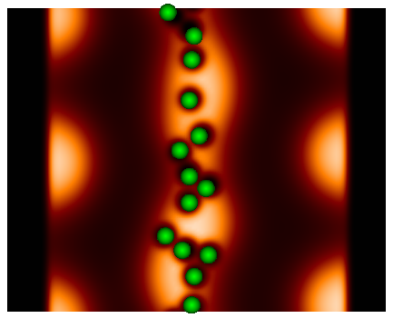

Slide 4
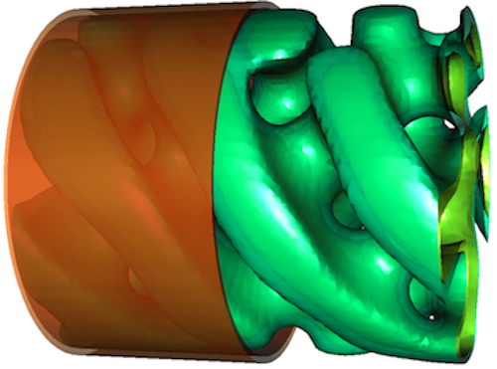





Slide 5
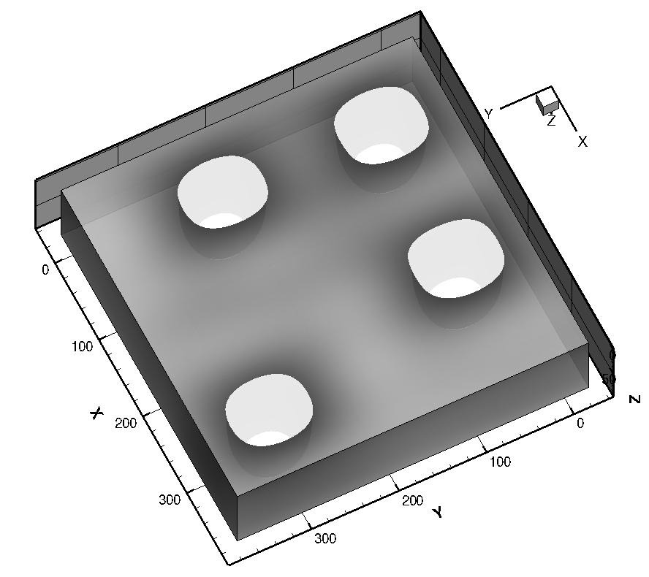
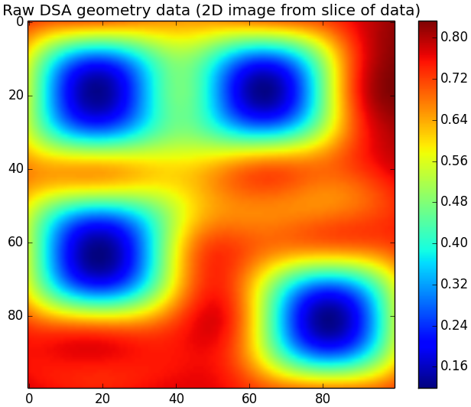
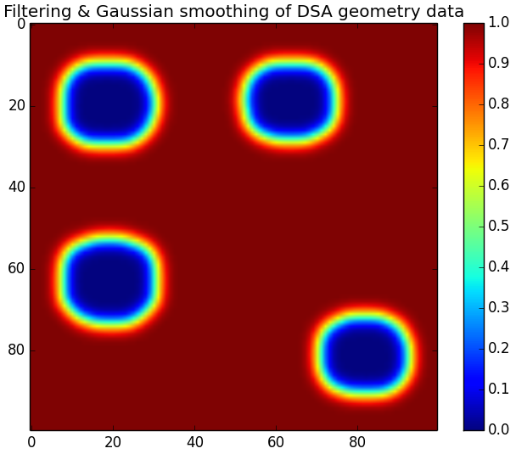
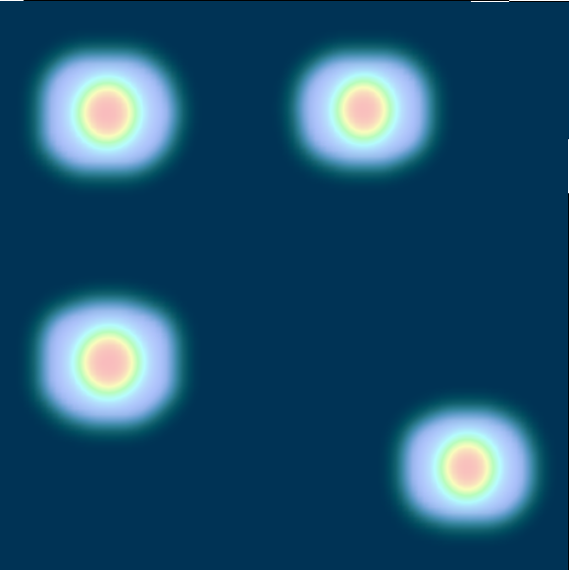
3D image of mask
(b)
(a)
Simulated diblock morphologies within pore geometry
(c)
(d)

Slide 6
pre-processing raw data of mask geometry with python scripts
Simulated diblock morphologies within 2D pore geometry
pre-processed file mask geometry file imported into PolySwift++ engine and used to simulate asymmetric diblock in confinement

Slide 7


Slide 8






Slide 9
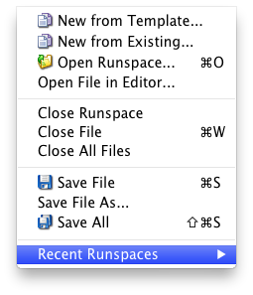


Slide 10
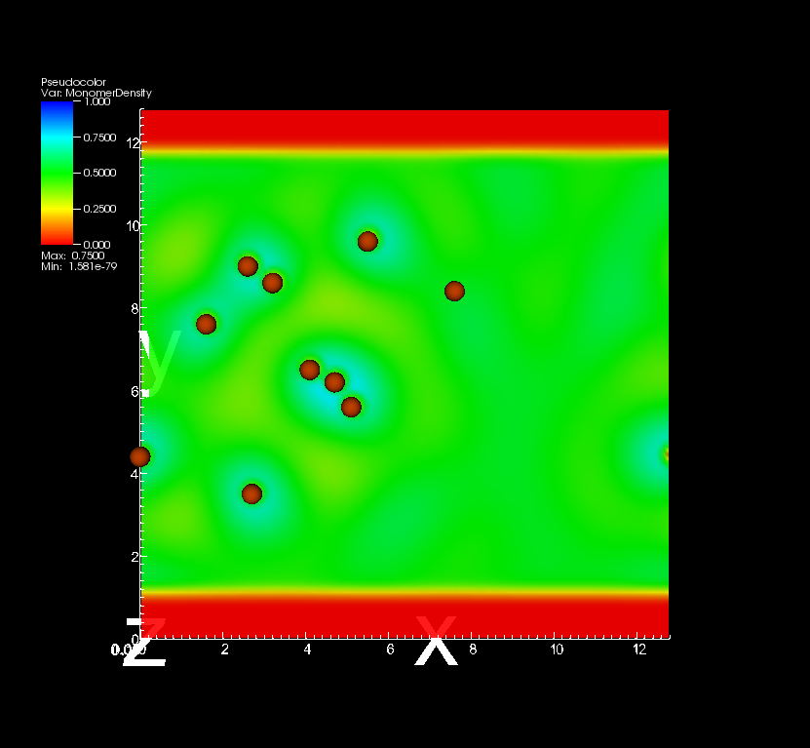
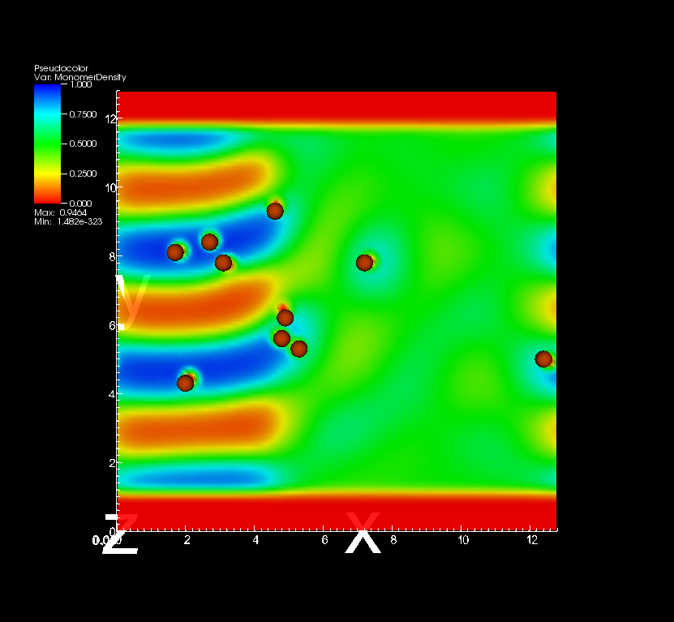
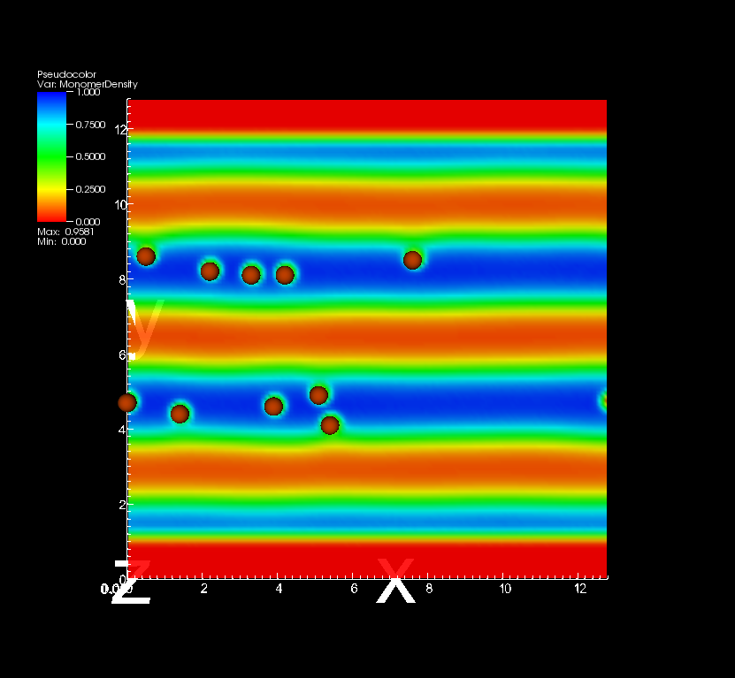
confinement walls
moving front of annealing zone
initially dispersed nanoparticles
aligned nanoparticles in copolymer domains

Slide 11
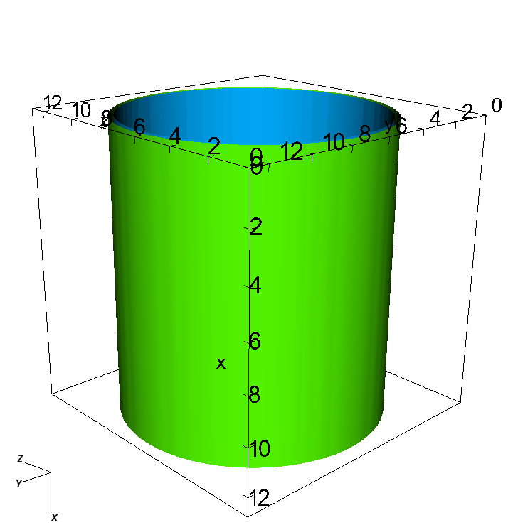
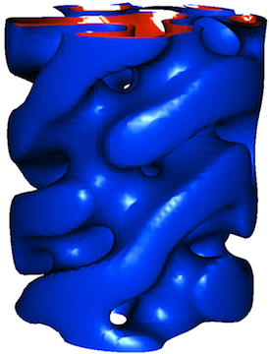
CYLRADIUS
L_{x}
L_{z}
L_{y}
cylindrical pore e.g. 3D SCFT symmetric diblock result

