Slide 1
IBM University Engagement Project Submission
“Exploring the Power of Agentic AI with IBM Granite and IBM Bob”

Slide 2

Project Tile – Travel Planner Agent
Domain of Project – TRAVELLING
Student Name | Recent Passport Photo | Email ID | Mobile number [WhatsApp]
HITESH KESWANI |  | HITESHKESWANI3@GMAIL.COM | 6261729132

Slide 3
Problem Statement -
Problem Statement : Travel Planner Agent
The Challenge
Planning a trip can be time-consuming and complicated, as travellers need to research destinations, transportation, accommodation, activities, weather, budgets, and local attractions from multiple sources. Information is often scattered across different platforms and may become outdated quickly. Without personalized, real-time travel guidance, users may struggle to create efficient itineraries, stay within budget, and adapt their plans when unexpected changes occur.
The Objective
Build an AI-powered Travel Planner Agent that provides personalized, intelligent, and real-time travel assistance for individuals, families, and groups. The solution should:
• Personalized Trip Planning – Recommend destinations, activities, attractions, and experiences based on the user's interests, travel dates, budget, group size, and preferences.
• Intelligent Itinerary Generation – Automatically create optimized day-by-day itineraries considering travel time, opening hours, distance between locations, user preferences, and available time.
• Budget & Expense Management – Estimate transportation, accommodation, food, and activity costs and help users create and maintain a travel budget.

Slide 4
Proposed Solution -
Proposed Solution
The proposed solution is an AI-powered Travel Planner Agent built using IBM Granite and IBM Cloud Lite services that helps users plan complete trips through a single intelligent platform.
The system will collect user preferences such as destination, travel dates, budget, number of travelers, interests, preferred transport, accommodation type, and trip duration. Based on these inputs, the AI agent will generate a personalized and optimized travel plan.
The solution will use a Multi-Agent Architecture, where different AI agents perform specialized tasks and work together to create the final travel plan.
Destination Recommendation Agent
This agent analyses the user's budget, interests, season, travel duration, and preferences to recommend suitable destinations and tourist attractions.
2. Itinerary Planning Agent
This agent generates a complete day-wise itinerary including sightseeing locations, activities, meal breaks, travel time, and recommended visiting hours. It also optimizes the route to reduce unnecessary travel.
3. Transport & Accommodation Agent
This agent recommends suitable flights, trains, buses, local transportation, hotels, hostels, and other accommodation options according to the user's budget and preferences.

Slide 5
Technology Used
IBM Bob platform -For designing and orchestrating multi-agent workflows visually
IBM Granite model - for eg – ibm-granite-3-2-8b – For natural language understanding, reasoning, and personalization
IBM Cloud – It provides the infrastructure to build, deploy, and scale the Nutrition Agent efficiently. IBM Cloud enables a reliable, secure, and scalable environment for deploying the Nutrition Agent.
IBM Watsonx.ai - For model deployment, embeddings, and AI governance

Slide 6
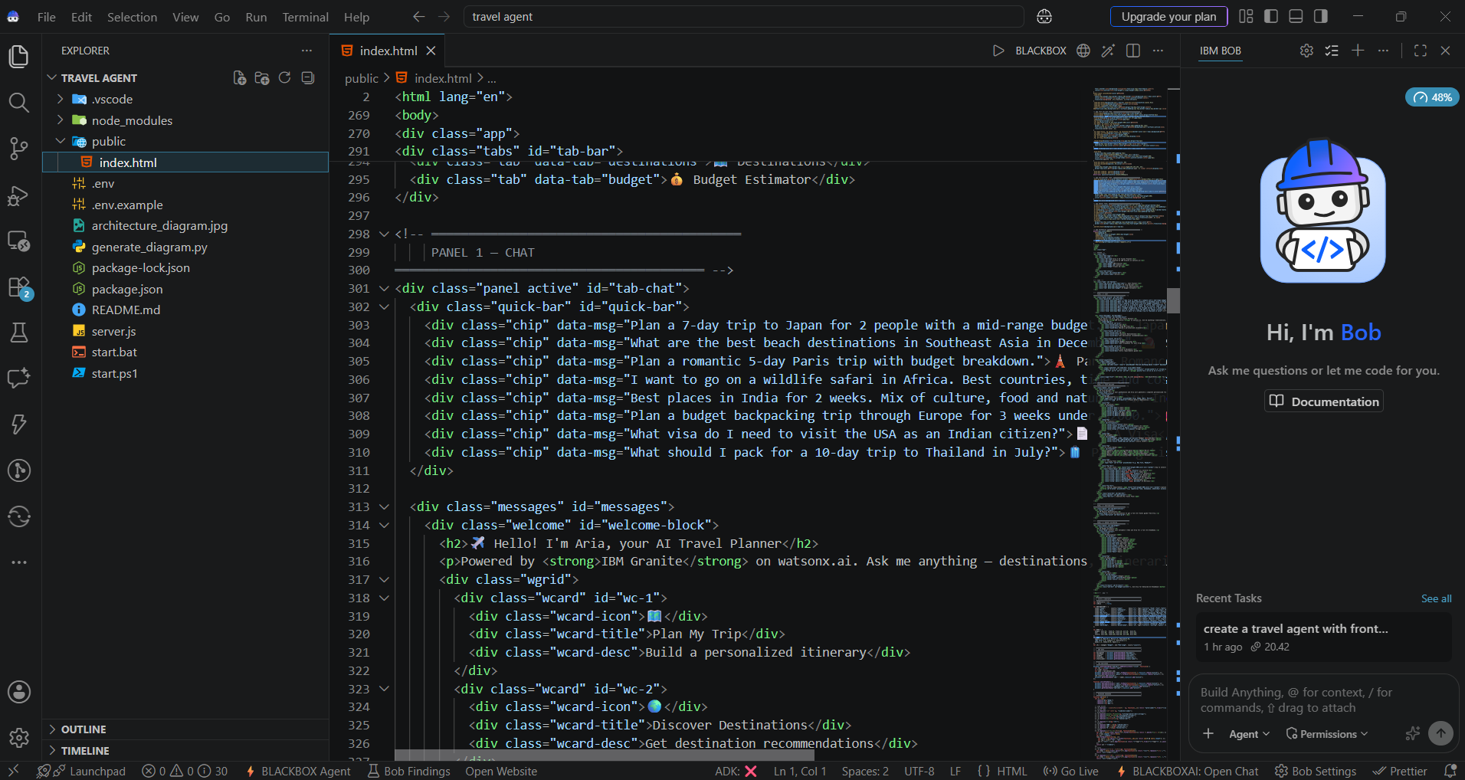
Required Files created using IBM bob -

Slide 7
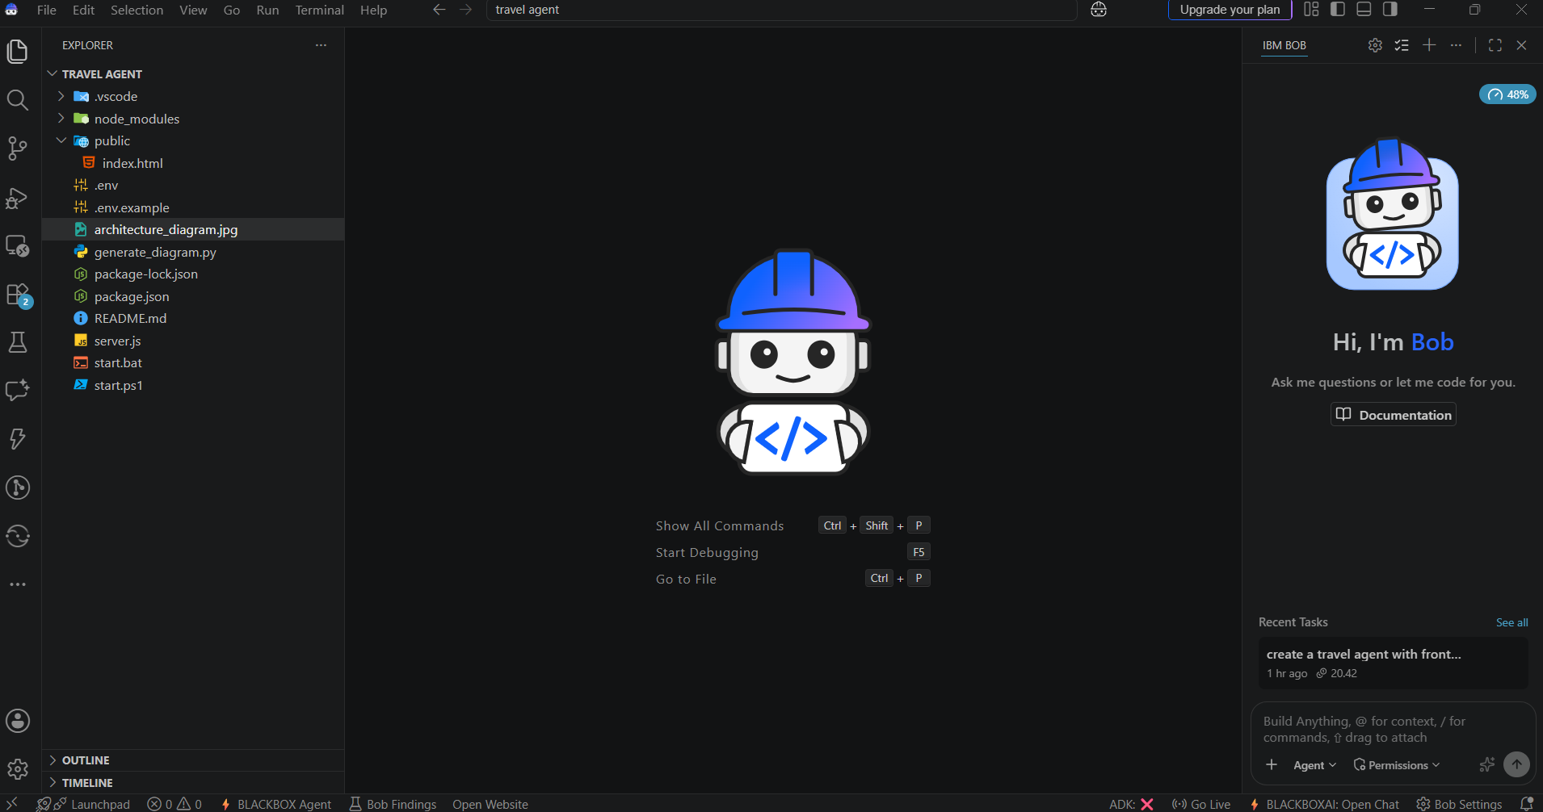
IBM Bob Screenshots:

Slide 8
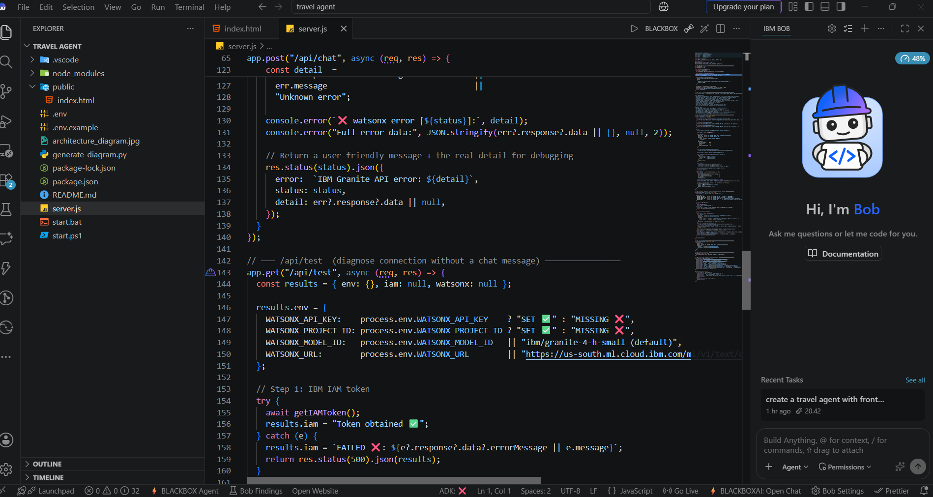

Slide 9
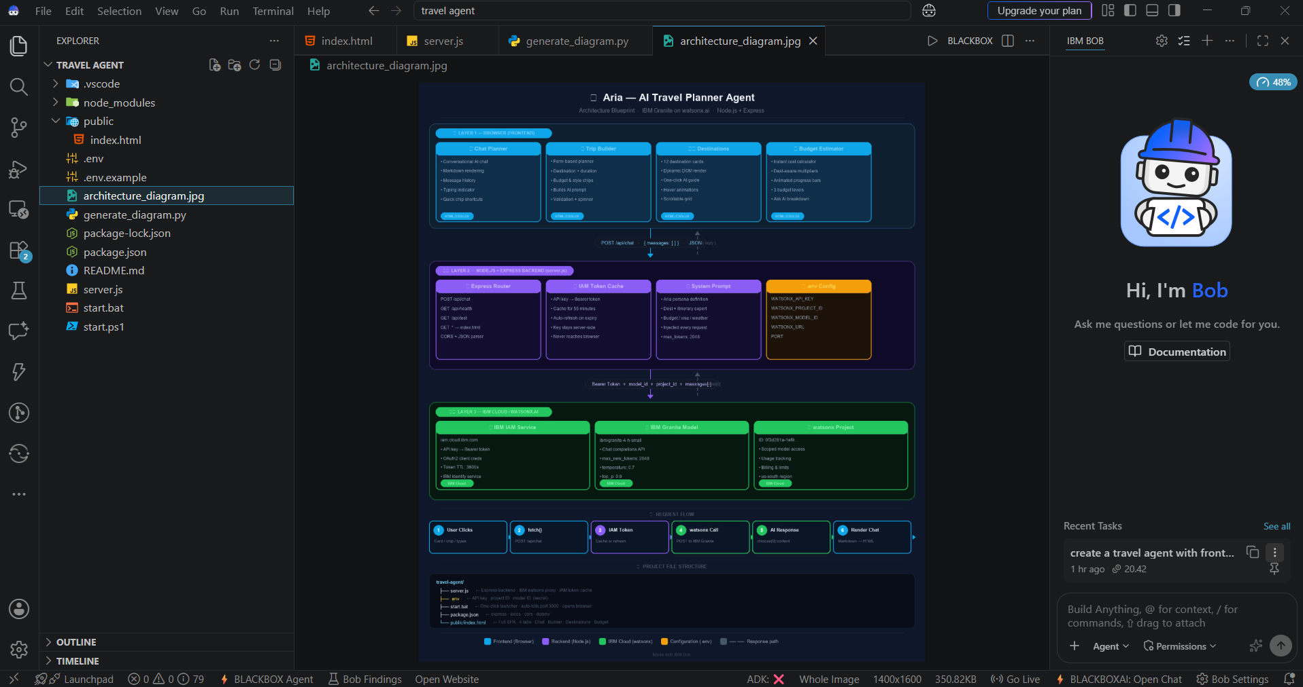
Architecture blueprint for IBM bob:

Slide 10

Role of Agentic AI in the solution
Role of Agentic AI in the Solution
Agentic AI acts as the intelligent decision-making and coordination layer of the Travel Planner Agent. Instead of simply answering user questions, the AI agents can understand goals, plan tasks, retrieve information, make decisions, coordinate with other agents, and adapt the travel plan according to changing conditions.
• Goal Understanding – The Agentic AI understands the user's requirements such as destination, budget, duration, interests, number of travellers, and preferred transportation.
• Task Planning & Decomposition – It breaks the overall travel-planning task into smaller activities such as destination selection, itinerary creation, transport search,
accommodation selection, budget calculation, and weather monitoring.
• Multi-Agent Collaboration – Different specialized agents work together. The Destination Agent, Itinerary Agent, Transport & Stay Agent, Budget Agent, and Weather & Alert Agent share information and coordinate their decisions.

Slide 11
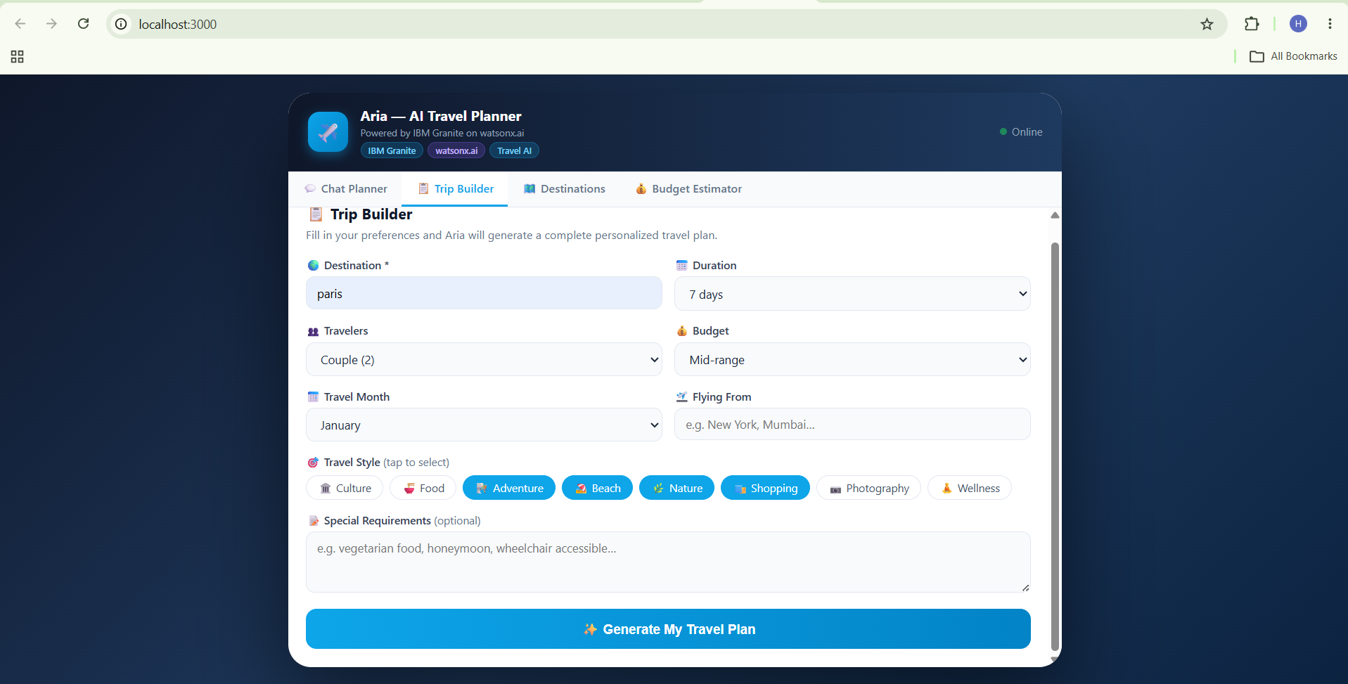

Slide 12
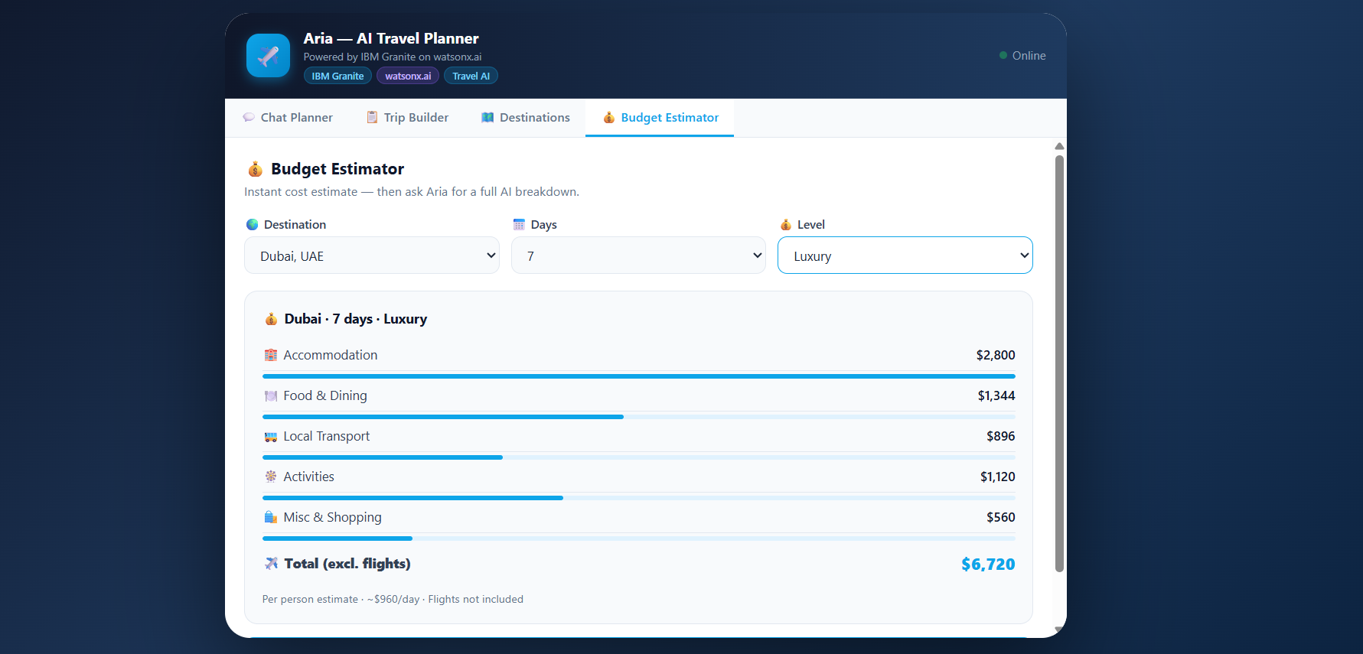
Project Output Screenshot

Slide 13
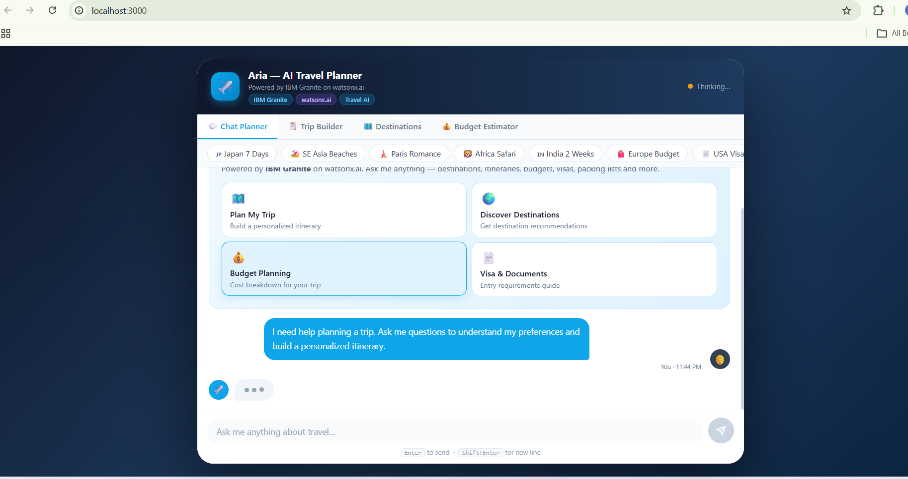
Project Output Screenshot
Please put IBM Bob output screenshots with 2-3 prompts.
You can take 2-3 more slides for each screenshot
·
·
·

Slide 14
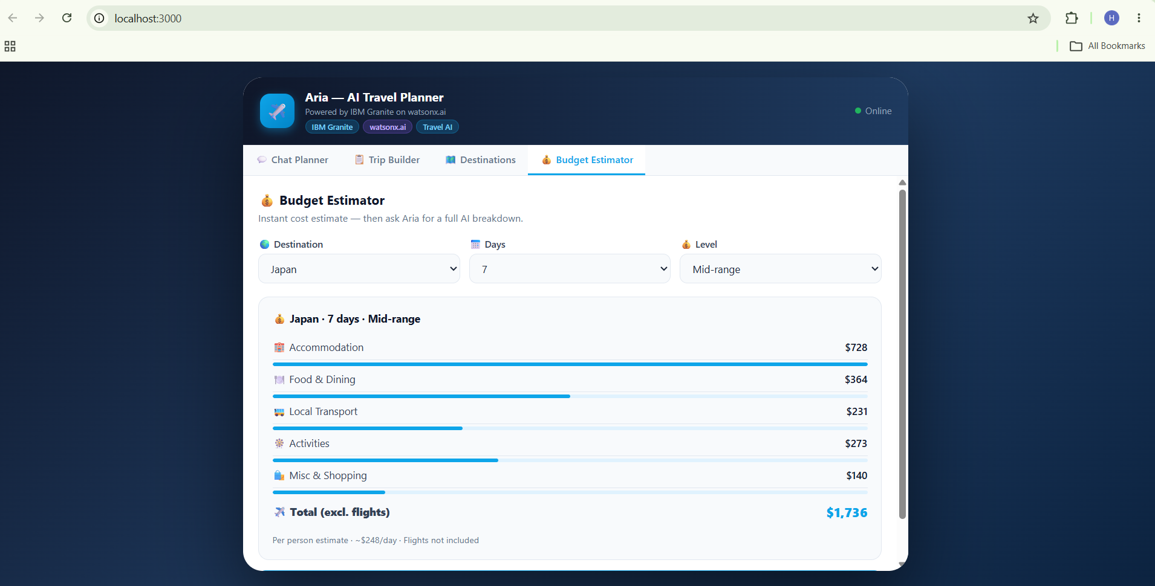
Project Output Screenshot
Please put IBM Bob output screenshots with 2-3 prompts.
You can take 2-3 more slides for each screenshot
·
·
·

Slide 15
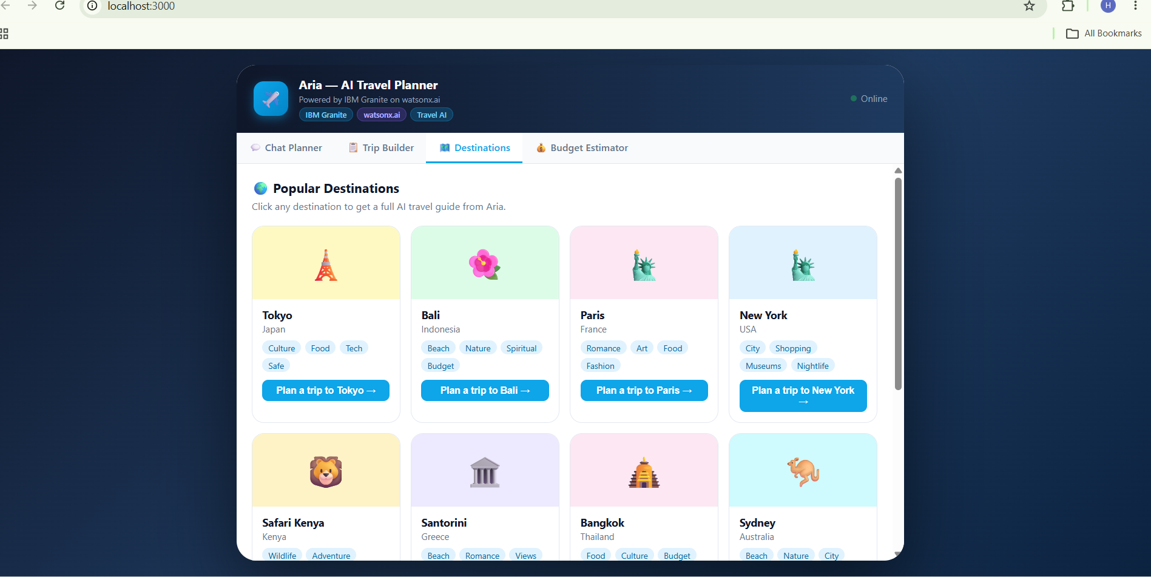
Project Output Screenshot
Please put IBM Bob output screenshots with 2-3 prompts.
You can take 2-3 more slides for each screenshot
·
·
·

Slide 16
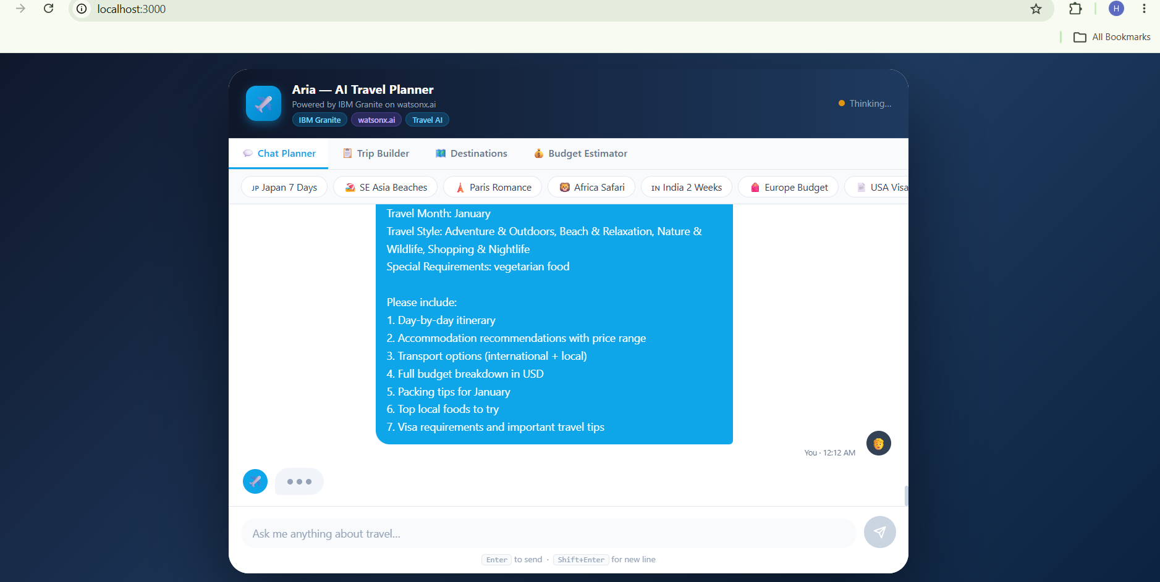
Project Output Screenshot

Slide 17
Novelty and Uniqueness
The proposed AI-powered Travel Planner Agent stands out from conventional travel-planning applications by combining IBM Granite, RAG, real-time data, and a Multi-Agent System into a single intelligent travel assistant.
• AI-Powered Personalization – Generates travel plans based on individual preferences such as budget, interests, travel duration, group size, preferred activities, and transportation choices, rather than providing generic recommendations.
• Multi-Agent Collaboration – Uses specialized AI agents for destination discovery, itinerary planning, transport and accommodation, weather alerts, and budget management. These agents collaborate to produce a complete travel plan.
• Dynamic Itinerary Optimization – Unlike static itineraries, the system can modify the travel schedule dynamically when weather conditions, transportation availability, user preferences, or time constraints change.

Slide 18
Git Hub Link :-
https://github.com/Tech-hitesh/travel-agent
·
·

Slide 19
Future Scope
Future Scope The Travel Planner Agent can be further enhanced with advanced AI, real-time services, and automation to provide a more intelligent and complete travel experience.• Real-Time Booking Integration – Integrate with flight, train, bus, hotel, and activity-booking platforms to allow users to search, compare, and book services directly through the agent.• Voice-Based Travel Assistant – Add voice interaction so users can ask questions, modify itineraries, and receive travel updates using voice commands.• Advanced Personalization – Use previous trips, preferences, spending patterns, and feedback to continuously improve recommendations and create highly personalized travel experiences.• Computer Vision for Travel Assistance – Allow users to upload images of landmarks, menus, signs, or destinations and use AI to identify and provide relevant information.
·
·
·

Slide 20
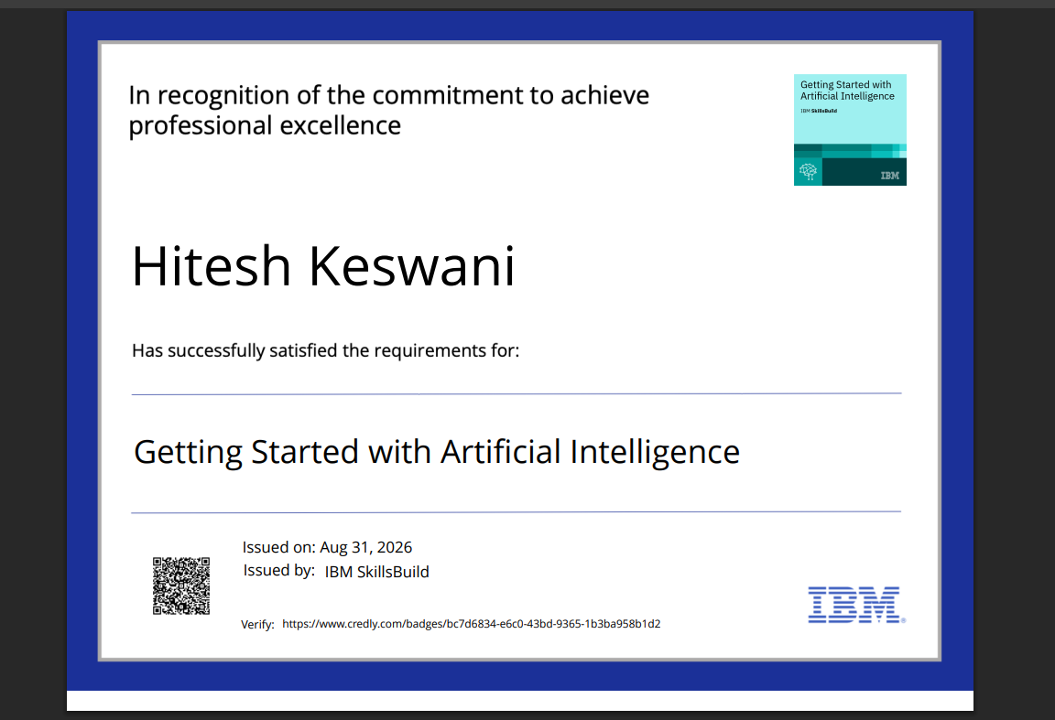
Certificates Earned:
Please add your credly certificate(Getting Started with Artificial Intelligence)

Slide 21
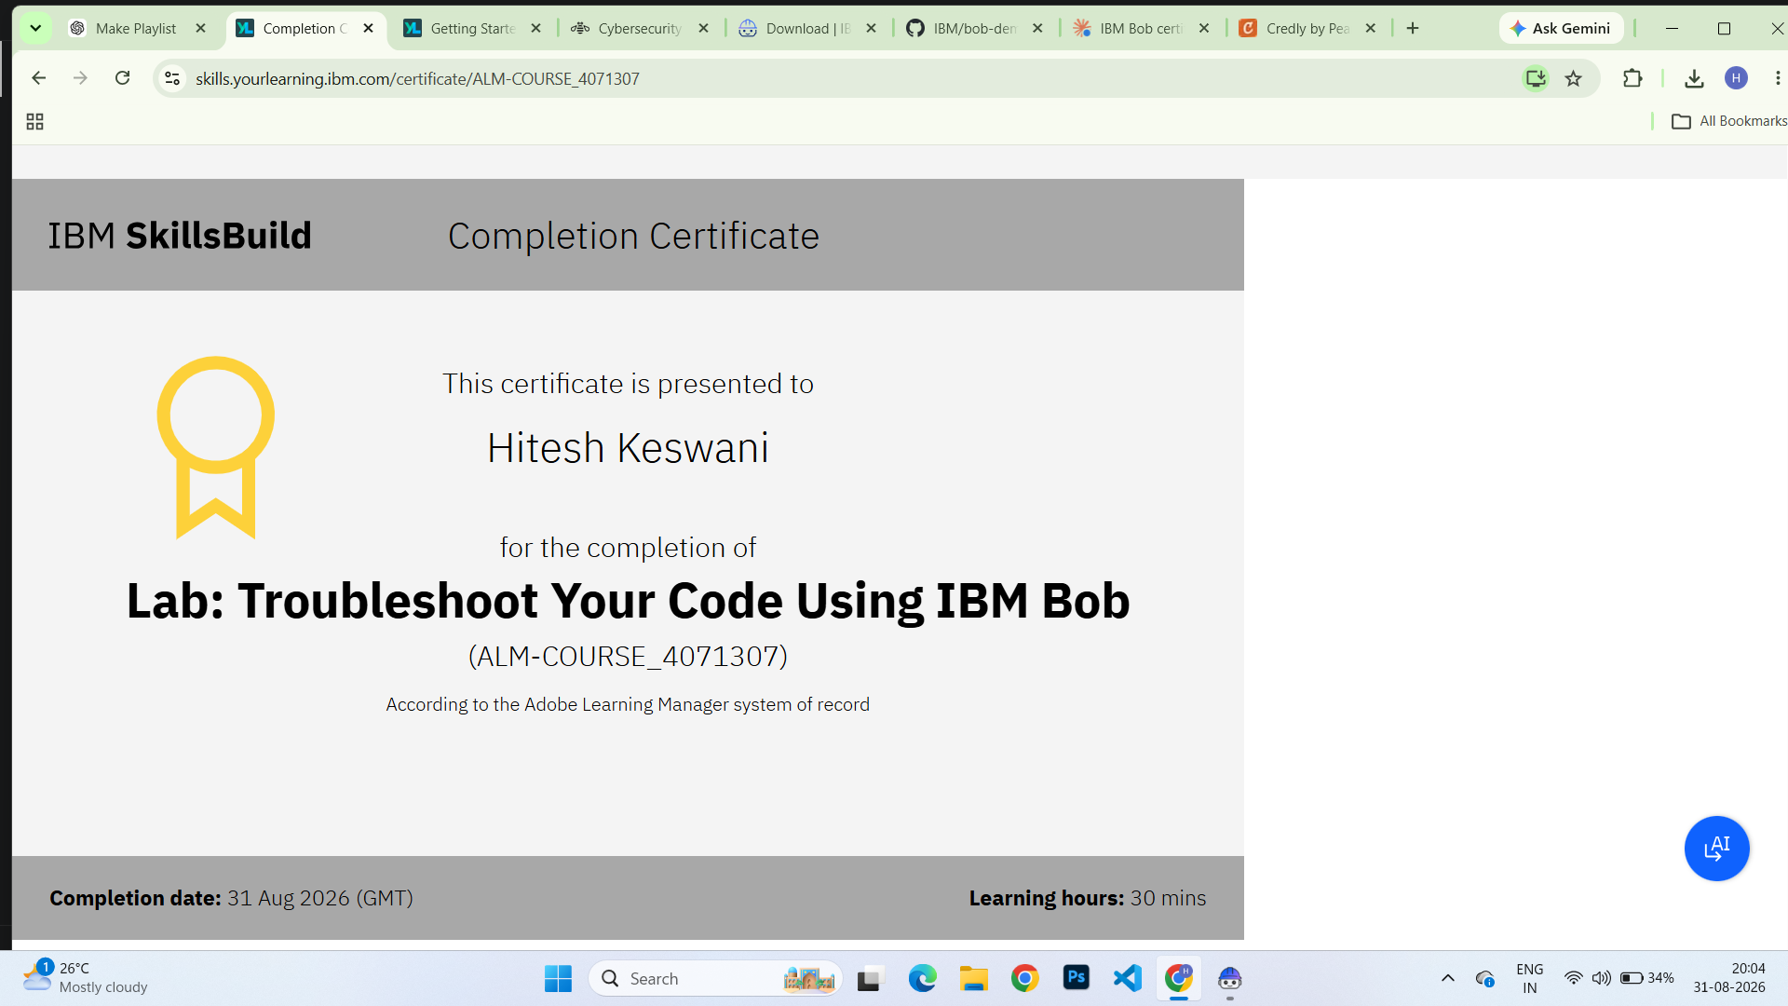
Certificates Earned:​
Add your IBM BOB Certificate

Slide 22


