Slide 1


‹#›
FPN-Mamba: A Feature Pyramid Network with
Bidirectional State Space Models for
Medulloblastoma Classification
Adetoro Damilola | Adeniji Samuel
22/04/2026
Notes:
‹#›
Main title: 40 pt. Arial
Presenter Name: 16 pt. Arial
Presenters Title: 16 pt. Arial Italic

Slide 2
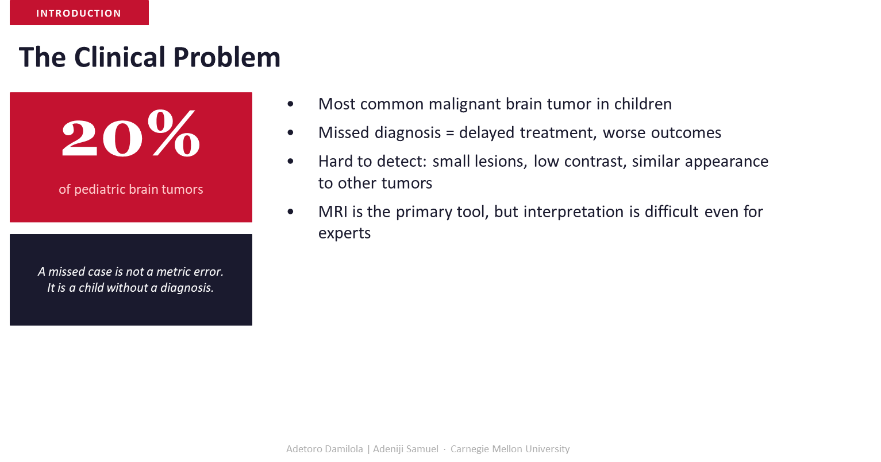
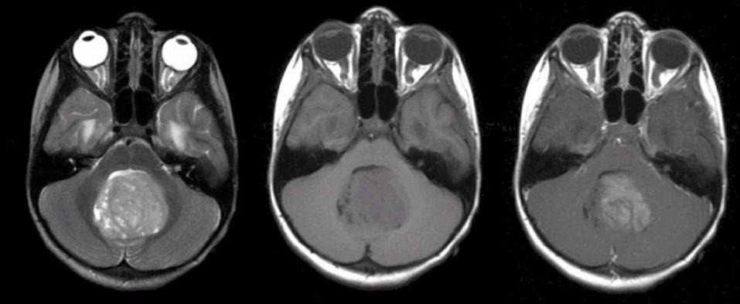

Slide 3

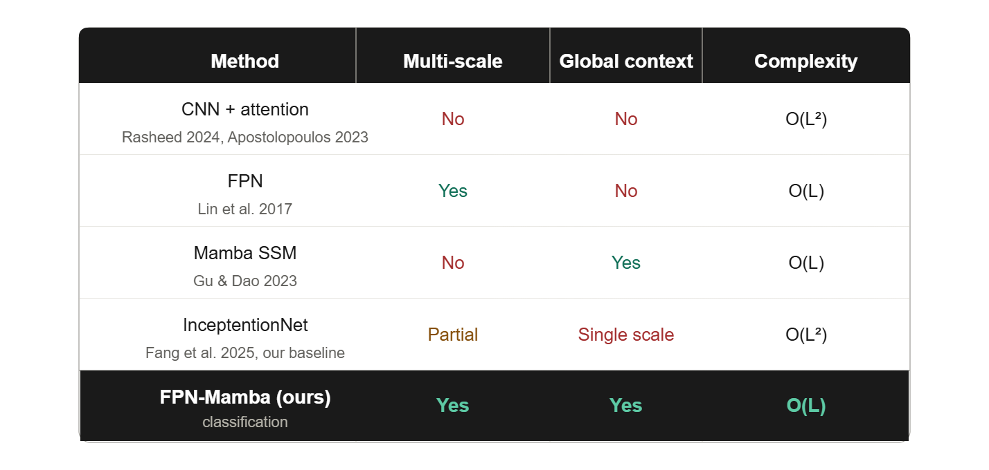
Notes:
‹#›

Slide 4
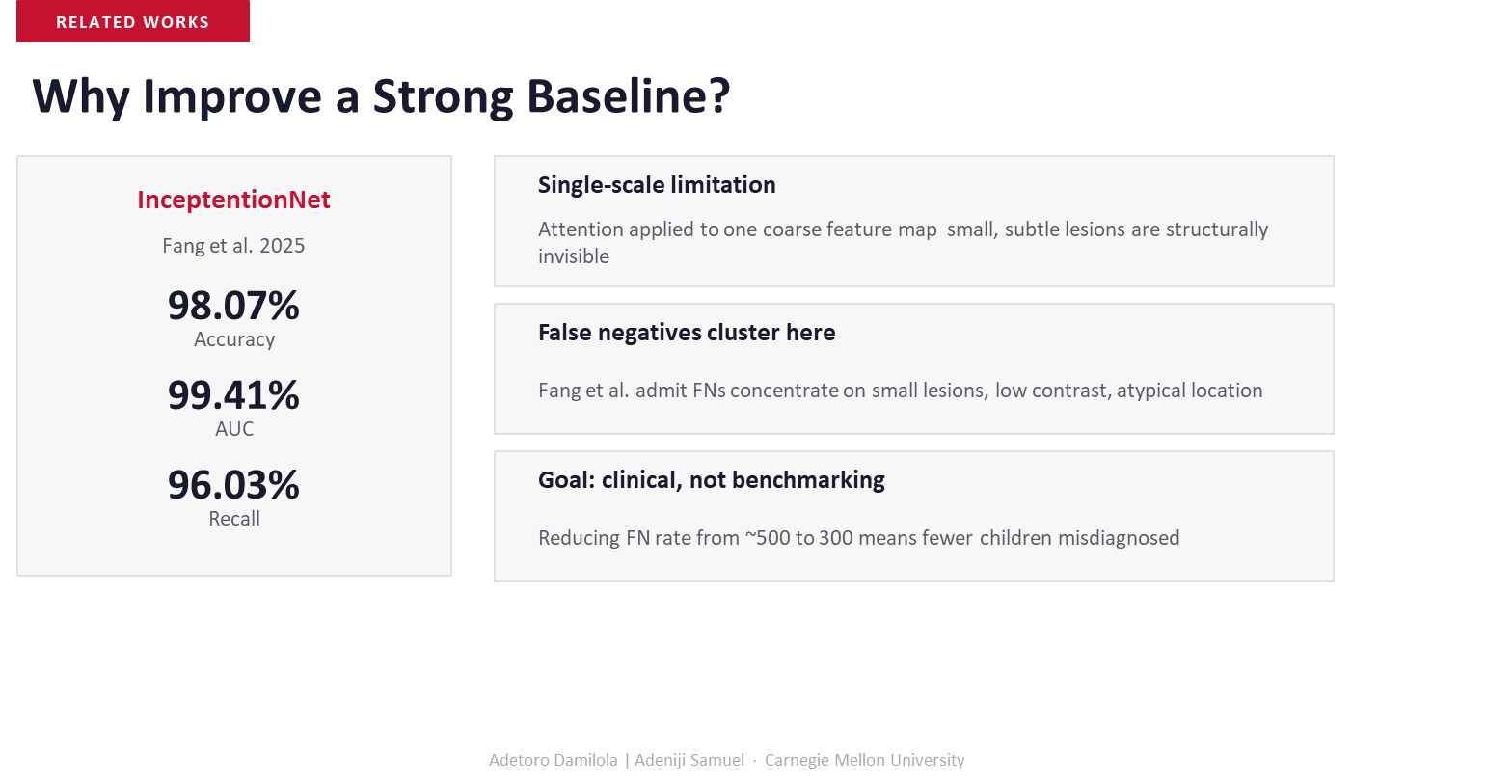
‹#›
Notes:
‹#›

Slide 5
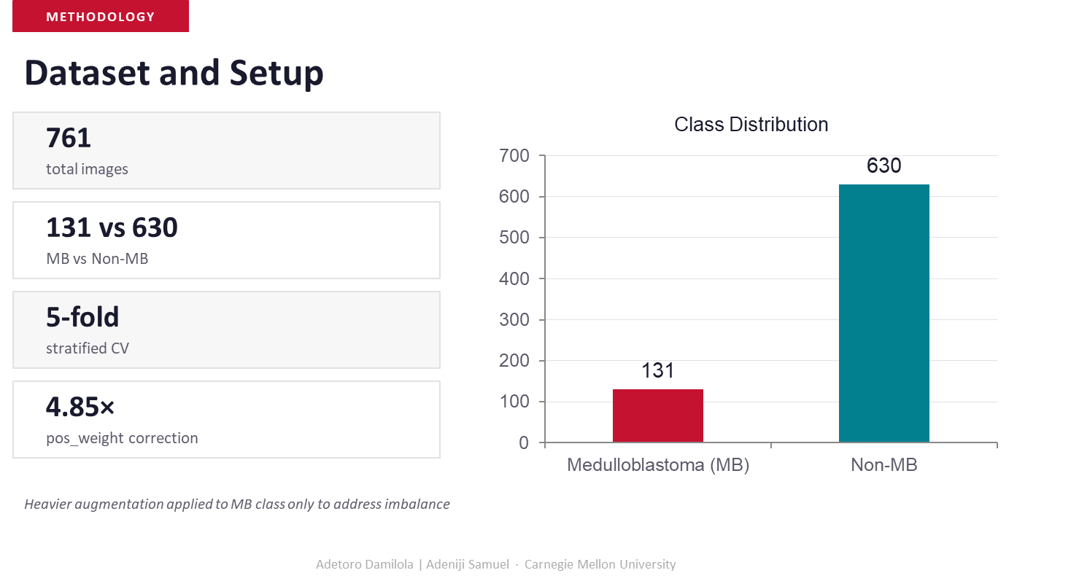

‹#›
‹#›
‹#›
Notes:
‹#›

Slide 6
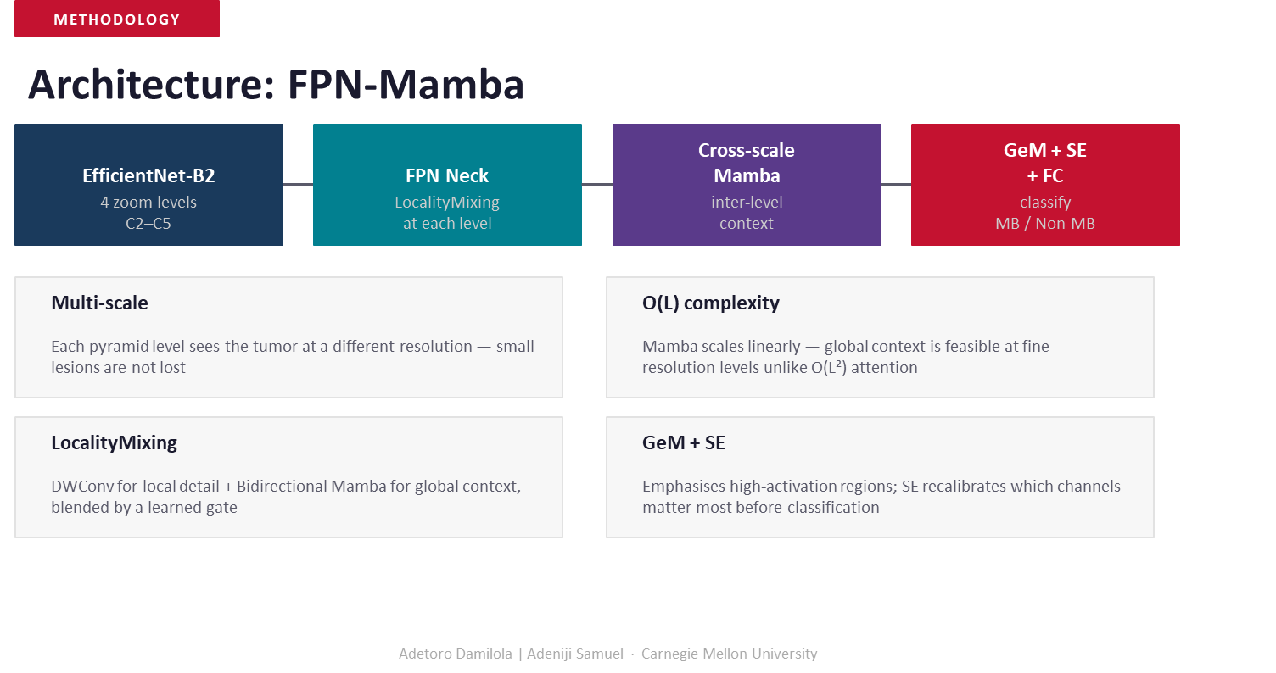
Notes:
‹#›

Slide 7
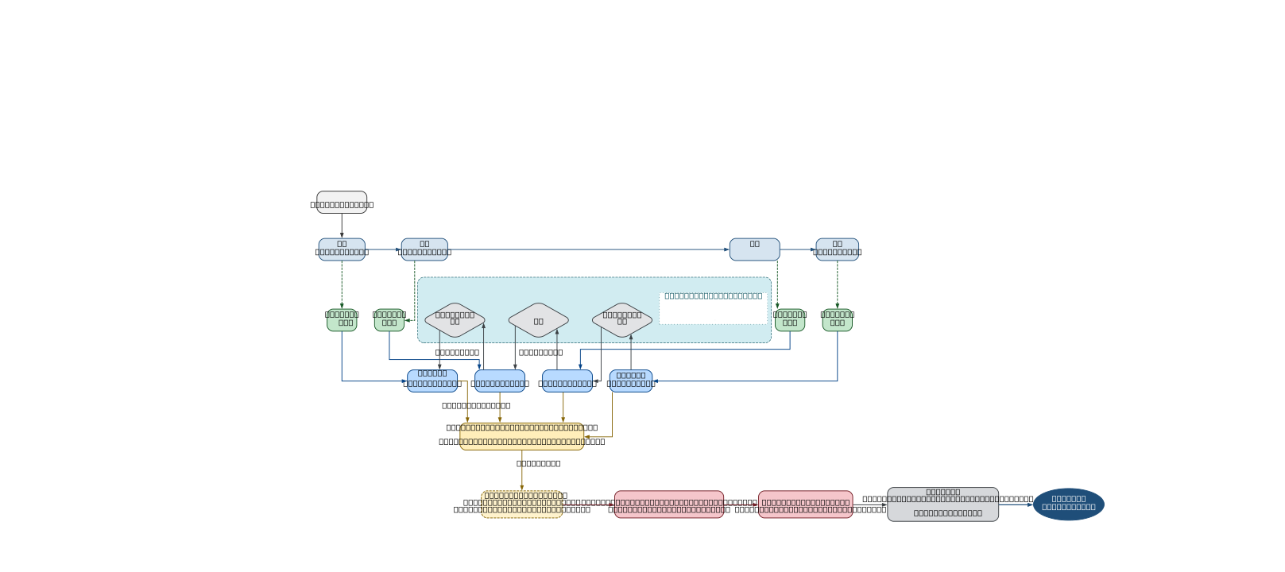

Notes:
‹#›

Slide 8
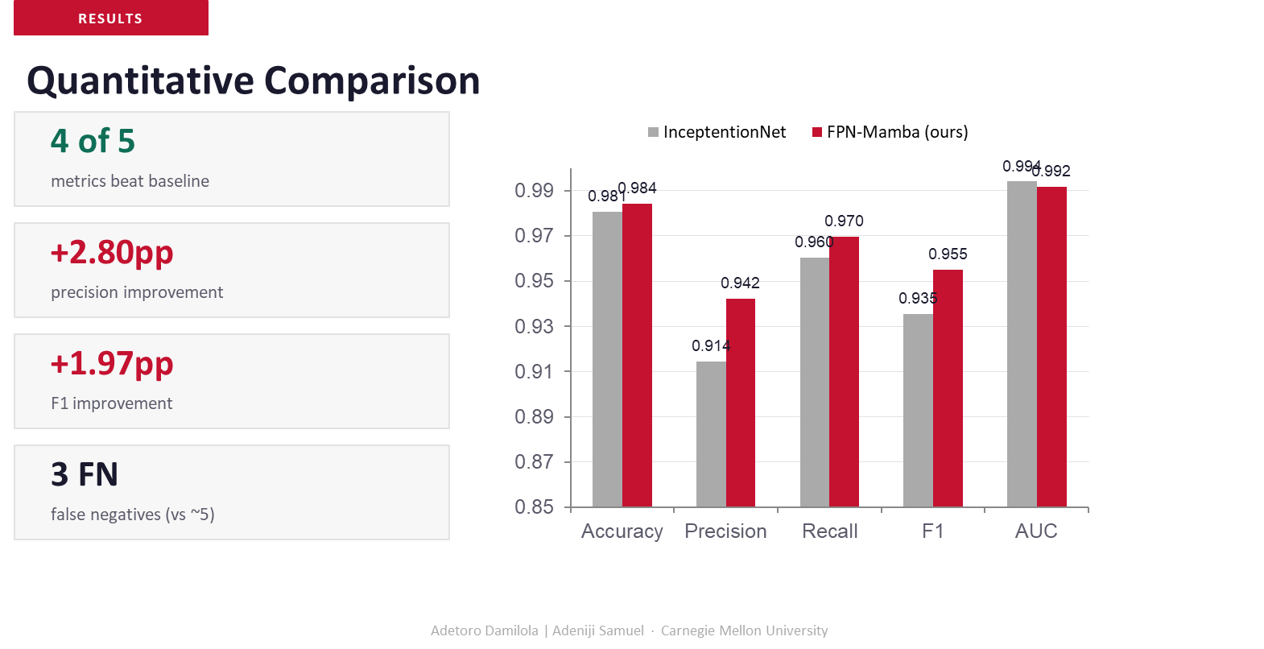
Notes:
‹#›

Slide 9
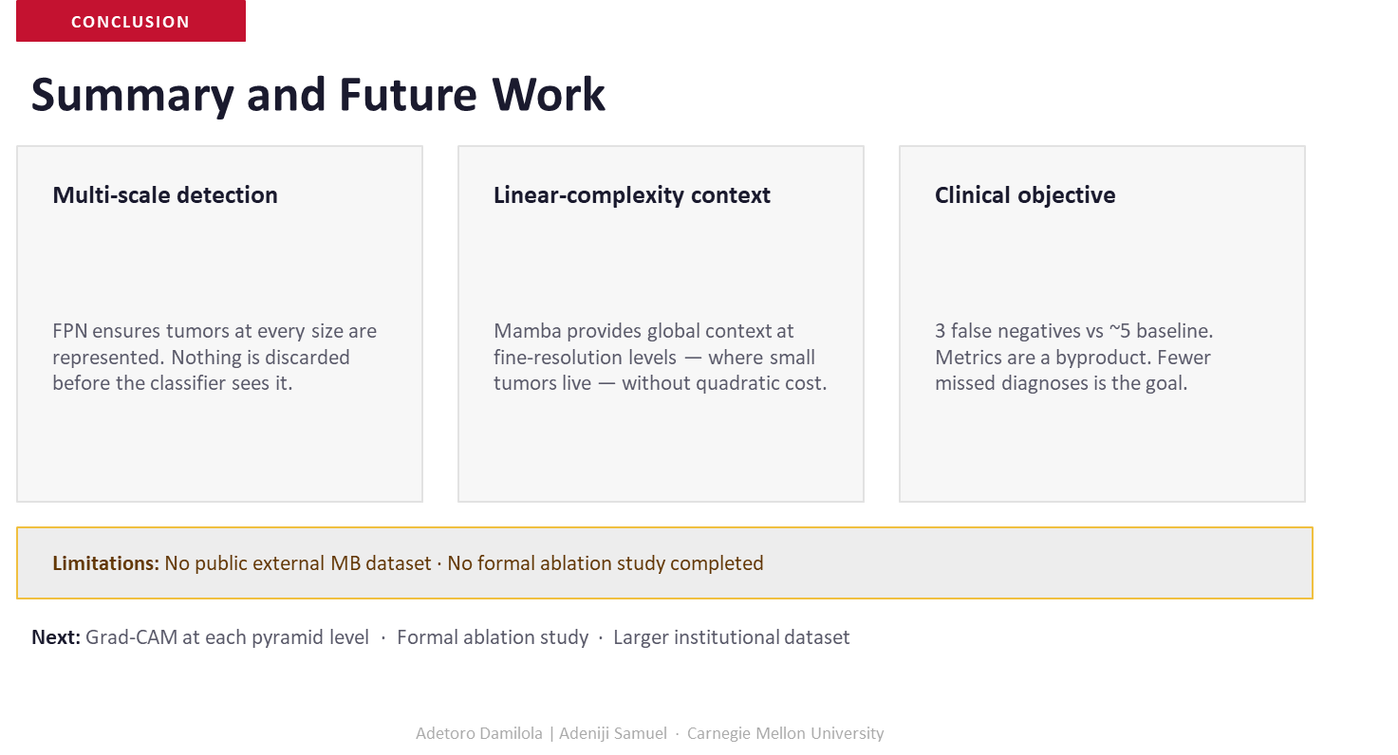
Notes:
‹#›

Slide 10

Notes:
‹#›

Slide 11

‹#›
‹#›
‹#›
‹#›

