Slide 1
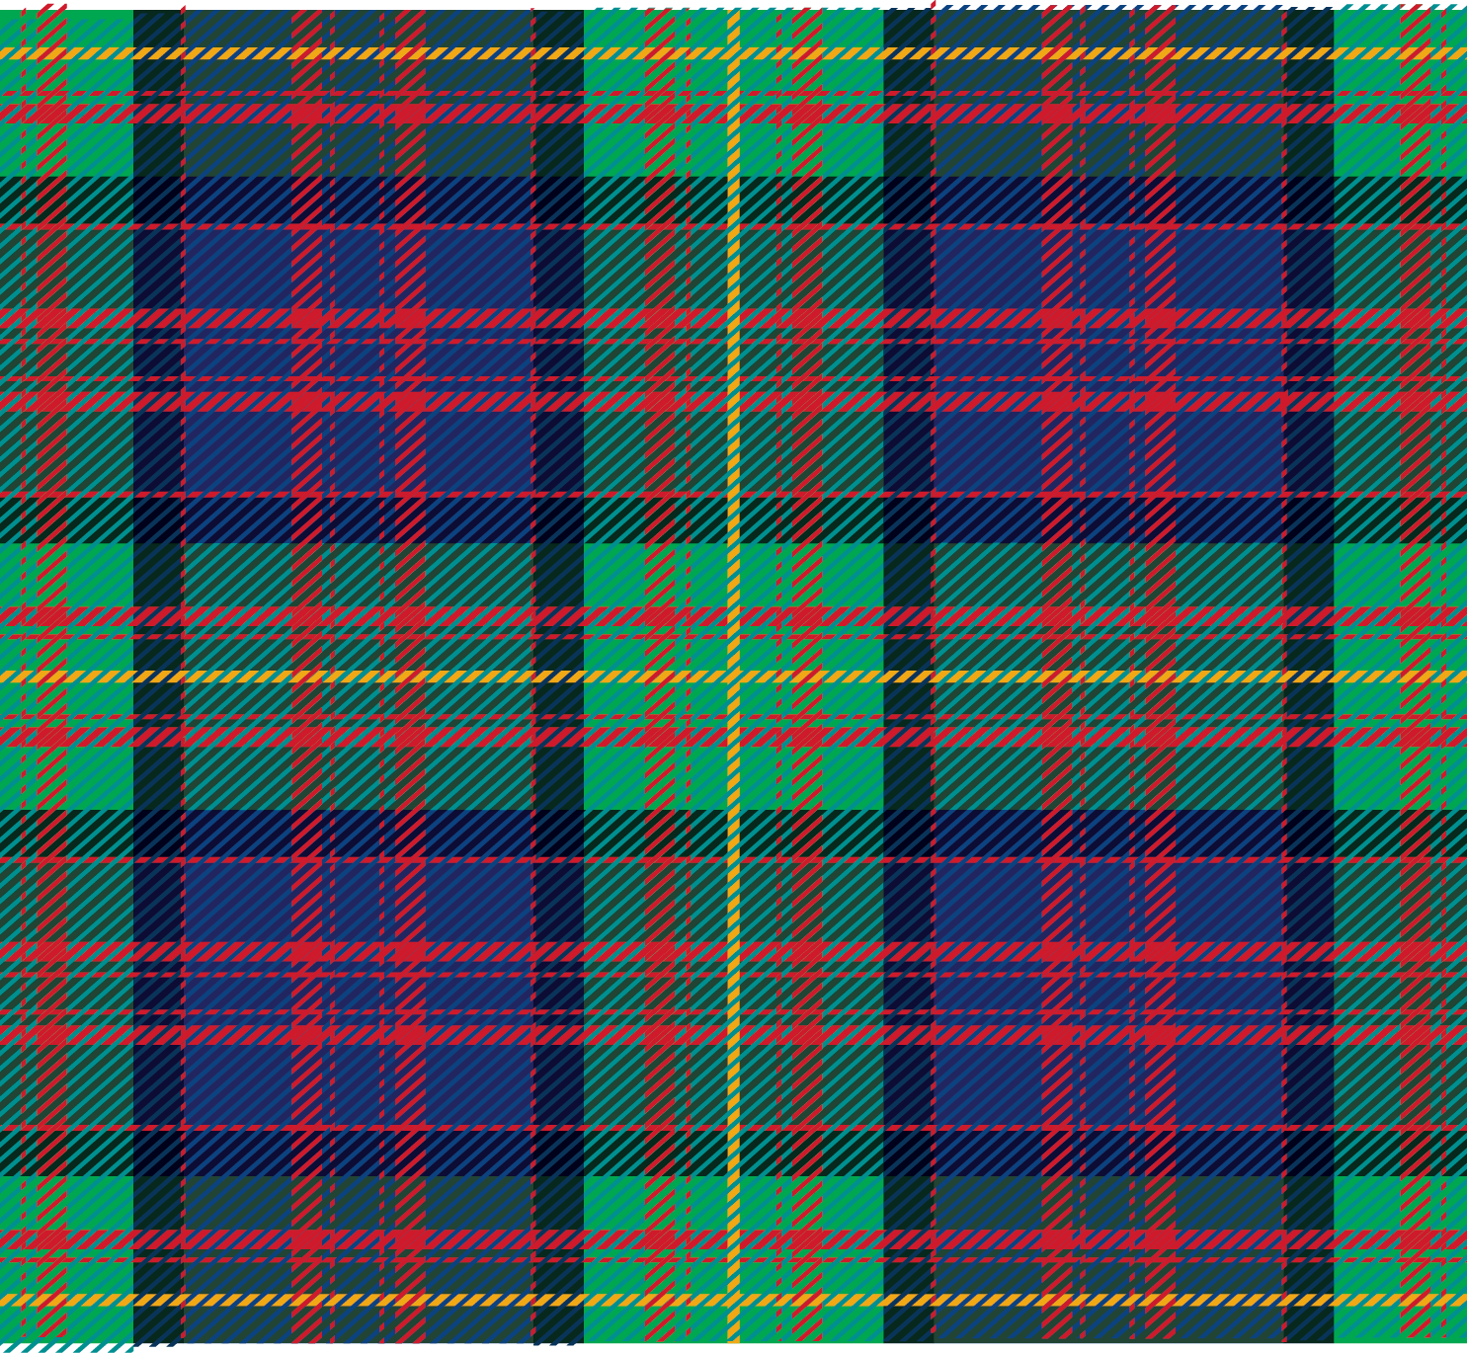

‹#›
FPN-Mamba: A Feature Pyramid Network with
Bidirectional State Space Models for
Medulloblastoma Classification
Adetoro Damilola | Adeniji Samuel
22/04/2026
Notes:
Welcome and Introduction
Good [morning/afternoon], everyone. My name is [Adetoro Damilola / Adeniji Samuel], and today my partner and I are presenting our project: FPN-Mamba — a Feature Pyramid Network combined with Bidirectional State Space Models for the classification of Medulloblastoma brain tumors. This work was developed at Carnegie Mellon University and was submitted on April 22, 2026.
Let me set the stage quickly: Medulloblastoma is the most common malignant brain tumor found in children. Diagnosing it accurately and early is a matter of life and death. Radiologists rely on MRI scans, but these tumors can be extremely subtle — small, low-contrast, and easy to confuse with other tumor types. Our goal was to build a deep learning model that is not only accurate on a benchmark, but actually helpful in a clinical setting, by reducing the number of children whose tumors are missed entirely.
Over the next several slides, we will walk you through: the clinical problem, what existing methods get right and wrong, the design of our model, the dataset we used, the results we achieved, and finally what we learned and where this work can go next. Please feel free to hold questions until the end, or raise your hand if something needs immediate clarification.

Slide 2
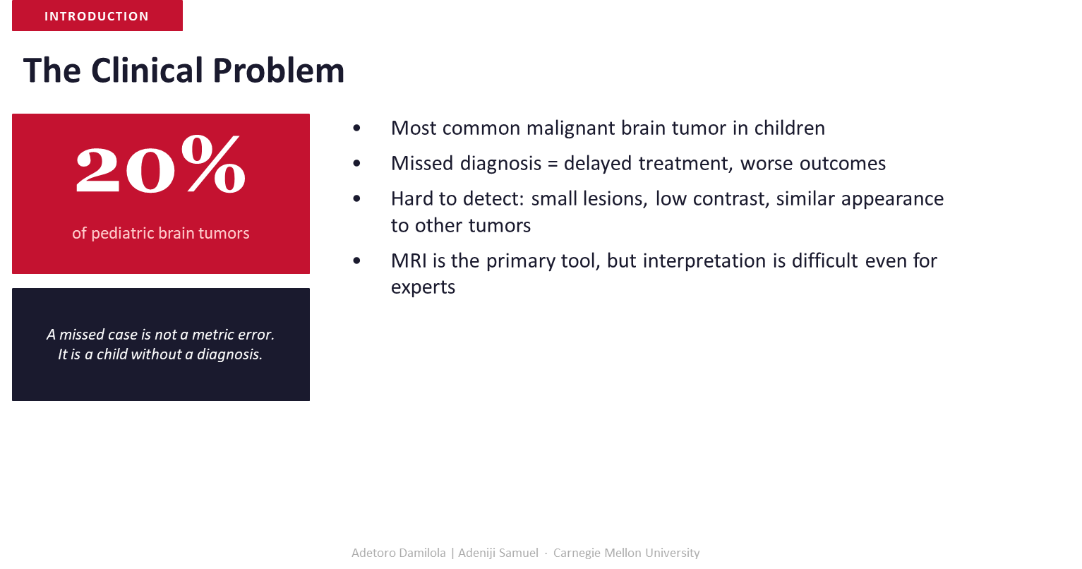
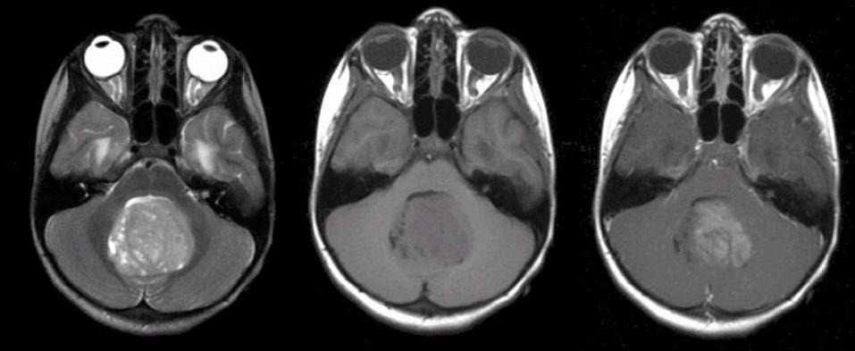
Notes:
The Clinical Problem — Why This Matters
This slide grounds the entire project in a real-world, human problem. Medulloblastoma accounts for roughly 20 percent of all pediatric brain tumors — so roughly one in five malignant brain tumors in children is this type. That makes it not a rare edge case, but the dominant challenge facing pediatric neuro-oncology.
The core diagnostic difficulty is this: these tumors are detected using MRI, but MRI interpretation for Medulloblastoma is genuinely hard — even for experienced radiologists. The lesions can be very small, they have low contrast against surrounding tissue, and they can look similar to benign or different malignant tumors. This makes false negatives — cases where a tumor is present but missed — far too common.
And here is what the dark box on this slide is trying to make viscerally clear: A missed case is not a metric error. It is a child without a diagnosis. When we talk about false negatives in this project, we are not discussing a statistical abstraction. We are talking about real children who do not receive timely treatment, and for whom the prognosis worsens dramatically with every passing week. That is the lens through which every design decision in this project was made.

Slide 3

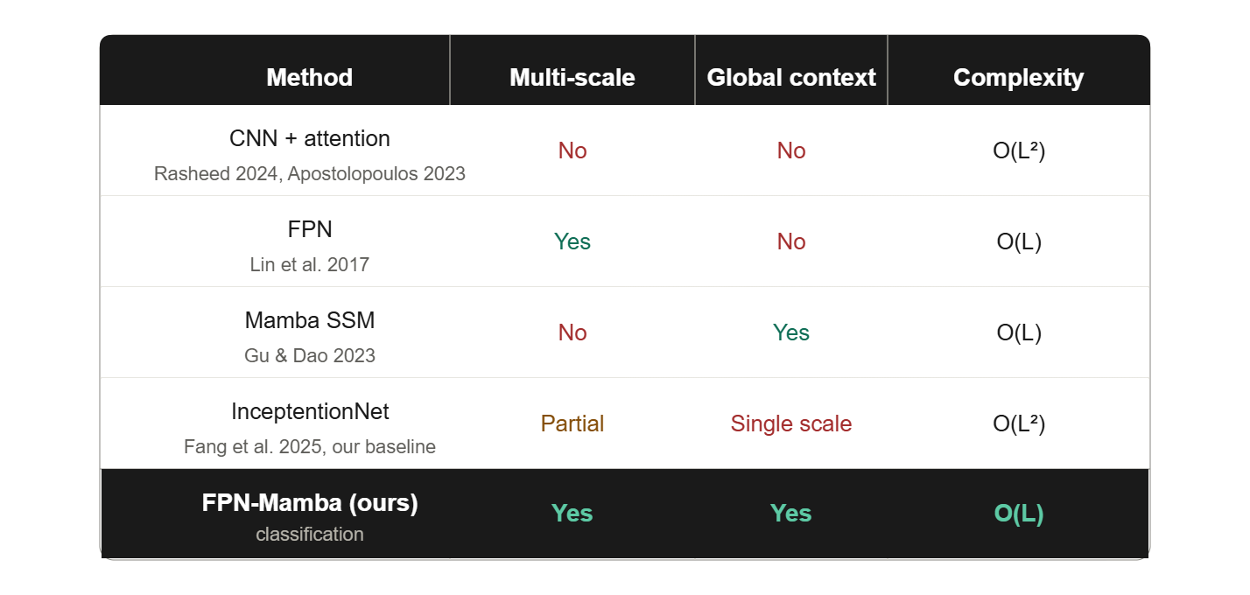
+
Notes:
Related Works — The Research Landscape
Before building our model, we reviewed the existing landscape. This comparison table summarizes the four most relevant approaches and how our method, FPN-Mamba, differs from them.
CNN with attention models — from Rasheed 2024 and Apostolopoulos 2023 — neither support true multi-scale feature extraction nor global context modeling. They also have quadratic O(L squared) complexity, which limits how fine-grained their analysis can be at high resolutions. Feature Pyramid Networks, as introduced by Lin et al. in 2017, do support multi-scale processing — which is a major advantage — but they lack global context. The Mamba SSM approach from Gu and Dao in 2023 is the opposite: excellent global context modeling at linear O(L) complexity, but only at a single scale. InceptiontionNet from Fang et al. 2025 — which becomes our baseline — achieves partial multi-scale processing, but only at a single coarse scale, and still carries quadratic complexity.
The gap is clear and was our research motivation: no prior work combines full multi-scale feature extraction with global context modeling at linear complexity specifically for Medulloblastoma classification. FPN-Mamba is our attempt to fill that gap. Every other method sacrifices at least one of these three desirable properties. We sacrifice none.

Slide 4
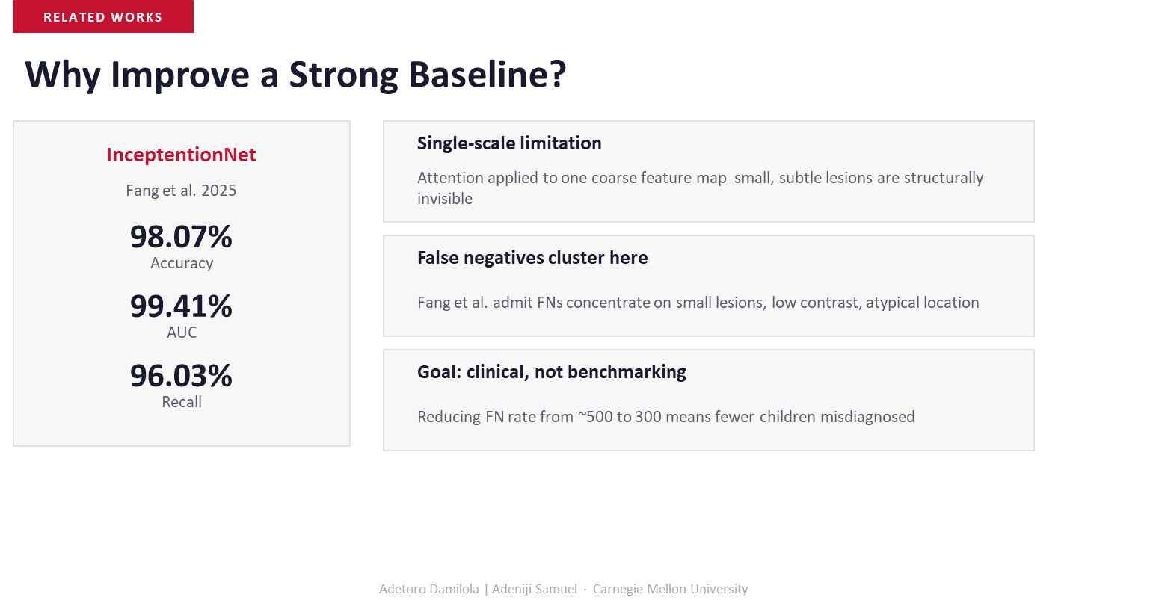
‹#›
Notes:
Why Improve a Strong Baseline?
You might reasonably ask: InceptiontionNet from Fang et al. already achieves 98.07% accuracy and a 99.41% AUC. Why would you try to improve on something so strong?
The answer is that accuracy alone is not the right objective in a clinical setting. Fang et al. themselves admit in their paper that false negatives cluster in a very specific and troubling pattern: small lesions, low-contrast regions, and atypical anatomical locations. These are exactly the hardest cases — and these are the cases that matter most clinically. A model that gets 98% accuracy but systematically misses the hardest 2% of cases is not safe to deploy.
Think about it concretely: if there are roughly 15,000 pediatric Medulloblastoma cases diagnosed globally each year, a model with a 2% false negative rate would miss approximately 300 children. A reduction from roughly 500 to 300 missed cases is not a marginal improvement — it is 200 fewer children going undiagnosed. That is the clinical goal we set for ourselves. Every architectural decision we made was oriented toward minimizing false negatives, not just maximizing accuracy.

Slide 5
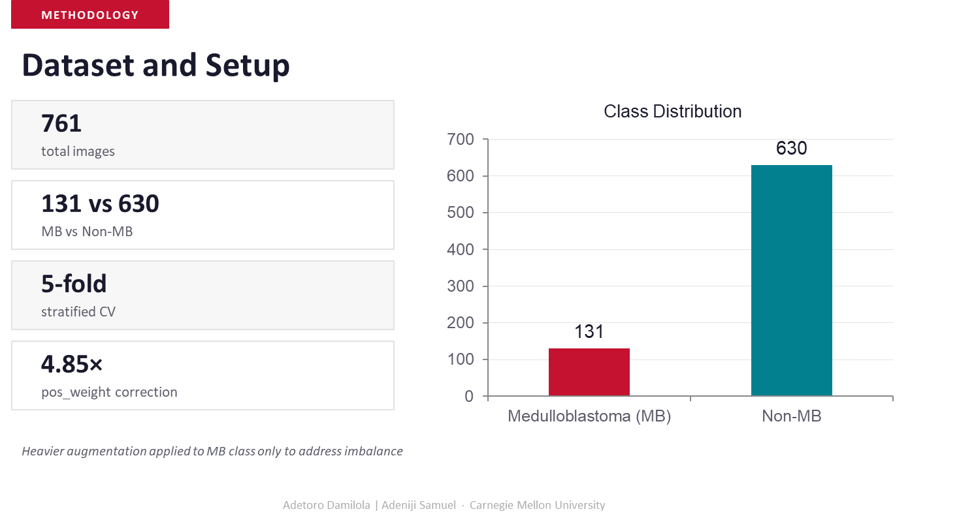

‹#›
‹#›
‹#›
Notes:
Dataset and Experimental Setup
Let me walk you through the data we worked with and how we configured our experiments. The full dataset contains 761 MRI images in total. However, these images are not evenly distributed: 131 are labeled as Medulloblastoma, and 630 are labeled as Non-MB. That is a class imbalance ratio of roughly 4.85 to 1 in favor of the negative class.
This imbalance is itself clinically meaningful — it reflects the real-world rarity of Medulloblastoma relative to all other brain conditions that might appear on a pediatric MRI. But it also presents a machine learning challenge, because a naive model could achieve 83% accuracy simply by predicting Non-MB every time. To address this, we took two complementary approaches: first, we applied a pos_weight correction of 4.85x to the Binary Cross-Entropy loss function, which penalizes the model more heavily for missing a positive Medulloblastoma case. Second, we applied heavier data augmentation specifically to the MB class — including random flips, rotations, and color jitter — to artificially expand the minority class representation during training.
For evaluation, we used 5-fold stratified cross-validation. Stratification ensures that each fold maintains the same 131-to-630 MB-to-Non-MB ratio as the full dataset. This is important because non-stratified folds could accidentally create folds with no positive cases, making evaluation unreliable. All results reported in this presentation are averaged across all 5 folds.

Slide 6
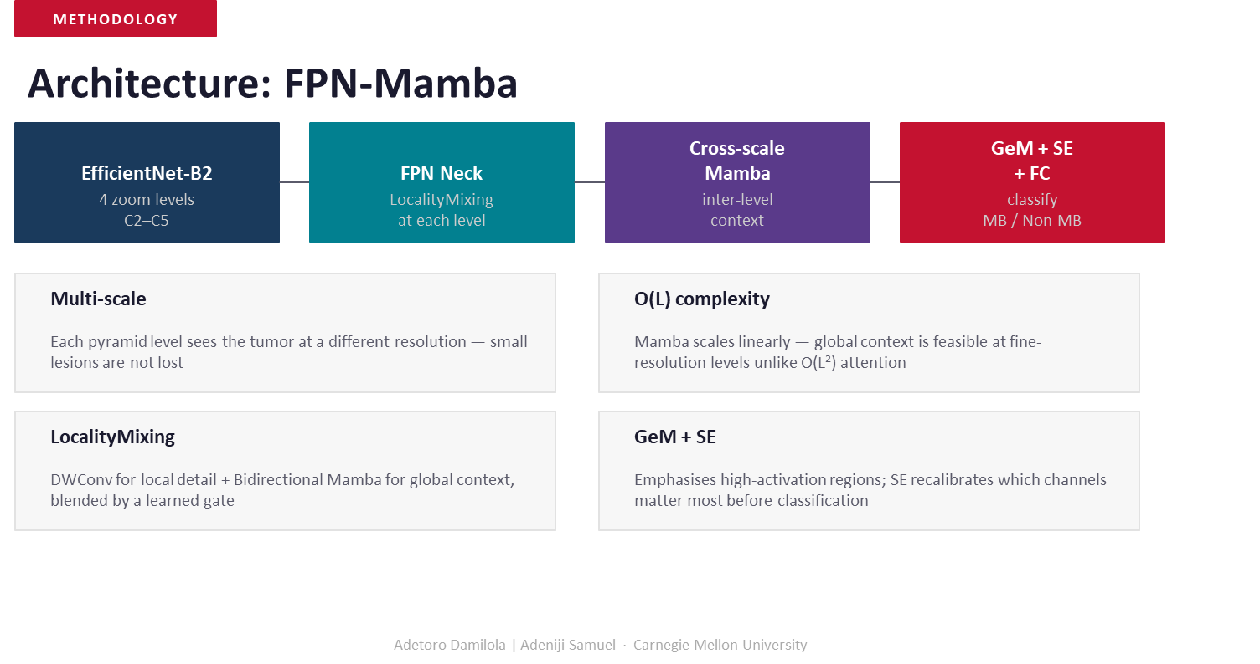
Notes:
Architecture Overview — FPN-Mamba
This slide gives you the high-level architecture before we dive into the detailed diagram on the next slide. FPN-Mamba is composed of four major components chained together.
The backbone is EfficientNet-B2, operating at four zoom levels — specifically feature map stages C2 through C5. EfficientNet-B2 was chosen for its strong performance-to-parameter ratio. It extracts feature maps at progressively smaller spatial resolutions but increasingly rich semantic content as you go from C2 to C5.
These four feature maps are then passed through the FPN Neck, which includes our custom LocalityMixing module at each pyramid level. LocalityMixing fuses local spatial detail — captured via a depthwise 3x3 convolution — with global context captured via a Bidirectional Mamba sequence model, blended using a learned sigmoid gate. This is the key innovation in the neck.
The four pyramid outputs — P2 through P5 — are then serialized and passed through a Cross-Scale Bidirectional Mamba block, which allows the model to reason about inter-level relationships — for example, connecting a pattern at the coarse P5 level to a corresponding region at the fine P2 level.
Finally, generalized mean pooling followed by Squeeze-and-Excitation channel attention and a three-layer fully connected head produces the final binary classification output: MB or Non-MB. The O(L) complexity of Mamba means this entire pipeline scales linearly with image resolution — unlike attention-based alternatives which scale quadratically.

Slide 7
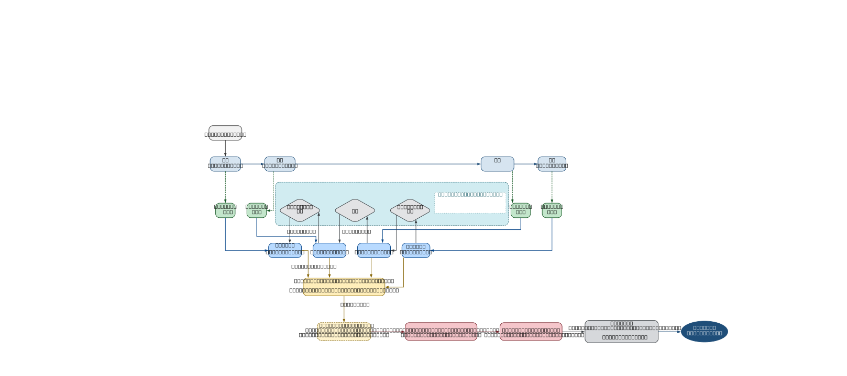

6
Notes:
Full Architecture Diagram
This slide shows the complete data flow through FPN-Mamba in engineering detail. Let me walk you through it step by step.
The input is a 224x224x3 MRI image. EfficientNet-B2 extracts four feature maps: C2 at 56x56 with 24 channels, C3 at 28x28 with 48 channels, C4 at 14x14 with 120 channels, and C5 at 7x7 with 352 channels. Each of these is projected to a common 256-channel width via a 1x1 lateral convolution.
Within the FPN Neck, top-down upsampling merges higher-level semantics with lower-level spatial detail. At each level, the merged feature map passes through our LocalityMixing block, which runs a DWConv3x3 path for local feature detail in parallel with a Bidirectional Mamba path for global context, and blends them via a learned sigmoid gate. This produces pyramid maps P2 through P5, each at 256 channels but different spatial resolutions.
All four pyramid maps are then flattened and concatenated into a single sequence, which is fed into the Cross-Scale Bidirectional Mamba module. This module processes the entire multi-scale sequence in both forward and backward directions, capturing inter-level dependencies. The output is then reshaped back into four spatial maps.
GeM Pooling with learned parameter p=3 pools each pyramid level independently into a 256-dimensional vector, and these are concatenated into a 1024-dimensional representation. SE Channel Attention recalibrates channel importance via a bottleneck of 64 dimensions. Finally, three fully connected layers — 1024 to 512 to 128 to 1 — with GELU activations, batch normalization, and dropout produce the final logit, passed through sigmoid for binary classification.

Slide 8
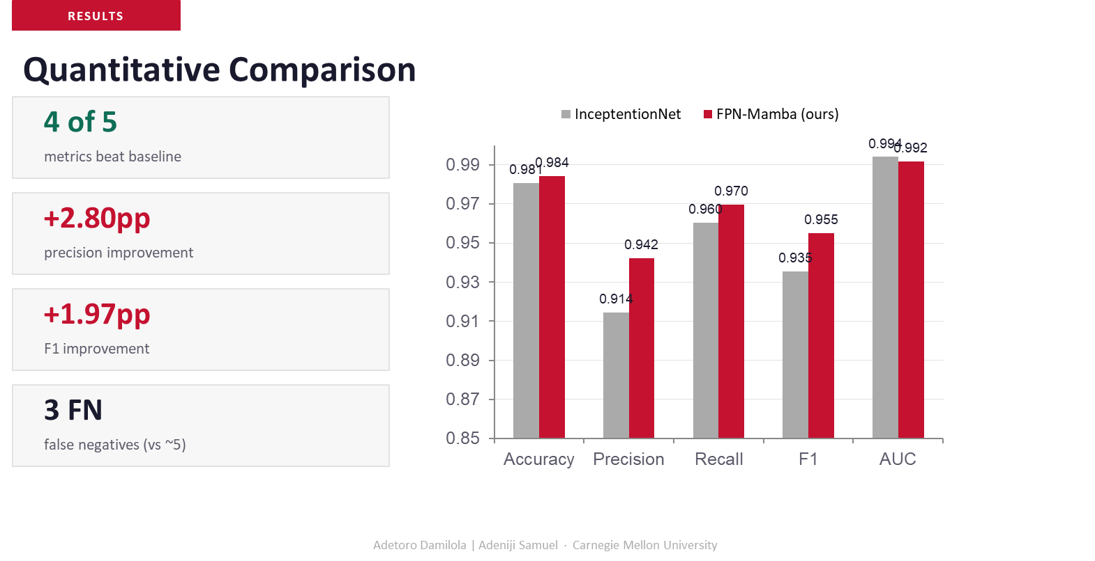
Notes:
Quantitative Results
Let me now present the quantitative comparison between our FPN-Mamba model and the InceptiontionNet baseline. The headline result is that FPN-Mamba beats InceptiontionNet on 4 out of 5 evaluation metrics.
Looking at the bar chart: Accuracy improved from 0.980 to 0.984. Precision improved substantially from 0.914 to 0.942, a gain of plus 2.80 percentage points. Recall improved from 0.960 to 0.970. F1 score improved from 0.935 to 0.955, a gain of plus 1.97 percentage points. AUC remained essentially the same, with both models achieving near-perfect 0.99 AUC.
But the most important number on this slide is not one of those five metrics. It is the false negative count. FPN-Mamba produced only 3 false negatives across the test folds, compared to approximately 5 for the baseline. In the context of this problem — where each false negative represents a child with an undetected tumor — reducing the FN count from 5 to 3 is the real result. That is a 40% reduction in missed diagnoses, which is clinically meaningful.
We want to be clear that these results come from a relatively small dataset of 761 images. The model has not been validated on an independent external dataset. But the direction of the results is encouraging, and the architectural design choices appear to be paying off in exactly the ways we hypothesized.

Slide 9
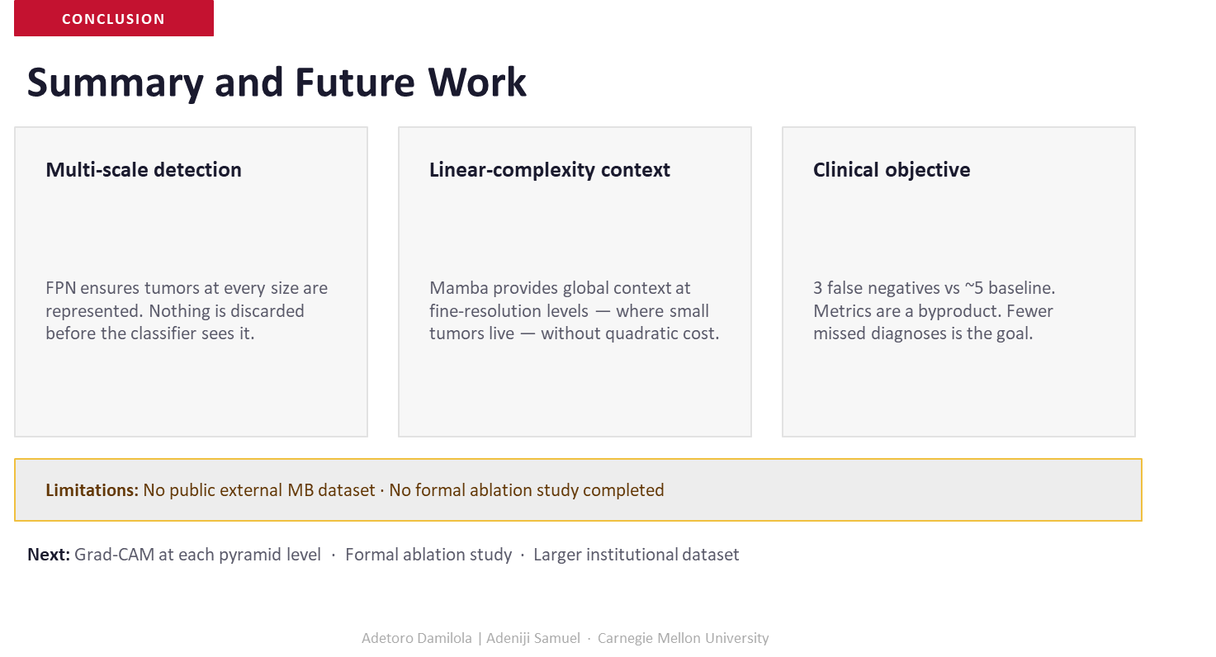
Notes:
Summary and Future Work
To conclude, let me summarize the three core contributions of this project and then outline the path forward.
First, multi-scale detection: by using a Feature Pyramid Network, we ensure that tumor-related features at every spatial scale — from fine-grained 56x56 detail at P2 to coarse 7x7 semantic content at P5 — are all preserved and presented to the classifier. Nothing is discarded because it is too small or too subtle.
Second, linear-complexity global context: by using Bidirectional Mamba rather than attention, we can model global relationships across the entire feature map at fine resolutions without the quadratic computational cost that would otherwise make this prohibitive.
Third, clinical objective: with 3 false negatives versus approximately 5 for the baseline, we have moved the needle in the direction that matters — fewer missed diagnoses, not just higher benchmark scores.
We are honest about our limitations. We do not have access to a public external Medulloblastoma MRI dataset to test generalizability across different hospitals and scanners. We also have not yet completed a formal ablation study — meaning we have not systematically isolated the contribution of each component such as LocalityMixing, Cross-Scale Mamba, or GeM Pooling individually.
For future work, we plan to apply Grad-CAM visualization at each pyramid level to understand which spatial regions the model is attending to, which will be important for clinical interpretability. We also plan a formal ablation study and aim to validate on a larger, multi-institutional dataset.

Slide 10
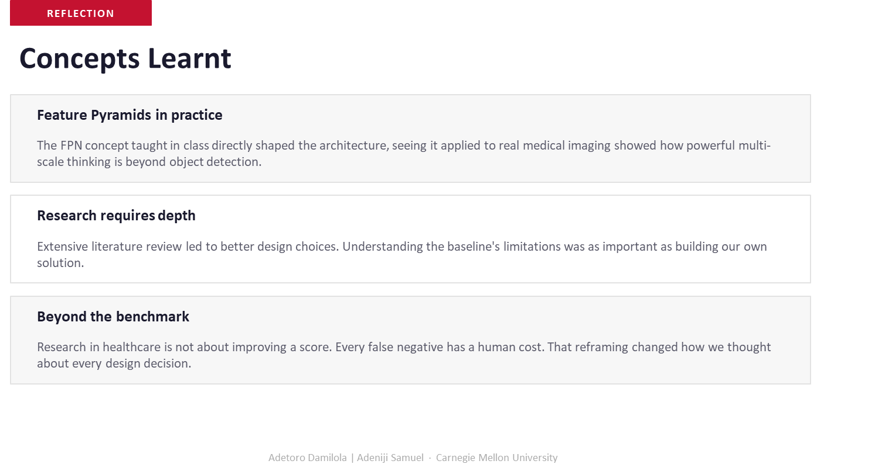
Notes:
Concepts Learnt — Reflection
This slide captures some of the key learning moments from this project beyond the technical results.
The first lesson is Feature Pyramids in practice. In class we studied FPNs in the context of object detection benchmarks. Applying them to a real medical imaging task made the concept click differently — we saw first-hand why representing an object at multiple scales is not just a performance trick but a necessity when the object of interest can appear at many different sizes and locations in the image. That shift from abstract concept to concrete application is something we will carry forward.
The second lesson is that research requires depth. We initially underestimated how much the literature review would shape our design. Understanding InceptiontionNet's specific failure modes — that false negatives cluster on small lesions and atypical locations — directly led us to design LocalityMixing as a fine-scale preservation mechanism. Without depth in the related work, our solution would have been much less targeted.
The third and perhaps most profound lesson is about going beyond the benchmark. Healthcare AI is fundamentally different from benchmark AI. In a Kaggle competition, a 0.01 improvement in AUC is a win. In a hospital, a model that achieves excellent AUC but systematically misses small tumors in children can cause real harm. Reframing the objective — from accuracy maximization to false negative minimization — changed how we thought about every design choice, every hyperparameter, and every trade-off throughout this project.

Slide 11

‹#›
‹#›
‹#›
‹#›
Notes:
Thank You — Carnegie Mellon University
This is our closing slide. We want to thank Carnegie Mellon University and our course instructors for providing the framework and resources that made this project possible.
We are happy to take questions. Some areas where we anticipate questions: the specific mechanics of the LocalityMixing block and the learned sigmoid gate; how exactly Bidirectional Mamba processes the flattened pyramid sequence; the details of the class imbalance handling including pos_weight and augmentation strategy; the choice of EfficientNet-B2 as backbone versus alternatives; and the limitations around dataset size and external validation.
If you would like to reproduce this work, the key hyperparameters are: input size 224x224, EfficientNet-B2 pretrained on ImageNet, FPN channels 256, Mamba state dimension 16, batch size 16, learning rate 1e-4 with cosine decay, and 5-fold stratified cross-validation. Thank you very much for your time and attention.

