Slide 1
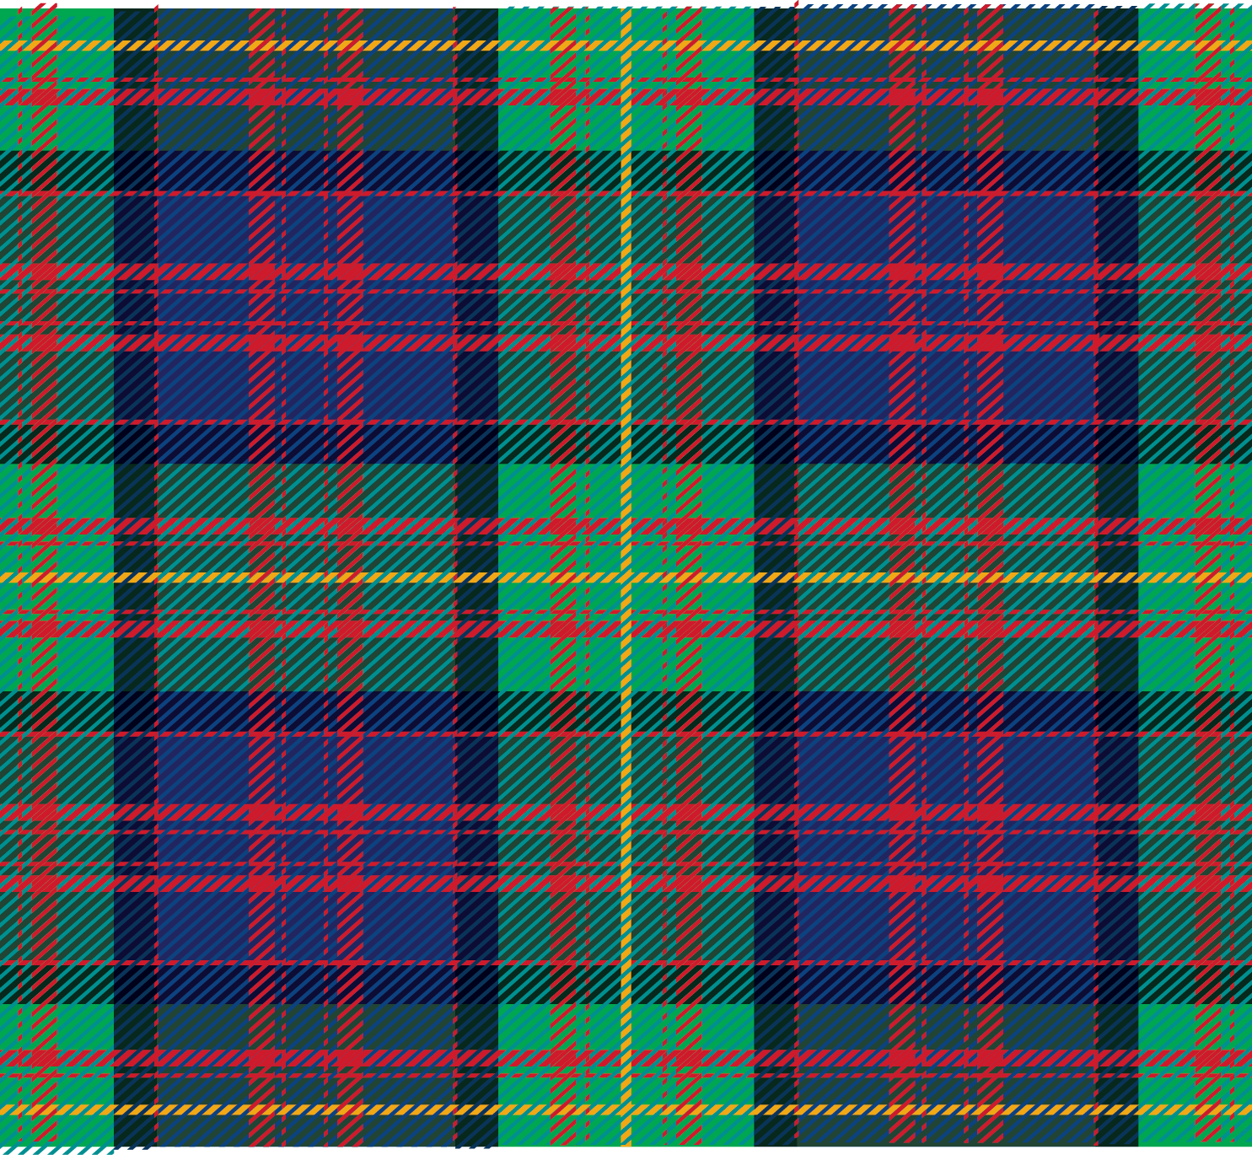

‹#›
FPN-Mamba: A Feature Pyramid Network with
Bidirectional State Space Models for
Medulloblastoma Classification
Adetoro Damilola | Adeniji Samuel
26/04/2026
Notes:
[~20 sec] Good [morning/afternoon]. We're Adetoro and Adeniji from Carnegie Mellon. Today we're presenting FPN-Mamba — a model we built to classify Medulloblastoma brain tumors in children using MRI scans. Let's get into it.

Slide 2
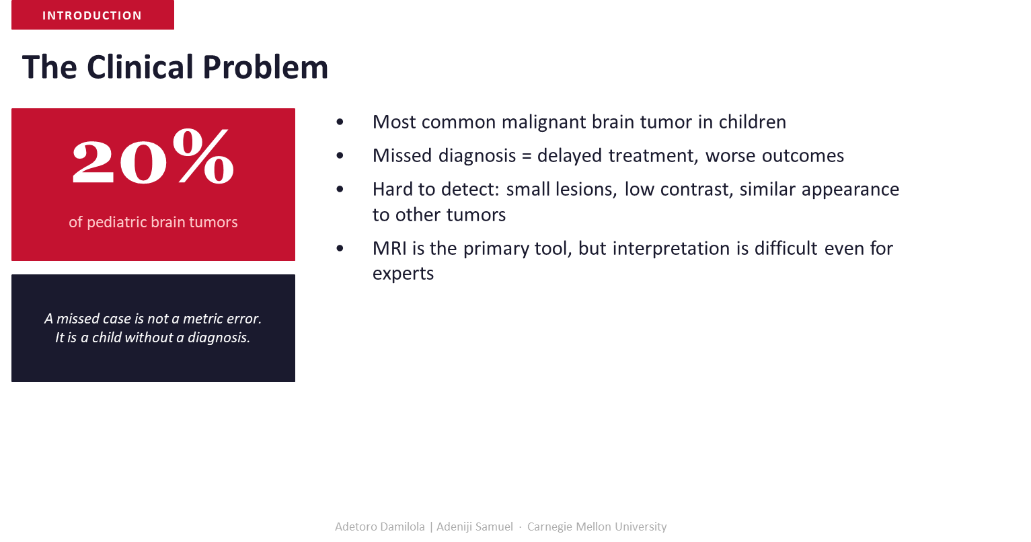
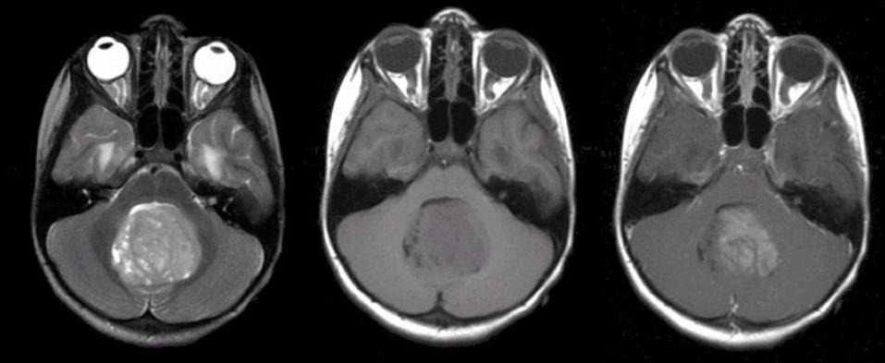
Notes:
[~70 sec — KEY SLIDE]
Medulloblastoma is the most common malignant brain tumor in children, making up 20% of pediatric brain tumors. The core problem: MRI is the only tool radiologists have, but these tumors are tiny, low-contrast, and easy to confuse with other tumor types. That means missed diagnoses are common.
And a missed diagnosis is not a metric error — it is a child who doesn't get treated in time. That framing shaped every decision we made in this project. Our goal wasn't to beat a benchmark. It was to reduce the number of children whose tumors get missed.

Slide 3

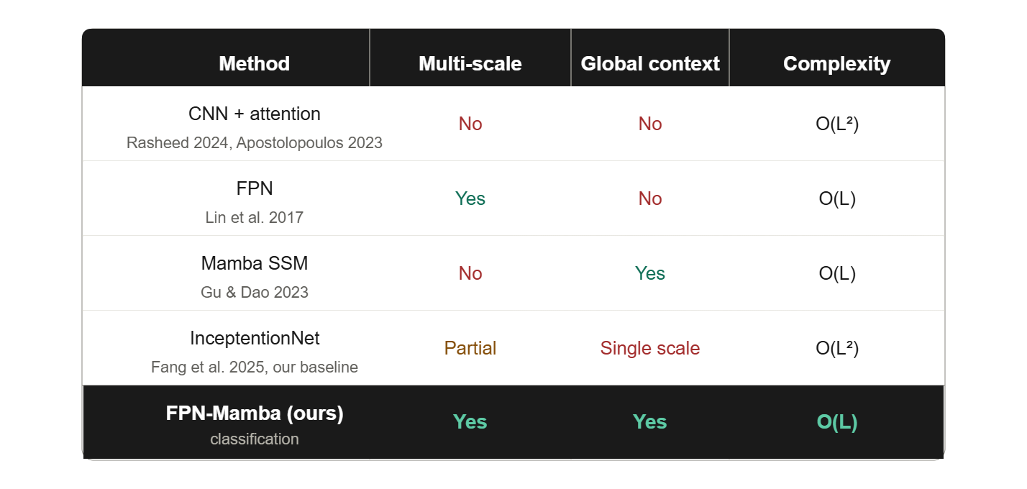
Notes:
[~65 sec — KEY SLIDE]
Here's the landscape of existing approaches. CNN+attention models lack both multi-scale processing and global context. FPN gives you multi-scale but no global context. Mamba SSM gives global context but only at one scale. InceptiontionNet — our baseline — partially handles multi-scale but only at a single coarse level, and still has quadratic complexity.
The gap is clear: no prior work combines full multi-scale features with global context at linear complexity for MB classification. That's exactly what FPN-Mamba is designed to do.

Slide 4
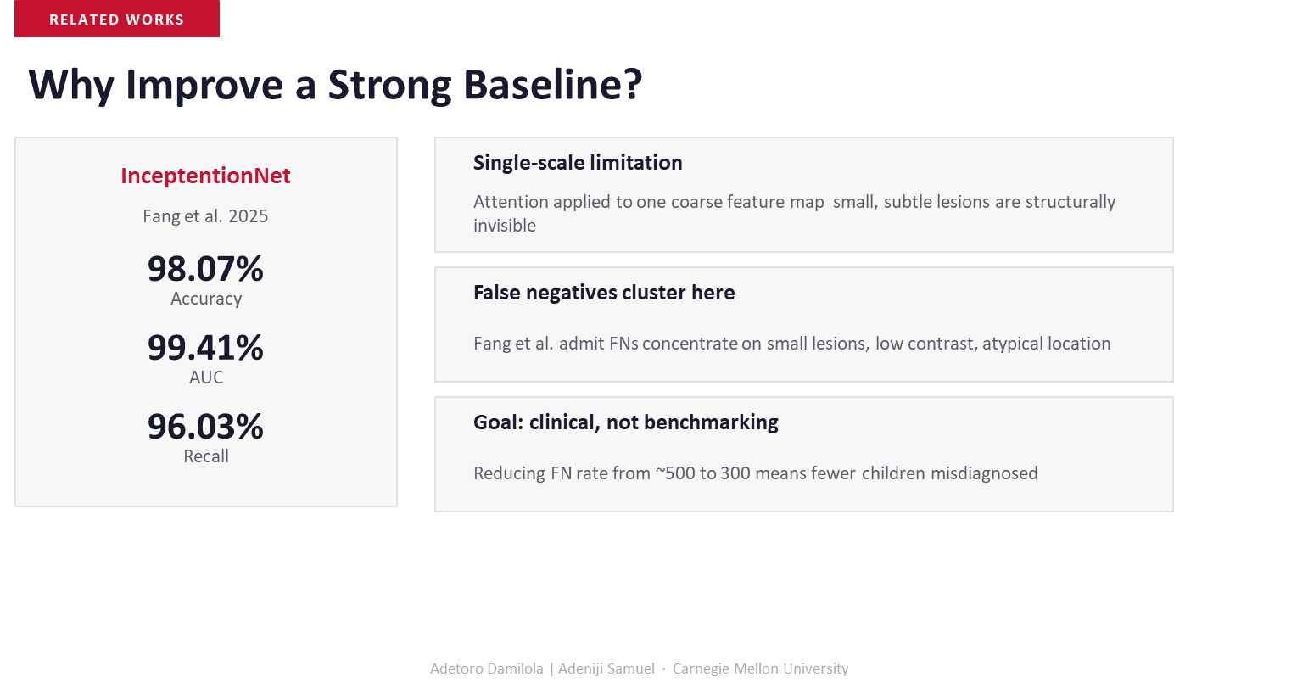
‹#›
Notes:
[~20 sec] InceptiontionNet scores 98% accuracy — but Fang et al. admit their false negatives cluster on small lesions and atypical locations. That's the hardest and most important 2%. Reducing FN rate from ~500 to 300 cases globally means 200 fewer missed children. That's why we built on top of this baseline.

Slide 5
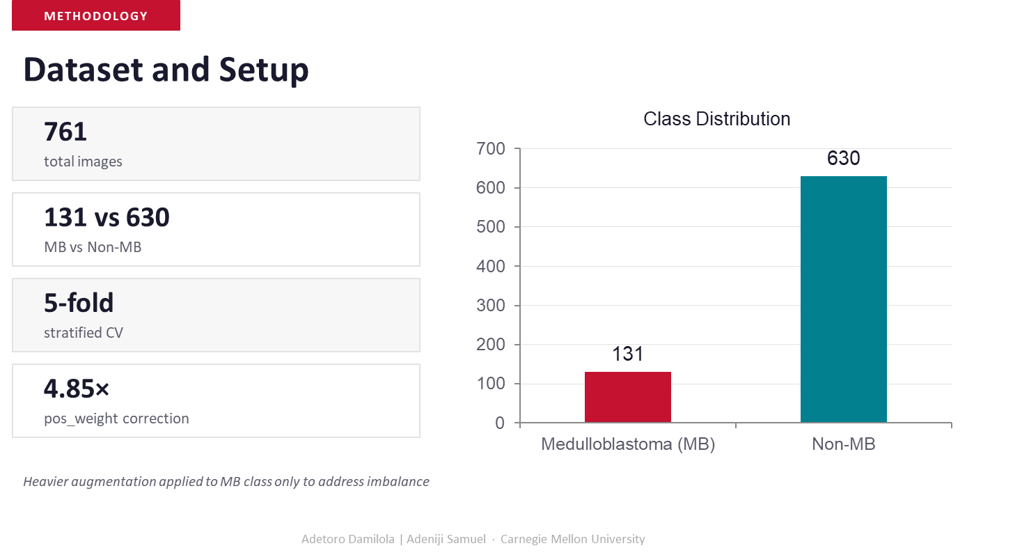

‹#›
‹#›
‹#›
Notes:
[~20 sec] Our dataset: 761 MRI images, 131 MB vs 630 Non-MB — a 4.85x imbalance. We corrected for this with pos_weight in the loss function and heavier augmentation on the MB class. Evaluation used 5-fold stratified cross-validation to ensure reliable results across all splits.

Slide 6
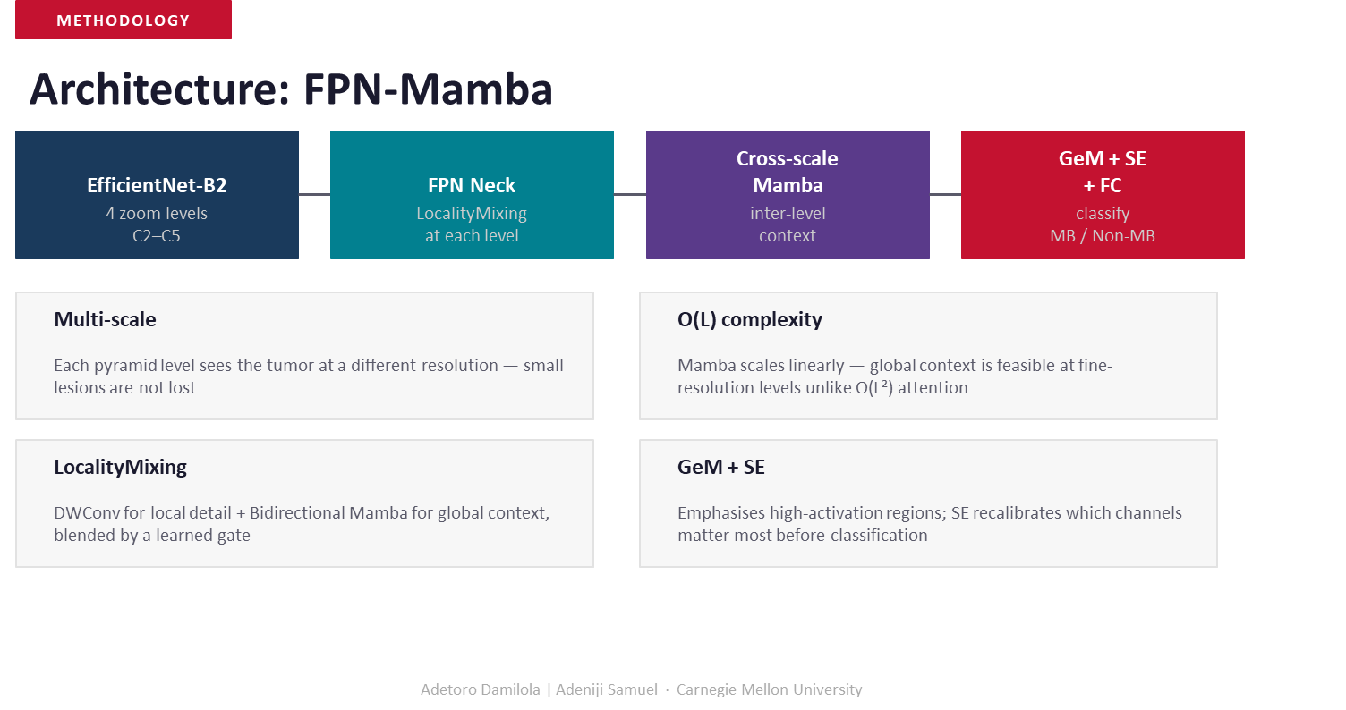
Notes:
[~25 sec] FPN-Mamba has four stages: EfficientNet-B2 backbone that extracts features at 4 scales (C2–C5). The FPN Neck fuses them using our LocalityMixing block — local conv + Bidirectional Mamba, which is then blended by a learned gate. A Cross-Scale Mamba then reasons across all pyramid levels. Finally GeM pooling + SE attention + FC head outputs MB or Non-MB.

Slide 7
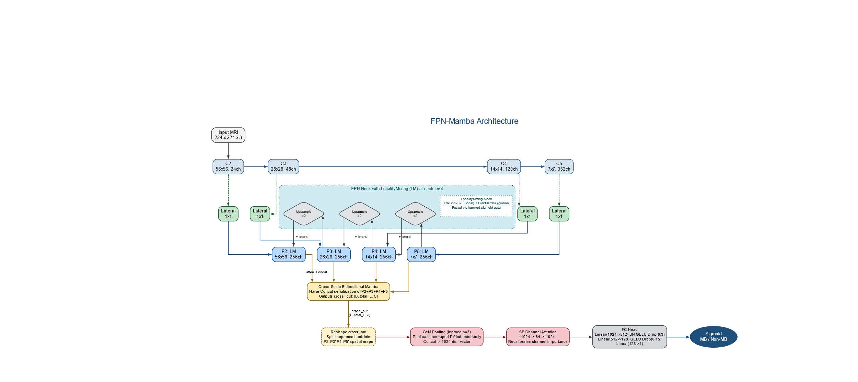

Notes:
[~75 sec — KEY SLIDE]
Let me walk through the full data flow. Input is 224x224. EfficientNet-B2 outputs C2 at 56x56, C3 at 28x28, C4 at 14x14, C5 at 7x7 and Each of them is projected to 256 channels via 1x1 lateral convolutions.
Inside the FPN Neck, each level goes through LocalityMixing which has 3 structure, a DWConv3x3 that captures local texture, a Bidirectional Mamba captures global context across the whole feature map, and a sigmoid gate learns how to blend them. This gives us rich, multi-scale feature maps P2–P5.
All four maps are then flattened and concatenated into one sequence for the Cross-Scale Bidirectional Mamba. this is where the model connects patterns across different resolutions. The output is then reshaped, pooled with GeM (p=3), recalibrated by SE channel attention, and classified by a 3-layer FC head with dropout. Sigmoid outputs the final MB/Non-MB probability.

Slide 8
RESULTS
Quantitative Comparison
4 of 5
metrics beat baseline
+2.80pp
precision improvement
+1.97pp
F1 improvement
3 FN
40% decrease in recall
Sensitivity/Recall 0.970, Specificity: 0.966
Adetoro Damilola | Adeniji Samuel · Carnegie Mellon University
Notes:
[~70 sec — KEY SLIDE]
FPN-Mamba beats the baseline on 4 of 5 metrics. Precision up +2.80pp (0.914 to 0.942). F1 up +1.97pp (0.935 to 0.955). Accuracy up to 0.984, Recall to 0.970. AUC stays near-perfect at 0.992.
But the most important number here is false negatives: 3 versus ~5 for the baseline. That's a 40% reduction in missed diagnoses. In a real-world context, that gap translates directly to children receiving timely treatment. These numbers come from one dataset, so external validation is still needed — but the direction is exactly what we designed for.

Slide 9
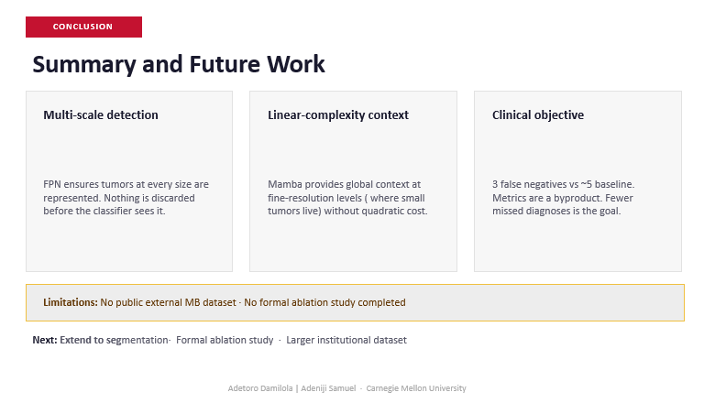
Notes:
[~20 sec] To summarize: FPN-Mamba achieves multi-scale detection, linear-complexity global context, and clinically-oriented results. Limitations: no external dataset, no formal ablation study yet. Next steps: generalize to image segmentation, ablation study, and larger multi-institutional data.

Slide 10
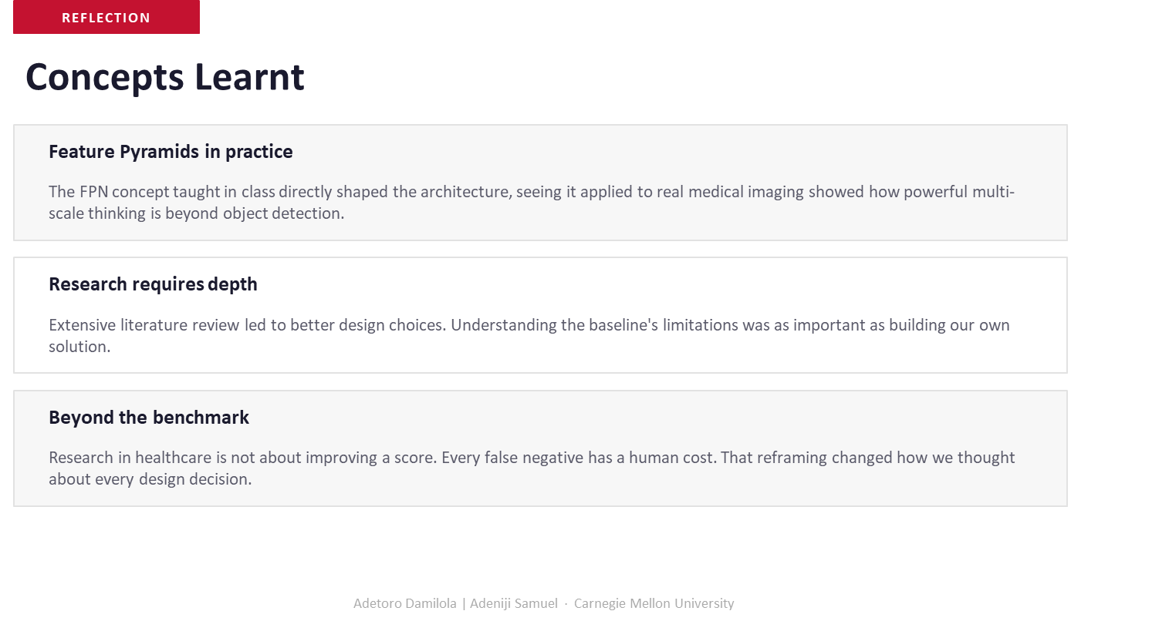
Notes:
[~15 sec] Three takeaways: FPNs were first introduced in class for object detection, we were able to see it applied directly to real medical imaging. Another lesson is that Deep literature review is non negotiable. And in healthcare AI, every false negative has a human cost and that reframing changed how we built everything.

Slide 11
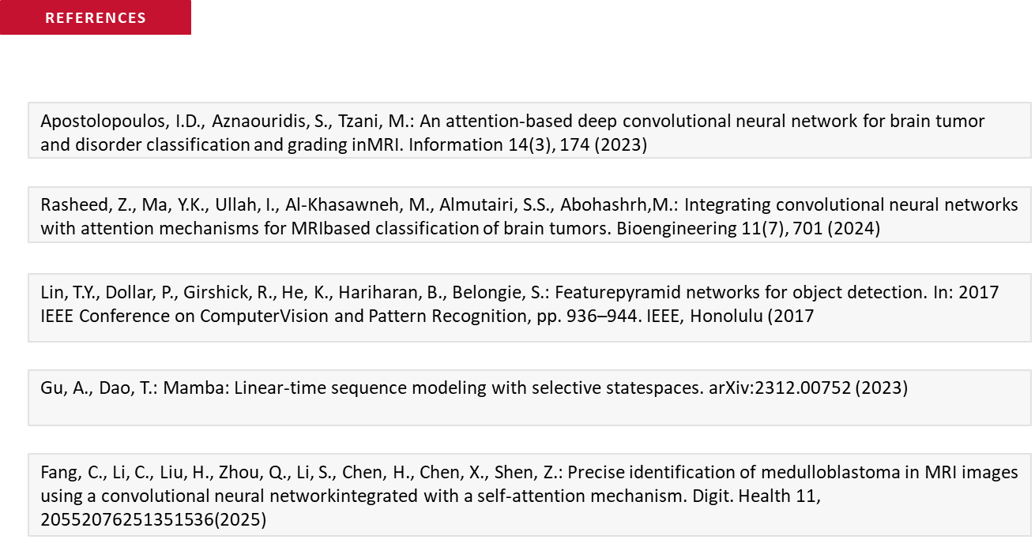
Notes:
[~15 sec] Three takeaways: FPNs were first introduced in class for object detection, we were able to see it applied directly to real medical imaging. Another lesson is that Deep literature review is non negotiable. And in healthcare AI, every false negative has a human cost and that reframing changed how we built everything.

Slide 12

‹#›
‹#›
‹#›
‹#›
Notes:
[~10 sec] Thank you. We're happy to take questions — especially on LocalityMixing internals, the class imbalance handling, or our false negative results.

