Slide 1
Time Series
ARCH and GARCH

Slide 2
Agenda
Introduction Time Series
ARCH
Volatility
Higher Lag ARCH
GARCH Model

Slide 3
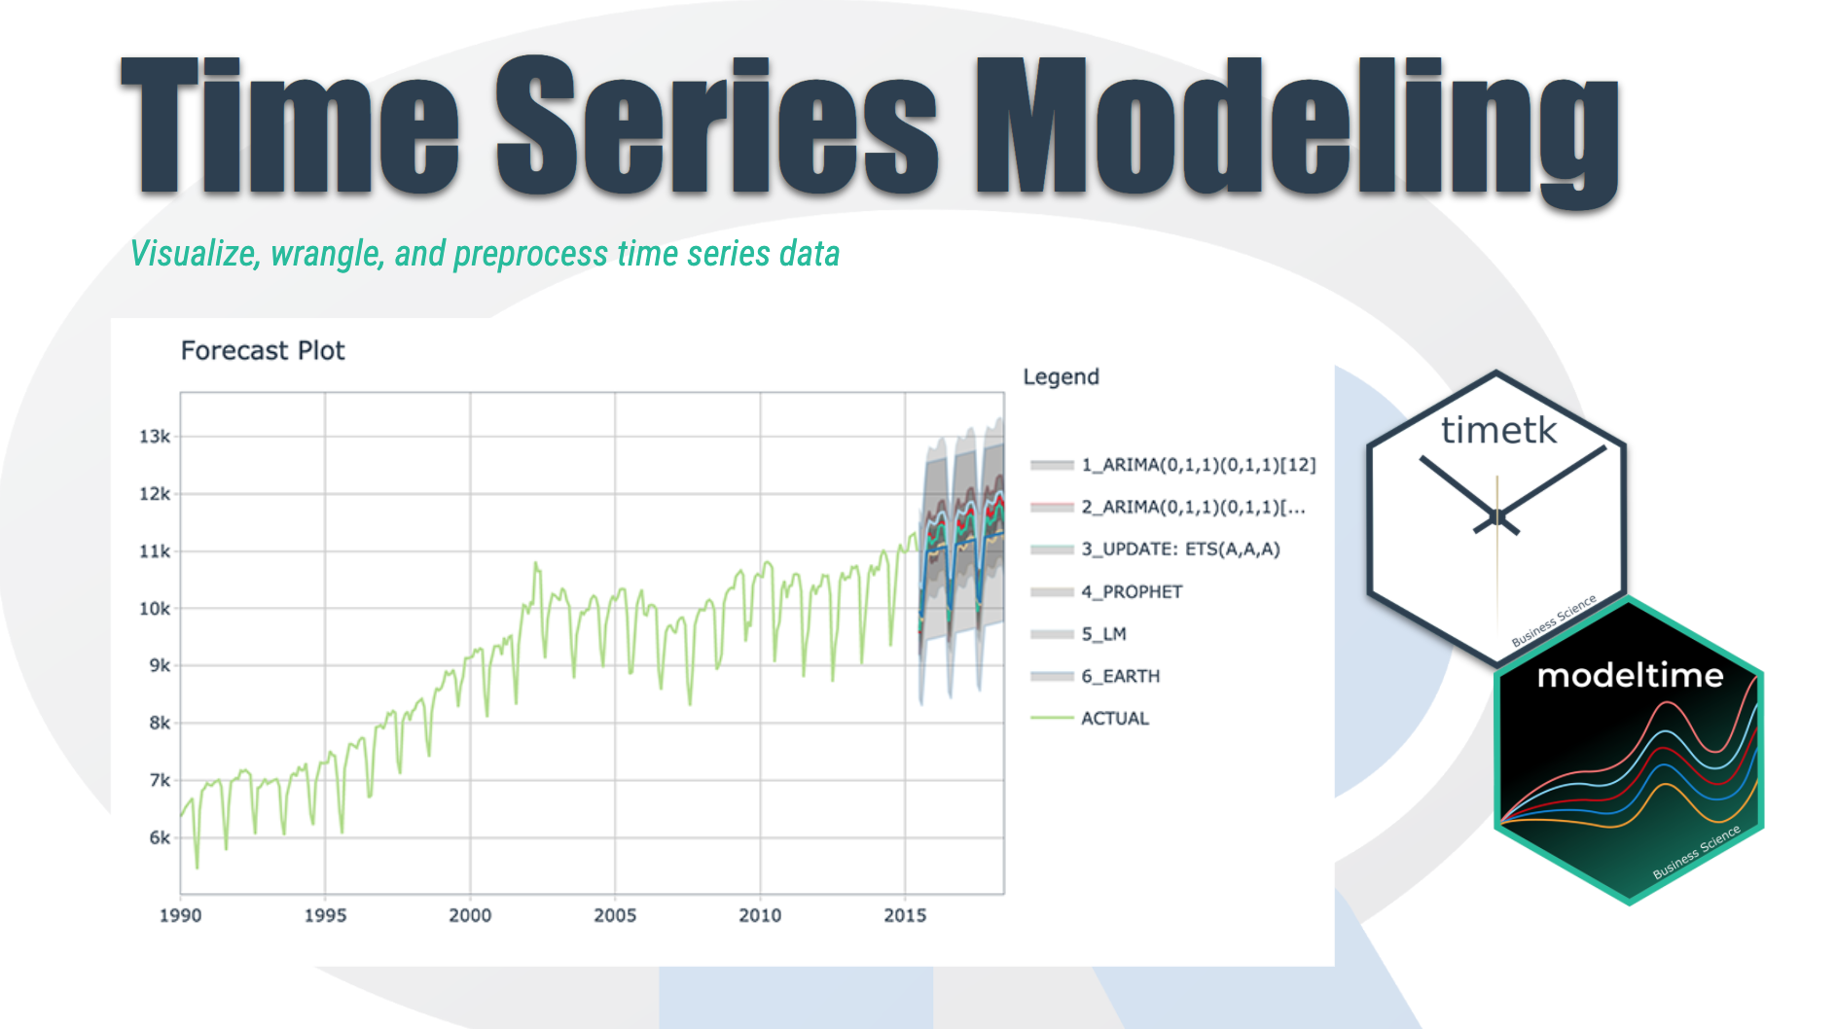
Time Series Introduction
We're going to discover how it differs from other types of data you've previously encountered and why
Time series is a sequence of information which attaches a time period to each value
The value can be pretty much anything measurable.
It depends on time in some way, like prices, humidity or number of people.
As long as the values we record are unambiguous, any medium could be measured with Time series.
There aren't any limitations regarding the total time span of our Time series.
It could be a minute, a day, a month or even a century.
All we need is a starting and an ending point.

Slide 4
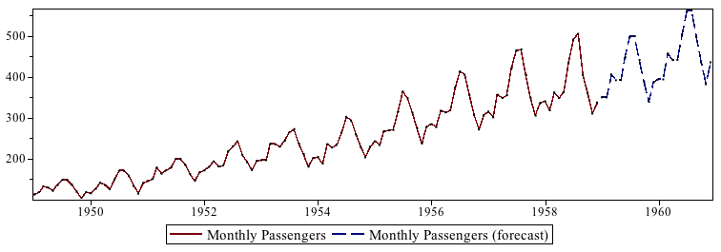
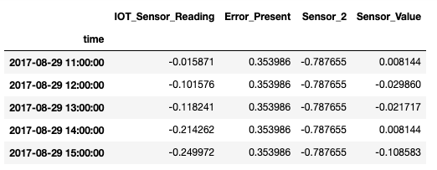
Time Series Basics
Chronological Data
Cannot be shuffled
Each row indicate specific time record
Train – Test split happens chronologically
Data is analyzed univariately and multivariately (for given use case)
Nature of the data represents if it can be predicted or not

Slide 5
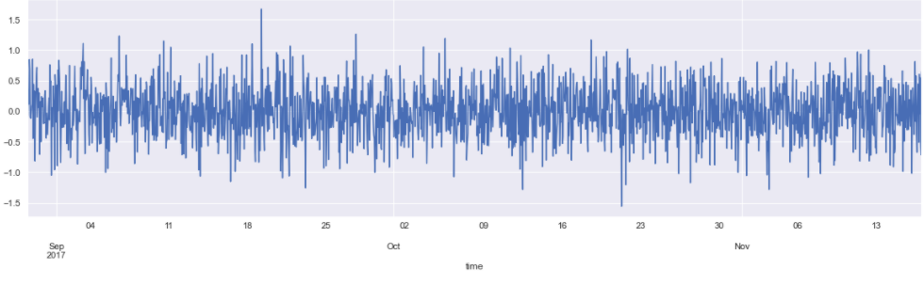
Data Examining & Preprocessing
Reading Data using Pandas – describe, head
Check for null values
Line plot for each feature
Convert Date from String to Date time feature
Setting the desired frequency
Handling missing Values
QQ plots

Slide 6
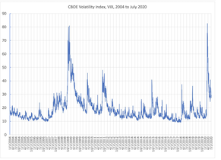
Volatility
Volatility is a statistical measure of the dispersion of returns for a given security or market index
The higher the volatility, the riskier the security
Volatility is often measured as either the standard deviation or variance between returns from that same security or market index.
Volatility represents how large an asset's prices swing around the mean price—it is a statistical measure of its dispersion of returns.
There are several ways to measure volatility, including beta coefficients, option pricing models, and standard deviations of returns.

Slide 7
Volatility
Autoregressive conditional heteroskedasticity (ARCH) is a statistical model used to analyze volatility in time series in order to forecast future volatility. In the financial world, ARCH modeling is used to estimate risk by providing a model of volatility that more closely resembles real markets.
ARCH modeling shows that periods of high volatility are followed by more high volatility and periods of low volatility are followed by more low volatility.
This means that volatility or variance tends to cluster, which is useful to investors when considering the risk of holding an asset over different time periods.

Slide 8
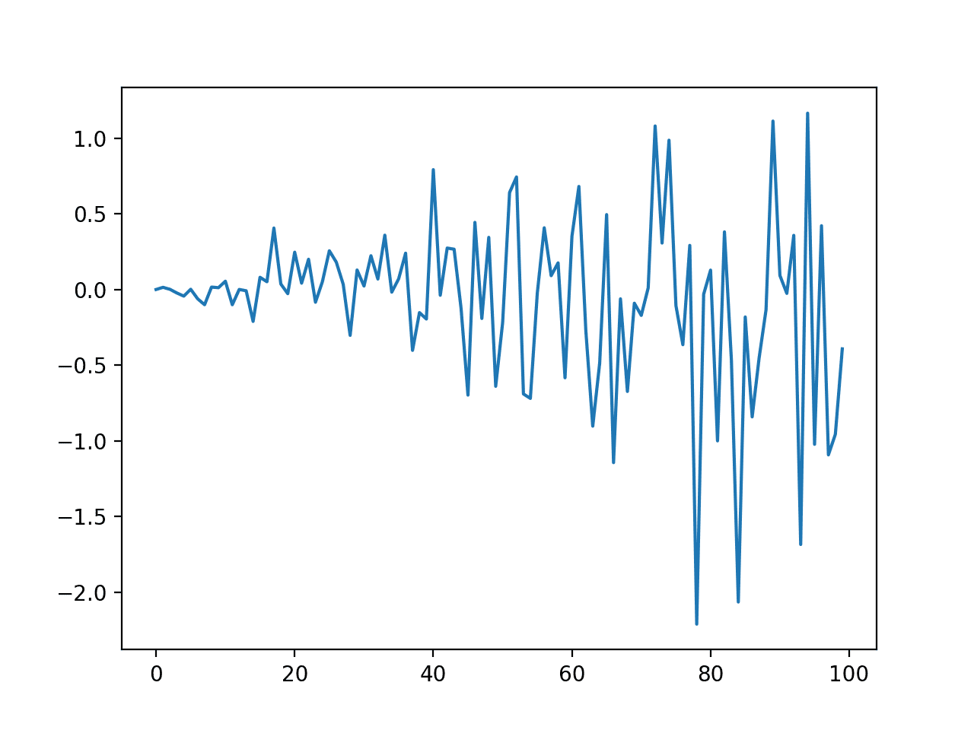
Introduction to ARCH
ARCH — Autoregressive Conditional Heteroskedasticity
The ARCH process introduced by Engle (1982) explicitly recognizes the difference between the unconditional and the conditional variance allowing the latter to change over time as a function of past errors.
Autoregressive: The current value can be expressed as a function of the previous values i.e. they are correlated.
Conditional: This informs that the variance is based on past errors.
Heteroskedasticity: This implies the series displays unusual variance (varying variance).

Slide 9
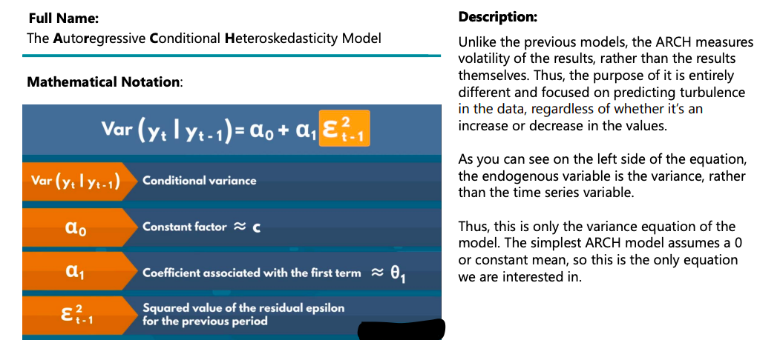

Slide 10
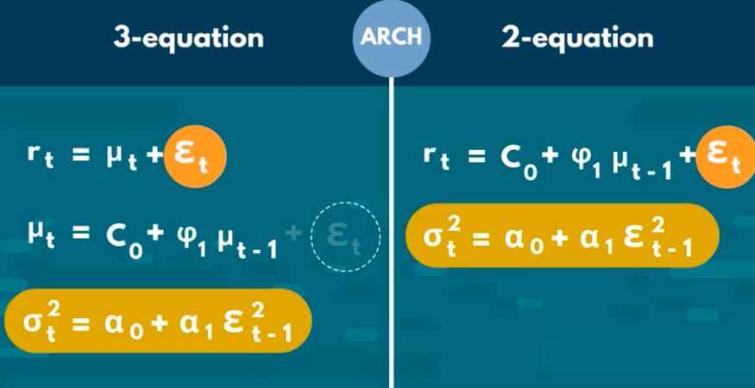

Slide 11
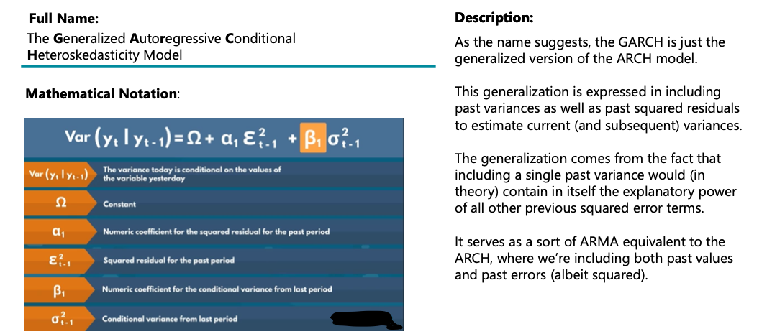

Slide 12
Why an ARCH model?
Autoregressive models can be developed for univariate time-series data that is stationary (AR), has a trend (ARIMA), and has a seasonal component (SARIMA). But, these Autoregressive models do not model is a change in the variance over time.
The error terms in the stochastic processes generating the time series were homoscedastic, i.e. with constant variance.
There are some time series where the variance changes consistently over time. In the context of a time series in the financial domain, this would be called increasing and decreasing volatility.

Slide 13
When to Apply ARCH?
In practice, this can be used to model the expected variance on the residuals after another autoregressive model has been used, such as an ARMA or similar.
Since we can only tell whether the ARCH model is appropriate or not by squaring the residuals and examining the correlogram, we also need to ensure that the mean of the residuals is zero.
Crucially, ARCH should only ever be applied to series that do not have any trends or seasonal effects, i.e. that have no (evident) serially correlation. ARIMA is often applied to such a series (or even Seasonal ARIMA), at which point ARCH may be a good fit.

Slide 14
What is a GARCH model?
Generalized Autoregressive Conditional Heteroskedasticity, or GARCH, is an extension of the ARCH model that incorporates a moving average component together with the autoregressive component.
Thus GARCH is the “ARMA equivalent” of ARCH, which only has an autoregressive component. GARCH models permit a wider range of behavior more persistent volatility.

Slide 15
What is GARCH?
GARCH is a better fit for modeling time series data when the data exhibits heteroskedacisticity but also volatility clustering.
As the name suggests, the GARCH is just the generalized version of the ARCH model. This generalization is expressed in including past variances as well as past squared residuals to estimate current (and subsequent) variances.
The generalization comes from the fact that including a single past variance would (in theory) contain in itself the explanatory power of all other previous squared error terms.
It serves as a sort of ARMA equivalent to the ARCH, where we’re including both past values and past errors (albeit squared).

Slide 16
How to configure the ARCH and GARCH Model(s)
The configuration for an ARCH model is best understood in the context of ACF and PACF plots of the variance of the time series.
This can be achieved by subtracting the mean from each observation in the series and squaring the result, or just squaring the observation if you’re already working with white noise residuals from another model.
The ACF and PACF plots can then be interpreted to estimate values for p and q, in a similar way as is done for the ARMA model.

