Slide 1
Time Series
Gaussian Process

Slide 2
Agenda
Introduction Time Series
Date Transformation Timestamp
Normality
Gaussian Process

Slide 3
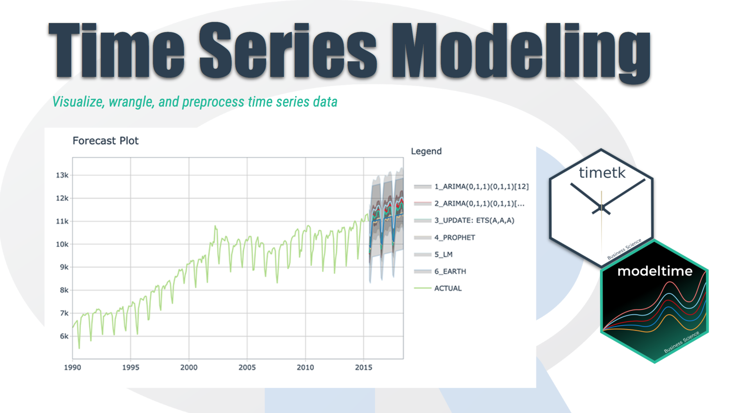
Time Series Introduction
We're going to discover how it differs from other types of data you've previously encountered and why
Time series is a sequence of information which attaches a time period to each value
The value can be pretty much anything measurable.
It depends on time in some way, like prices, humidity or number of people.
As long as the values we record are unambiguous, any medium could be measured with Time series.
There aren't any limitations regarding the total time span of our Time series.
It could be a minute, a day, a month or even a century.
All we need is a starting and an ending point.

Slide 4
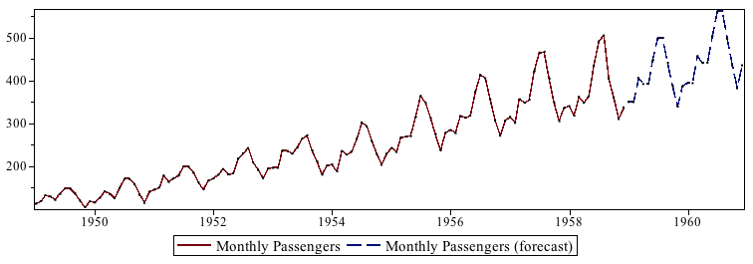
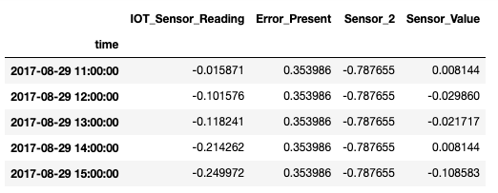
Time Series Basics
Chronological Data
Cannot be shuffled
Each row indicate specific time record
Train – Test split happens chronologically
Data is analyzed univariately and multivariately (for given use case)
Nature of the data represents if it can be predicted or not

Slide 5
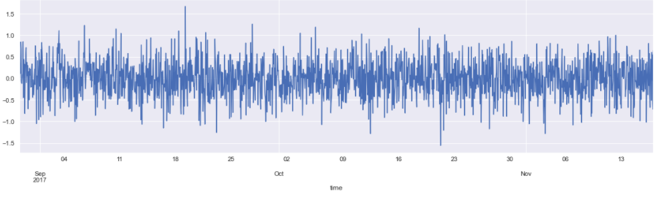
Data Examining & Preprocessing
Reading Data using Pandas – describe, head
Check for null values
Line plot for each feature
Convert Date from String to Date time feature
Setting the desired frequency
Handling missing Values
QQ plots

Slide 6
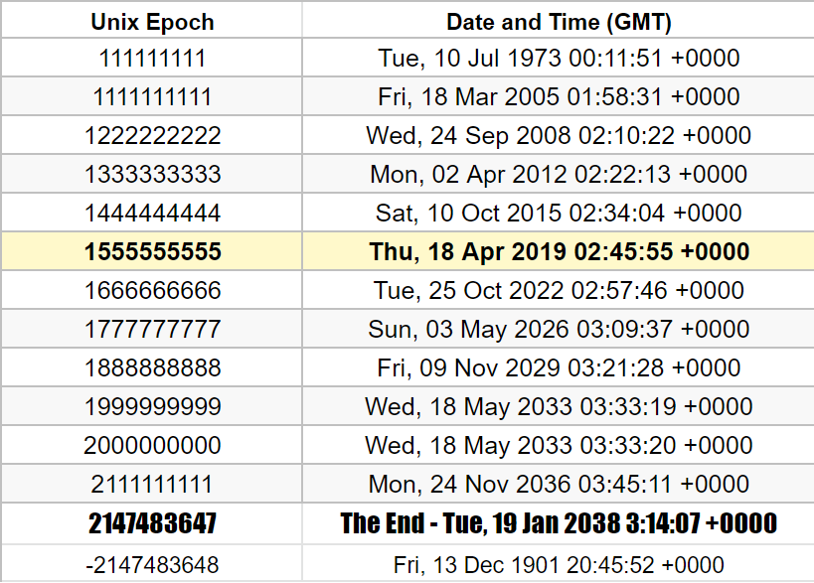
Date Timestamp
A timestamp is a sequence of characters or encoded information identifying when a certain event occurred, usually giving date and time of day, sometimes accurate to a small fraction of a second.
Unix time is a system for describing a point in time. It is the number of seconds that have elapsed since the Unix epoch.
The Unix epoch is 00:00:00 UTC on 1 January 1970.

Slide 7
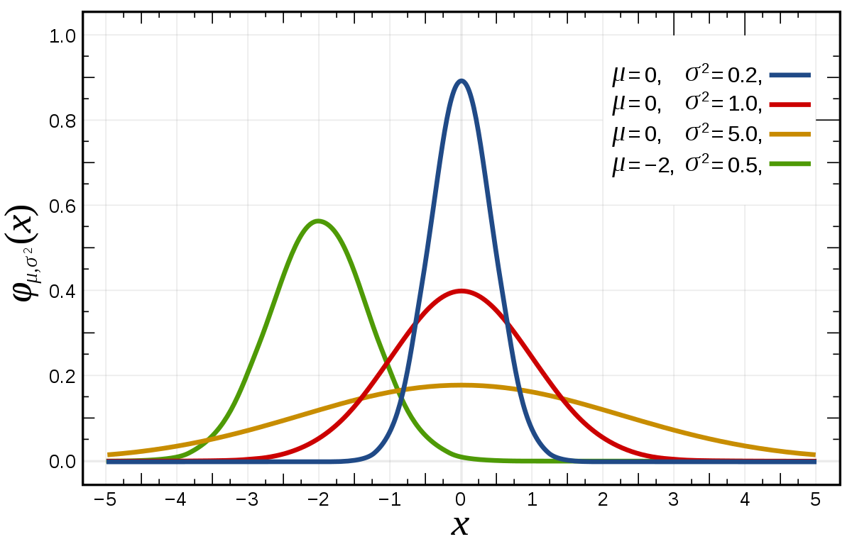
Normal Distribution
Normal distribution, also known as the Gaussian distribution, is a probability distribution that is symmetric about the mean, showing that data near the mean are more frequent in occurrence than data far from the mean.
The normal distribution is a continuous probability distribution that is symmetrical around its mean, most of the observations cluster around the central peak, and the probabilities for values further away from the mean taper off equally in both directions.

Slide 8
Gaussian Process
Gaussian Processes are a generalization of the Gaussian probability distribution and can be used as the basis for sophisticated non-parametric machine learning algorithms for classification and regression.
Gaussian probability distribution functions summarize the distribution of random variables, whereas Gaussian processes summarize the properties of the functions, e.g. the parameters of the functions.
Gaussian processes can be used as a machine learning algorithm for classification predictive modelling.

Slide 9
Gaussian Kernel
Gaussian processes require specifying a kernel that controls how examples relate to each other; specifically, it defines the covariance function of the data.
The way that examples are grouped using the kernel controls how the model “perceives” the examples, given that it assumes that examples that are “close” to each other have the same class label.
Therefore, it is important to both test different kernel functions for the model and different configurations for sophisticated kernel functions.

Slide 10
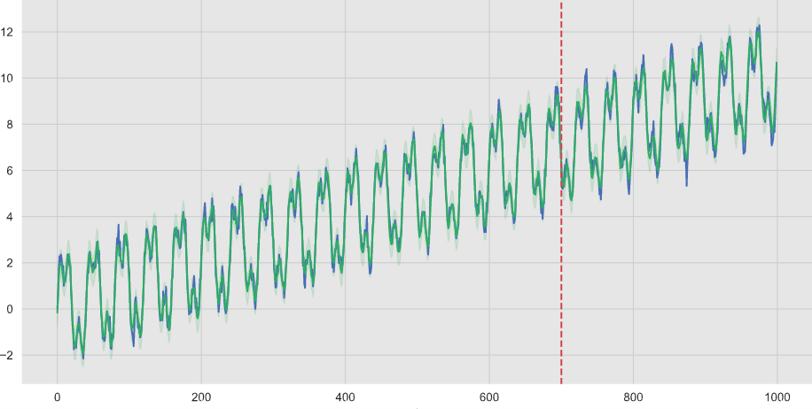
Gaussian Processes for Time Series
The covariance function’s role is to describe the correlation between points. It exists several covariance functions. They generally describe the prior knowledge we have over the training points.
Choosing the right kernel will incorporate fluctuations in Time Series and fit the data best

Slide 11
Hyperparameters Gaussian Scikit
WhiteKernel: The main use-case of this kernel is as part of a sum-kernel where it explains the noise of the signal as independently and identically normally-distributed.
ConstantKernel: Can be used as part of a product-kernel where it scales the magnitude of the other factor (kernel) or as part of a sum-kernel, where it modifies the mean of the Gaussian process.
ExpSineSquared: The ExpSineSquared kernel allows one to model functions which repeat themselves exactly. It is parameterized by a length scale parameter l>0 and a periodicity parameter p>0.
GaussianProcessRegressor

