Slide 1

CprE 381: Computer Organization and Assembly Level Programming
Virtual Memory
Berk Gulmezoglu
Electrical and Computer Engineering Iowa State University

Slide 2
















Remember the System View!
Control
Input
Datapath
Output
Memory
Processor
Peripherals
A Computer
Lec14.1.2

Slide 3
Virtual Memory
Use main memory as a “cache” for secondary (disk) storage
Managed jointly by CPU hardware and the operating system (OS)
Programs share main memory
Each gets a private virtual address space holding its code and data
Frequently used code and data pulled into main memory
Protected from other programs
CPU and OS translate virtual addresses to physical addresses
VM “block” is called a page
VM translation “miss” is called a page fault

Slide 4
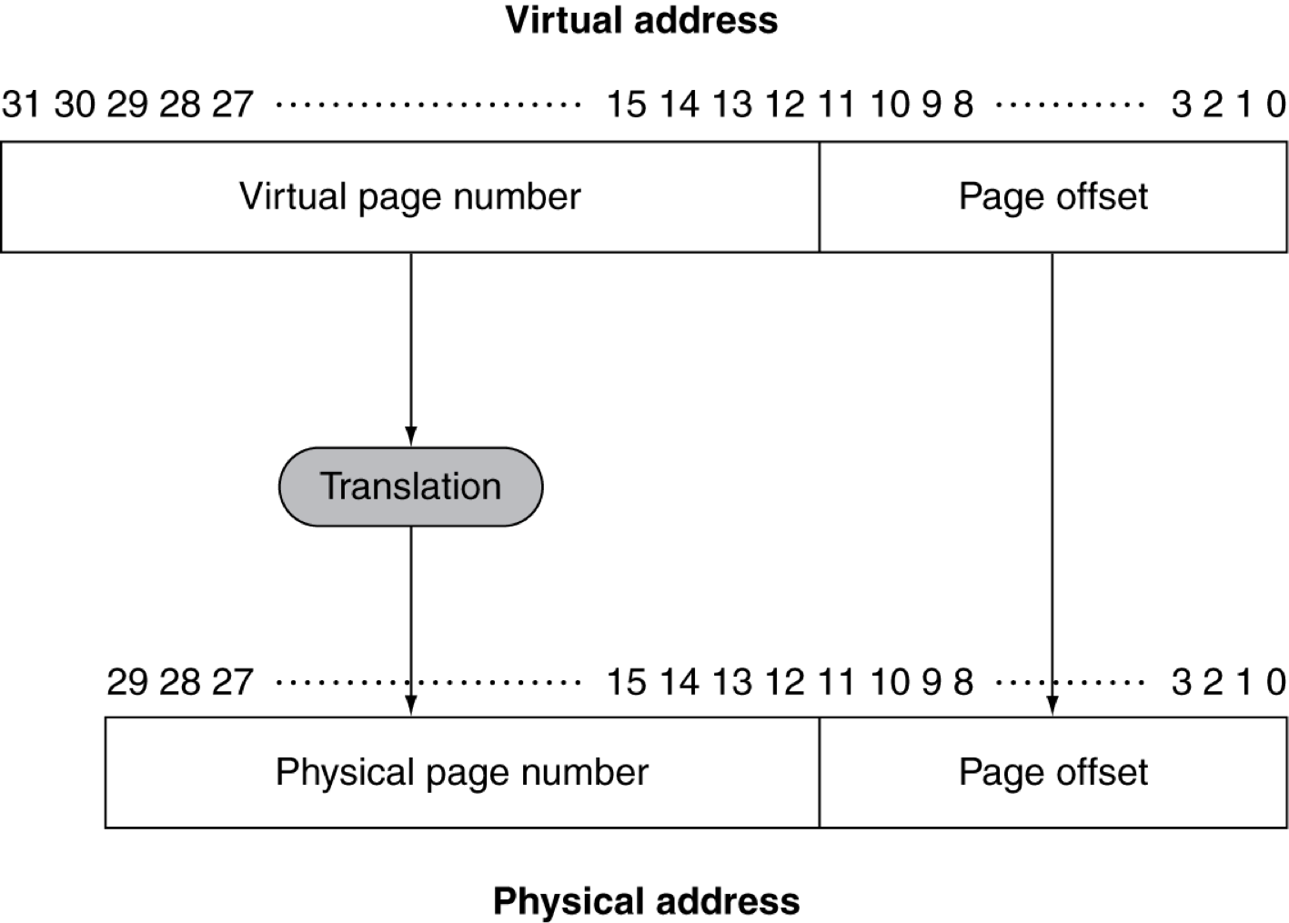
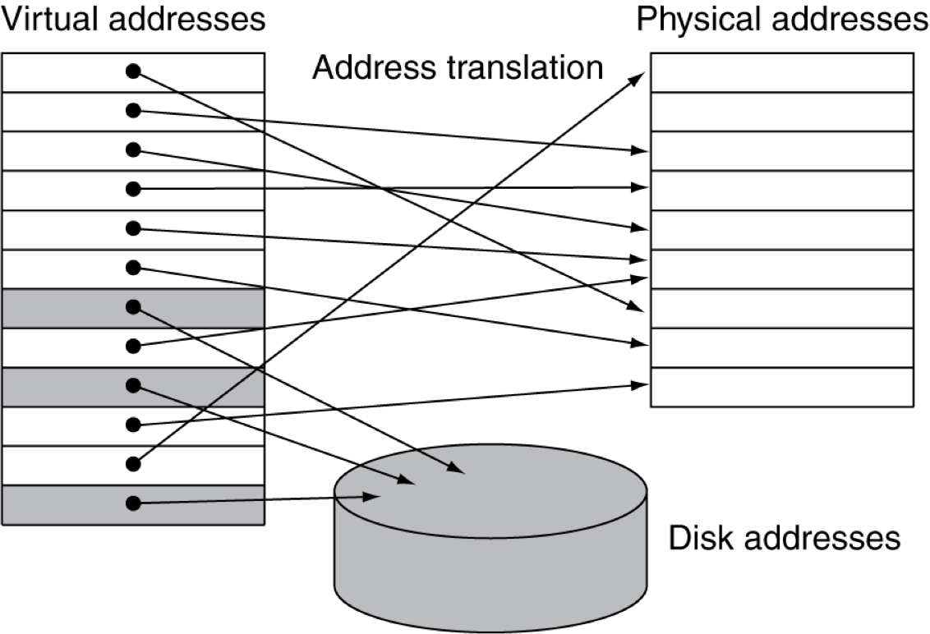

Address Translation
Fixed-size pages (e.g., 4K)
Main Memory → seen as a cache for disk

Slide 5
Page Fault Penalty
On page fault, the page must be fetched from disk
Takes millions of clock cycles
Handled by OS code
Try to minimize page fault rate
Fully associative placement
Smart replacement algorithms

Slide 6
Page Tables
Stores placement information
Array of page table entries, indexed by virtual page number
Page table register in CPU points to page table in physical memory
If page is present in memory
PTE stores the physical page number
Plus other status bits (referenced, dirty, …)
If page is not present
PTE can refer to location in swap space on disk

Slide 7
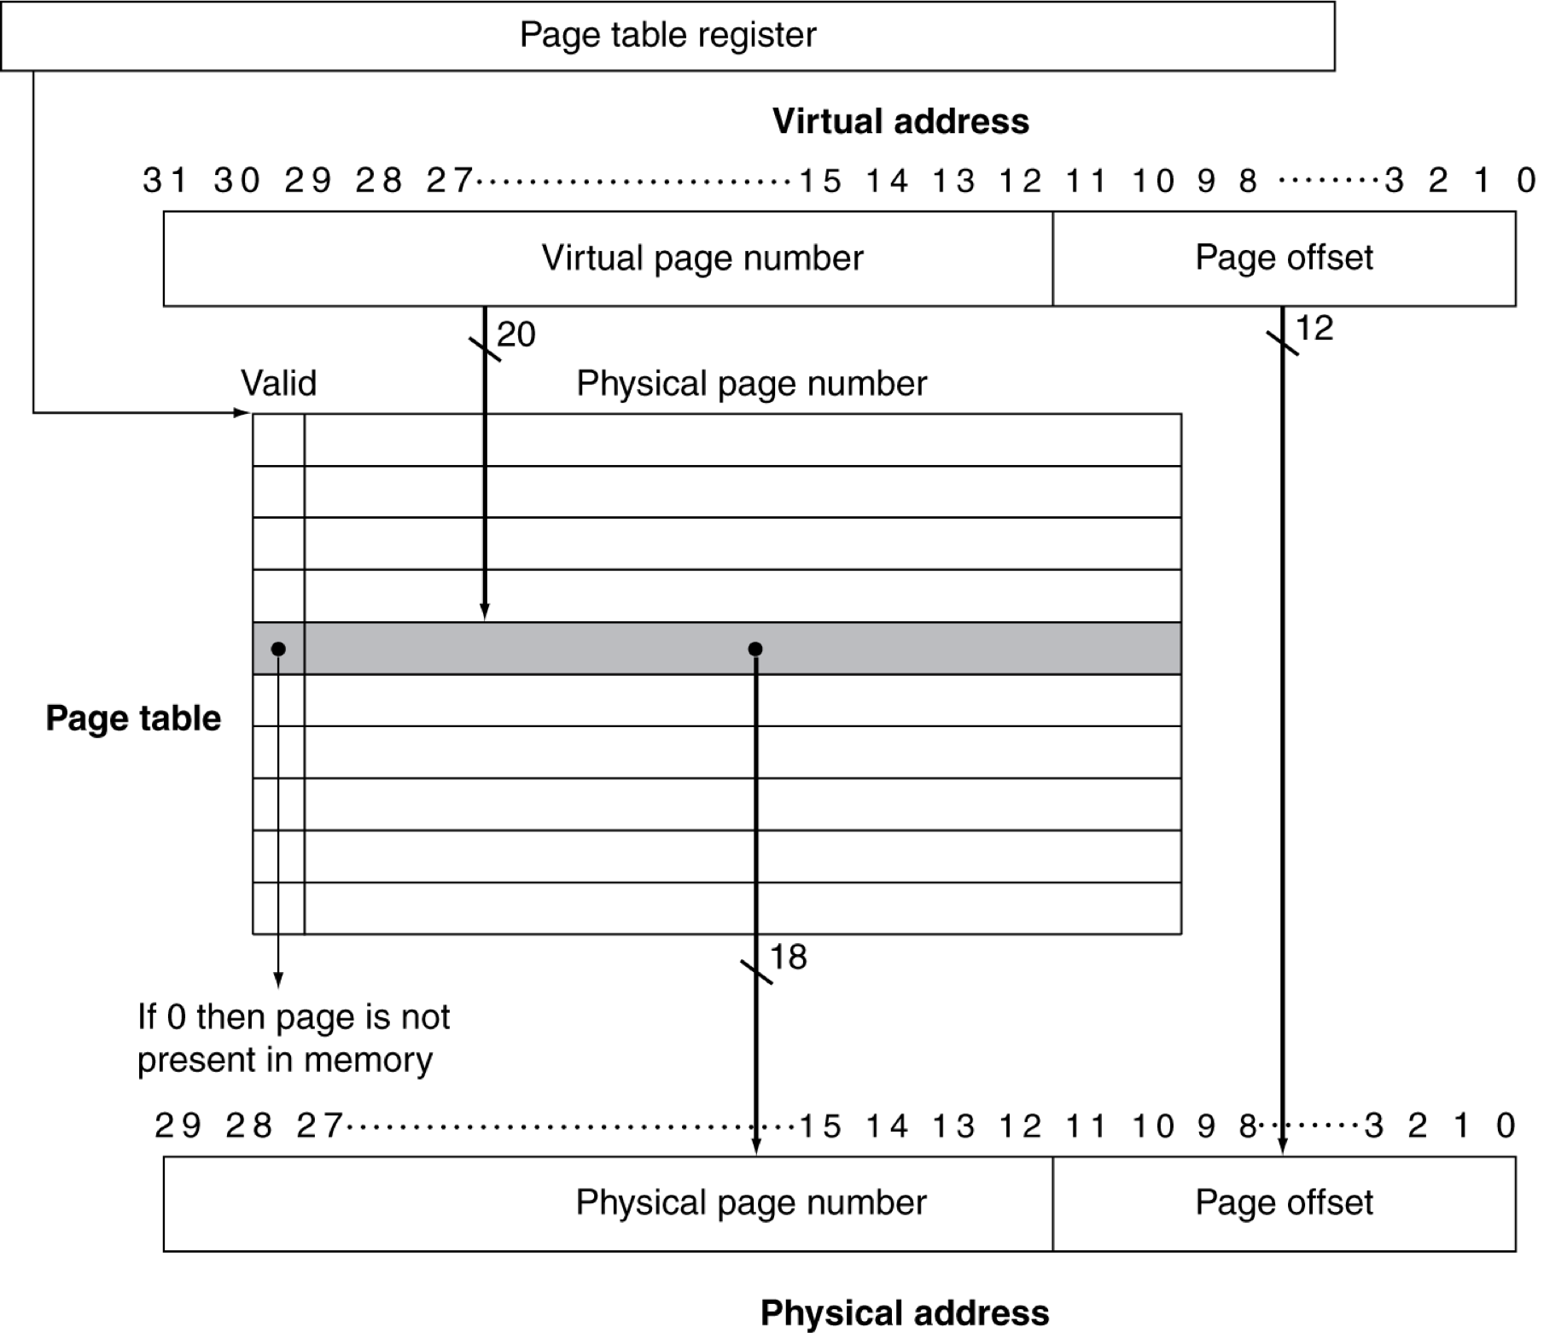
Translation Using a Page Table

Slide 8
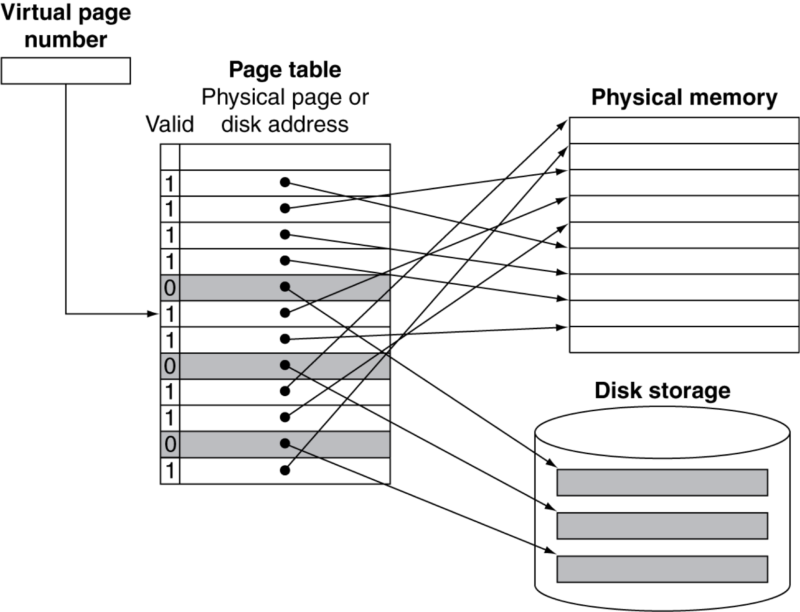
Mapping Pages to Storage

Slide 9
Replacement and Writes
To reduce page fault rate, prefer least- recently used (LRU) replacement
Reference bit (aka use bit) in PTE set to 1 on access to page
Periodically cleared to 0 by OS
A page with reference bit = 0 has not been used recently
Disk writes take millions of cycles
Block at once, not individual locations
Write through is impractical
Use write-back
Dirty bit in PTE set when page is written

Slide 10
Page Table Size
Calculate the size of a page table
32-bit virtual address
4KB pages
4 byte page table entries (PTEs)

Slide 11
Page Table Size
Calculate the size of a page table
32-bit virtual address
4KB pages → page offset is 12 bits
4 byte page table entries (PTEs)
_{# PTEs = 2}# bits in virtual address _{/ 2}# bits page offset
₌ ₂32_{/2}12 ₌ ₂20
PT Size = # PTEs * PTE Size
= 2²⁰ PTEs * 2² bytes/PTE = 4 MB

Slide 12
Page Table Size
Calculate the size of a page table
64-bit virtual address
16KB pages → page offset is 14 bits
8 byte page table entries (PTEs)
_{# PTEs = 2}# bits in virtual address _{/ 2}# bits page offset
₌ ₂64_{/2}14 ₌ ₂50
PT Size = # PTEs * PTE Size
= 2⁵⁰ PTEs * 2³ bytes/PTE = 8 PB

Slide 13
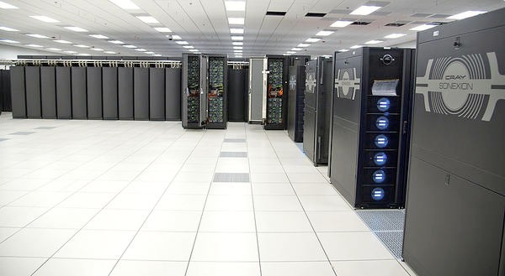
Page Table Size
•
Calculate the size of a page table
– 64-bit virtual address
– 16KB pages → page offset is 14 bits
– 8 byte page table entries (PTEs)
_{PTEs = 2}# bits in virtual address _{/ 2}# bits page
₌ ₂64_{/2}14 ₌ ₂50
Blue Waters Supercomputer: 1.5PB Memory
#
offset
PT Size = # PTEs * PTE Size
= 2⁵⁰ PTEs * 2³ bytes/PTE = 8 PB

Slide 14
Acknowledgments
These slides contain material developed and copyright by:
Joe Zambreno (Iowa State)
Akhilesh Tyagi (Iowa State)
David Patterson (UC Berkeley)
Mary Jane Irwin (Penn State)
Christos Kozyrakis (Stanford)
Onur Mutlu (Carnegie Mellon)
Krste Asanović (UC Berkeley)
Morgan Kaufmann

