Slide 1
ACE-IT LIVE BUSINESS CHALLENGE · JIIT NOIDA
Box Space Optimizer
Aditya Pandey Akriti Srivastava
Vibhi Jain Prince
Aayushman Mittal Saksham Bharadwaj
Fit it right, not just fit it.
A rule-aware loading planner for real-world logistics.
144
24.6 m³
2,495 kg
1
units across 36 SKUs
total load volume
total weight
20 ft container needed
Notes:
Open with the answer: for the provided move (144 units, 24.6 m3, 2,495 kg) only the 20 ft container works in one trip. The rest of the deck shows why the obvious math is not enough and how we plan the load.

Slide 2
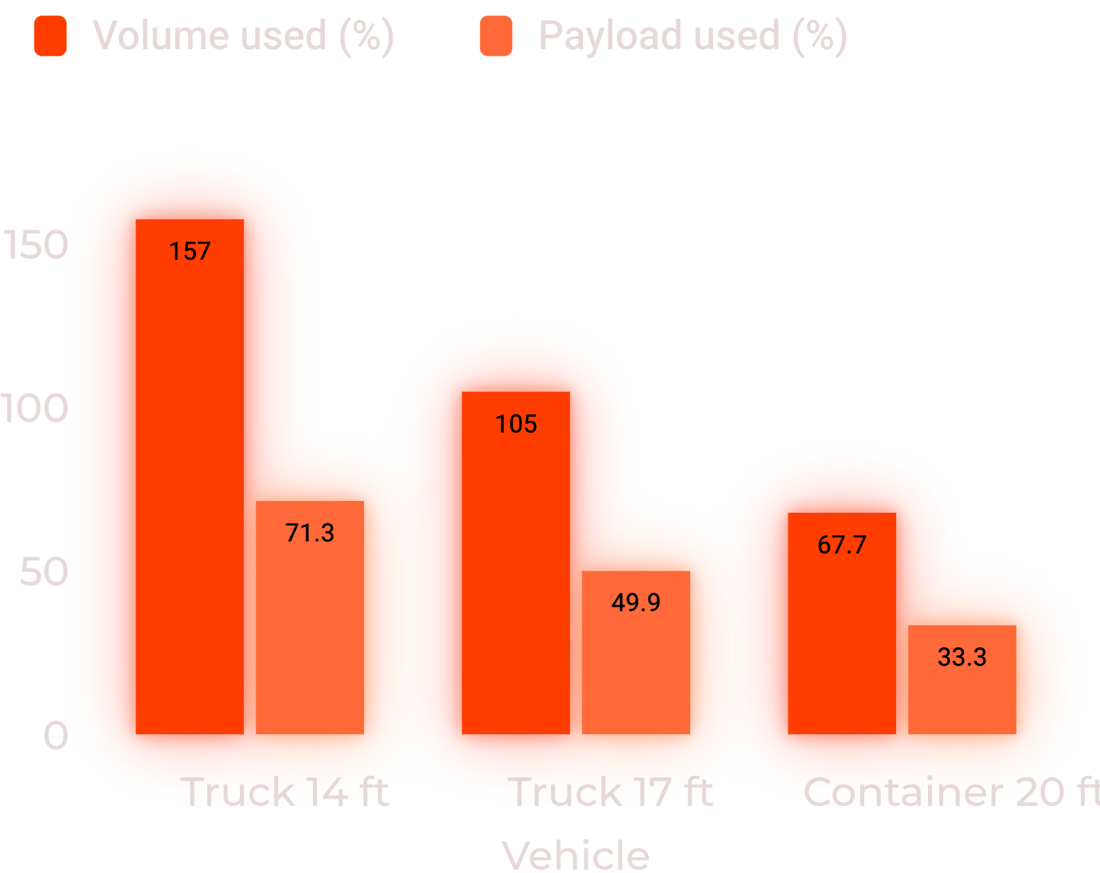
THE FEASIBILITY GATE
Volume, not weight, is the binding limit
The load is light and bulky: average density is about 101 kg/m³. Payload never exceeds 71%, but volume rejects two of the three vehicle options.
1 of 3
105%
vehicles can carry this load in a single trip: the 20 ft container.
of volume is needed by the 17 ft truck, before 3D rules.
Volume feasibility first. Payload remains below the limit.
Notes:
Compute raw volume and weight of every SKU x quantity against each vehicle. T1 needs 157% of volume, T2 105%, T3 68%. Payload is never the constraint (max 71%), because the load is light and bulky at about 101 kg per cubic metre.

Slide 3
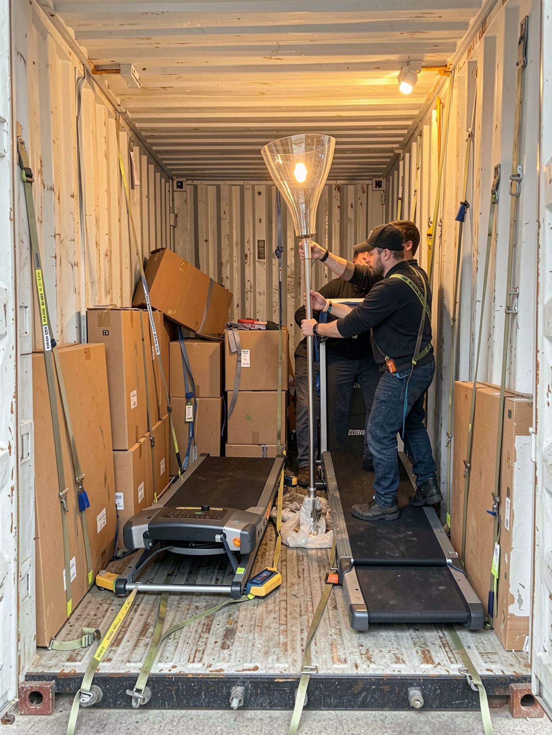
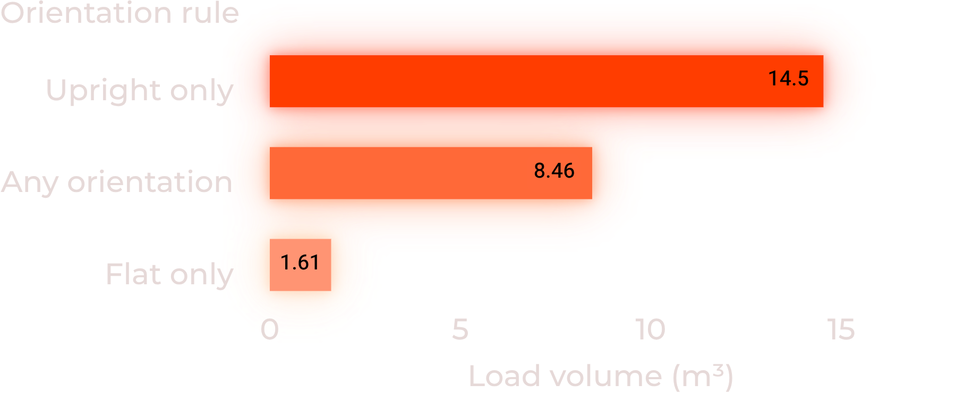
THE 3D REALITY CHECK
68% full on paper is not 68% usable
Volume feasibility is only the first gate. Actual loading must validate orientation, stack-load limits, fragile items, base support and payload.
PROTOTYPE STRESS TEST
Rules set real capacity.
Base load: 136 units fit the 20 ft container with every rule enforced.
But the greedy plan used 590 of 610 cm of floor length; the 8 late units could not be added.
24
10
fragile units · 3.3 m³
cannot be stacked on · 3.5 m³
Notes:
56 of 144 units are upright-only (14.5 m3, 59% of volume). Our constraint-aware greedy 3D packer respects orientation, stack-load limits, fragile items, base support and payload. It places the base load but leaves almost no slack, and could not absorb the 8 late items. This is a baseline, not the final optimum; it shows why rules must drive the plan.

Slide 4

THE NARRATIVE SPINE
Our approach: Screen, Plan, Adapt
01
02
03
Screen
Plan
Adapt
Pick the right vehicle.
Place every item by rules.
Re-plan when things change.
Check volume, payload and door size per vehicle; keep a planning buffer, not 100% fill; this move: 20 ft container.
Orientation, stack-load budget, fragile on top; heavy and rigid low, base support of 80%+; weight balanced left-right and front-back.
Reserve a last-loaded slot at the door; re-run in seconds for rush orders; update the item master on product changes.
Output for the crew: a numbered loading sequence and zone map, not a spreadsheet.
Notes:
Screen: feasibility gate on volume, payload and door size. Plan: extreme-point 3D packing with a rule engine; production version adds local search and a C++ solver for speed. Adapt: reserve capacity and fast re-planning. The 80% base-support and planning-buffer values are assumptions to calibrate in a pilot.

Slide 5
THE LATE-ITEM SIGNAL
4.7%
BUILT FOR RUSH ORDERS, PRODUCT CHANGES AND PEAKS
Rush orders
Product changes
of volume arrives late
Hold back a door-side reserve sized to the usual late share. A new item gets a yes or no in seconds, against its rules.
One item master, with size, weight and rules, feeds the planner. Cartons are 76% of units: fewer, modular sizes pack better.
8 units · 180 kg
Small share, awkward items: a 90 kg flat treadmill and a 160 cm fragile lamp.
Peak seasons
Plan all loads together and consolidate, so a 1% gain per load multiplies across hundreds of trips.
Notes:
Late items in the data: H-034 pantry cartons, H-035 floor lamp, H-036 treadmill: 8 units, 1.17 m3 (4.7%), 180 kg (7.2%). Cartons are 109 of 144 units and 10.0 m3. Peak-season benefit is a scaling argument, not a measured number.

Slide 6
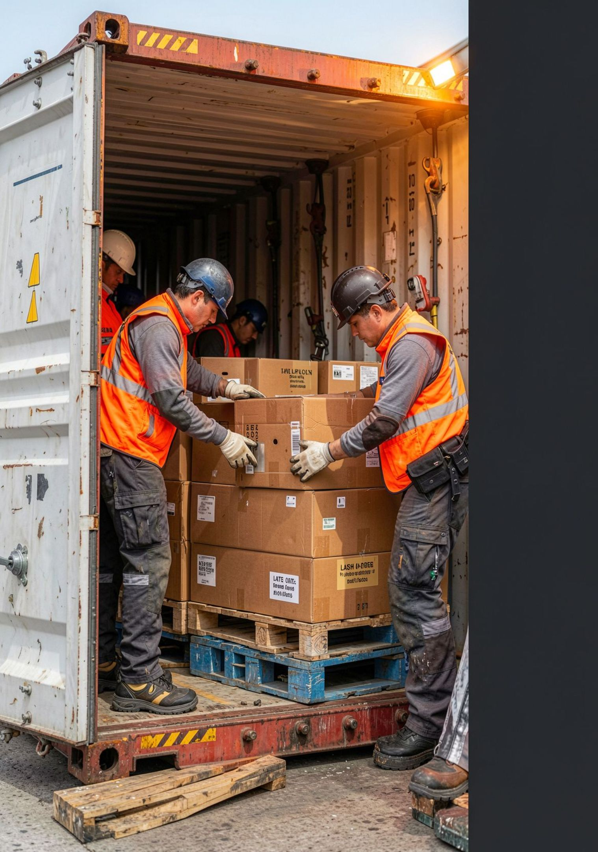
THE DECISION
Impact: one vehicle, then a pilot to prove it
≥50%
Fewer vehicles on this move: 1 container vs at least 2 trucks.
The 17 ft truck alone is at 105% by volume.
Weeks 1–2 · Capture item master and last 3 months of loads
Weeks 3–6 · Pilot planner on one route; compare to actual loads
Weeks 7–12 · Add re-planning and peak batching; scale to all routes
KPIs: space used %, vehicles per move, damage claims, planning time, late-order acceptance.
No cost data was supplied, so savings are stated in trips; apply your rate card. The planning buffer and the 80% base support are assumptions to calibrate in the pilot.
Notes:
Close with the decision: adopt the Screen-Plan-Adapt approach, start with data capture, and prove the gain on one route. Be upfront: savings are expressed in vehicles because no cost data was given.

