Slide 1
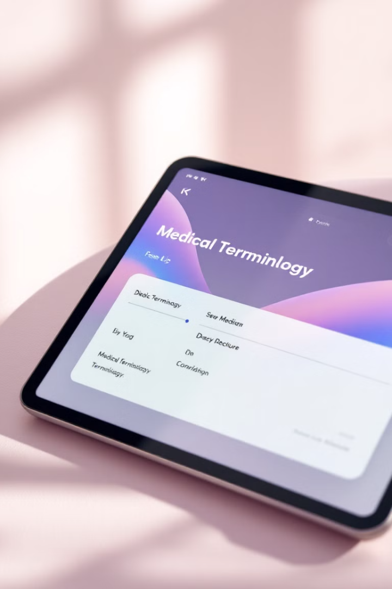
Healthcare Translation Web App with Generative AI
This application facilitates real-time, multilingual communication between patients and healthcare providers, leveraging Generative AI for accurate and clear medical translations.
by Ayomide Oluwanifesimi

Slide 2
Core Features
1
Language Options
2
Voice-to-Text
3
Real-Time Translation
Select and swap languages easily.
Accurate transcription of spoken language.
Immediate translation for quick communication.
4
Audio Playback
5
Clear Text
Listen to translations for clarity.
Remove text for a fresh start.

Slide 3
Technical Architecture
Frontend
Backend
Voice Recognition
Security
HTML, CSS, JavaScript for UI.
Flask with Groq API for translation.
Web Speech API for voice input.
Flask Limiter for rate limiting.

Slide 4




Security Measures
Input Sanitization
Rate Limiting
Data Privacy
Prevents code injection attacks.
Protects against server abuse.
Does not store user data; processing occurs in real-time.

Slide 5

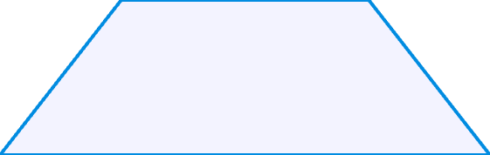

Role of Generative AI
Accurate Translations
1
Medically precise output.
Clarity
2
Clear medical terminology.
Real-Time
3
Instantaneous responses.

Slide 6





User Guide
1. Select Languages
Input and output.
2. Start Recording
Initiate voice input.
3. View Translation
Real-time display.
4. Play Audio
Listen to the translation.
5. Clear Text
Reset the interface.

Slide 7

Conclusion
Improved Communication
Breaks down language barriers in healthcare.
Future Enhancements
More languages and better accuracy planned.

