Slide 1
NFT MINING WEBSITE
DAVIDSON LOUISSAINT, ANTHONY LYNCH,

Slide 2
MISSION STATEMENT AND KEY OBJECTIVE
MISSION
Our mission is to create the first ever successful NFT Minting website at the University of Massachusetts Boston. Evolving for the future one NFT at a time.
KEY OBJECTIVE
Our objective for this project is to create a platform where users would be able to mint NFT on a blockchain.

Slide 3
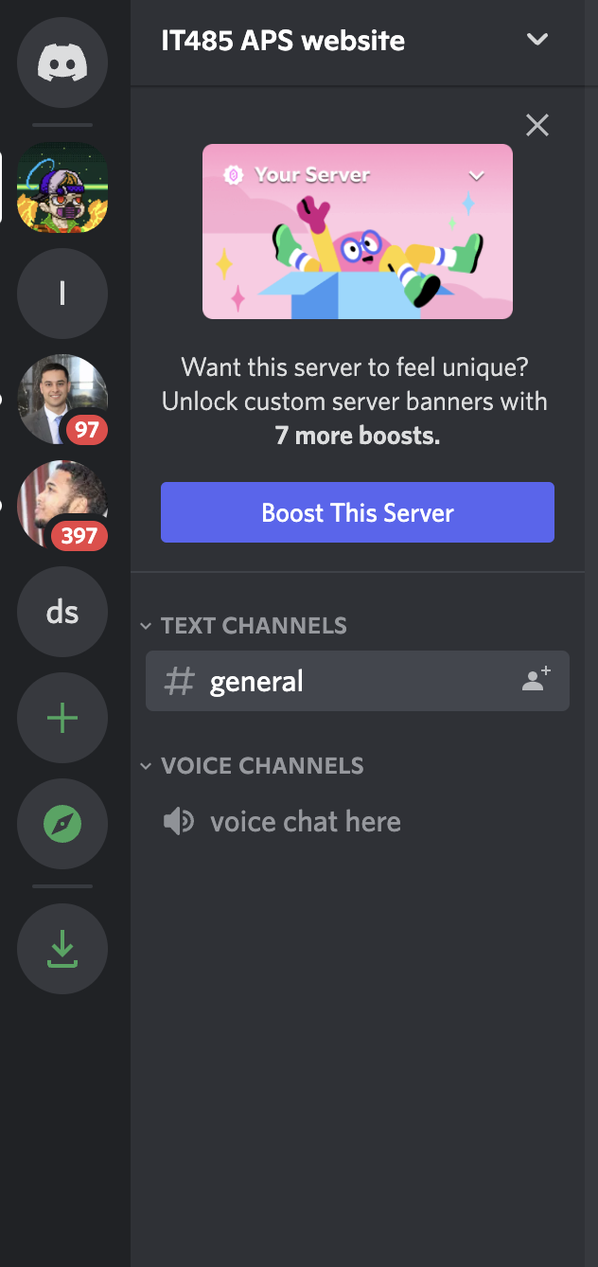
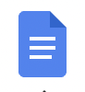
Project Communication
Sources of Communication
Discord - Primary source of communication
Weekly Check-ins
Voice Meetings
Google Docs - Used to collectively create project reports .
Google Slides - Used to collectively create presentation slides.

Slide 4
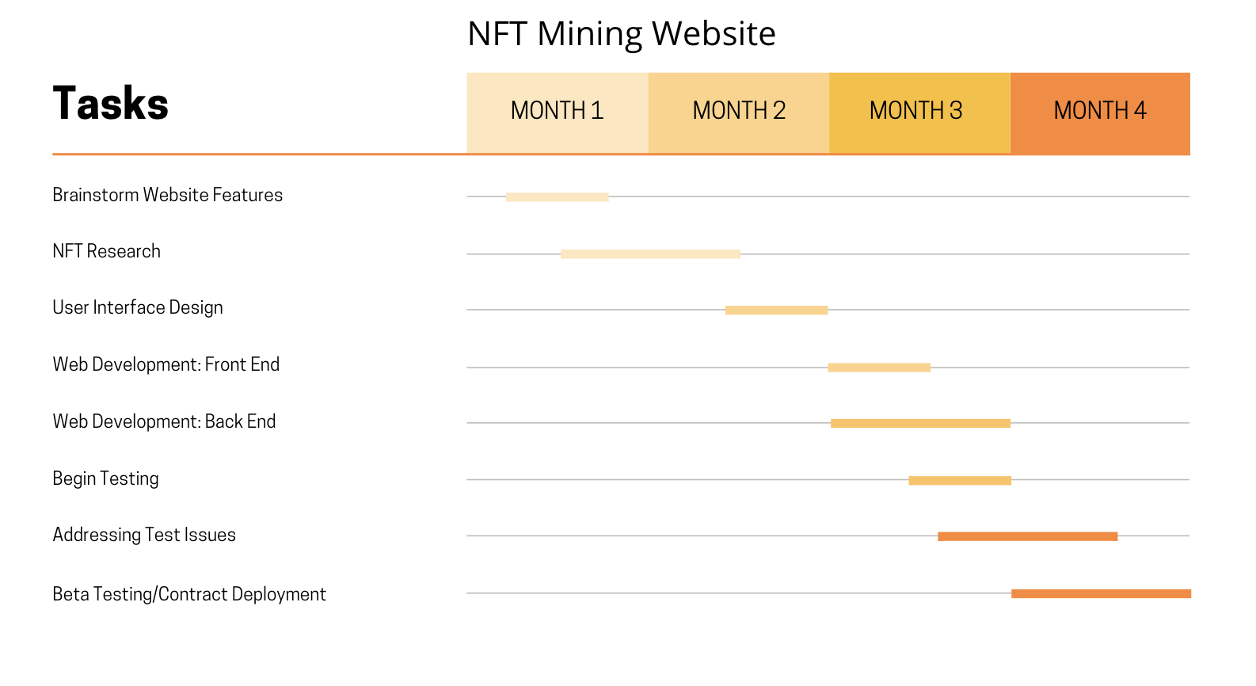

Slide 5
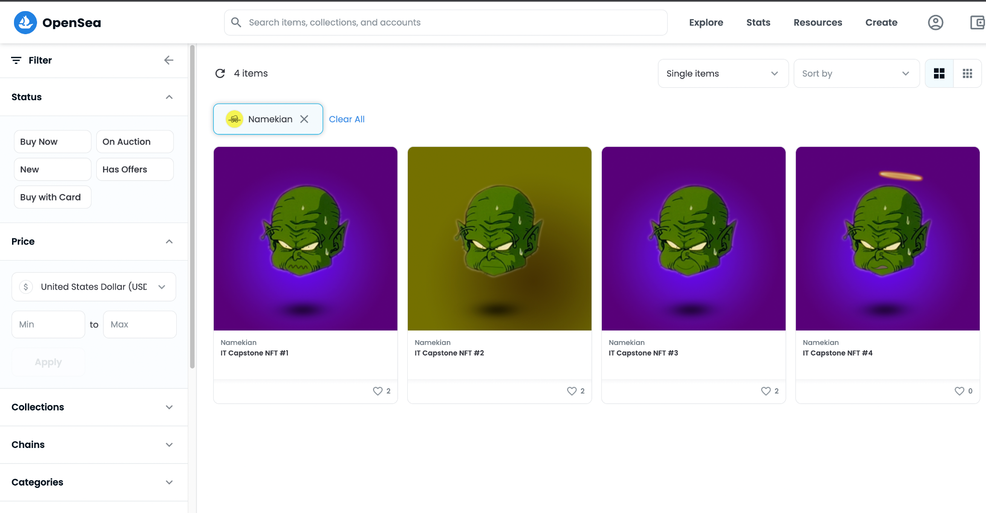
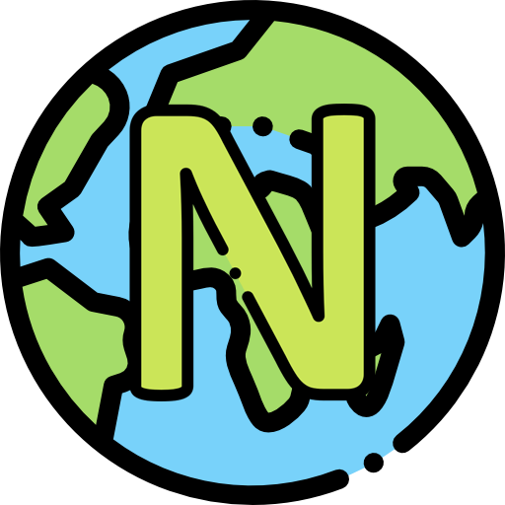

Slide 6




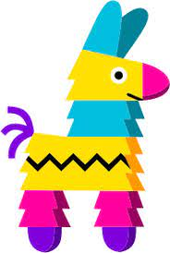




How This All Connects
Photoshop
Github Repository
Visual Studio Code
IT485 art engine main
Pinata
IT485_nft_contract
Remix.ethereum.org
OpenSea Testnet
Etherscan
IT485_nft_minting_web
Canva
OpenSea
Lucid Charts

Slide 7
Why UML?
UML diagrams can be used as a way to visualize a project before it takes place or as documentation for a project afterward. But the overall goal of UML diagrams is to allow teams to visualize a system.
The following slide will display a context diagram aka DFD.
A data flow diagram (DFD) maps out the flow of information for any process or system. It uses defined symbols like rectangles, circles and arrows, plus short text labels, to show data inputs, outputs, storage points and the routes between each destination.

Slide 8
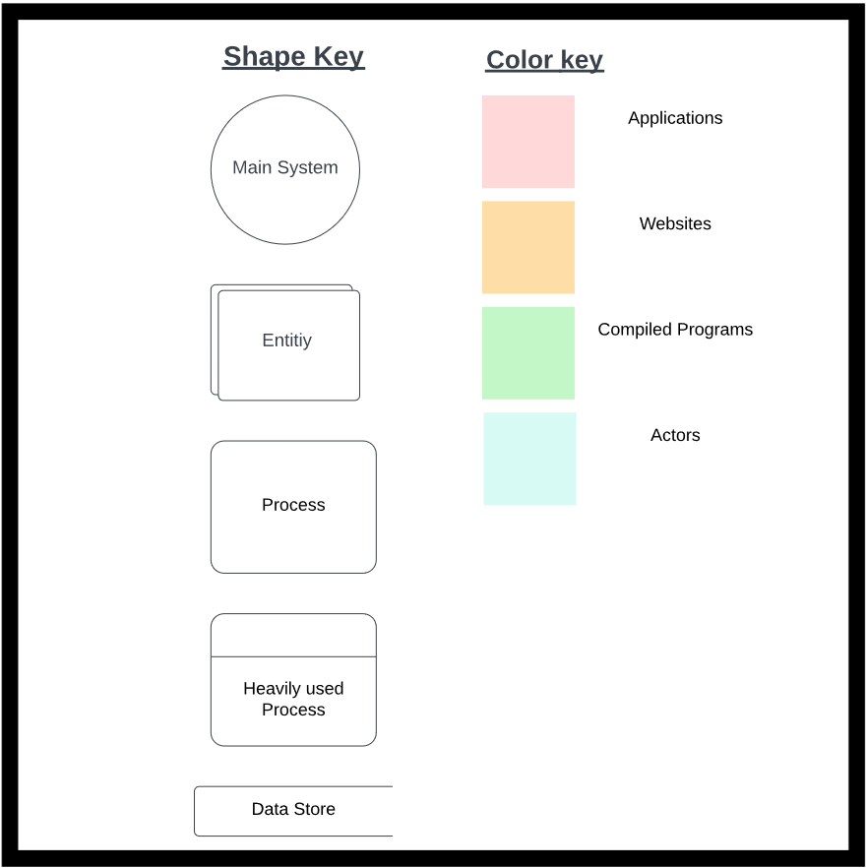
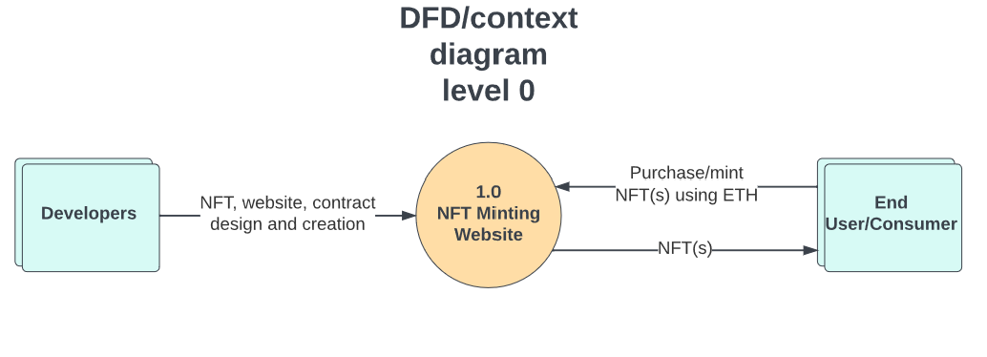
Context Diagram aka (DFD)

Slide 9
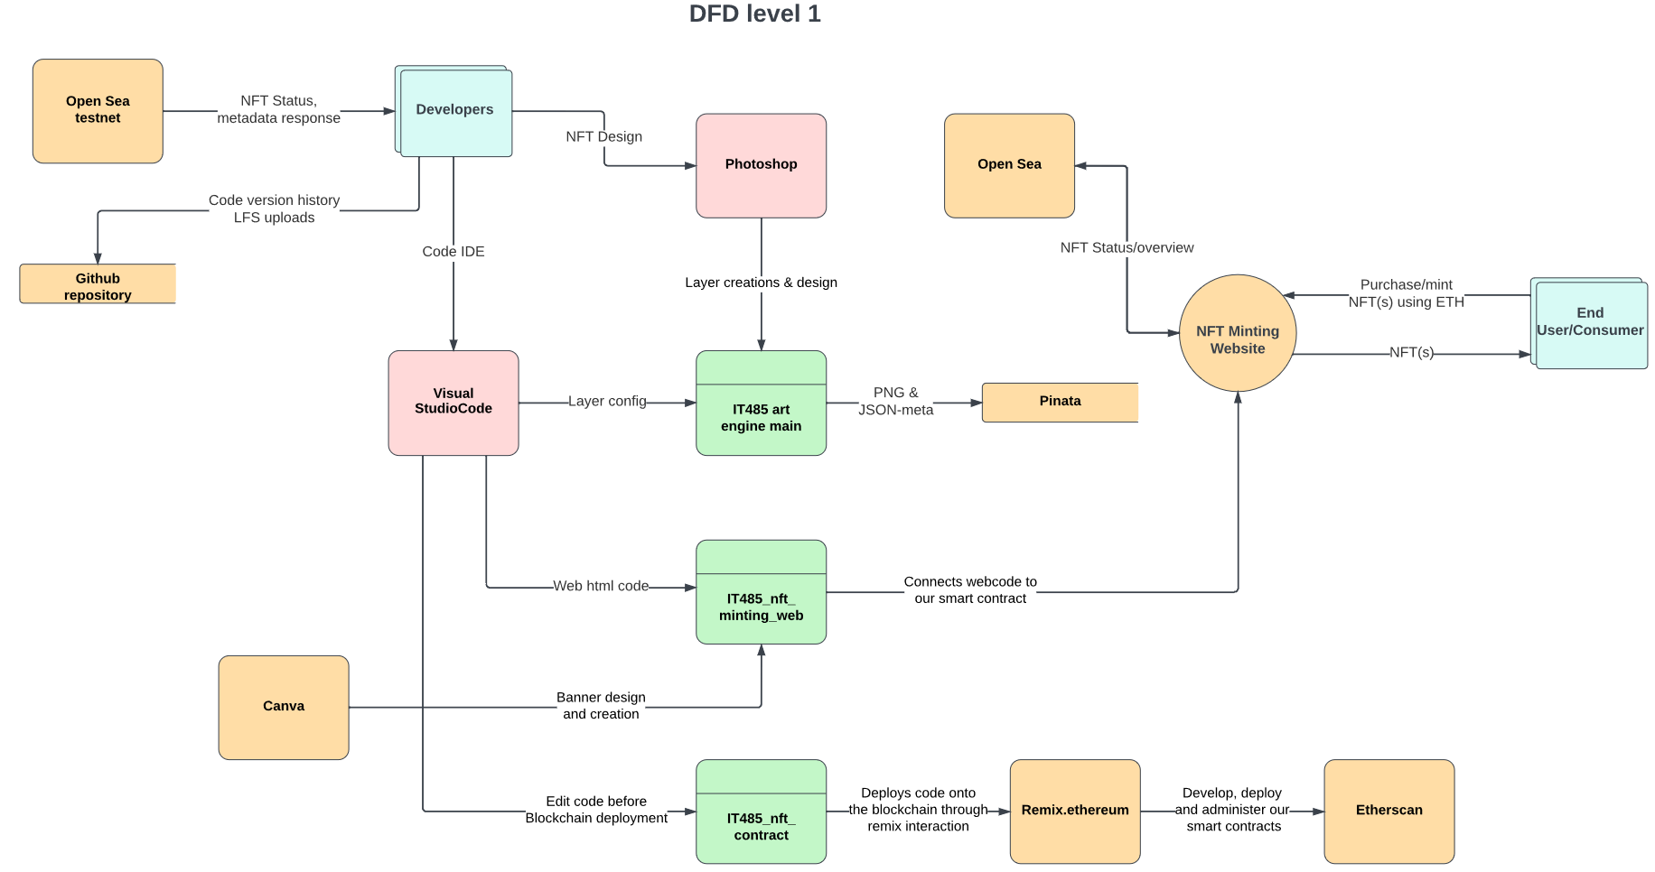
DFD(s) Data Flow Diagram

Slide 10
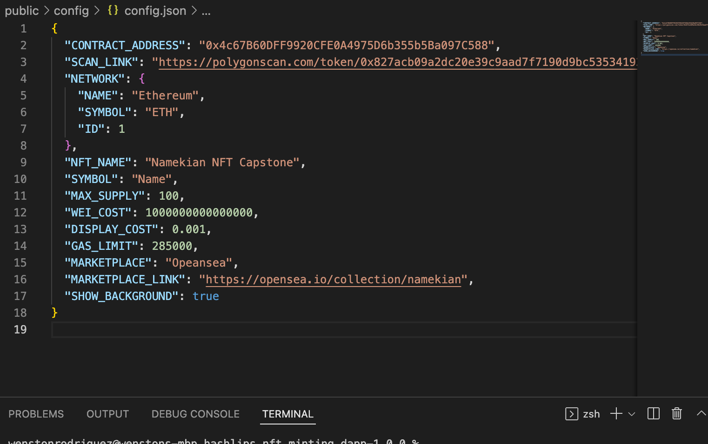

Slide 11
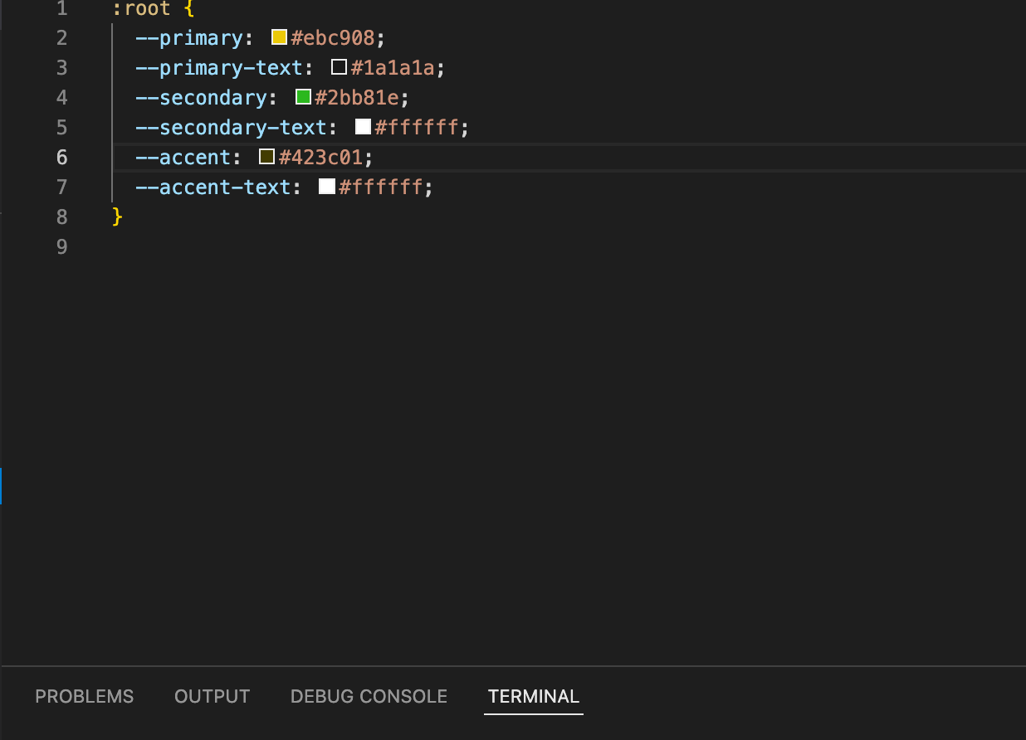
Color Theme for our Website

Slide 12
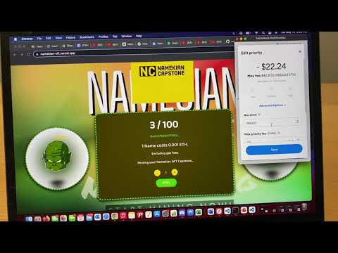
If Gas is too high heres a Video

Slide 13
References
https://namekian-lr95p74mm-wenston7.vercel.app/ OUR WEB!
https://www.bluescape.com/blog/uml-diagrams-everything-you-need-to-know-to-improve-team-collaboration/
https://www.lucidchart.com/pages/data-flow-diagram

