Slide 1

Data Warehousing: General Security
Philip Arcuri, Anthony Lynch, MD Khan

Slide 2
Who are we
Private Security Company
We don’t have any database
Need to track things like addresses for clients, warehouse previous incidents, and provide all necessary employee information
Provide better customer service

Slide 3
Analysis
The owners of the company want to modernize and autonomize their job workload. In doing so they want to be able to analyze information to better service their clients, employees and view where there needs to be reinforcements.

Slide 4

Problem & Solutions
No efficient way to track employees & clients
Database including
Employee & client contacts
Current job location
Job description
Employment status

Slide 5

Problem & Solutions cont.
Profit ratio
Calculate
Earnings from contracts
Contract cost including
Employee compensation
Finding profit ratio
To set future price point

Slide 6
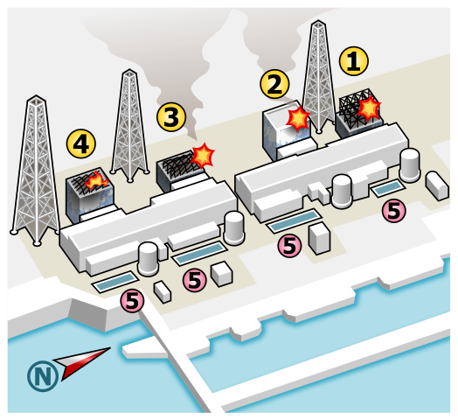
Problem & Solutions cont.
Incident
Track & record incidents
Figure out the impact
Financial
Reputational
Remediation

Slide 7
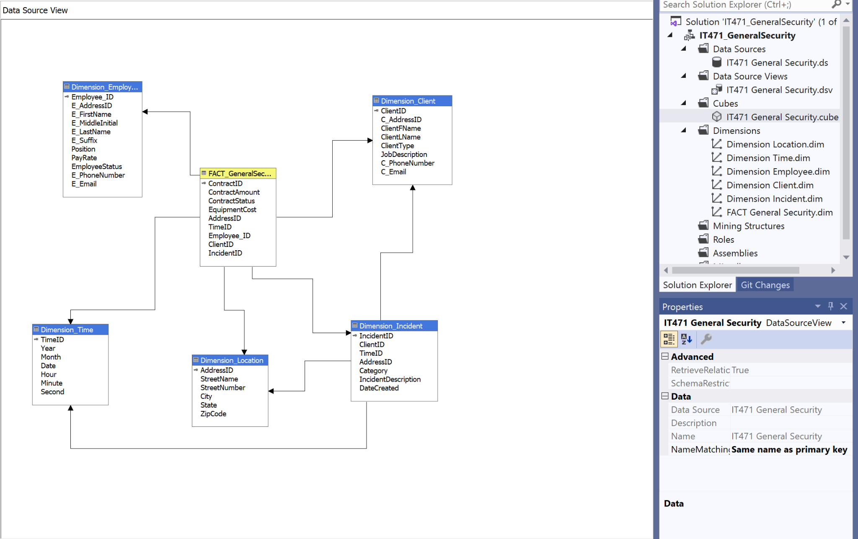
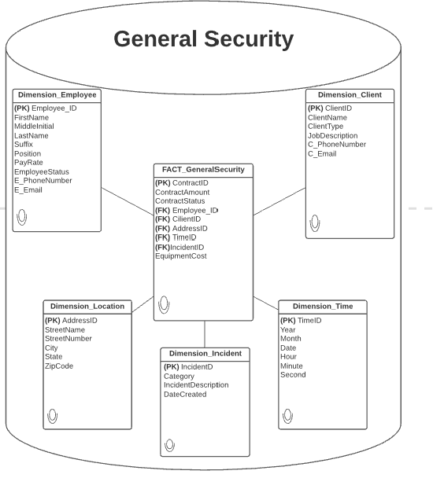
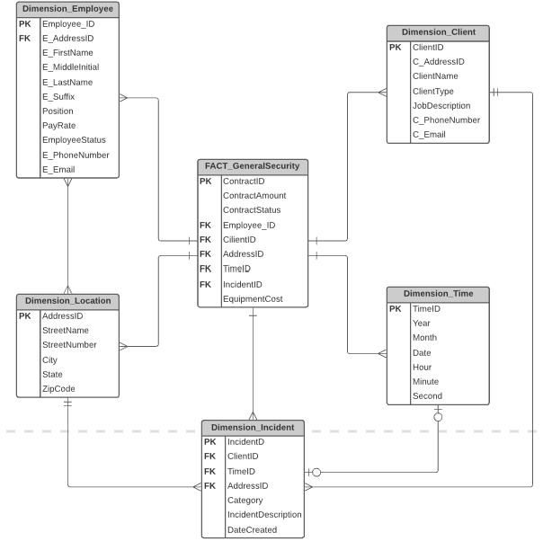
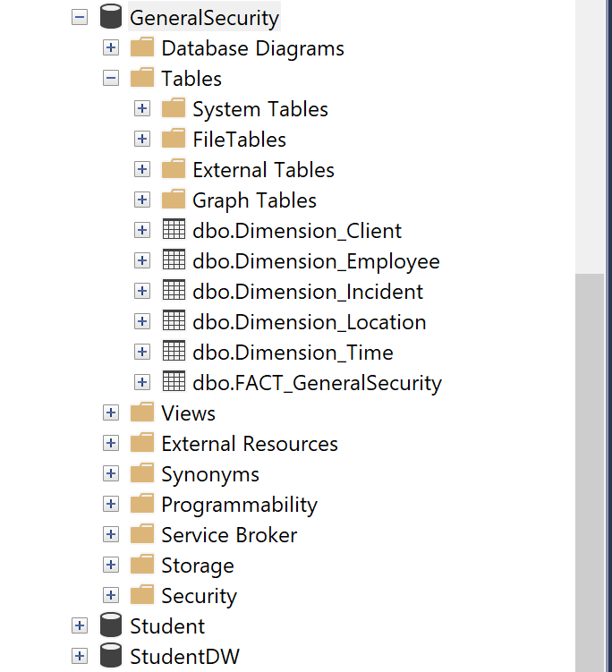
Data Visualization Prep.
Because this the real company we are basing these issues on lacks a database, we had to create a dummy one in respects to what they would need and deem useful to see!

Slide 8
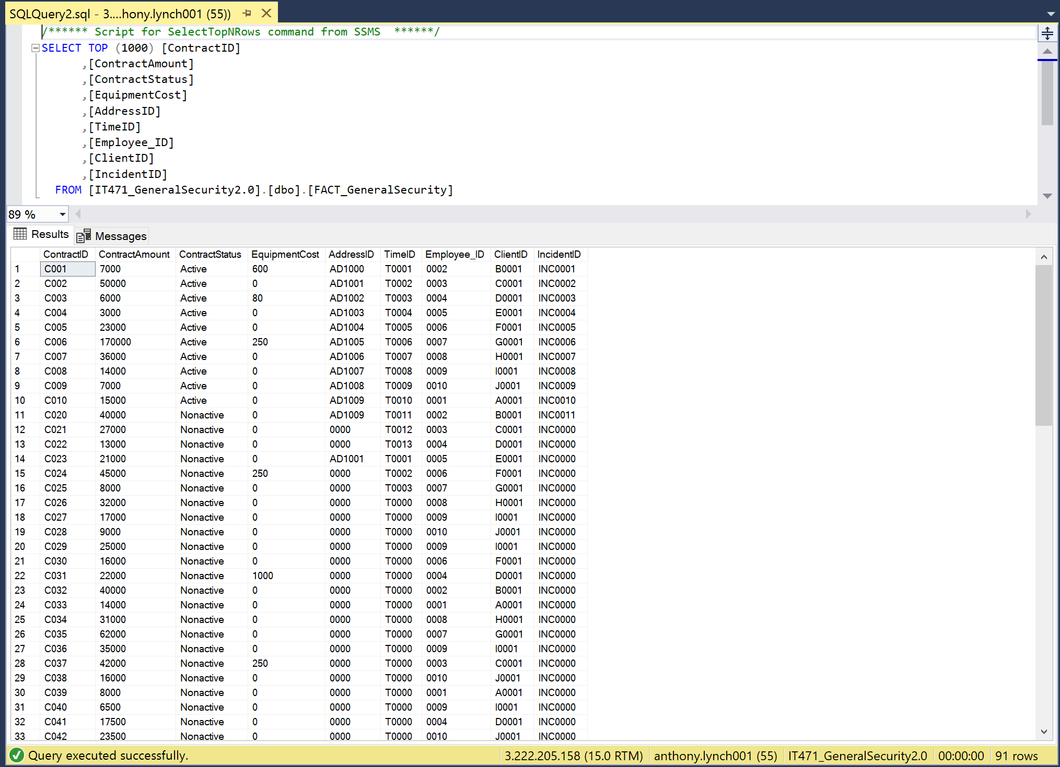
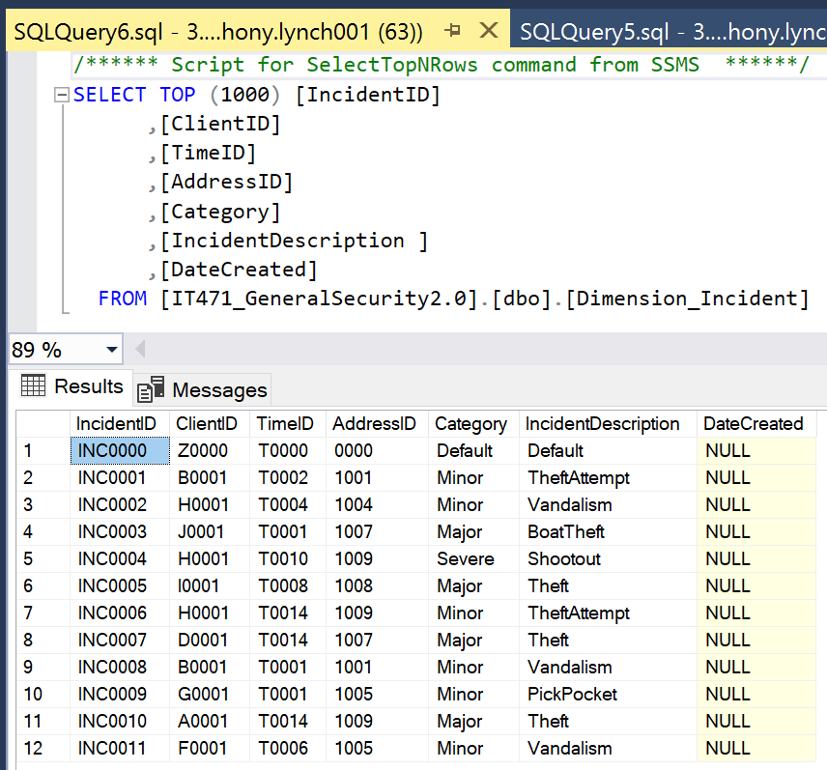
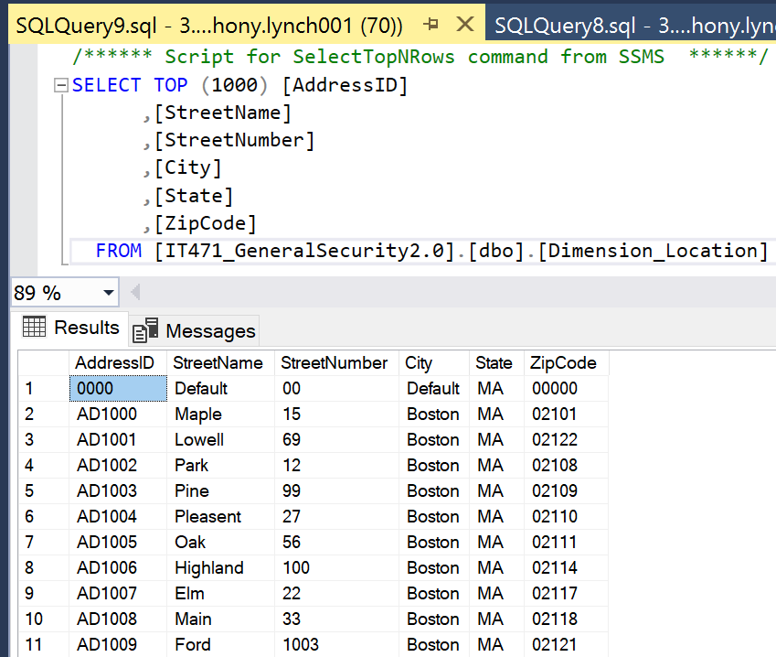
Data Visualization Prep. Extended
Data SnapShots

Slide 9
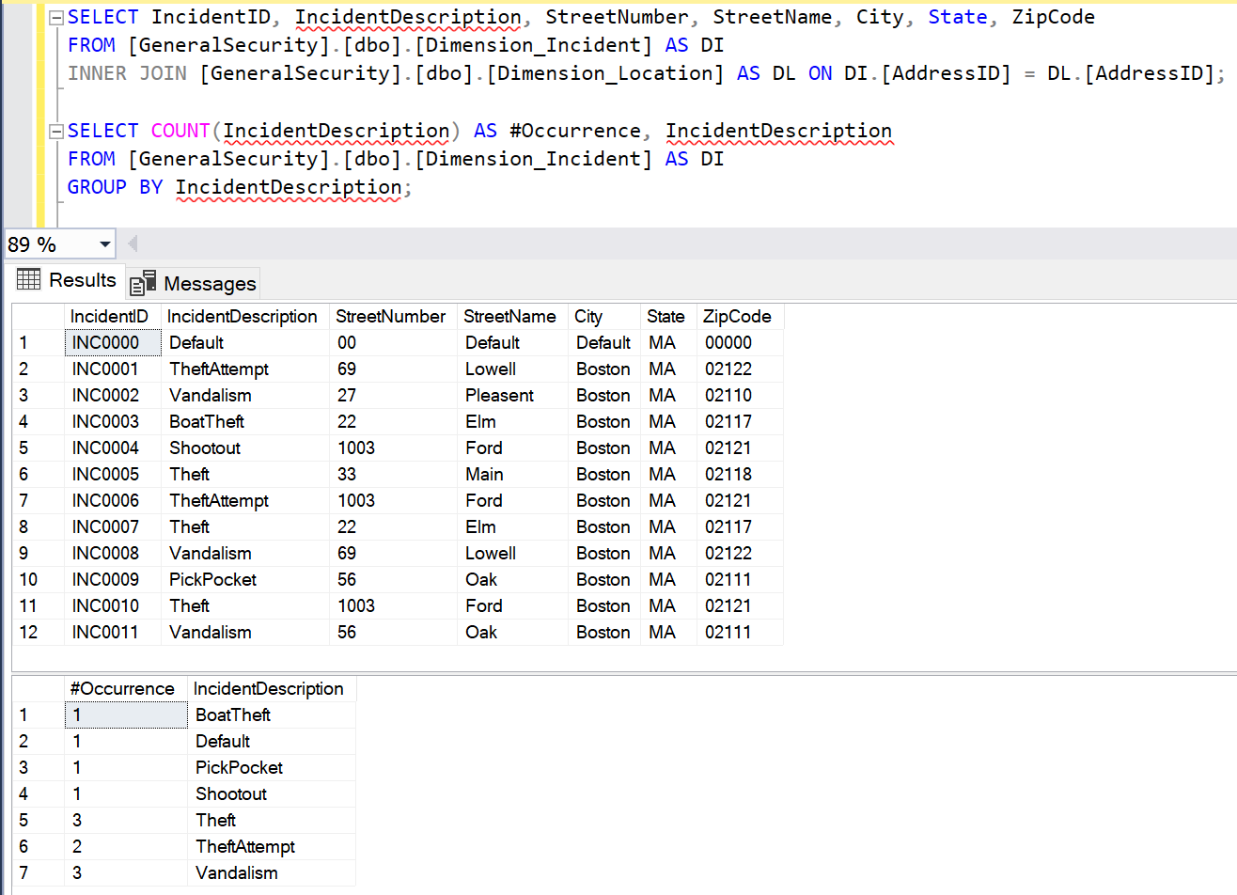
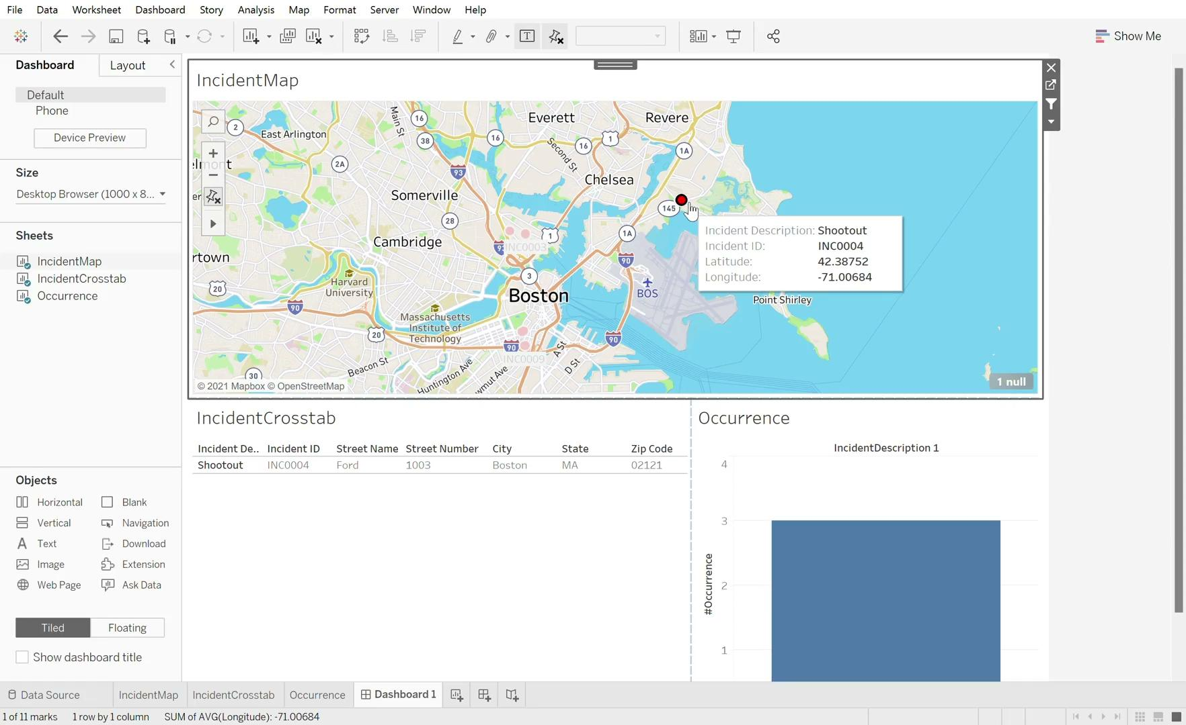
Multi-Dim Visualization
Based off this query and thanks to tableau, security officers and top management can use an interactive map to view and pinpoint where incidents are occurring most often. Based off of this we can see that theft and vandalism are most prominent for general Security.

Slide 10
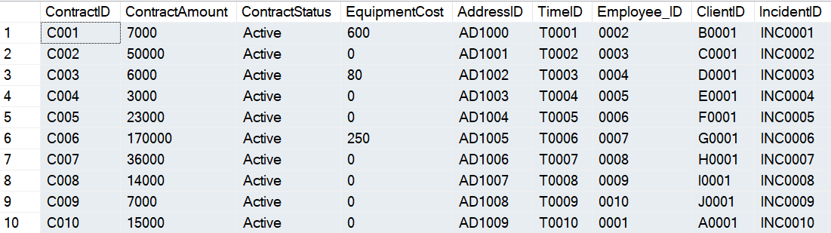
Data Visualization:
Through the use of the database, we were able to see how many contracts were active and calculate profit ratio for all active contracts based on the “Contract Amount” and “Equipment Cost”
This process has shown us that the profit ratio for active accounts is 191.39:1.
There is very little equipment cost for General Security because they typically already have all necessary equipment before starting a contract.
Query: SELECT * FROM [FACT_GeneralSecurity] WHERE ([ContractStatus]) = ‘Active’

Slide 11
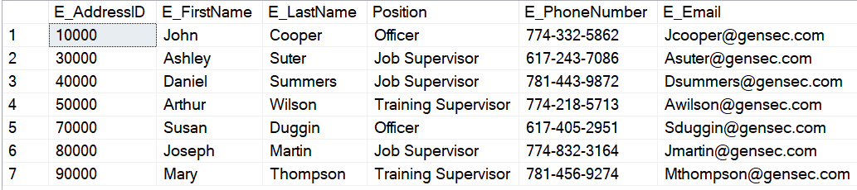
Data Visualization 2:
This next query allowed us to see only the employees that are full time within General Security and present all the necessary information to get in contact with them.
This query will allow General Security to see which employees are normally available and get in contact with them as quickly as possible.
Query:
SELECT [E_AddressID],[E_FirstName],[E_LastName],[Position],[E_PhoneNumber],[E_Email] FROM [Dimension_Employee]
WHERE ([EmployeeStatus]) = 'Full Time'

Slide 12

Questions?

