Slide 1
.NET
Past, Present, & Future

Slide 2

TechBash 2019
github.com/TechBash/techbash2019

Slide 3



Scott Kay
scott@syntaxnode.com
SyntaxNode

Slide 4

github.com/prebid/prebid-server

Slide 6
.NET 5
November 2020

Slide 7


Slide 8


One language,
many platforms.
Many languages,
one platform.

Slide 9
.NET Languages
Ada
APL
C#
C++.NET
COBOL
Eiffel
Fortran
Haskell
J# (Java / J++)
JScript
Mercury
ML
Oberon
OCaml
Oz
Pascal
Perl
Python
RPG
Scheme
SmallTalk
Visual Basic.NET

Slide 10
“
.NET is the Microsoft XML Web services platform, which will
significantly change how people interact with applications and devices via the Web.
“

Slide 11
“
The .NET Framework itself is a new platform designed from the
ground up to target the Internet.
“

Slide 12
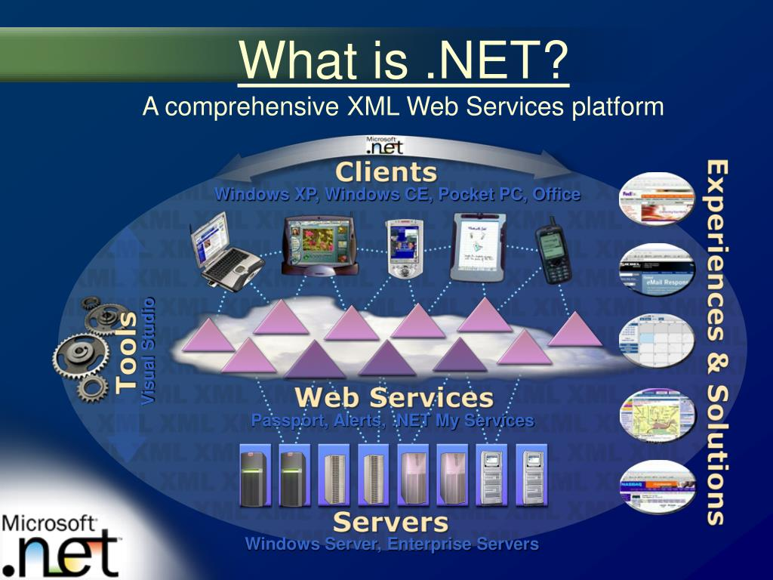

Slide 13
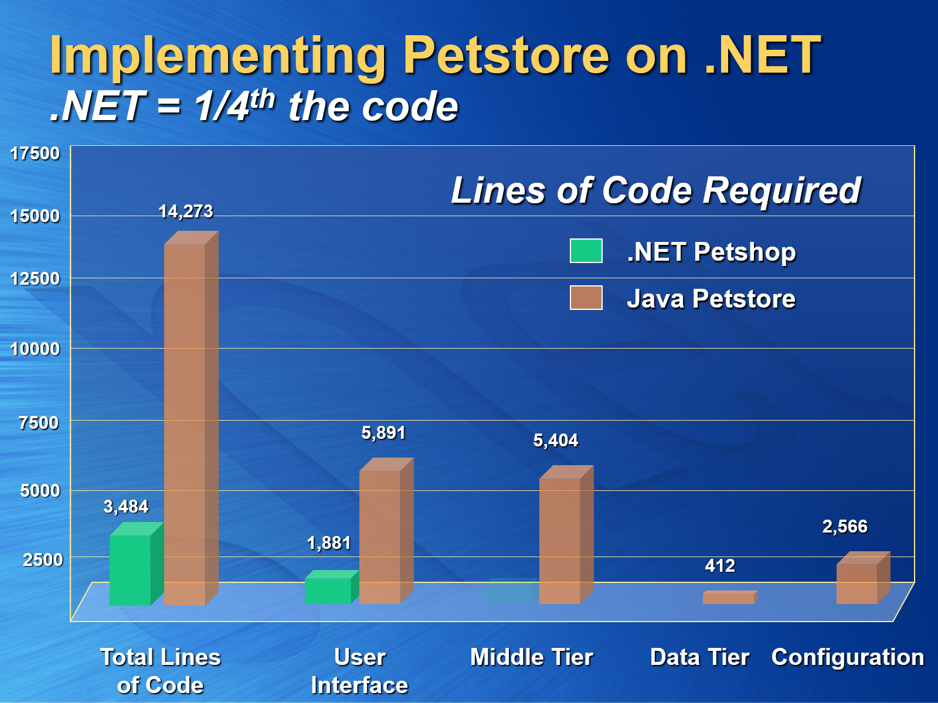

Slide 15


Slide 16



Slide 17


Slide 18



Slide 19


Slide 20

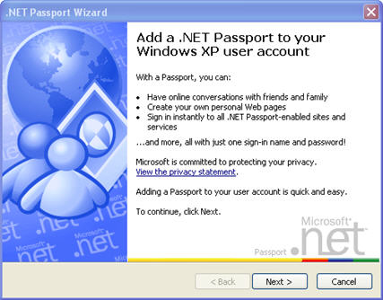

Slide 21

.NET Platform
C# Compiler
Intermediate Language (IL)
BCL/FCL
Just In Time (JIT)
Garbage Collector (GC)
CPU

Slide 22

.NET Platform
VB Compiler
Intermediate Language (IL)
BCL/FCL
Just In Time (JIT)
Garbage Collector (GC)
CPU

Slide 23
.NET Platform
VB Compiler
Intermediate Language (IL)
BCL/FCL
Ahead Of Time (AOT)
Garbage Collector (GC)

Slide 24
Singularity / Midori

Slide 25
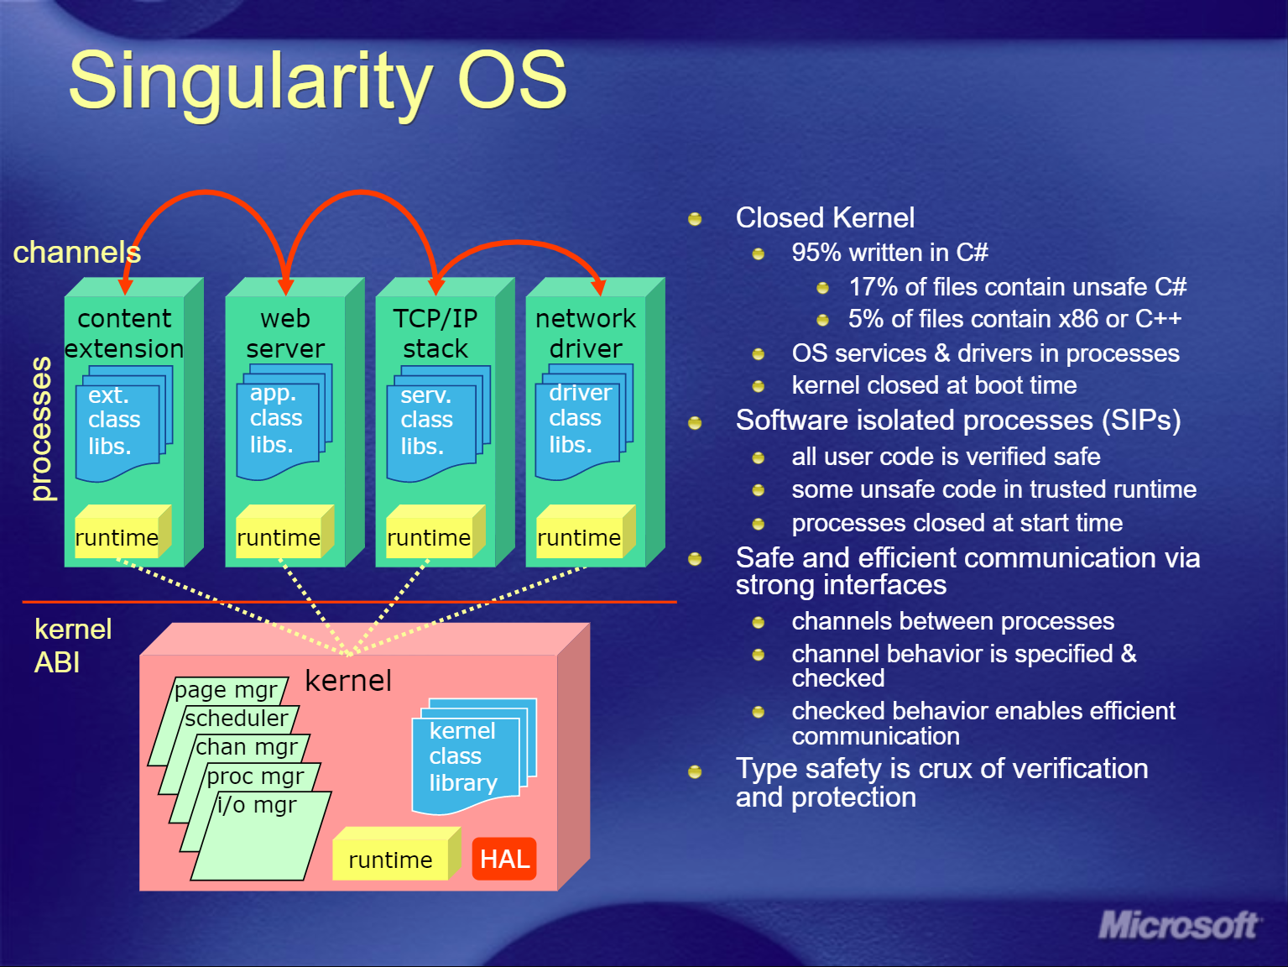

Slide 26
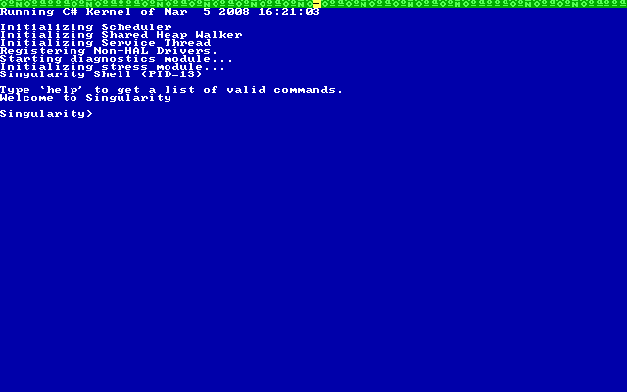

Slide 27


Standards

Slide 28
C#
CLI
ECMA-334
ISO-23270
ECMA-335 ISO-23271

Slide 29
SSCLI
Shared Source
Common
Language
Infrastructure

Slide 30
codename
ROTOR

Slide 31
Initial Release
ECMA/ISO Standards
SSCLI/Rotor
C# 1.0
VB.NET 7.0
1.0
CLR 1.0

Slide 32
Side-By-Side Release
Minor Improvements
C# 1.2
VB.NET 7.1
1.1
CLR 1.1

Slide 33
Side-By-Side Release
Generics!
64 Bit Support
ECMA/ISO Standards Update
SSCLI/Rotor Update
C# 2.0
VB 8.0
2.0
CLR 2

Slide 34


Slide 35


Slide 36

Avalon
WPF
WCF
WinFS
Indigo

Slide 37
In-Place Release
WPF
WCF
Windows Workflow (WF)
Card Space
3.0
CLR 2

Slide 38
2.0

Slide 39
2.0 +
3.0

Slide 40
2.0 + 3.0 +
3.5

Slide 41


Slide 42
In-Place Release
LINQ
Entity Framework
Reference Source Library
C# 3.0
VB 9.0
3.5
CLR 2

Slide 43
Side-By-Side Release
Side-By-Side Execution
Streamlined
DLR
Parallel LINQ
C# 4.0
VB 10.0
4.0
CLR 4

Slide 44


Slide 45
In-Place Release
Store/UWP Support
Async Libraries
MEF
C# 5.0
VB 11.0
4.5
CLR 4

Slide 46


Slide 47


Slide 48
In-Place Release
RyuJIT
SIMD
High-DPI Support
4.6
CLR 4

Slide 49
In-Place Release
Minor Improvements
ValueTuple
4.7
CLR 4

Slide 50
In-Place Release
Minor Improvements
4.8
CLR 4

Slide 51
.NET Core 5

Slide 52
.NET Core 1.0

Slide 53
“
.NET Core 5 is the small optimized runtime for ASP.NET 5.
“

Slide 54
“
A small runtime that is built from the same codebase as the .NET Framework CLR.
“

Slide 55
.NET Core Design Goals
Open Source
Cross-Platform
Fast & Light-Weight
Cloud Optimized

Slide 56
Always Side-By-Side Release
Uses Roslyn
Uses RyuJIT
100% Open Source
1.0

Slide 57
Expanded OS Support
1.1

Slide 58
Tooling Improvements
Linux Unification
Tons Of New APIs
2.0

Slide 59
Self-Contained Releases
JIT Improvements
System.Span
Brotli Compression
Security Improvements
Tiered Compilation
2.1

Slide 60
Compile to EXE
Diagnostic Improvements
Startup Hooks
2.2

Slide 61
Single File Executables
Unused Assembly Trimming
GC Improvements
WPF + WinForms
C# 8.0
VB 16.0
3.0

Slide 62


Slide 63


Slide 64


Slide 65


Slide 66
.NET Framework
.NET Compact Framework
.NET Micro Framework
.NET Core
Silverlight
Rotor/SSCLI
Mono
Moonlight
Xamarin
Unity
Windows Store/UWP
MANY
FRAMEWORKS

Slide 67
.NET Standard

Slide 68
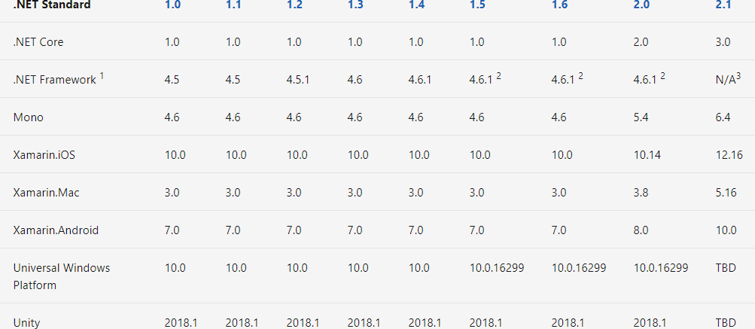

Slide 69
.NET 5

Slide 70
.NET 5
Roslyn (C#/VB)
F#
ML.NET
.NET Standard
CoreFX
CoreCLR JIT
Mono AOT/JIT

Slide 71
The Future

Slide 72
Blazor CLIENT SIDE

Slide 73
High Performance

Slide 74
Kestrel
ASP.NET CORE WEB SERVER

Slide 75
CPU Intrinsics

Slide 76
GPU Intrinsics

