Slide 1
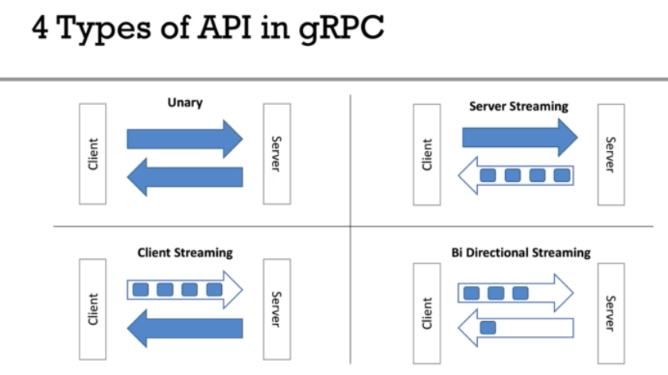
GPRC website: https://grpc.io/
REST vs GPRC: https://husobee.github.io/golang/rest/grpc/2016/05/28/golang-rest-v-grpc.html
gRPC JAVA git repo: https://github.com/grpc/grpc-java
gRPC works on HTTP2 (also binary)
Protocol buffers:
Programming language dependent.
Code can be generated by almost every programing language.
Data is binary and efficiently serialized. (small payload.) lighter than JSON
Very good at transporting lot of data.

Slide 2
Unary API
Basic request response ( client send one message to server and server send one response to client. )
Unary RPC suitable for:
When data is small
Server Streaming API
Client send one request to server and Server sent many response (may be infinite) to client.
Suitable for
Server needs to send lot of data
When server needs to push data to client with out having client request.
Client Stream API
Client send multiple (stream) request / message to server and server send only one response to client.
Suitable for
When clients need to send lot of data
When server processing is expensive and should happen as client send data.
In both previous cases grpc service methods are VOID. But here service method needs to return StreamObserver<XRequest>
Client Stream API ClientStub should be async client.
Bi-Directional Stream API
Client send many number of request and server response many number of responses. No need to equal number of request to number of responses.
Suitable for:
Client and server needs to send more data asynchronously. Ex : Chat
Long running connections.

Slide 3
ERROR Codes:
With gRPC there a few error codes (not much as http response codes) :
https://grpc.io/docs/guides/error/ http://avi.im/grpc-errors/
DeadLine:
Client can set dead line (timeout) for request.
https://grpc.io/blog/deadlines/
Deadlines are propagated across if gRPC calls are chained.
A => B => C ( deadline for A is passed to B and then pass to C )
Security
https://grpc.io/docs/guides/auth/
https://github.com/grpc/grpc-java/blob/master/SECURITY.md

Slide 4
GRPC

