Slide 1
URI : https://kubernetes.io/docs/concepts/workloads/pods/pod-overview/
API : https://kubernetes.io/docs/reference/generated/kubernetes-api/v1.11/#pod-v1-core
minikube start --memory 4096 - allocate 4GB RAM for minikube.
Get Docker information's inside minikube: minikube docker-env
Pods :
Basic component
all are pods.
Wrapped containers.
One microservice container wrap by one pod. We can use multiple container (not a best practices on pod)
when microservice
Is not interdependent. Eg : log handler/ microservice. we call it as sidecar.
Pods has short life time
Pods regularly die.
Pods get long time than service to up and running. Since pod need to download image,
Read logs : kubectl logs <pod name>
Pod Examples :
first_basic_pod
first_pod

Slide 2
Pods are not visible for out side from kuberntes cluster.
Create pod : kubectl apply -f first-pod.yaml
Get all details under kube-cluster : Kubectl get all
Get pod details : kubectl describe pod <pod_name>
Get pod details with labels: kubectl get pods --show-labels
Get pod details filtered by selector: kubectl get pods --show-labels –l <release=0>
Execute command inside pod (same as docker) : kubectl exec <podname> <command (ls)>
Open sh inside pod : kubectl –it exce <podname> sh
Delete: kubectl delete pod <pod_name>

Slide 3
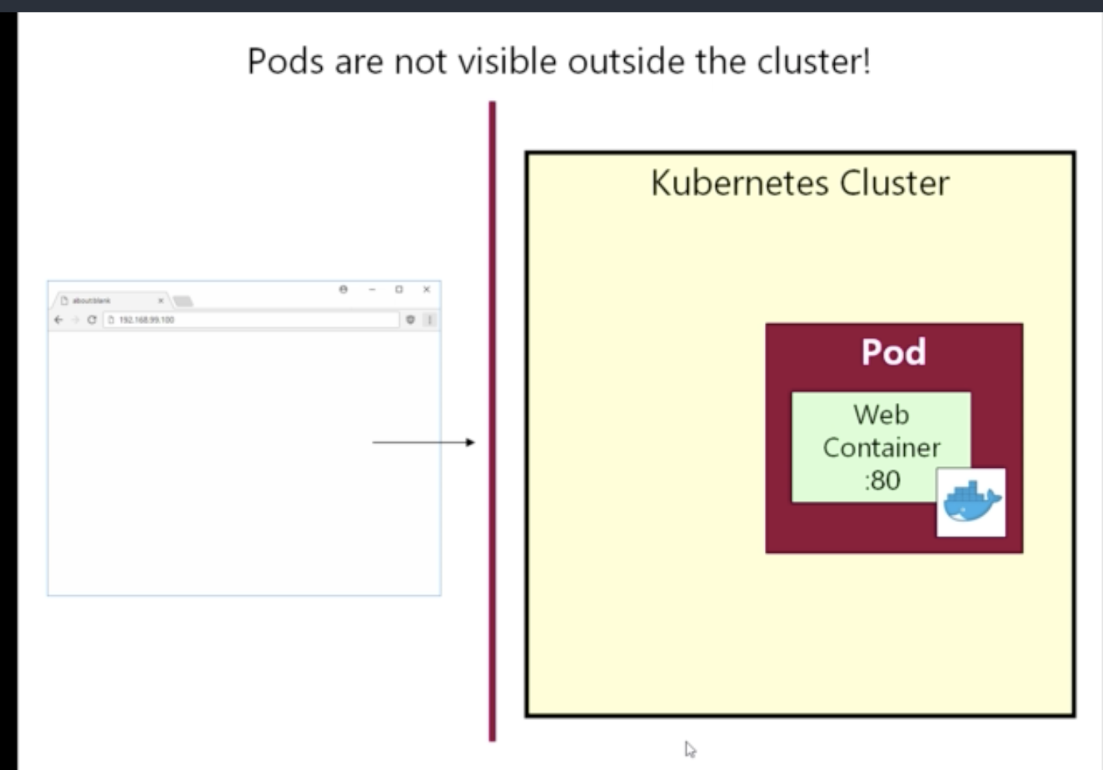
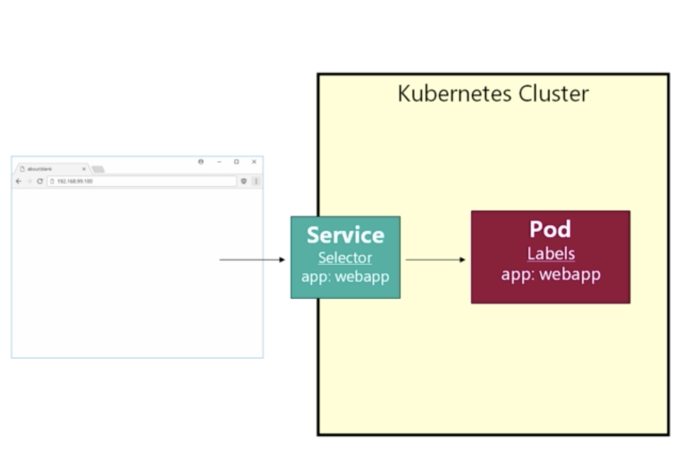
We cant access POD by using IP address of docker for kub or minukube IP s.
Its need to create service.

Slide 4
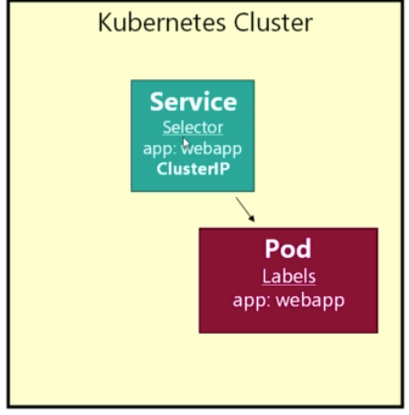
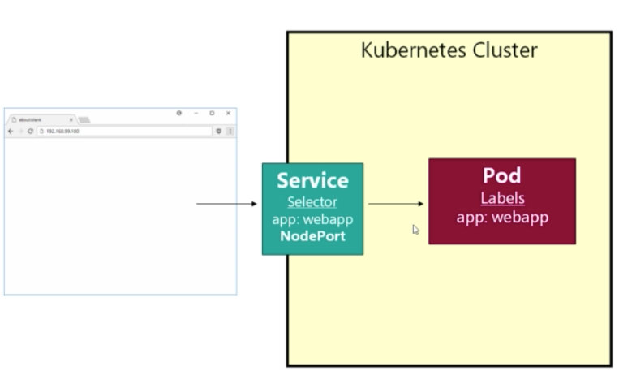
Service:
Services discover pods - by selector in service and labels in pod.
Pod labels are just key value pairs,
Ex : basic_service
Delete service : kubectl delete service <service_name>
Kubectl describe service <service_name> - you can find all
Services are having private ip address. Since services are long running ip address of service not get change.
Service name will use to communicate between two services. So its need to give meaningful name as service name.
Best practice for service name : <application_name>-<pod_name>
Service Types
ClusterIP : this service only accessible inside k8 cluster. Cant access from outside. Specially for internal services
( private service). ‘
NodePort : this is for expose service to outside world from k8 cluster ( web applications). For node port we can
Configure nodeport inside ports. But k8 only allow to upper that 30000 port as nodePort

Slide 5
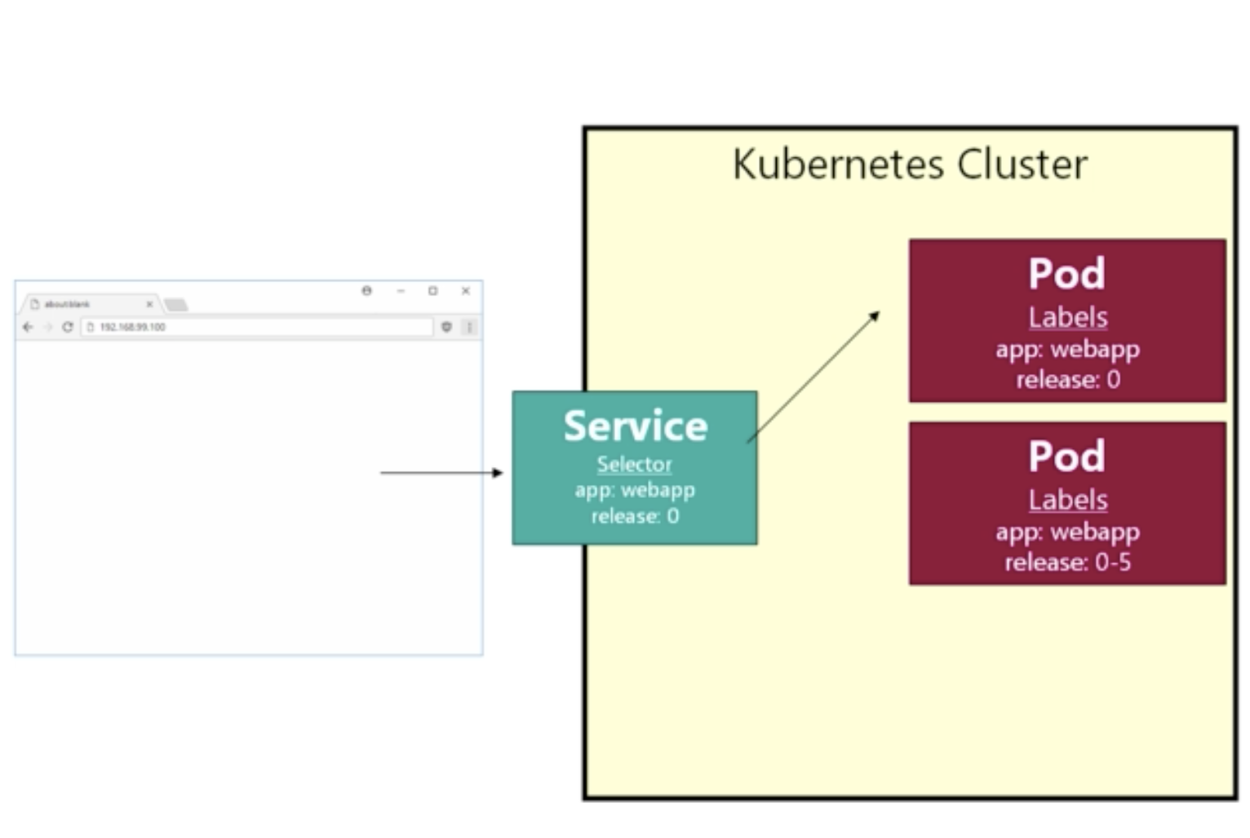
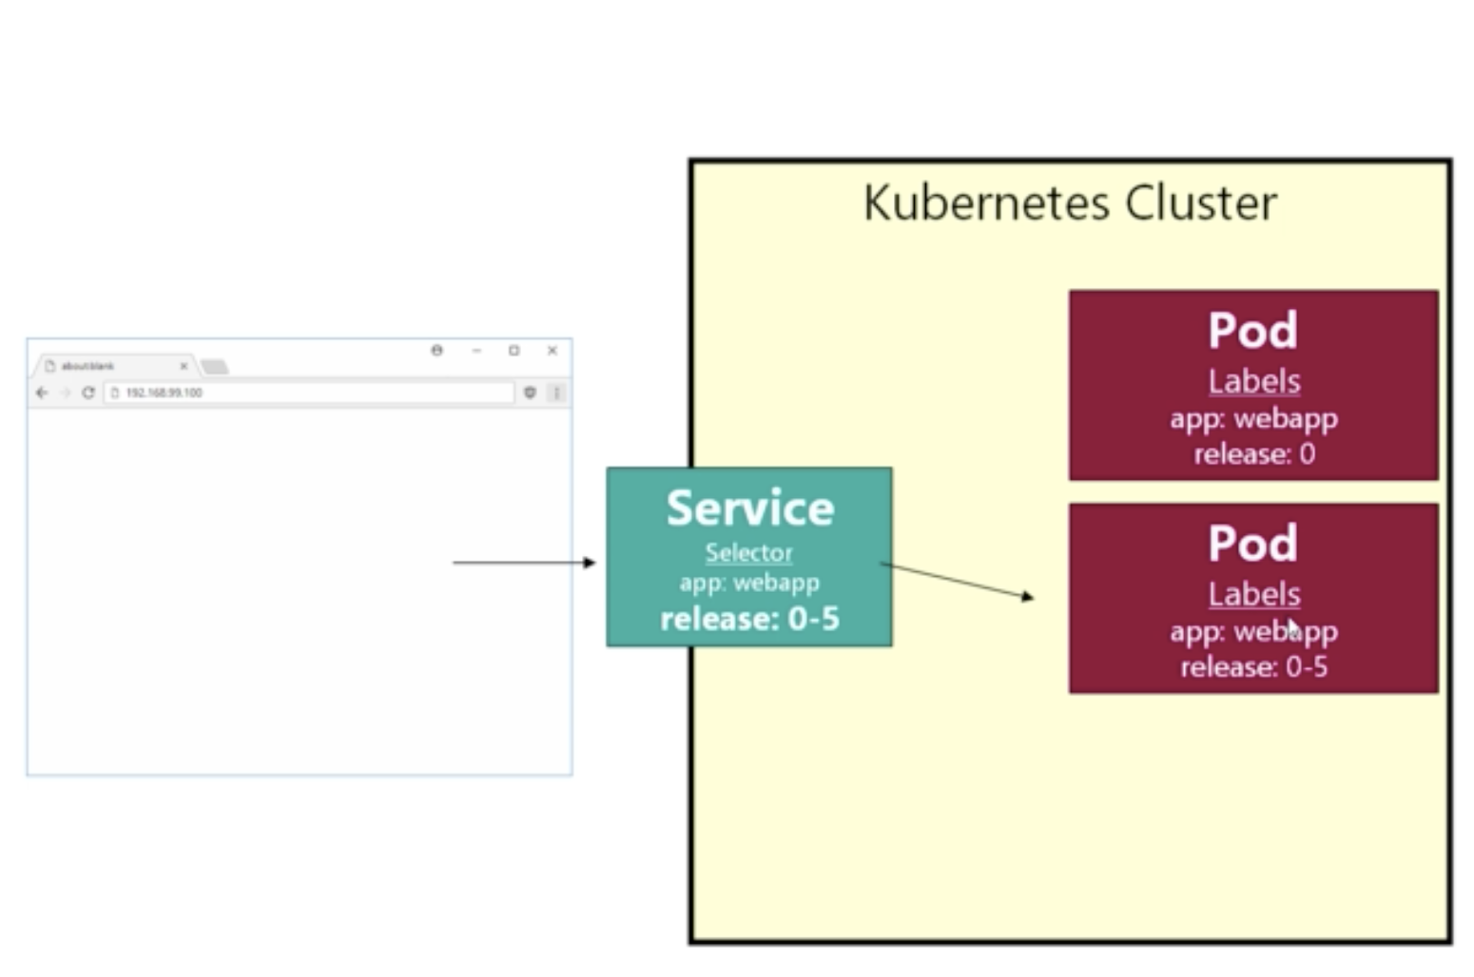
How to apply New Release:
Introduce new selector property / labels to pod as release.
Then deploy new pod with new release – this may take some time to deploy – docker image download…
After pod deployment point service to new POD by changing selector properties. This makes minimum downtime release.
kubectl describe service/svc todo-webapp-ui
Can view selector. : Selector: app=todo-ui,release=v2
Ex : to-do/3_multi_ver_po.yaml / to-do/3_multi_ver_svc.yaml
(Change service labels as v2 to test new version of release)
microservice/pods.yaml microservice/services.yaml
Queue : user/password : admin/admin

Slide 6
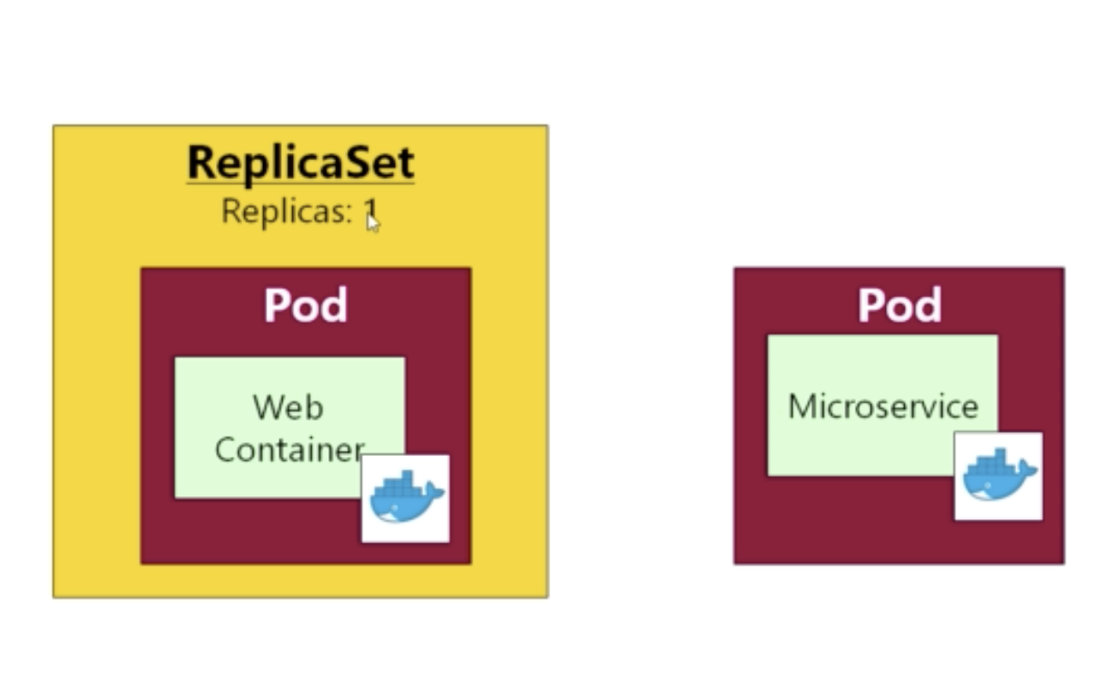
ReplicaSet,
ReplicaSet wrap Pod to handle crashes ( template tag represent pod in replica set) and it create pods internally
when replicaset start.
In production, we should use ReplicaSet / Deployment, not Pod. If we deployed Pod we are responsible for pod lifetime,
So If pod is crashed the service will be unavailable.
Ex : kubctl delete pod <podname> – service will be unavaialbe.
But If use ReplicaSet k8 will automatically up another instance of pod.
If we configure replicas: 2 then there is no downtime.
How to check :
Delete on of POD and refresh all the time.
Once ReplicaSet deleted all the pods created by replicaset terminating.

Slide 7
Deployment
Same as ReplicaSet but with additional feature, automatic rolling update with 0 downtime.
Deployment create -> replicaset > pod under the hood.
Example yaml : deployment_release_0 - deployment_release_0-5
Test :
Run deployment_release_0
Kubectl get all –> you can replicaset refer to release 0 : 3_1_deployment.png
Then apply 3_2_pods_deployment.yaml
Execute kubectl get all -> and monitor changes. 3_2_deployment_1.png 3_2_deployment_2.png
You can see k8 automatically update the release.
Rollout
K8 keep last 10 rollout history
Find out rollout history : kubectl rollout history deploy <deployment name>
Rollout for specify history revision :
kubectl rollout undo deploy <deployment name> --to-revision=2
Issue with rollout : since we are not updating yaml, live yaml differ with live application revisions.

Slide 8
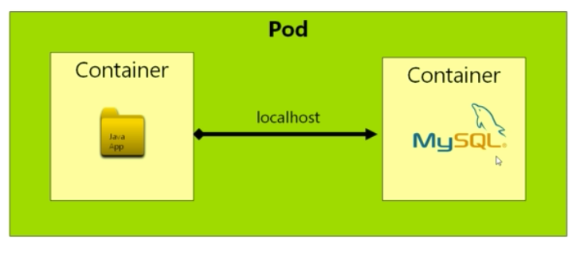
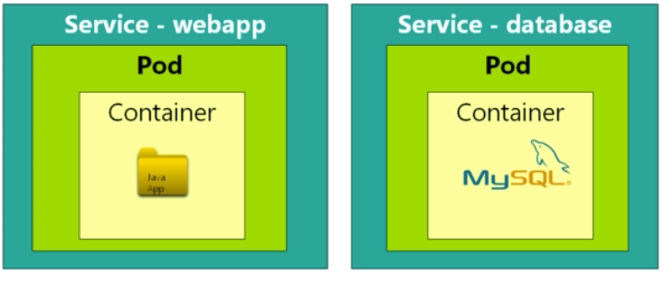
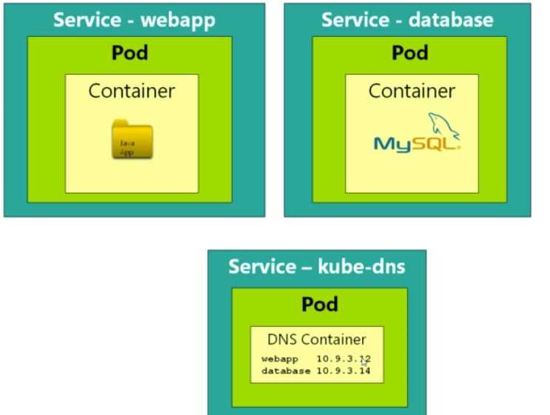
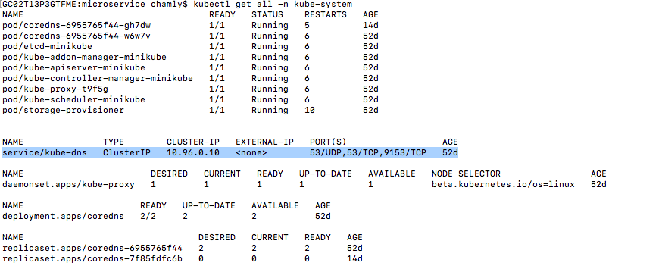
Service Discovery
If deploy two service in same POD can use localhost.
but its not recommended. Recommendation is use single container inside pod.
K8 internally use DNS Service. It allocate IP and maintain ip table for services (service name – kube-dns).
Service to service communication can done through service name
Test Service Discovery
kubectl exec -it <pod id> sh
Nslookup <service_name>

Slide 9
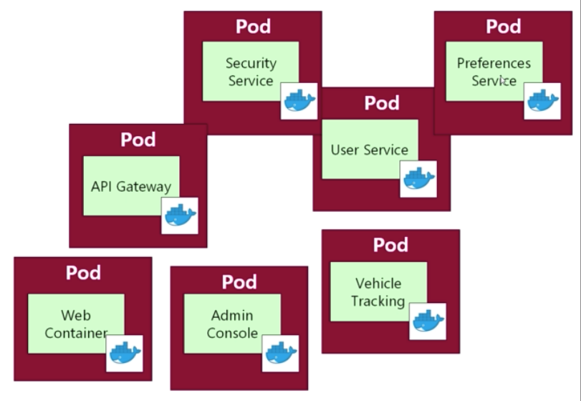
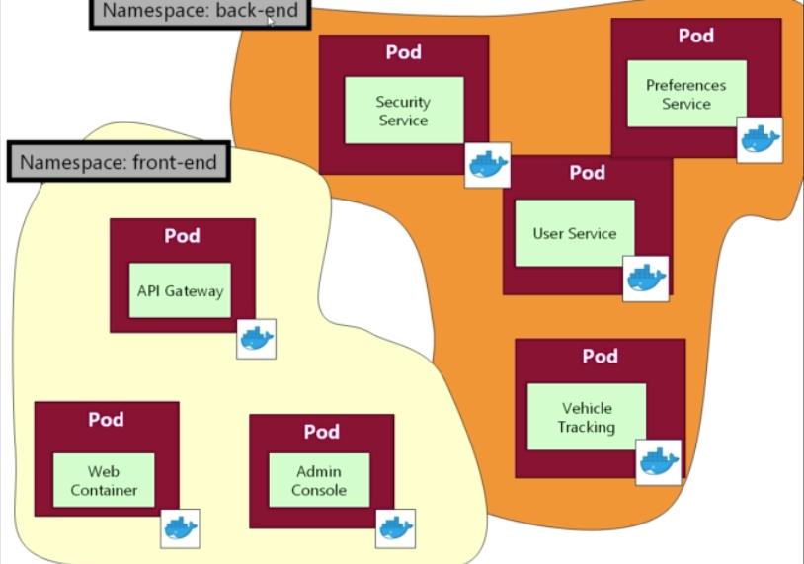
Networking & NameSpace – kube-system
NameSpace is partitioning resources (pods and service) in k8 clsuter into separate areas. (java packages)
To list name spaces - kubectl get namespaces or kubectl get ns
Get all resources inside name space – kubectl get all –n kube-system
Move resources to
name space

Slide 10
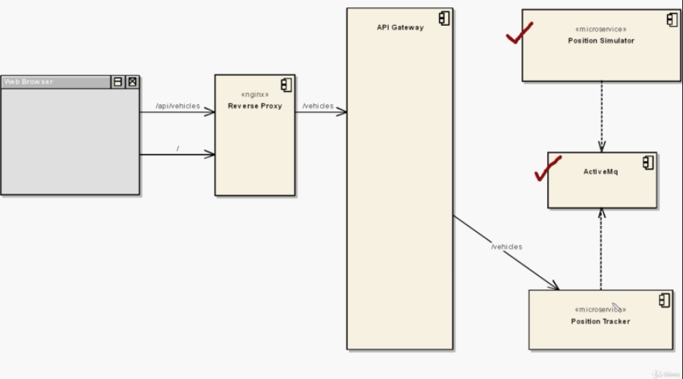
Deploying Microservice
Ex : 11_workload.yaml. 11_service.yaml
Architecture :

Slide 11
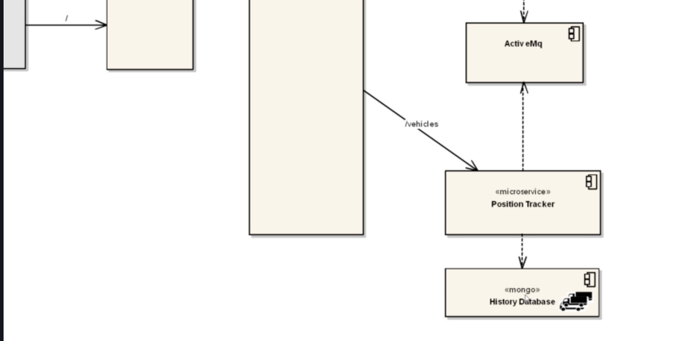
Persistence and Volumes
Alter previous architecture and introduce mongoDB to save data for tracker ( currently it store data in memory)
Ex : 12_storage.yaml 12_mongo-stack.yaml 12_workloads.yaml. 12_services.yaml
Can point separate volume from out side by using PersistentVolumeClaim. This let us to isolate volume configuration from env to env ( ex: AWS/Local/Dev..)
PersistentVolume – Real volume (100GB Hard drive) – storageClassName is reference.
PersistentVolumeClaim – claim some volume from persistence volume (20GB – this should be lesser than real volume) storageClassName is reference.
From POD refer persistent volume claim through claimName: mongo-pvc
To list persistent volume: kubectl get pv

Slide 12
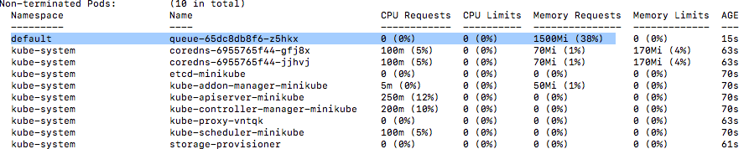
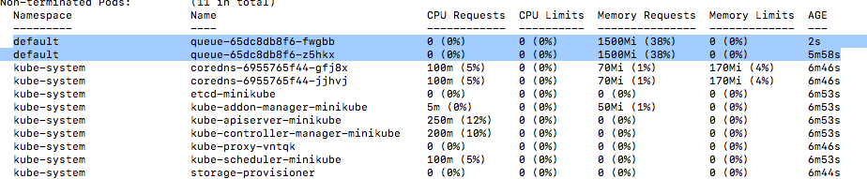
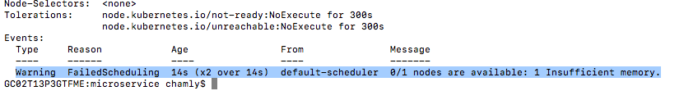
Requests & Limits.
Resource Request:
Memory request – ex : 20_memory_request.yaml
execute - kubectl describe node minikube – can see memory usage
for 1 pod – (repicaset 1)
for 2 pod – (repicaset 2)
no enough memory error : – (repicaset 3) (kubectl describe <pending pod name>
CPU request.
Limits:
Ex : 20_limits.yaml
Memory Limits : container is getting kill and up new container by pod if limit exceed.
CPU Limits: k8 not allowed to exceed this limit. - not killing.
BEST PRACTICE IS ALWAYS CONFIGURE REQUEST AND LIMITS ON PODS

Slide 13

Matrix Profiling.
Find minikube addons: minikube addons list
Enable Matrics server: minikube addons enable metrics-server
Find how much memory CPU used by pod: kubectl top pod

Slide 14
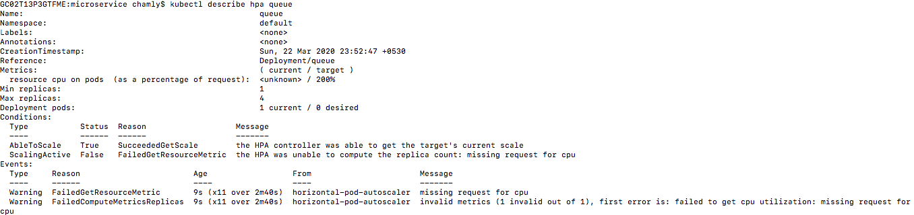
Automatic Rescaling.
Creating HPA (horizontally pod auto scale) Ex : 22_autoscale-rules.yaml
Create HPA through k8 :
kubectl autoscale deployment <deployment name> --cpu-percent <percentage against request> --min 1 --max 4
Ex : kubectl autoscale deployment api-gateway --cpu-percent 200 --min 1 --max 4
Get generated HPAs : kubectl get hpa
Get details of HPA: kubectl describe hpa queue
Get HPA as YAML : kubectl get hpa queue -o yaml

Slide 15
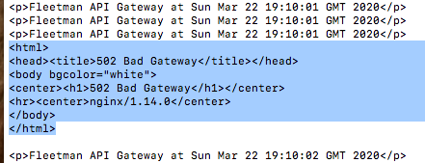
Rediness probs
Usage is here: once pods start even though container not ready accept traffic service send request to pod. To avoid this use case k8 introduce liveness and rediness.
Test Issue :
Delete api-gateway HPA - kubectl delete hpa api-gateway
Execute : 22_apigateway.yaml
Hit api endpoint continuously : while true; do curl http://192.168.64.5:30080/api; echo; done;
Change replicaset value to 3 in api-gateway pod
Monitor infinite curl terminal – you can see errors.
Fix Issue:
Adding readinessProbe configuraton to deployment. Ex : 22_apigateway_fix_rediness_issue.yaml
Test : make replicaSet to 1 apply. Then reset replicaSet to 3 and test.
Liveness:
Check whether container is LIVE
https://kubernetes.io/docs/tasks/configure-pod-container/configure-liveness-readiness-startup-probes/#define-a-liveness-command

Slide 16
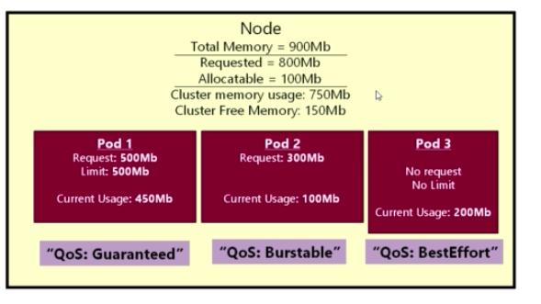
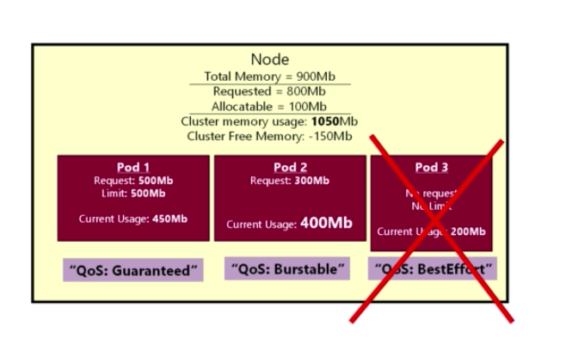
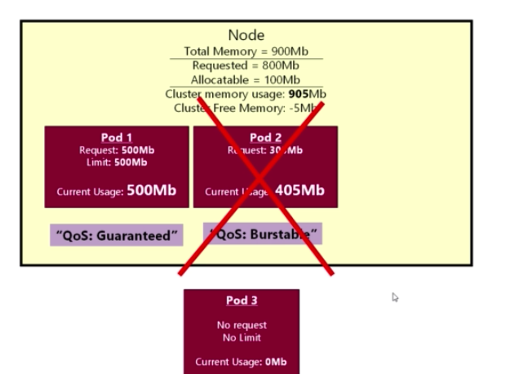
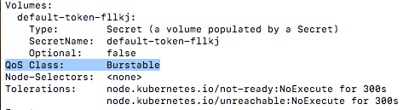
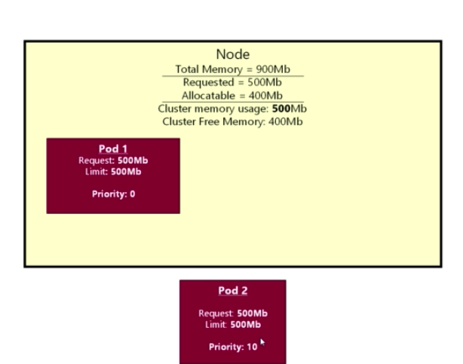
Quality of Service (QoS) and Eviction:
For Guaranteed you have configure both memory and cpu
Find QoS of POD - kubectl describe pod <pod name>
Evictions
QoS example
Priority

Slide 17
RBAC – Role base access control
Role : ex: 25_rules-for-new-joiners.yaml
Get Roles: kubectl get roles / kubectl get role <role name>
Get Role Details: kubectl describe role new-joiner
RoleBinding
Get role bindings: kubectl get rolebinding / kubectl get rolebinding <rolebinding name>
Get role bindings details: kubectl describe rolebinding <rolebinding name>
User creating and authentication should done from outside.
Reference: https://kubernetes.io/docs/reference/access-authn-authz/authentication/
ClusterRole & ClusterRoleBinding
Its for whole cluster

Slide 18
ConfigMaps
ConfigMap – Ex: 26_1_database-config.yaml
Create configMap: kubectl apply –f <yaml>
List config Maps: kubectl get cm
Get details of config map: kubectl describe cm < config map name>
Map ConfigMap to POD / Deployment ( valueFrom) – Ex: 26_1_workload.yaml
test config map properties inject to pod : kubectl exec -it position-simulator-config-map-587689cfb-6bhd9 bash
echo $DATABASE_URL
No mechanism to pods load config map changes automatically, we need to manually delete and up the pod.
Rollout new config map changes:
Normal practice create new version of config map. Ex : 26_2_database-config.yaml. 26_2_workload.yaml
Map ConfigMap to POD / Deployment ( envFrom) – Ex: 26_3_database-config.yaml 26_3_workload_envFrom.yaml
Here we should maintain system variable names as key.
Map configMap as VOLUME ( as property file) - Ex: 26_4_database-config.yaml. 26_4_workload_volume.yaml
you can see database.properties in /etc/any/directory/config folder

Slide 19
Secrets:
Secrets not seucred
If use stringData with out double quote (“) its need to enter base64 encoded value as value.
stringData:
accessKey: MTIzNDU2Nzg5MAo=
secretKey: U0VDUkVUMTIzNAo=
Secret yaml – ex: 26_1_aws-credentials.yaml
List secrets : kubectl get secret
Get details of secret: kubectl describe secret <secrent_name>
Get secret back from k8 secret : kubectl get secret <secret name> -o yaml
Get base64 encoded value for parameter via terminal : echo "chamly" | base64 -> Y2hhbWx5Cg==
Decode base64 value via terminal : echo MTIzNDU2Nzg5MAo= | base64 –D
Usage of secret ?

Slide 20
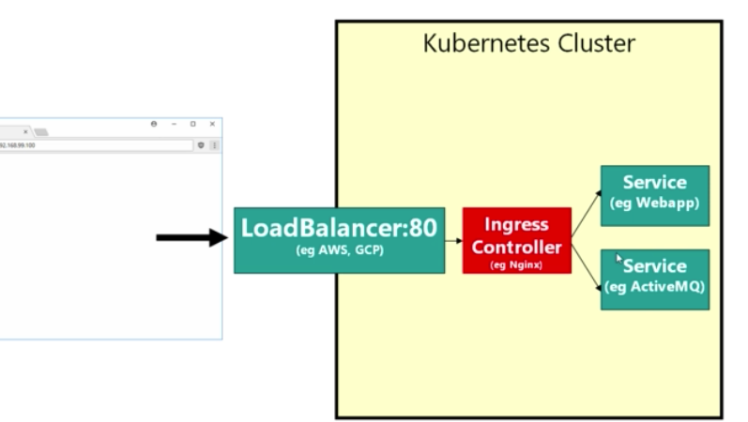
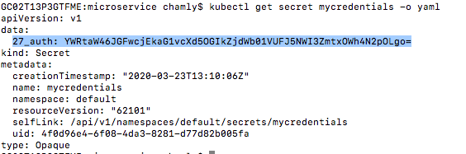
Ingress (NGINX) Controllers: https://kubernetes.github.io/ingress-nginx/user-guide/nginx-configuration/ Basically work as load balancer, routing.
Enable ingress in minikube: minikube addons enable ingress
Routing ex: 27_ingress.yaml
Need to add entry for host file for mapping minikube server to host name
Authentication: https://kubernetes.github.io/ingress-nginx/examples/auth/basic/
User/password : admin / admin
Create secret : kubectl create secret generic <mycredentials:secret name> --from-file <auth: htpasswd file>
Get yaml of secret: kubectl get secret mycredentials -o yaml

Slide 21
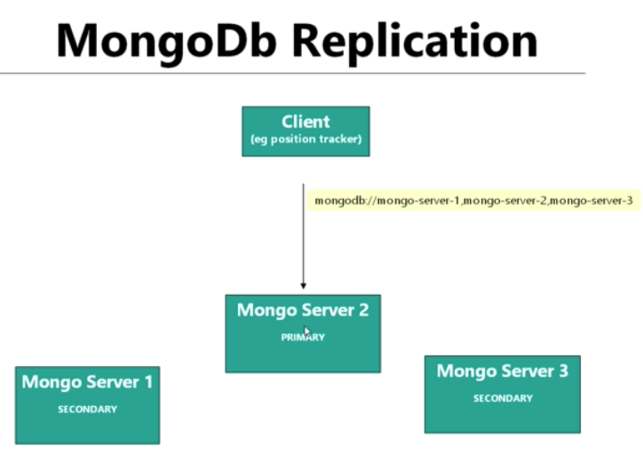
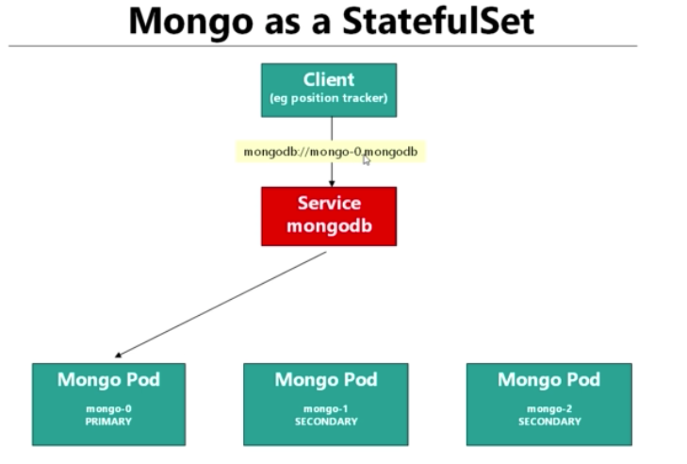
Workload Types:
Batch Jobs: ex: 28_job.yaml – Makes sure task get complted. Even pod died k8 will create new pod and makes sure completion of task.
Cron Jobs: Schedule tasks ex: 28_cron.yaml.
DaemonSets: Ex: Advance type of ReplicaSet which k8 run pod in every node in cluster. ( no need to mention #of replica sets sicne k8 automatically run this pod in every node in cluster. (Ex: Log collector)
StatefulSets: A StatefulSet is NOT used for persistence ( data should not loss even pod get restart- means data should not store inside pod).
Ex: 28_stateful_mongo-replicated.yaml
StatefulSets: Lets clients to call by POD name. ( Even though pod generated through Deployment -( deployment is responsible for pod name) enable static name for POD)
Ex: Database Replications. (Master slave replication)
StatefulSet connected outside from HeadlessService. It just Service (no syntax change). You can call StatefulSet pod as <pod_name>.<service_name> ex: mongo-0.mongodb
To call mongo replicaset: mongoDB://mongo-0.mongo,mongo-1.mongo,mongo-2.

Slide 22
CI-CD
Create Organization (TechCR-CI-CD) fork all repositories.
Start minikube wth 4GB RAM: minikube start –memory 4096
Install Jenkin inside K8
Clone Jenkin repository.
Access minikube docker environment: minikube docker-env
Create Jenkin image from DockerFile: docker build image –t myjenkins .
Execute jenkin in k8: kubectl apply—f jenkins.yaml

Slide 23
Requests & Limits.

Slide 24
Requests & Limits.

Slide 25
More Resource to Read
https://blog.devops.dev/how-to-achieve-zero-downtime-application-with-kubernetes-ba52fdea9a9b

