Slide 1

A Project On: Socially Augmented Hybrid Recommendation Engine (SAHRE)
Mentor:
Dr. Sonali Agarwal
Group Members
Shivendra Soni (IIT2010027)
Prateek Porwal (IIT2010035)
Kshitij Mittal (IIT2010040)

Slide 2

Project Abstract
In this project, we aim to provide users of an e-commerce application with better recommendations based on not only his/her preferences but also from his/her social circle.
We will be calculating predicted ratings for every item(I) in the inventory based on users preference for items similar to I, general acceptance of item I from other users like user U and influence from user’s immediate friends.

Slide 3

Prediction Formula
Given the attribute values of item I, the attribute values of user U, and the ratings on item I rated by U's immediate friends, the probability distribution of the target user U's rating on the target item I will be:
Once we obtain this distribution, R_{UI} is calculated as the expectation of the distribution. Items with high estimated ratings will be recommended to the target user.

Slide 4
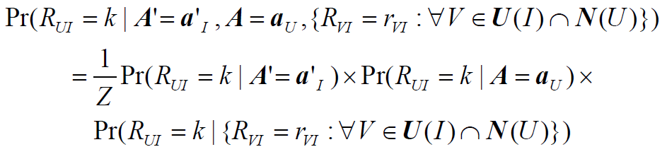
Adopting naive Bayes assumption, we assume that the influences from item attribute values, user attribute values, and immediate friends' ratings are independent, we get
Where,
Pr(R_{U} = k | A’= a'_{I},) is the conditional probability that the target user U will give a rating k to an item with the same attribute values as item I.
Pr(R_{I} = k | A = a_{U}) is the probability that the target item I will receive a rating value k from a reviewer whose attribute values are the same as U.
Pr(R_{UI} = k | {R_{VI} = r_{VI} : ∀ V∈ U(I)∩N(U)}) is the probability that the target user U gives a rating value k to the target item I given the ratings of U's immediate friends(V) on item I.

Slide 5
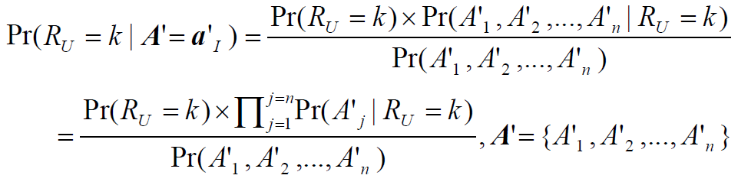
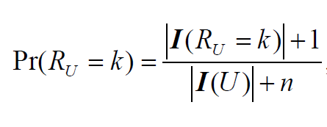
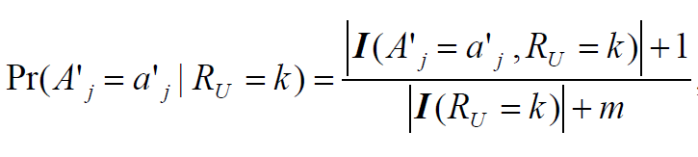
User Preference
We again assume that the item attributes in A are independent of each other. Therefore, we have
where Pr(A'₁, A'₂, ..., A'_{n}) can be treated as a normalizing constant, Pr(R_{U} = k) is the prior probability that U gives a rating k, and Pr(A'_{j} | R_{U} = k) is the conditional probability that each item attribute A'_{j} in A' has a value a'_{j} given U rated k.
The last two probabilities can be estimated from counting the review ratings of the target user U. Specifically,

Slide 6
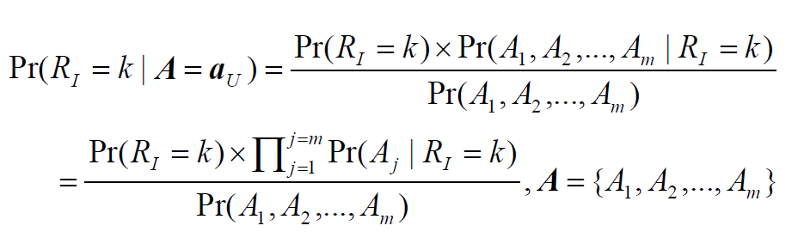
Item Acceptance
Using naïve Bayes assumption, we have
Where,
Pr(R_{I} = k) is the prior probability that the target item I receives a rating value k, and Pr(A_{j} | R_{I} = k) is the conditional probability that user attribute A_{j} of a reviewer has a value of a_{j} given item I receives a rating k from this reviewer. These two probabilities can be learned by counting the review ratings on the target item I in a manner similar to what we did in learning user preferences.

Slide 7

Influence from Immediate Friends
To estimate this probability, SAHRE learns the correlations between the target user U and each of his/her immediate friends V from the items that they both have rated previously, and then assume each pair of friends will behave consistently on reviewing the target item I too. Thus, U's rating can be estimated from r_{VI} according to the correlations.
Pr(R_{UI} = k | R_{VI} = r_{VI}) can be determined from the histogram of U's and V’s rating differences H(R_{UI} – R_{VI}) ∀I ∈ I(U) ∩ I(V). Thus, H(R_{UI} – R_{VI}) serves as the correlation measure between U and V.
When R_{VI} has a rating r_{VI} on the target item, the probability that R_{UI} has a value k is proportional to H(k - r_{VI}).

Slide 8

When the target user has more than one immediate friend who co-rates the target item, the influences from all of those friends can be incorporated in a product of normalized histograms of individual friend pairs.
where Z_{V} is the normalizing constant for the histogram of each immediate friend pair, and Z is the normalizing constant for the overall product.
Finally combining all three probabilities to find out ultimate probability for a target user for a specific item can be stated as

Slide 9
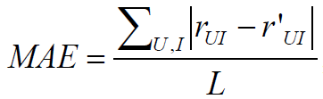
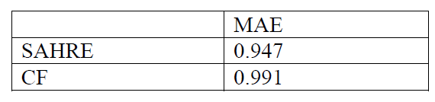
Prediction Accuracy And Coverage
As a comparison, we considered the following methods along with our Social Networking Based Recommendation System. -Friend Average (FA) -Weighted Friends (WVF) -Naïve Bayes (NB) -Collaborative Filtering (CF)
The prediction accuracy was measured by the mean absolute error (MAE), which is defined as the average absolute deviation of predictions to the ground truth data over all the in-stances, i.e., target user/item pairs, in the testing set.
Another metric that we study for each method is the coverage, which is defined as the percentage of the testing in-stances for which the method can make predictions.
Comparison:

Slide 10
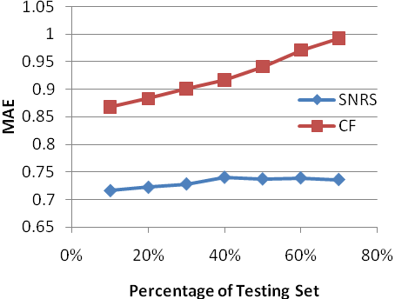
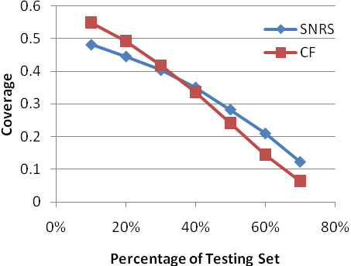
Data Sparsity Problem
CF suffers from problems with sparse data. So we considered a study to evaluate the performance of SAHRE at various levels of data sparsity. In the considered study, whole user/item pairs of dataset were divided into ten groups and then randomly n sets were selected as testing sets and remaining as training sets. The value of n controls the sparsity of the dataset. At each value of n, experiment was repeated 100 times. The performance was measured by the average MAEs and the coverage.

Slide 11
Cold-Start Problem
Cold-start is an extreme case of data sparsity where a new user has no reviews. In such a case, CF cannot make a recommendation to this new user since CF is not able to find similar users for him/her.
SAHRE cannot either if this new user has also no friends. However, in some cases of cold-start when a new user is invited by some existing users in the system, the initial friend relationships of this new user can still make the inference of SAHRE possible.
Even though there is no prior knowledge of the new user's own preference, SAHRE can make recommendations to this new user based on the preferences of his/her friends.

Slide 12

Future Considérations
Usage of implicit factors (in addition to explicit factors) to generate better recommendations.
Using Semantic Filtering Further improve the performance of SAHRE by applying semantic filtering of social networks. Two friends who have a common taste in Gaming Items can have different tastes for Books. Therefore, to recommend Books, we should not consider friends who have common preferences only in Gaming Items. In other words, to effectively use the social influence, an appropriate set of friends needs to be selected according to the type of target items, which is what we called semantic filtering of social networks.

Slide 13
References
G. Adomavicius, and A. Tuzhilin. Toward the Next Generation of Recommender Systems: A Survey of the State-of-the-Art and Possible Extensions. IEEE Transactions on Knowledge and Data Engineering.
C. Basu, H. Hirsh, and W. Cohen. Recommendation as Classification: Using Social and Content-based Information in Recommendation. In Recommender System Workshop '98. pp. 11-15, 1998.
D. Billsus and M. Pazzani. Learning Collaborative Information Filters. In Proceedings of International Conference on Machine Learning, 1998.
P. Bonhard and M. A. Sasse. "Knowing me, knowing you" - Using Profiles and Social Networking to Improve Recommender Systems. BT Technology Journal, Vol 24 No 3, July 2006.
J. S. Breese, D. Heckerman, and C. Kadie. Empirical Analysis of Predictive Algorithms for Collaborative Filtering. In Proceedings of the 14th Conference on Uncertainty in Artificial Intelligence, pp. 43-52, 1998.
V. Carvalho, and W. W. Cohen. On the Collective Classification of Email Speech Acts. Special Interest Group on Information Retrieval. 2005
B. Chandra, M. Gupta, and M. P. Gupta. Robust Approach for Estimating Probabilities in Naive-Bayes Classifier. In Pattern Recognition and Machine Intelligence, Volume 4815/2007, pp. 11-16, 2007
J. He and W. W. Chu Social Impact in Modern Recommender Systems. University of California, Los Angeles, June 2007.
J. He, W. W. Chu and Z. Liu. Inferring Privacy Information from Social Networks. In Proceedings of IEEE Intelligence and Security Informatics Conference (ISI 2006), San Diego, California, May 2006.

Slide 14
THANK YOU

