Slide 1
Workshop: How to create an ML portfolio
Nov 2022

Slide 2
Table of Contents
Introduction
Showcase
Streamlit 101
Finance: Stock Price Prediction
Multipage Applications
Calssification: Heart Attack Prediction
Conclusion

Slide 3

Introduction - Marc Gruener
3rd semester MBI
Background in MechEng & Business
Started coding ~3 years ago
Python, JS [+ SQL, HTML, CSS]
Projects
VC portfolio network analysis
Hackathon Platform
Biddit.app
…
Now: Digital Biomarker & Diabetes Tech

Slide 4
Introduction – Who are you?
Name
Program
Programming Knowledge
Projects?
What are your expectations for today?

Slide 5
Why are you (not) doing projects?

Slide 6
Introduction – Why projects?
Curiosity
’Advantage’

Slide 7
Introduction – Why projects?
Curiosity
+
Sharing
=
’Advantage’

Slide 8
Showcase
Streamlit Gallery
Migros Store Optimization

Slide 9
Streamlit 101 – Installation 1/3
Sign up for Github
Fork this repo
Sign up for Replit using your GitHub Account
Create a new Repl by importing the GitHub Repo
Install Requirements: > pip install –r requirements.txt
…

Slide 10





Streamlit 101 – General Project Process
Data
Analysis
Visualization
Deployment

Slide 11
Streamlit 101 – The Basics
Content
Title/Header/…
Text
Code Blocks
Image/Audio/Video
…
Layout
Sidebar
Columns
Tabs
…
Widgets
Files
Buttons
Slider
…
Utilities
- config
State
- Sessions
Performance
Caching
Memo
…

Slide 12
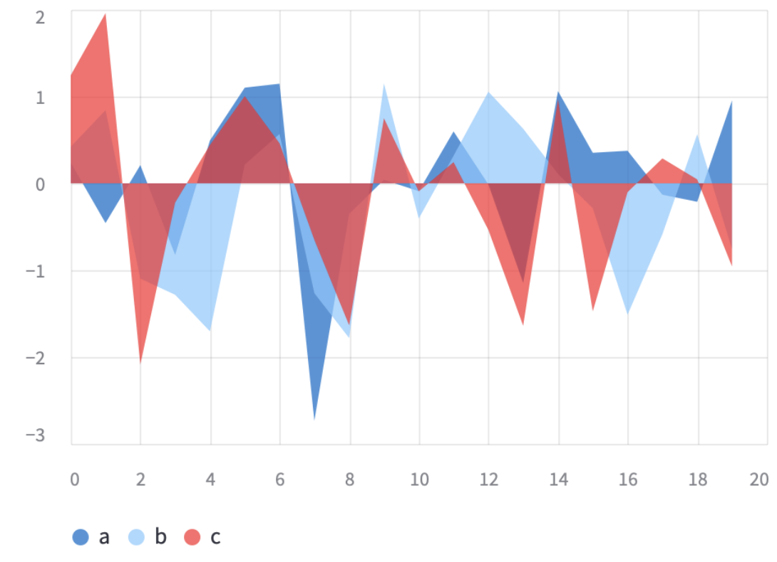
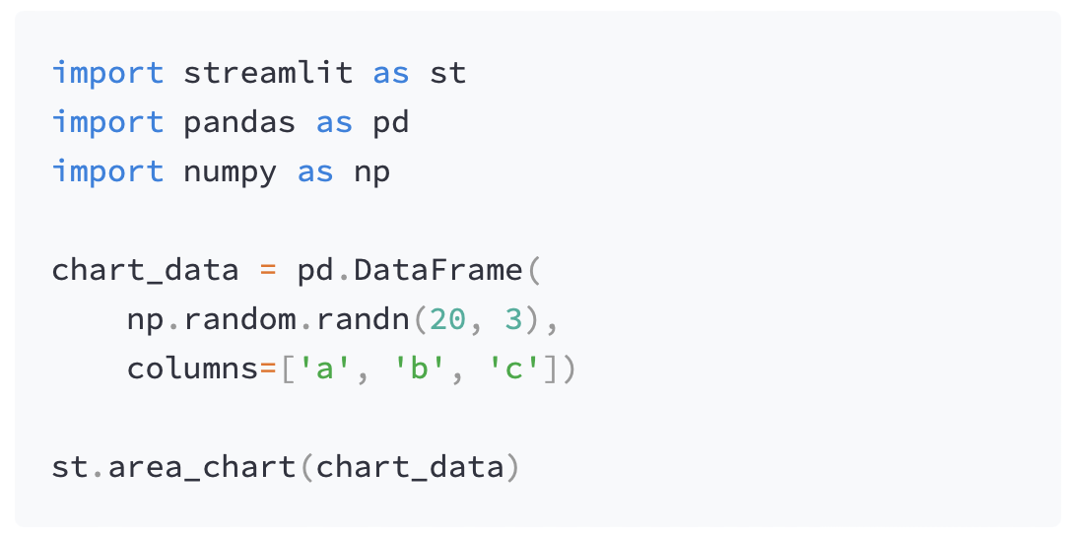
Streamlit 101 – General Syntax

Slide 13
Streamlit 101
Advantages
Disadvantages
Super simple syntax
Powerful
One workflow
One language
Speed of development
Easy to share
Support
Performance
Customization might require additional skills (HTML/CSS/JS)
Scalability

Slide 14
Streamlit 101 – Installation 2/3
Sign up for Github
Fork this repo
Sign up for Replit using your GitHub Account
Create a new Repl by importing the GitHub Repo
Install Requirements: > pip install –r requirements.txt
Test Streamlit: > streamlit hello
Sign up for Streamlit using your GitHub Account
Add a new app
Deploy!

Slide 15
Finance: Stock Price Prediction
How to turn a data science project into a website and share it (especially for non-techies like most recruiters)
Streamlit components we’ll use:
Title/Headers/Text/Markdown
Dataframes
Metrics
Interactive Charts
Tabs/Columns/Extenders

Slide 16
Research Project Structure:
Introduction
Data
Methods
Results
Discussion
Limitations
Conclusion
(Lessons Learned)

Slide 17
What if I add a second project?
Multipage Applications
Streamlit components we’ll use:
Images

Slide 18
Streamlit 101 – Installation 2/3
Sign up for Github
Fork this repo
Sign up for Replit using your GitHub Account
Create a new Repl by importing the GitHub Repo
Install Requirements: > pip install –r requirements.txt
Test Streamlit: > streamlit hello
Sign up for Streamlit using your GitHub Account
Add a new app
Deploy!

Slide 19
Classification: Heart Attack Prediction
How to make something interactive aka. user inputs
New Streamlit components we’ll use:
Slider
Dropdown
Radiobuttons

Slide 20
Any Questions?

Slide 21
Congrats!

Slide 22
Some Features to Explore
APIReference/TextElements/Latex
APIReference/Chart/Elements/.
APIReference/InputWidgets/.
APIReference/LayoutsAndContainers/Sidebar
APIReference/StateManagement/Session/State
APIReference/Performance/Caching
AdvancedFeatures/Theming
GDPR

Slide 23
Helpful Resources
Streamlit Documentation
Streamlit Gallery
Machine Learning Mastery
FreeCodeCamp
Kaggle
Nick Singh
TechClub

