Slide 1
Introduction to Spring Framework
CodeMash 2015
Pre-Compiler
Java: Beginner to Intermediate
David Lucas
Lucas Software Engineering, Inc.
www.lse.com
ddlucas@lse.com

Slide 2
Spring Framework: Introduction
Agenda
Who is the speaker ?
What setup do we need ?
Why dependency injection ?
What are the basics of the Spring Framework?
Core
Data
Web
What else?

Slide 3

Spring Framework: Introduction
Who is the speaker?
David Lucas
Lucas Software Engineering, Inc. (LSE) www.lse.com
Focus on highly scalable Java Services
Worked in various industries: military, insurance, financial, manufacturing, utilities
Provide software engineering, performance tuning, mentoring and training
Love to use SQuirreL Client

Slide 4
Spring Framework: Introduction
Ground Rules
You will not hurt my feelings if you …
ask questions
take your phone or text conversation outside
leave because you are bored
want me to change speed (slower / faster)
This requires audience participation

Slide 5
Spring Framework: Introduction
Assumptions
This is an introduction, should not drill too deep into details
Will not go into scripting or domain specific languages
Will not dig into Spring Batch or Spring XD
Will touch on basics of Spring Framework
Will build examples using maven
Examples are for information purposes
Unit tests are not exhaustive

Slide 6



Spring Framework: Introduction
What setup do we need?
Java JDK 1.8
Spring Tool Suite 3.6.3
Copy of examples
Unzip examples and import projects into STS
https://github.com/lseinc/intro-spring
Verify Setup

Slide 7
Spring Framework: Introduction Dependencies
Are dependencies good ?
Why we like them ?
Why we don’t like them?
What patterns do we end up using?
singleton
factory
service locator
push versus pull

Slide 8
Spring Framework: Introduction
Core
What does POJO dependencies look like? Lab 01
What does it look like with Spring XML ? Lab 02
What does it look like with Spring Annotations? Lab 03
What are Spring profiles? Lab 04 / Lab 05

Slide 9
Spring Framework: Introduction Dependencies
LAB 01 simple POJO dependencies
Go to unit test and uncomment the Asserts
Change code to make test green
Create the HAS-A relationships between User to ATM to Bank

Slide 10
LAB 01: Model
User
ATM
AcmeATM
Bank
AcmeBank

Slide 11
LAB 01
Wait here until ready to move on…

Slide 12
Spring Framework: Introduction
What are frameworks?
What are containers?
What is IOC?
What is the Spring Framework?
Core Components
Some examples

Slide 13
What are Frameworks?
Software library that provides reusable API
An abstraction providing generic functionality that can be extended to provide specialized features
owns flow of control and/or lifecycle
default behavior that is usable
examples: MFC, X11, Qt, Eclipse RCP, ASP.NET, EJB, JSP / Servlets, Hibernate, etc… and of course, Spring

Slide 14
Example Framework
Region
draw()
Button
TextField
Window
draw()
draw()
draw()

Slide 15
What are Containers?
an environment that contains and manages the access to one or more objects
collections are simple containers
more complex containers manage the lifecycle of objects
containers can also handle configuration dependencies
dependency injection takes creation away from the constructor
examples: EJB Container, Web Container

Slide 16
Example Container
MyBusinessService
MyAdapter
MyWebService
MyDAO

Slide 17
What is IOC?
IOC is inversion of control (implicit versus explicit)
Martin Fowler compared it to the Hollywood Principle, “Don’t call us, we’ll call you !”
You don’t call the APIs directly, the container framework calls you
Leverage existing template patterns
A subset is known as Dependency Injection (DI), lifecycle of object part of framework
dependent object configuration and control are taken away from the typical construction
containers manage wiring of dependencies

Slide 18
Why IOC?
Inversion of Control removes direct dependencies (no concrete knowledge of implementation)
The most flexible systems make change additive.
Avoid modifying code.
Configuration can be abstracted.
Life Cycle Management: patterns: singleton, prototype, factory, service locator
Loose coupling
EASIER TO TEST !

Slide 19
What is the Spring Framework?
Created in 2002-2003 by Rod Johnson
goal: to simplify java development
Invented out of necessity; J2EE was still overly complex and hard to assemble
pico container that manages beans (pojo: plain old java object)
leverages common patterns in a framework to reduce developers re-inventing the wheel
Apache License 2.0 (open source)

Slide 20
What is the Spring Framework?
Spring is not focused on implementations, but wiring implementations together
provides “context” to a set of configured beans and properties
provides dependency injection (DI) to decouple implementations
provides cross-cutting of concerns (aspects and interceptors)
leverages proxies to extend objects at runtime and delegate to targets

Slide 21
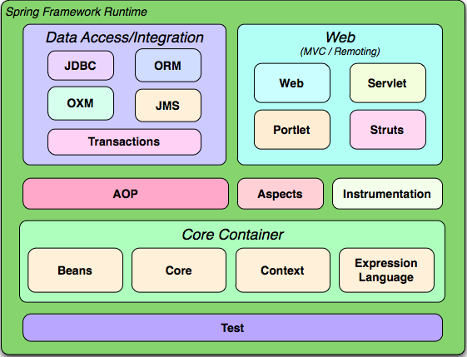

Slide 22
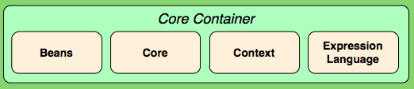
Spring Core
http://docs.spring.io/spring/docs/current/spring-framework-reference/html/beans.html
Core Container are the common objects leveraged in all the extensions
Core consists of Core, Beans, Context, and Expression Language modules
Core and Beans modules are focused on the IOC and Dependency Injection features as well as life cycle management using the BeanFactory
Context module provides the container the ability to look up beans (service locator like JNDI).

Slide 23
Spring Core
Context module adds
internationalization
property configuration.
Context integrates with Java EE containers like:
EJB
JMX
Web Containers

Slide 24
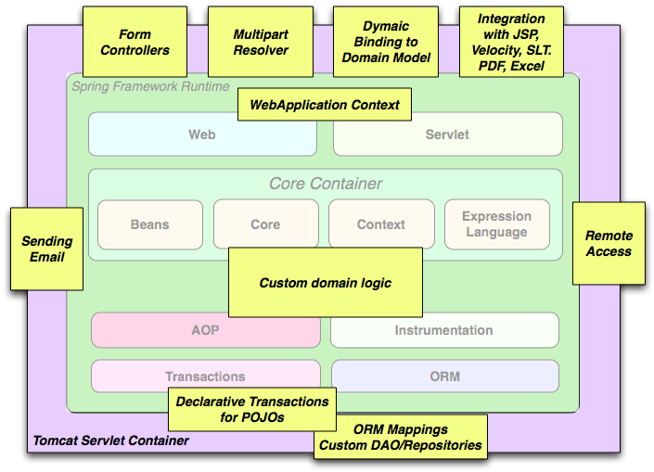

Slide 25
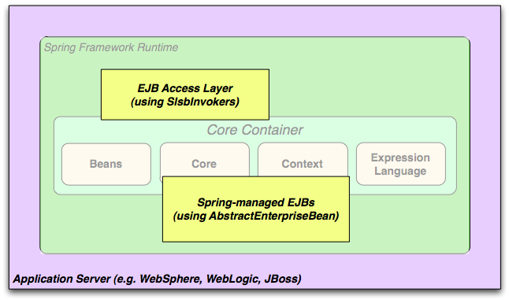

Slide 26
Spring Core
Context is about the caller's point of view
Beans are created based on a context's lifecycle
Spring IOC uses two types of Dependency Injection (DI)
Type 2 (property)
Type 3 (constructor) creation of dependencies

Slide 27
Spring Core
Bean Lifecycle
scope (instances)
initialization (callbacks)
finalization (callbacks)

Slide 28
Spring Framework: LifeCycle
IOC Type 2 setters
Java Bean Property ( requires getter / setter )
Injected via
XML: via property name/value of bean
@Autowired
IOC Type 3 constructor
Java Bean public constructor
Injected via
XML via constructor-arg elements
@Autowired on parameters

Slide 29
Spring Framework: Introduction Beans
Beans have scope (singleton , prototype) Just like Web has request, session, application
<bean id="accountDao"
lazy-init="true" scope="singleton"
class="AccountDaoJDBC">
<!-- ... -->
</bean>

Slide 30
Spring Framework: LifeCycle
Beans have lifecycle
InitializingBean and DisposableBean
@PostConstruct / @PreDestroy
Lifecycle (interfaces for events)
public class AccountDaoJDBC implements AccountDao,
InitializingBean, DisposableBean{
public void afterPropertiesSet() throws Exception {}
public void destroy() throws Exception {}
//...
}

Slide 31
Spring Core
Bean Properties
conversion (String to double)
validation (check for nulls)
formatting (String formats)

Slide 32
Spring Framework: Introduction Beans
Example Service Implementation public class AcmeBank { //… private String name; //… }

Slide 33
Spring Framework: Introduction Beans
XML Application Context
Uses XSD to define capabilities
http://docs.spring.io/spring/docs/current/spring-framework-reference/html/xsd-config.html
<beans xmlns="http://www.springframework.org/schema/beans"
xmlns:xsi="http://www.w3.org/2001/XMLSchema-instance" xmlns:context="http://www.springframework.org/schema/context"
xsi:schemaLocation="http://www.springframework.org/schema/context http://www.springframework.org/schema/context/spring-context.xsd http://www.springframework.org/schema/beans http://www.springframework.org/schema/beans/spring-beans.xsd">
<bean id="bank" class="AcmeBankImpl">
<property name="name" value="Last Bank of America=" />
</bean>
</beans>

Slide 34
Application Container
Id: bank
Type: singleton (default) Class: AcmeBank
Properties: { name=“Last Bank of America” }

Slide 35
Spring Framework
Beans
Factory Methods
static method to create object instance
<bean
id="clientService"
class="examples.ClientService"
factory-method="createInstance"/>
instance reference and factory method name
<bean
id="serviceLocator"
class="examples.DefaultServiceLocator"/> <bean
id="clientService"
factory-bean="serviceLocator"
factory-method="createClientServiceInstance"/>

Slide 36
Spring Core
Example of Expression Language Usage: <bean class="mycompany.RewardsTestDatabase"> <property name="databaseName" value="#{systemProperties.databaseName}" />
<property name="keyGenerator" value="#{strategyBean.databaseKeyGenerator}" /> <!— …. —>
</bean>

Slide 37
Spring Framework: Introduction Dependencies
Spring Beans Maven Configuration
properties
via PropertyConfiguration
via Environment
dependencies
via explicit depends on attribute
via implicit references to other beans

Slide 38
Spring Framework: Introduction Dependencies
Enable Spring Configured Annotations (Using @Configuration on a class, the class gets injections on @Autowired and @Resource) <context:spring-configured/>
Enable Spring Properties (${prop.key} key references in XML and @Value on fields are injected with property value) <context:property-placeholder location="classpath:application.properties"/>

Slide 39
Spring Core
Expression Language module provides a unified EL as specified in JSP 2.1
EL supports setting/getting property values, property assignments, method invocations, and conversions of types (lists, maps)
Spring supports configuration via XML Configuration file or via @Annotations

Slide 40
Spring Framework: Introduction Core Annotations
DZone Reference Card (very handy)
Spring Configuration http://refcardz.dzone.com/refcardz/spring-configuration
Spring Annotations http://refcardz.dzone.com/refcardz/spring-annotations

Slide 41
Spring Framework: Introduction Dependencies
LAB 02 wire POJO with Spring XML
Go to unit test and uncomment the Asserts
Change XML to make test green
Create the HAS-A relationships between User to ATM to Bank

Slide 42
LAB 02
Wait here until ready to move on…

Slide 43
Spring Framework: Introduction Dependencies
Enable Spring Configured Annotations (Using @Configuration on a class, the class gets injections on @Autowired and @Resource) <context:spring-configured/>
Enable Spring Properties (${prop.key} key references in XML and @Value on fields are injected with property value) <context:property-placeholder location="classpath:application.properties"/>

Slide 44
Spring Framework: Introduction Core Annotations
Injections @Autowired @Value
Component Beans @Service @Repository @Component

Slide 45
Spring Framework: Introduction Core Annotations
Bean Configurations @Configuration @ComponentScan @PropertySource @EnableAutoConfiguration @Import @EnableTransactionManagement

Slide 46
Spring Framework: Introduction Dependencies
LAB 03 wire POJO with Spring Annotations
Go to unit test and uncomment the Asserts
Change Objects to make test green
Create the HAS-A relationships between User to ATM to Bank

Slide 47
LAB 03
Wait here until ready to move on…

Slide 48
Spring Framework: Introduction Core Annotations
On Component Classes @Profile("acme-bank")
On JUnit Test Class @ActiveProfiles("acme-bank")
java -Dspring.profiles.active=acme-bank argument to set from command line application
XML Config uses a beans wrapper with profile attribute <beans profile="acme-bank" > <bean id="theBank" class="com.lse.spring.example.pojo.AcmeBank" scope="singleton" > <property name="checkingBalance" value="${my.bank.balance}" /> <property name="bankName" value="${my.bank.name}" /> </bean>
</beans>

Slide 49
Spring Framework: Profiles
LAB 04 use profiles with Spring XML
Change old Bank Test to use a profile
Add new Bank Test with new profile
Add new Bank and wire it based on profile setting
Change Objects to make test green

Slide 50
LAB 04
Wait here until ready to move on…

Slide 51
Spring Framework: Profiles
LAB 05 use profiles with Spring Annotations
Change old Bank Test to use a profile
Add new Bank Test with new profile
Add new Bank and wire it based on profile setting
Change Objects to make test green

Slide 52
LAB 05
Wait here until ready to move on…

Slide 53
Spring Framework: Introduction
Data
Need a database: Derby on the back stretch ! Lab 06
Spring JDBC Lab 07
Spring Transactions Lab 08
Spring JPA Lab 09
Spring Boot

Slide 54
Spring Framework: LAB 06 - Setup Derby
perform maven clean install on derby project
perform maven run on derby project
should see java process listening on port 1527
setup STS to connect to database
either run the sql scripts under src/main/resources or unzip provided derby-data zip file

Slide 55
LAB 06
Wait here until ready to move on…

Slide 56
Spring Framework: Data
DAO: data access object (data layer)
Spring provides consistent access to JDBC interfaces to include JDO, JPA, Hibernate, iBatis templates.
Spring provides common exception hierarchy

Slide 57
Spring Framework: Data
@Repository configures DAO with common exception translation
JDBC Template (Spring JDBC)
iBatis SqlMapClient support
Hibernate Session API support
JPA supported entity manager (EJB)
@PersistenceContext
@PersistenceUnit

Slide 58
Spring Framework: Data
JdbcTemplate uses DataSource provided by Spring Application Context
DAO uses JdbcTemplate to execute JDBC type commands and manages closing of connections, statements, and result sets
update method is for executing SQL that performs insert, update, or delete operations
query executes selects
Results use a DataMapper to do manual mapping of each row to new entity object

Slide 59
Spring Framework: Data
DataSource leveraged via XML configuration
JNDI setup: <jee:jndi-lookup id="dataSource" jndi-name="java:comp/env/jdbc/myds"/>
<bean id="accountDao" lazy-init="true" scope="singleton" class="com.lse.spring.example.dao.AccountDaoJdbc"> <property name="dataSource" ref="dataSource" /> </bean>

Slide 60
Spring Framework: Data
DataSource leveraged via XML configuration
DBCP setup: <bean id="dataSource" class="org.apache.commons.dbcp.BasicDataSource" destroy-method="close">
<property name="driverClassName" value="${jdbc.driverClassName}"/>
<property name="url" value="${jdbc.url}"/>
<property name="username" value="${jdbc.username}"/>
<property name="password" value="${jdbc.password}"/>
</bean>
<bean id="accountDao" lazy-init="true" scope="singleton"
class="com.lse.spring.example.dao.AccountDaoJdbc">
<property name="dataSource" ref="dataSource" />
</bean>

Slide 61
Spring Framework: Data
Persistence
JDBC
Transactions
Local (JDBC)
Global (JTA)
ORM
Hibernate
MyBatis
JPA (example: EclipseLink / Hibernate)
NoSQL

Slide 62
Spring Framework:
Data - JDBC
LAB 07 use Spring JDBC Template to create an AccountDAO implementation
Uncomment Asserts in AccountDAOTest
Uncomment Asserts in UserTest
Change Objects to make test green

Slide 63
LAB 07: Data JDBC
Hint to model::
AccountDao
AccountDaoJdbc
Account
DefaultAccount

Slide 64
LAB 07
Wait here until ready to move on…

Slide 65
Spring Framework: Data Transactions (TX)
Spring Framework provides Transaction Management integration
Leverages application container TMs: WebLogic, WebSphere, JBoss, etc
Provides Local and Global support
JTA: Java Transaction API (XA support)
Spring provides consistent transaction management for multiple resources
database (JDBC, JPA)
messaging (JMS)
RMI / IIOP

Slide 66
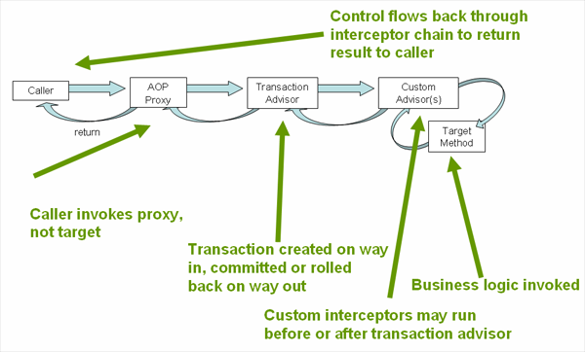

Slide 67
Spring Framework: Data Transactions
Simple DataSource TransactionManager
Not Two Phase Commit
Only Supports JDBC transactions
Local Transaction Support (not Global)
<!-- a PlatformTransactionManager is still required -->
<bean id="transactionManager" class="org.springframework.jdbc.datasource.DataSourceTransactionManager"> <!-- (this dependency is defined somewhere else) --> <property name="dataSource" ref="dataSource"/>
</bean>

Slide 68
Spring Framework: Data Transactions
@Transactional annotation wraps methods with transaction control using transaction manager calls to begin / commit / rollback
isolation and propagation level config
read-only optimization option
timeout (max time before rollback)
applied at class or method level
@Transactional(readOnly = false, propagation = Propagation.REQUIRES_NEW)
public void updateFoo(Foo foo) {
// do something
}

Slide 69
Spring Framework: Data Transactions
Propagation provides JTA information about the type of transaction and how it processes with other transaction
PROPAGATION_REQUIRED: DEFAULT, will create a transaction if one is not already created and will participate if one exists.
PROPAGATION_REQUIRES_NEW: will create a new transaction and not participate in existing one, if other exists, will suspend it
PROPAGATION_SUPPORTS: will use transaction if exists, otherwise will not create one (read only operations)
PROPAGATION_NESTED: will leverage save point or sub transactions if supported by resources.
Other options that allow for error handling if exception exists or does not

Slide 70
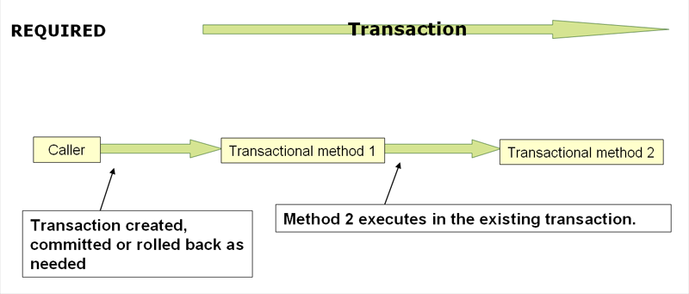

Slide 71
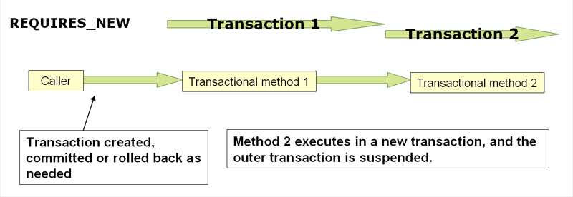

Slide 72
Spring Framework: Data Transactions
Unit Testing can utilize a third party Transaction Manager
Atomikos is open source and very stable
Transaction Essentials (Apache License 2)
DataSource wrappers for XA and non-XA connections
Support for JMS

Slide 73
Spring Framework: Data Transactions
Example XML Config
<bean id="dataSource" name="dataSource,datasource" class="com.atomikos.jdbc.nonxa.AtomikosNonXADataSourceBean" lazy-init="true" init-method="init" destroy-method="close" > <property name="uniqueResourceName" value="NONXADBMS" /> <property name="driverClassName" value="${jdbc.driverClassName}" /> <property name="url" value="${jdbc.url}" /> <property name="user" value="${jdbc.username}" /> <property name="password" value="${jdbc.password}" /> <property name="readOnly" value="false" /> <property name="poolSize" value="1" /> <property name="maxPoolSize" value="4" /> <property name="minPoolSize" value="0" /> <property name="testQuery" value="select 1 from dual" /> </bean> <bean id="atomikosTransactionManager" class="com.atomikos.icatch.jta.UserTransactionManager" init-method="init" destroy-method="close"> <property name="forceShutdown" value="true"/> <property name="transactionTimeout" value="${transaction.timeout}" /> </bean>

Slide 74
Spring Framework: Data Transactions
Example XML Config (cont) <bean id="atomikosUserTransaction" class="com.atomikos.icatch.jta.UserTransactionImp"> <property name="transactionTimeout" value="${transaction.timeout}" /> </bean>
<!-- Configure the Spring framework to use JTA transactions from Atomikos --> <bean id="transactionManager" class="org.springframework.transaction.jta.JtaTransactionManager"> <property name="transactionManager"> <ref bean="atomikosTransactionManager" /> </property> <property name="userTransaction"> <ref bean="atomikosUserTransaction" /> </property> </bean> <!-- enable the configuration of transactional behavior based on annotations --> <tx:annotation-driven transaction-manager="transactionManager"/>

Slide 75
Spring Framework: Data
Transactions
LAB 08 use Spring JDBC Repository to create an AuditDAO implementation
Uncomment Asserts in AuditDAOTest
Uncomment Asserts in UserTest
Change Objects to make test green
Use @Transactional appropriately

Slide 76
LAB 08
Wait here until ready to move on…

Slide 77
Spring Framework: Web with Boot
Provides easy boiler plates for starting apps
Support from STS File->New->Spring Starter Project
http://projects.spring.io/spring-boot
Easy getting started with InitializR
select types of options (Web, JMS, JPA, etc)
generates boiler plate zip to download
http://start.spring.io

Slide 78
DEMO Spring-Boot

Slide 79
Spring Framework: Resources
http://docs.spring.io/spring/docs/current/spring-framework-reference/htmlsingle/
http://spring.io/docs
http://spring.io/guides
http://www.theserverside.com/news/1364527/Introduction-to-the-Spring-Framework
http://www.javabeat.net/tutorials/8-spring-framework-beginners-tutorial.html
Spring In Action, Walls
Pro Spring, Harrop and Machacek

Slide 80
Spring Framework: Resources
http://refcardz.dzone.com/refcardz/spring-configuration
http://refcardz.dzone.com/refcardz/spring-annotations
http://refcardz.dzone.com/refcardz/core-spring-data
http://refcardz.dzone.com/refcardz/eclipse-tools-spring
http://refcardz.dzone.com/refcardz/spring-web-flow
http://refcardz.dzone.com/refcardz/expression-based-authorization
http://refcardz.dzone.com/refcardz/getting-started-with-jpa
http://refcardz.dzone.com/refcardz/whats-new-jpa-20
http://refcardz.dzone.com/refcardz/eclipselink-jpa
http://refcardz.dzone.com/refcardz/spring-integration
http://refcardz.dzone.com/refcardz/spring-batch-refcard

Slide 81
Thank You

