Slide 1
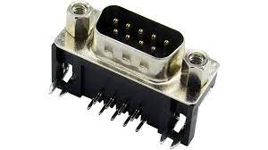
PCB Port view (male connector)
Up
Down
Left
Right
X
B1
X
GND
B2

Slide 2
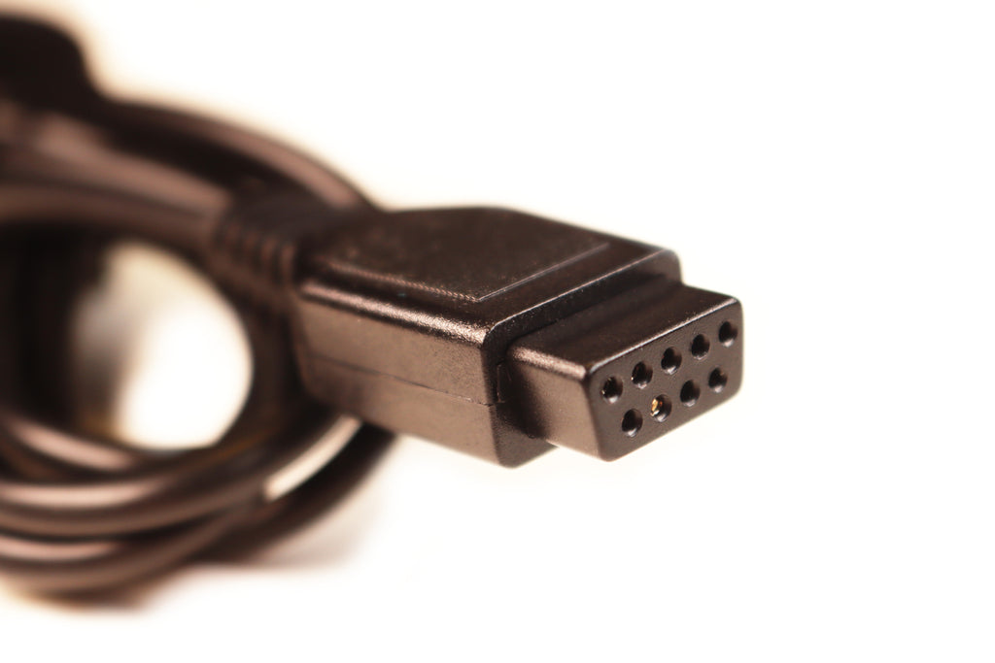
Cable view (female connector)
X
Right
Left
Down
Up
B2
GND
X
B1

