Slide 1
Data Collection
The data was collected from playing the game lunar lander.
Total of 30k+ data was collected, and duplicates were removed using Microsoft Excel.

Slide 2
Preprocessing
The preprocessing code will clean up the data and normalize it so that the Neural Network will perform better when the data is used.

Slide 3
Hidden
Neu.1
Input
Neu.1
Hidden
Neu.2
Output
Neu.1
Input
Neu.2
Hidden
Neu.3
Output
Neu.2
Hidden
Neu.4
Input
Neu. Bias (1)
Hidden
Neu. Bias
(1)

Slide 4
First : 2 Input Neuron + 2 Hidden Neuron = 2 Output
Second : (2 Input Neuron + Bias Neuron) + (2 Hidden Neuron + Bias Neuron) = 2 Output
Third : (2 Input Neuron + Bias Neuron) + (4 Hidden Neuron + Bias Neuron) = 2 Output
Fourth : (2 Input Neuron + Bias Neuron) + (8 Hidden Neuron + Bias Neuron) = 2 Output
Fifth : (2 Input Neuron + Bias Neuron) + (12 Hidden Neuron + Bias Neuron) = 2 Output

Slide 5
The lowest validation RMSE value I got for the assignment was 0.11234
Stopping Condition: When the validation RMSE is greater than the previous one, the code stops running.
The plan to avoid local minima, When the current RMSE is greater than the previous the one before will be stored to a list of lists with the weights got in the same row. Run 10 more epochs and see if the RMSE lowers if it does run further and this will be done until the decrement of RMSE is more or less the same (0.00001).

Slide 6
Changes observed in each change and constants
The optimal momentum and learning rate was found through trial and error. For my network, it was observed to give the least RMSE values at
Momentum = 0.2
Learning Rate = 0.6
The network was made to run with different numbers hidden as shown in the previous slide and out of which, the hidden layer with 4 hidden neurons and 1 bias neuron gave the best result for me.

Slide 7
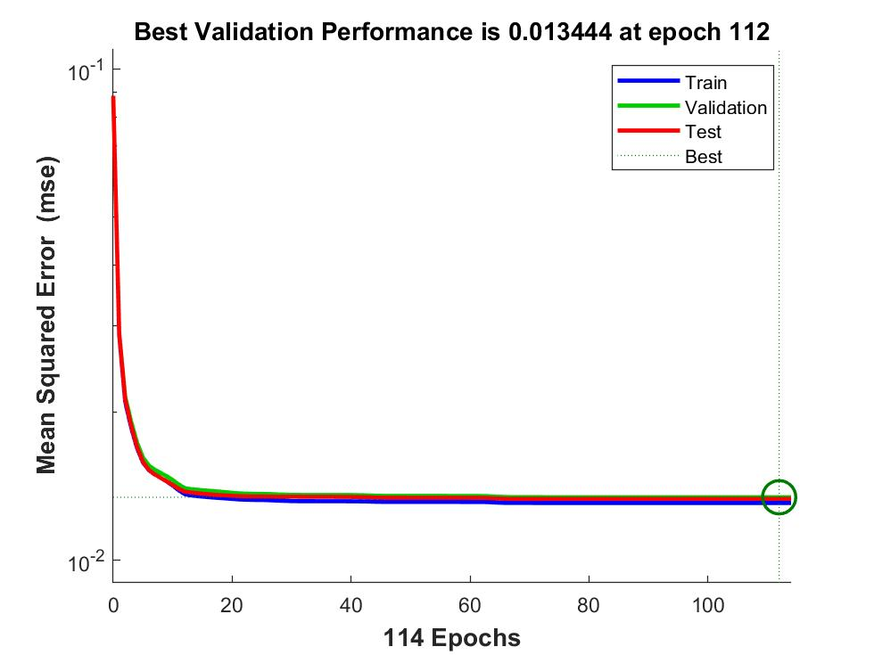

Slide 8
Planned Improvement to avoid local minima
The plan to avoid local minima, When the current RMSE is greater than the previous the one before will be stored to a list of lists with the weights got in the same row. Run 10 more epochs and see if the RMSE lowers if it does run further and this will be done until the decrement of RMSE is more or less the same (0.00001).

